Slide 1


An Hour of Code… with Artificial Intelligence!
Rebecca Vivian &
Thushari Atapattu
Computer Science Education Research (CSER) Group
The University of Adelaide
Martin Richards
Digital Technologies Hub
Education Services Australia
Notes:
Who we are

Slide 2
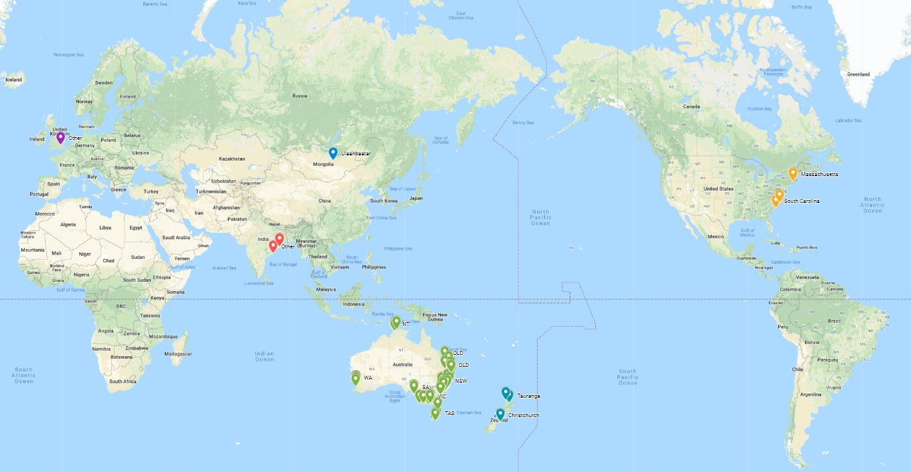
Registrations for webinar by location
Notes:
Map indicates interest in AI
This webinar builds on our previous webinar on AI presented by Dr Karsten Shultz.
AI draws on many aspects of the curriculum including a focus on data, how it is represented, algorithmic thinking and implementing programs, design of systems, computational thinking, systems thinking, creative and critical thinking and ethical understanding.
Hand over to Bec and Thushari if you have any comments or questions use the chat :)

Slide 3
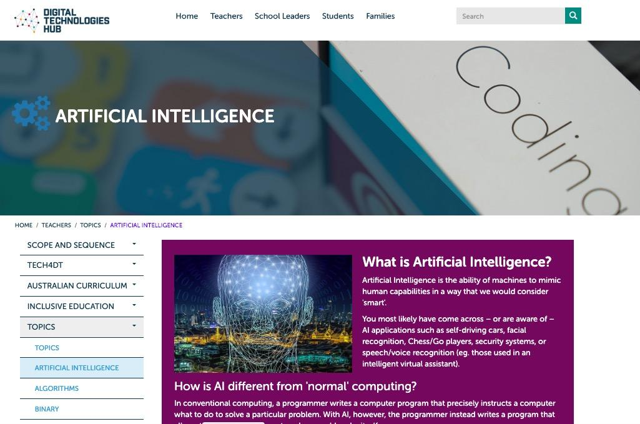
Notes:
The DT Hub have a whole section dedicated to teaching AI in the classroom.
https://www.digitaltechnologieshub.edu.au/

Slide 4
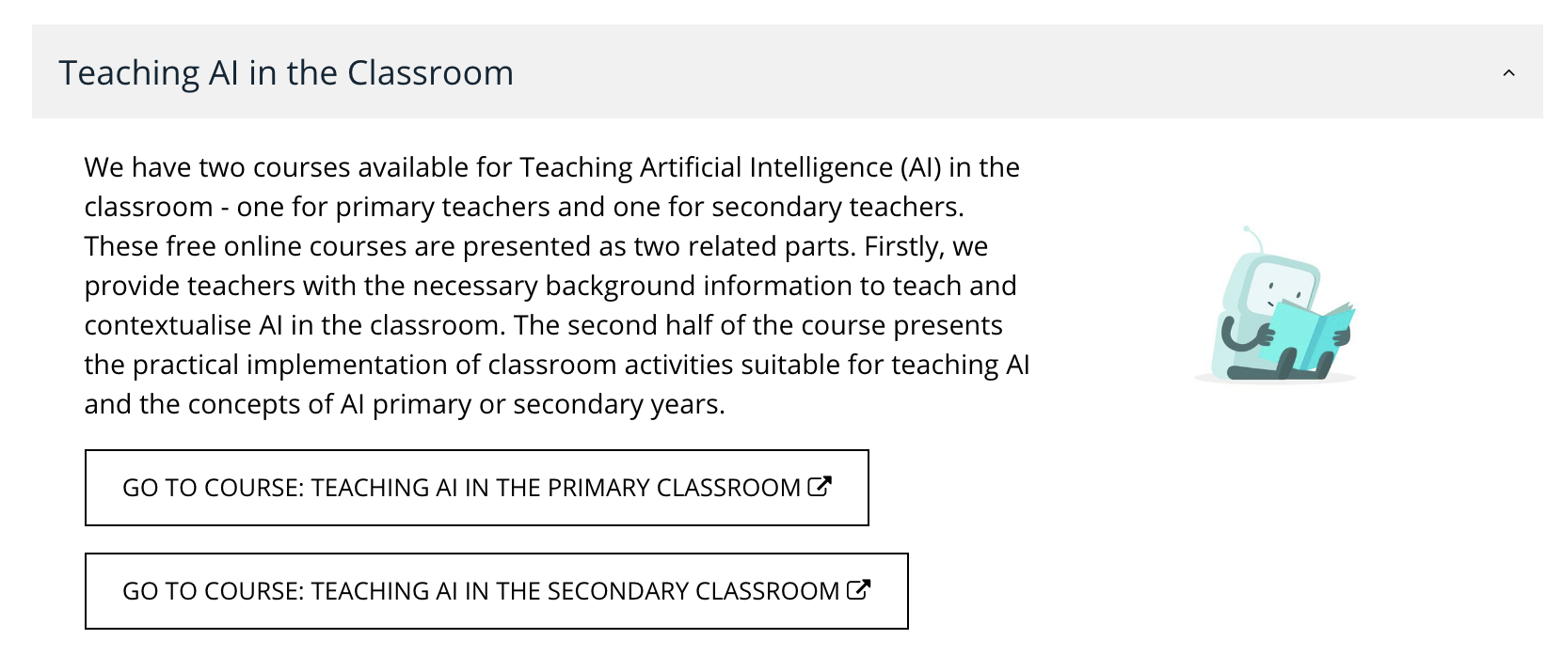
csermoocs.adelaide.edu.au/available-moocs
Notes:
The CSER Digital Technologies Education Program at The University of Adelaide provides open, free professional development in Digital Technologies aligned with the Australia Digital Technologies Curriculum. CSER run a range of Digital Technologies Programs for Australian teachers, including our free, online CSER MOOC courses, free professional learning events, and a National Lending Library.
There are two courses available for Teaching Artificial Intelligence (AI) in the classroom - one for primary teachers and one for secondary teachers. These free online courses are presented as two related parts. Firstly, CSER provide teachers with the necessary background information to teach and contextualise AI in the classroom. The second half of the course presents the practical implementation of classroom activities suitable for teaching AI and the concepts of AI primary or secondary years.
This session is based on materials from the AI MOOC and the Digital Technologies Hub.

Slide 5
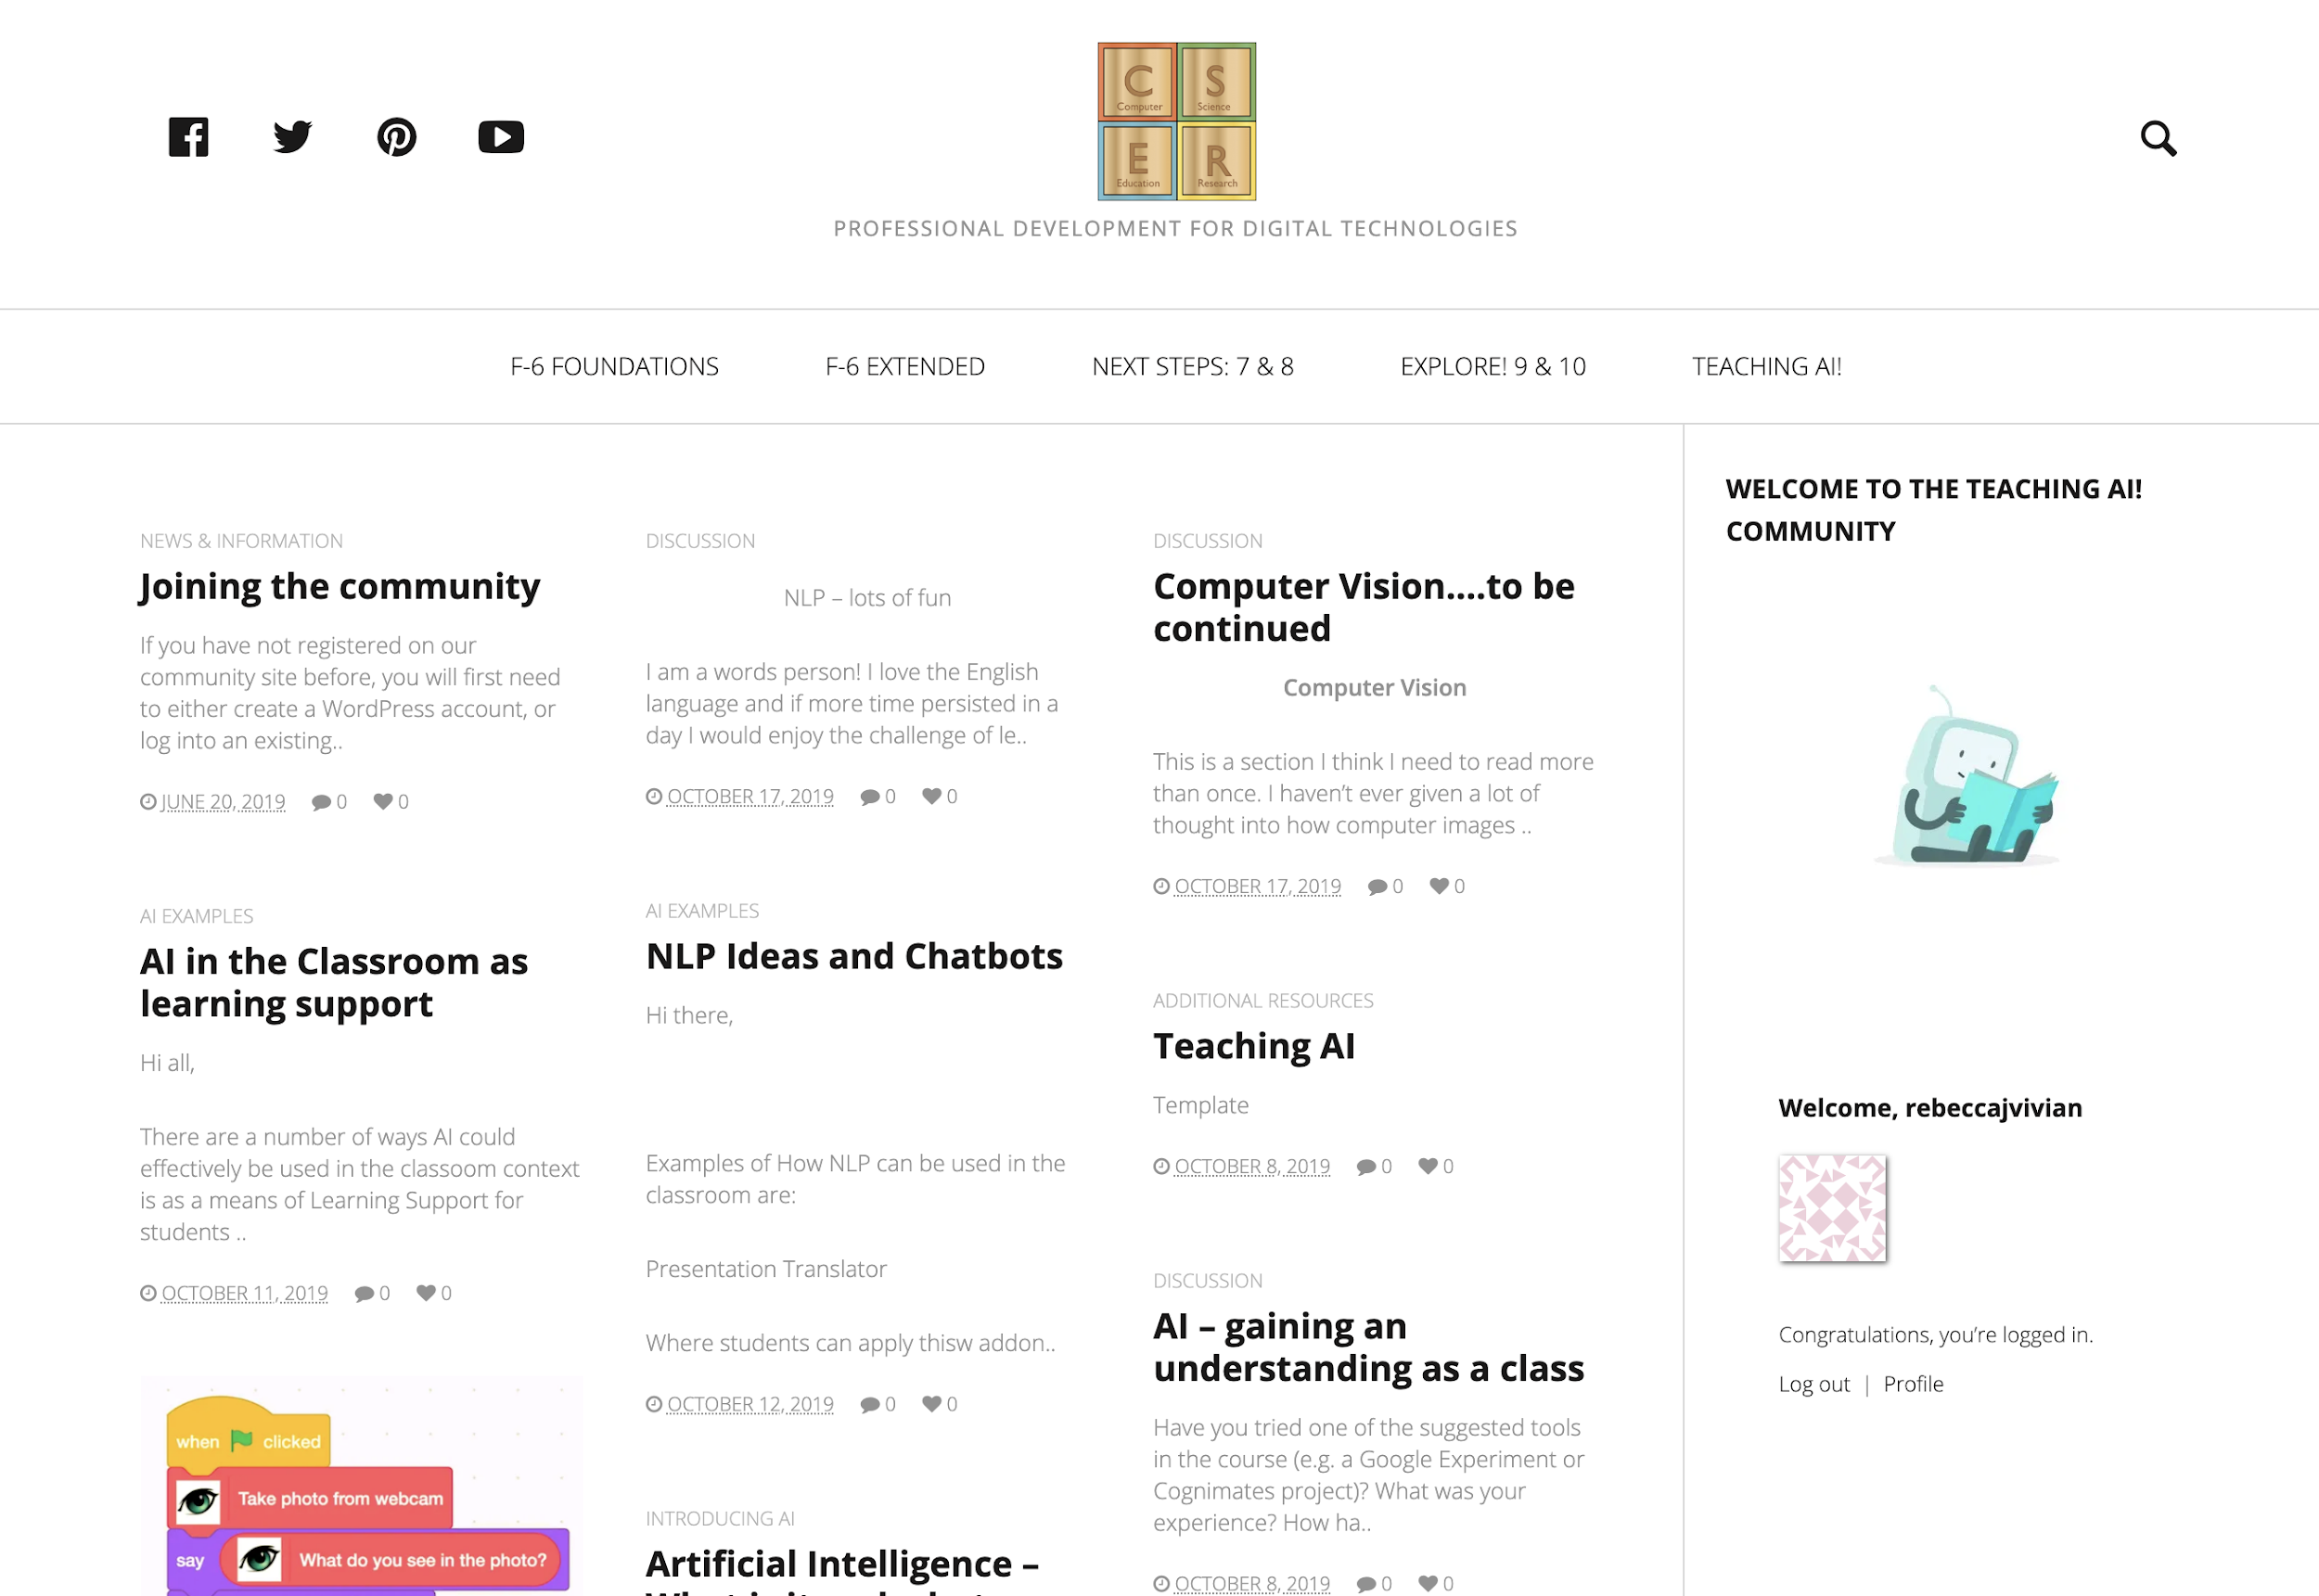
csermooc.blog
Notes:
In addition to course content, there is a wonderful community of teachers discussing learning activities from the AI MOOCs. Throughout the AI MOOC are “CSER Community Tasks”. This community is where teachers post the MOOC tasks. If all tasks are completed, participants will receive a certificate of completion.

Slide 6
Overview
What is Artificial Intelligence?
Defining AI
Real world examples
How does it work?
Classroom activities
Computer Vision
Natural Language Processing

Slide 7
The creation of machines to mimic human capabilities, such as teaching a machine to see (recognise objects in an image) and listen (interpret and analyse sounds).
What is Artificial Intelligence?
Notes:
Artificial Intelligence (AI) is the creation of machines to mimic human capabilities, such as teaching a machine to see (recognise objects in an image) and listen (interpret and analyse sounds).

Slide 8
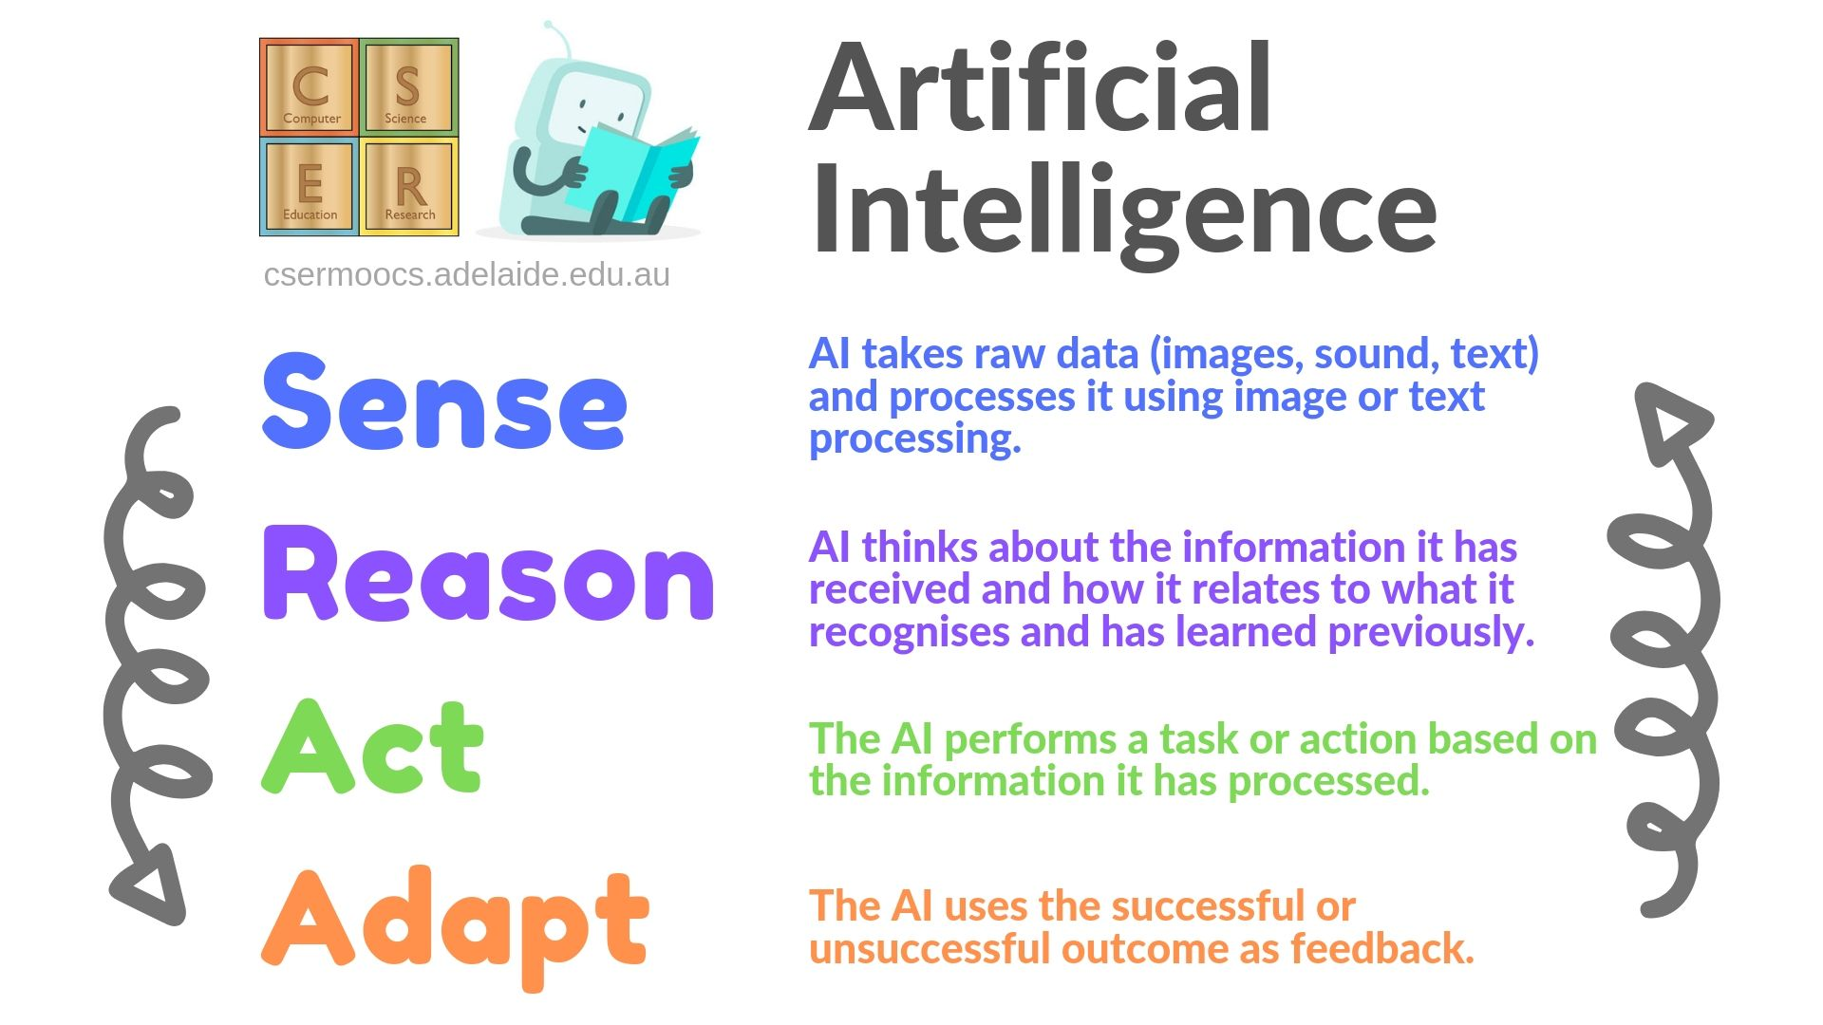
Notes:
In a regular programming activity we are telling the computer exactly what to do. But what if we want to use a machine to help us review new data rather than telling it explicitly?
Here we have an image that characterises the unique aspects of AI.
AI has the ability:
To Sense by taking raw data and processing it using image or text processing.
To Reason - by thinking about the information it has received and how it relates to what it has learned previously.
To Act - The AI then performs a task or action based on the information it has processed.
To then Adapt. The AI then uses the successful or unsuccessful outcome of its action as feedback.

Slide 9
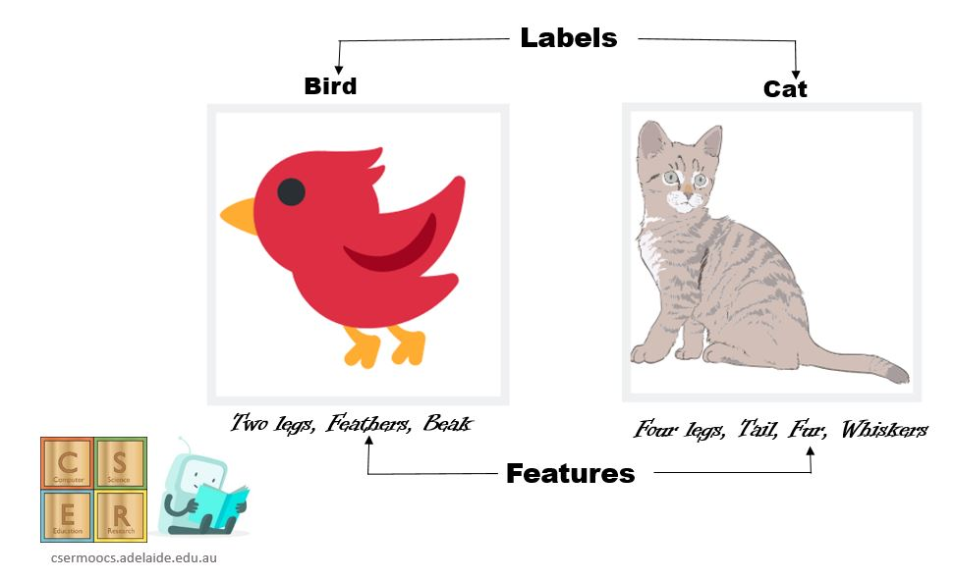
The process of achieving Artificial Intelligence. In Machine Learning, we teach the machine by training with lot of examples.
What is Machine Learning?
Notes:
Machine Learning (ML) is a process of achieving Artificial Intelligence. In machine learning, we teach the machine by training it with lots of examples of data demonstrating what we would like it to do so that the machine can figure out how to do it on its own.

Slide 10
What technologies use AI?
https://padlet.com/CSER/AI_examples_cser
Notes:
There are different ways AI can mimic human capabilities for a number of different purposes.
Efforts in AI have been teaching AI to SEE, to MOVE, to COMMUNICATE and to THINK.
Let’s look at some ways AI have been used to develop technological solutions. Have a think about what technologies we know of that might be created to see, move, communicate and think.

Slide 11
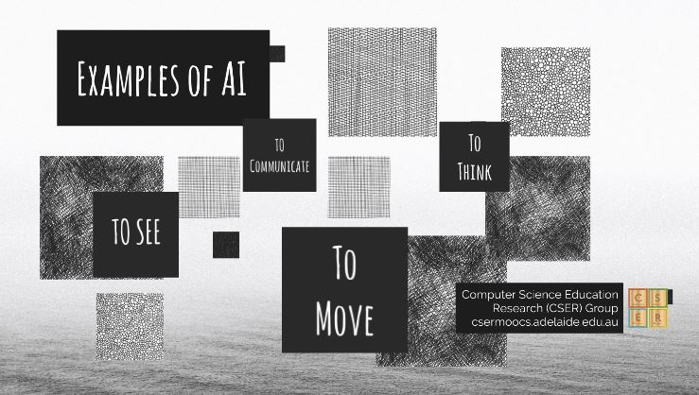
Notes:
You can view our CSER Prezi on examples of AI here: http://bit.ly/2ZKuoSv
Examples of AI
Smart Assistants
Self driving cars/buses
Search sites like Google
Recommendation systems, e.g. Netflix, YouTube, Spotify

Slide 12
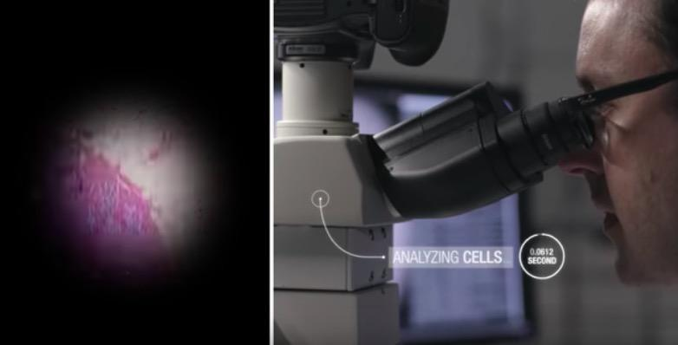
Notes:
Google have created a machine learning and augmented reality-powered microscope for real-time detection of cancer, helping to make pathologists more efficient and ultimately to save patient lives.
https://www.youtube.com/watch?v=9Mz84cwVmS0

Slide 13
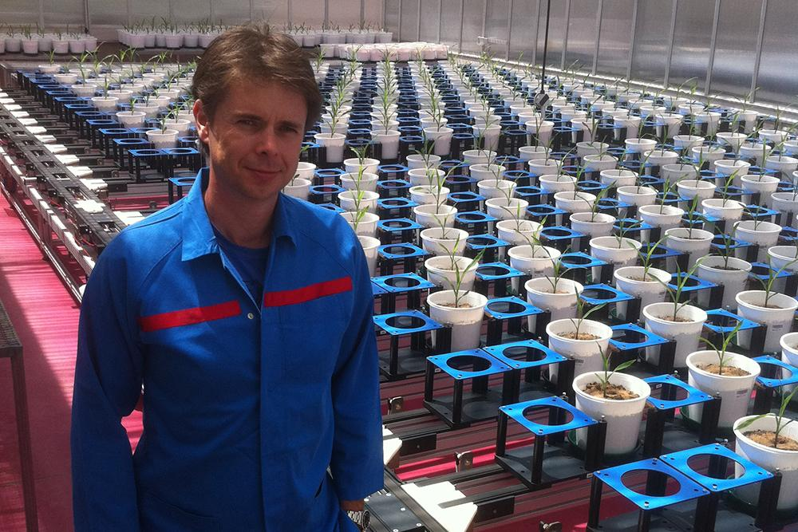
Notes:
https://www.adelaide.edu.au/aiml/news/list/2018/10/15/accelerating-crop-farmers-adaptation-to-climate-change
Led by Professor van den Hengel, AI technology is being tailored to accurately estimate potential new cereal varieties’ yields after only very short periods of growth, enabling rapid identification of robust varieties able to thrive in harsh conditions.
The system uses multiple images taken from numerous angles to construct computerised 3D models of the plants for analysis.
“The Plant Accelerator’s fully robotic plant management system allows automatic and repeatable control of growing conditions for up to 2400 plants at a time, and enables automatic delivery of those plants to our imaging stations. That’s going to allow rapid, detailed and accurate estimations of vast numbers of crop varieties’ potential yields under all kinds of climate-change-related stresses, such as high salinity or drought. We’ve no doubt it will expedite the development of hardy, high-yield varieties and help improve global food security.”

Slide 14
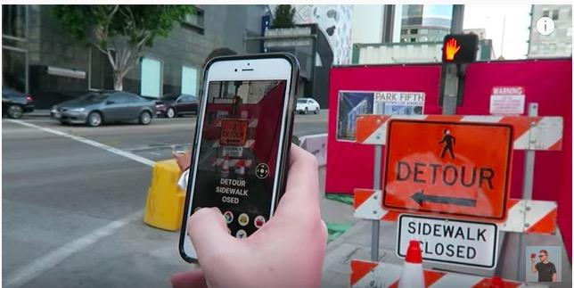
Notes:
AI apps have been developed to help people with vision impairment and blindness “see”.
Using image processing capabilities with the camera on the phone the app tells the user what it sees.
It can:
Read books, signs, menus
Listens & responds
Describes objects in environment e.g. bookcase, stop sign, food and drink.
This is an example of AI poly vision.
https://www.youtube.com/watch?v=FZBGjxQeP-A

Slide 15
How does AI work?
Notes:
Underlying process of AI - how does AI works?
In this part of the presentation, you will see that learning about AI techniques provides an excellent context for Australian Digital Technologies Curriculum - relating to 'data representation' and the 'collection, management and analysis of data'.
By learning about how AI use data, students will be exploring patterns in data and learning about how digital systems represent data as text, image and audio data for the AI system to process it.

Slide 16
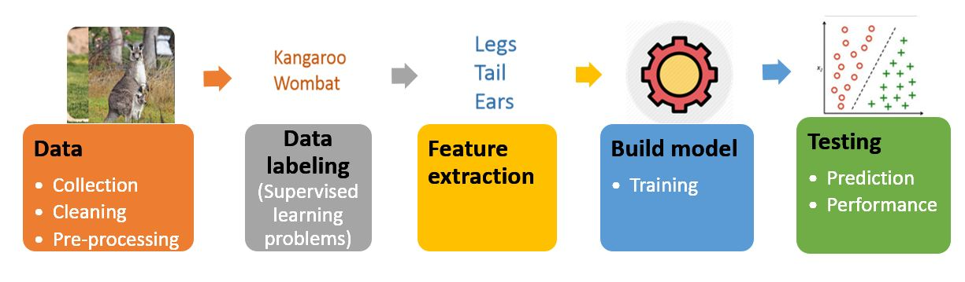
AI Workflow
Notes:
When working with AI systems there is a process that we can undertake to train, build and test our model. These stages include:
Data collection: such as collecting image, sound or text data, cleaning the data and preprocessing it so that it is ready to use.
Data labelling: such as labelling the data to tell the computer what is in the image - e.g. a kangaroo or wombat.
Feature extraction: labelling the data to tell the computer what features the object has - e.g. how many legs, ears.
Building the model: which involves developing the model and training it with the dataset collected.
Testing the model: for example feeding the machine a new image (sound or text data) it has not seen before and testing the accuracy/performance of the output.

Slide 17
Supervised Learning Unsupervised Learning
The process of the human providing the program with many examples of what it is we are wanting it to learn, along with a label that helps the machine classify or identify an object.
Involves providing the machine with a large amount of data and letting it find patterns in the data on its own, by trying to identify patterns in the features included. The machine then determines its own set of categories or labels by grouping the data.
Notes:
As similar to how we have different approaches to teach humans how to learn – for example, rote learning, discovery learning, there are different ways that we can teach machines how to learn.
The most common two types are supervised and unsupervised learning
The biggest difference between these two are in supervised learning your data has labels.
A label is basically the type or category of the data that you want to predict
When machine is trained to identify features of data by seeing many examples with labels, it can make judgments on its own for a new data without a label. We call this as ‘prediction’
On the other hand unsupervised data do not have labels but it involves looking at large amount of data (millions and billions) and find patterns in data based on their features
This way machine can categories or label data by grouping. This process is known as "clustering".

Slide 18
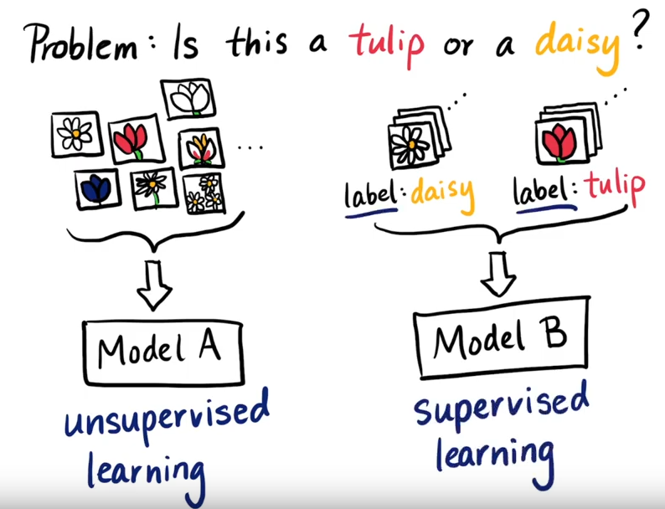
Video on ‘Types of Machine Learning’ by ML Tidbits
Notes:
https://www.youtube.com/watch?v=wy-m6sd1BOA&t=50s
To differentiate tulips and daisies
We can collect images of bunch of flowers and provide it to a machine learning algorithm
The machine will look at similar patterns or features or characteristics in data
For example, number of petals, color, weight etc.
And group the images of flowers into categories
This is called unsupervised learning

Slide 19
Labelling Data
Notes:
A label is a meaningful tag that can be attached to data from similar categories.
Humans can provide labels on the data that tell the machine about data
For example, ‘cats’ and ‘birds’ are meaningful labels.
Features are the attributes that describe what is in the data.
For example, in the images of cats and birds, we consider attributes that describe the appearance of cats and birds such as the number of legs, the presence (or not) of a tail, fur, features, ears, height and weight.

Slide 20
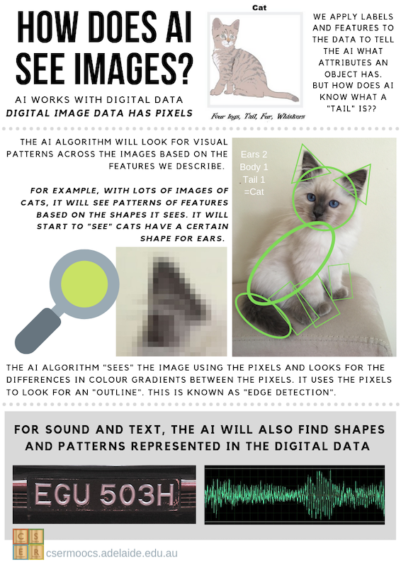
(Download CSER resource)
Notes:
How does this idea of label and features fit into the bigger picture of helping machines see objects in images? How does a machine “see” a cat, for example?
This infographic presents how AI sees images. Firstly, AI works with digital images - recall that digital image data contains pixels. The AI algorithm will look for patterns across the various images we provide based on the features we describe. It uses ‘edge detection’ to look for shapes according to the contrasting colour gradients in the pixels. For example, here we see that when we zoom in on the kitten’s ear the image becomes pixelated. Each one of those pixel colours are represented by a number. The AI will look for the edge of the cat ear, guided by the contrasting colour - the numbers. The AI will recognise the edge as being the point where pixels contrast between cream and grey.
The AI will also then look for features as represented by the shapes. We can see here that shapes for the kitten could be (broadly speaking) made up of triangles, ovals and rectangles. This process of looking for differences in colour gradients to see an outline is called “edge detection”.
For other types of data, such as sound and text, the same process is used.

Slide 21
Classroom Activities
Notes:
In teaching machines how to behave like humans, there are a number of areas in AI that focus on particular human-like capabilities. In this section we will explore two of these areas, "Computer Vision" and "Natural Language Processing".

Slide 22
Computer Vision
Notes:
In this part of the session we will look at different classroom activities you can try for primary and secondary years. If you’d like to go through them in detail, please visit our CSER MOOC on Teaching AI in the Primary or Secondary Classroom.
The field of AI that relates to human vision is called Computer vision. Computer vision is the ability for machines to recognise objects in images or videos. Computer vision aims to mimic human vision by teaching the machine using many examples of images either labelled or unlabelled, where it discovers patterns and learns to recognise objects on its own. Examples of computer vision include face tagging on social media photos, automatic recognition of number plates, and vision used by self-driving cars.
In the video here, we will learn about the concept of Computer Vision.

Slide 23
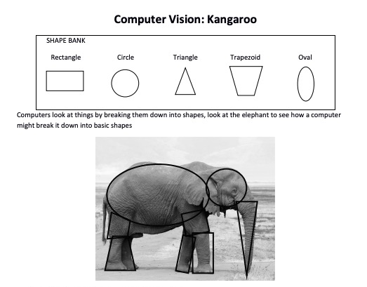
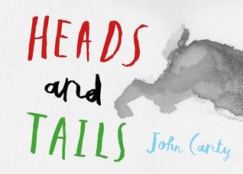
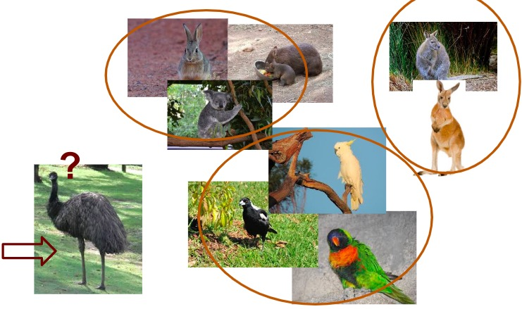
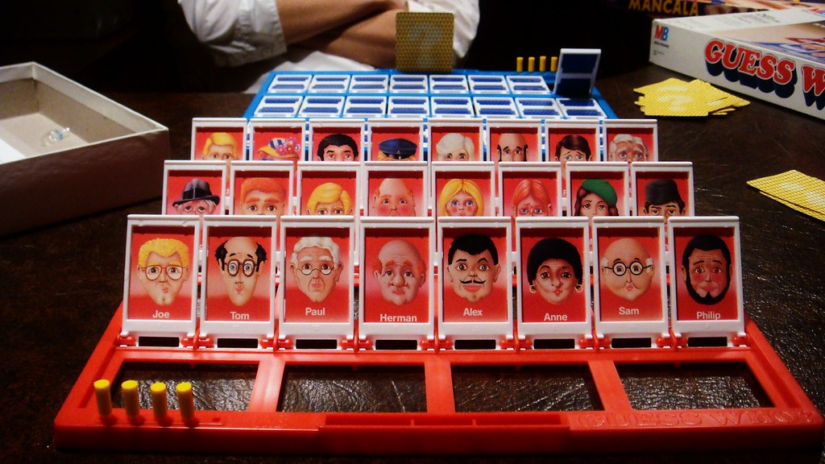
Feature Extraction (Unplugged)
Sorting and Organising Data by Features (e.g. images of transport, people, animals, etc).
Storybooks that talk about features of things (e.g. examples about animal features).
Data projects extracting features from images and presenting them as numeric data for analysis.
Games, such as Guess Who, that involve identifying features.
Notes:
The idea of feature extraction is not a new one. You will already be doing this in Science and Mathematics. In these examples, students can sort and organise data visual data such as images of transport, animals or people, according to their features.
Storybooks that present ideas around features of animals or other things could provide a good springboard or starting context into an activity. Similarly, a game like Guess Who, where students are identifying and asking about features of humans can be a great way to explore feature extraction.
Taking this further, students can take features from image data and represent it as numeric data for analysis. This is the kind of activity humans do in order to teach computers about what they can see in images.
Digital images are represented by a matrix of numerical pixel values. Perhaps the simplest image representation is grayscale, where pixels take on a range of shades of gray, from 0 (Black) to 255 (White). Edge detection works by comparing adjacent pixel values - if there is a large difference, either from light to dark, or from dark to light, then that can indicate the edge of an object in your image.
Tracy Camp and Cyndi Rader from the Colorado School of Mines have produced a wonderful CS Unplugged lesson plan that explores edge detection, as seen in the images on the screen.
Students can explore the concept of how a computer can use lines to represent a shape, perhaps a car or an animal. As a whole class, the teacher works with students to look at an image and to talk about the various shapes they see - triangles, circles, rectangles. In the first activity, students copy the first image of the elephant by drawing the shapes over the top of the kangaroo. Students can also take the shapes from this worksheet and work on a number of images, trying to fit the shapes to the image, and seeing whether there are common shapes that occur for the same type of image, for example always having circles to represent wheels on a car.
After working with provided images, students can then find and print (or draw!) a final image to work with and identify the shapes in that image. Students bring images of their animals back together as a whole class to compare and contrast the patterns they see across all of the images. Are there some that share similar shapes? Which shapes are most common for particular features? Can we group these?
In another activity from the Colorado School of Mines, we explore edge detection by colouring a matrix of numerical pixel values. In this activity students are examining a highly pixelated greyscale image using the numbering system as a way to detect the edges like an AI algorithm would.
Before starting students can predict where they think the edges of the object might be in the image simply by looking at the numbers in the grid and seeing where the number differences are. After making some predictions, students complete the activity by calculating two values and if they differ more than 50, they draw a thick line in between them on the grid. Once students have completed their line, they see if they can identify an edge of the image. Students could colour in their grid to complete the greyscale image.

Slide 24
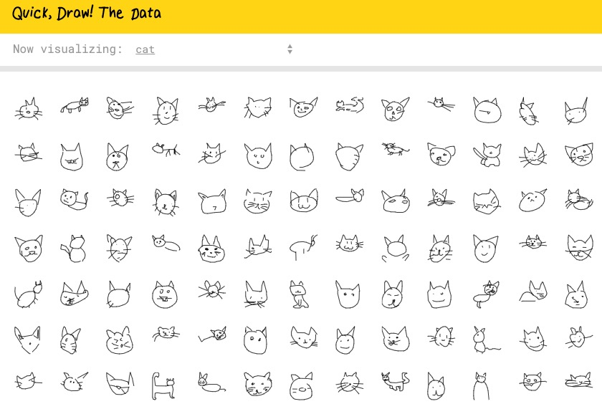
Feature Extraction (Plugged)
Google experiments that highlight classification (e.g. Quick Draw or Safari Mixer).
Search some great AI examples on Google Experiments experiments.withgoogle.com/collection/ai
Notes:
Google Experiments example - Quick Draw. https://quickdraw.withgoogle.com/
An example of drawings that had unexpected differences (identified by Google) was that people were drawing shoes in many different ways. Some were being drawn as high heels, others as sneakers, and some people drew boots. What kind of impact would this have on AI? What does this tell us about biases and developing AI technology?

Slide 25
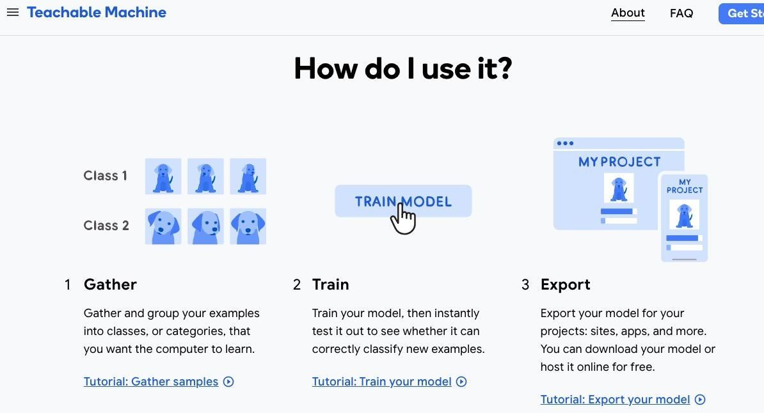

Slide 26
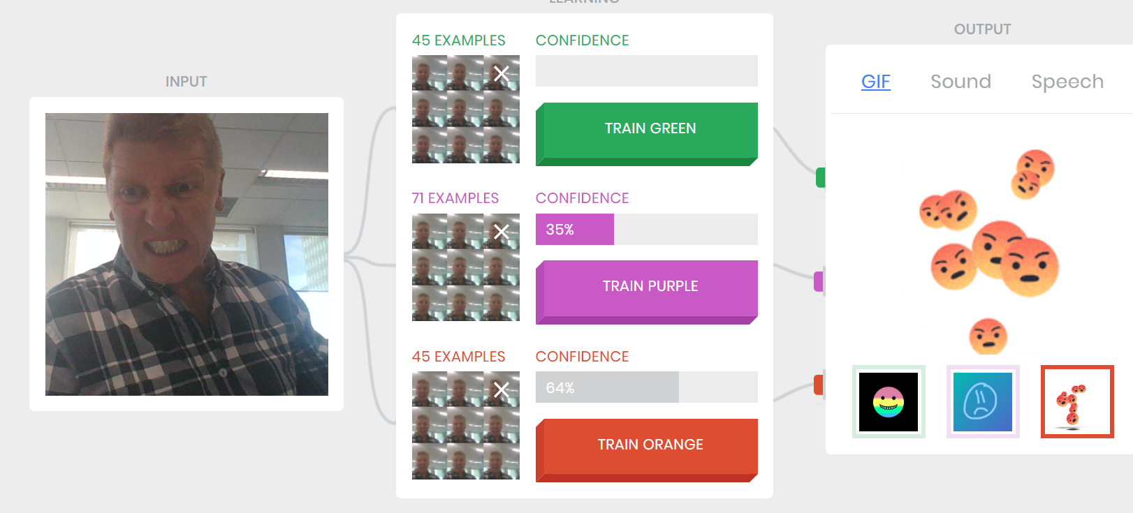

Can AI Guess your emotion?
Notes:
Years F-4
Supervised learning example, Classification
Students train the AI to recognise their emotion, happy sad or angry
Before using the tool we look at an unplugged activity looking at the features eyebrows, mouth, eye (feature extraction)
This is the V1 of teachable machine but I like it for its simplicity and options for output
Visual for the confidence level, how much of the coloured bar is shaded?
Also image of themselves not saved project no image is stored (privacy)
Discuss in other projects that may be saving data and models to take images that are not identifying

Slide 27
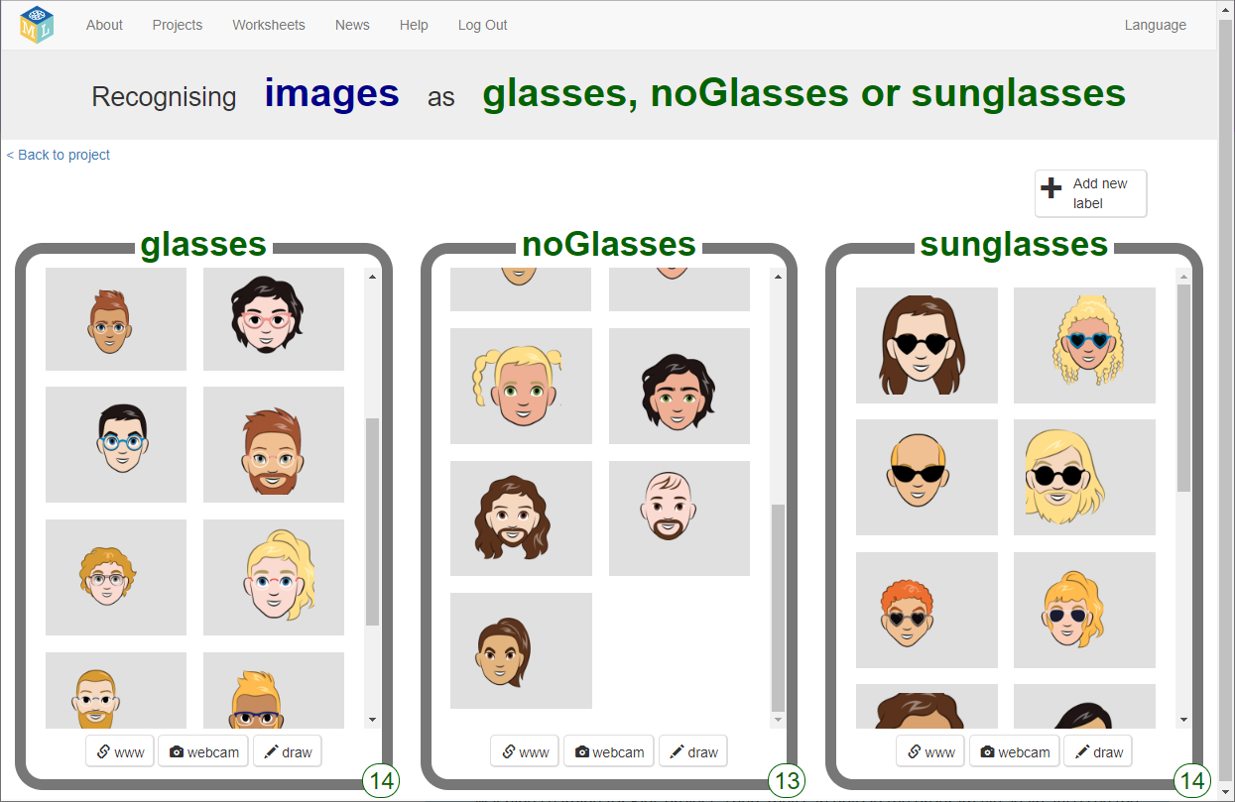
AI IMAGE RECOGNITION – EXPLORING LIMITATIONS AND BIAS
Train AI to recognise faces with without glasses.
Incorporate an AI model using Machine Learning for Kids.
Challenge in set up (we provide a step by step video)
Students create their own models and train the AI. Incorporate into Scratch or Python.
Notes:
Years 5-6, 7-8
We supply the copyright free images.
NOTE Machine Learning for Kids requires a set up which needs the teacher to set up API keys which enable students to build an AI model.
We have a video that explains the setup step by step. Once you have done that once and set up a class you can start to build the AI models.
It really is pretty cool. So a small hurdle but it is worth it.

Slide 28
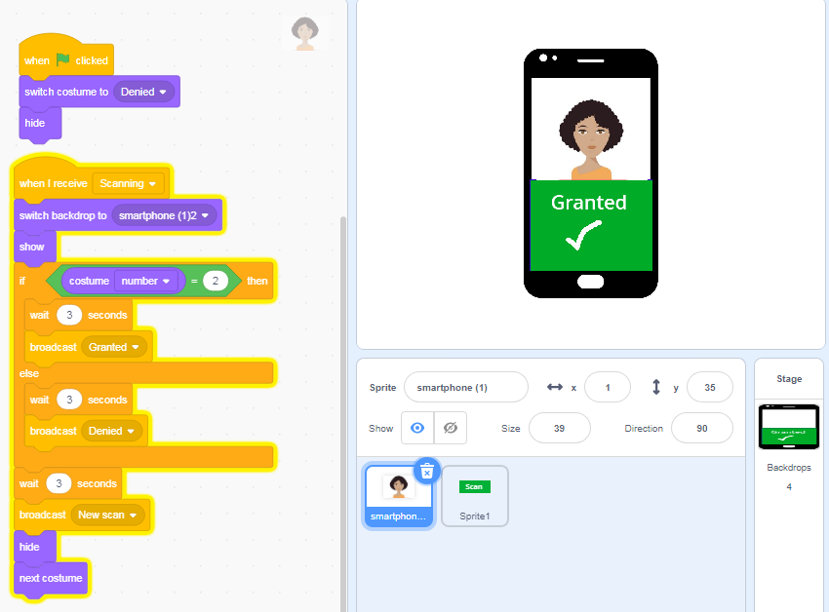
AI SMARTPHONE SECURITY
Scratch Basic Phone lock/unlock
Unplugged: PIN, Fingerprint and Iris scanning (what is powered by AI?)
Plugged:
Train AI (Teachable Machine) to recognise the correct face (easy)
Hard code PIN (easy)
Hard code Image recognised (granted broadcast a message to unlock) (med)
Incorporate an AI model using Machine Learning for Kids. (Med to hard)
Notes:
Years 5-6
Mimic AI using a visual programming language like Scratch
Code snippets to guide students and remix

Slide 29
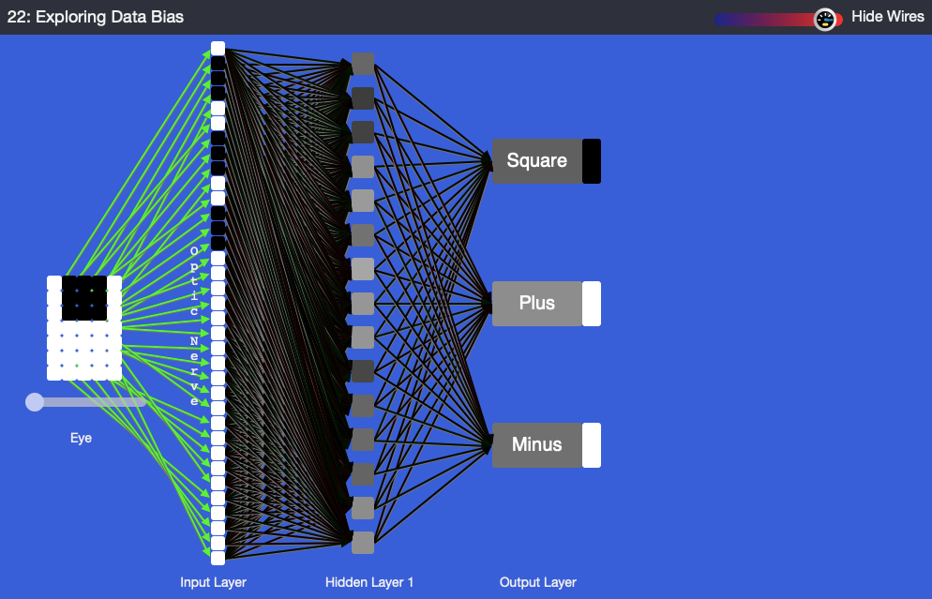
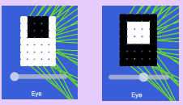
Data bias in AI
Unplugged: intro bias with an activity- draw a doctor, teacher, manager, court judge, receptionist (uncover gender bias)
Plugged:
Use an AI tool to test data bias based on backgrounds (ANN artificial neural network)
Train using only black images on white background. Test using white and black backgrounds. AI low confidence on new data.
Retrain and test.
Notes:
Years 5-6, Years 7-8
To learn more about ANNs, explore the other experiments in this course at https://mycomputerbrain.net/php/courses/ai.php. The first experiment is free and provides a good introduction to ANNs.

Slide 30

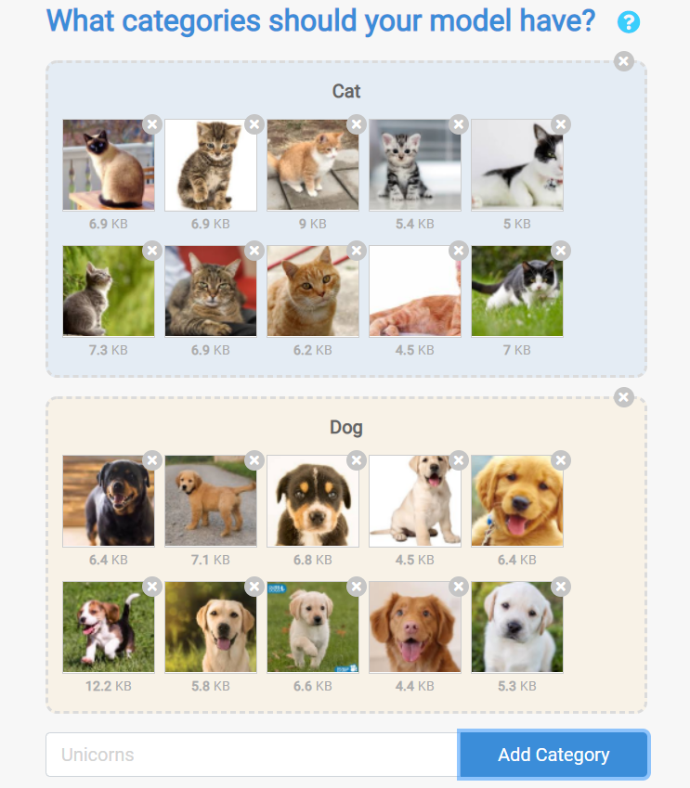
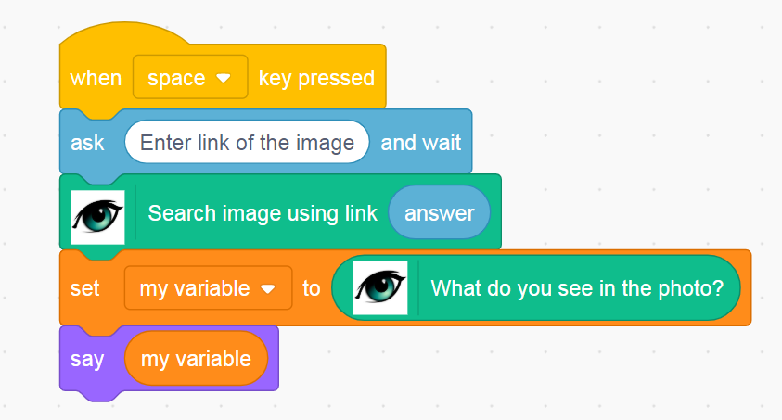

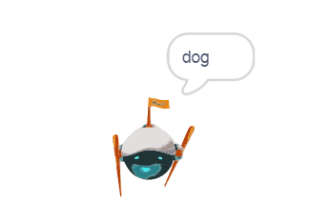
Cognimates image classification project
Notes:
Cognimates (Cognimates.me) is a program that allows students to train AI models and code using familiar block-based visual programming. There are a number of existing projects that students can use, remix or extend or students can create their own program! This is a great way for students to learn about the process of Machine Learning, the use of data to train models, testing of AI and how they can build AI into a visual programming solution.
In this example on the screen, students are learning about how to train and AI model to classify one of two animals - cats and dogs.
Teachers can download the CSER resource on how AI see to support in explaining image processing.
Cognimates: a visual programming platform build as a Scratch extension by MIT Media Lab (creator - Stefania Druga). This is a free platform for everyone.
Clarifai vision API: Cognimates platform uses Clarifai vision API to build custom AI projects.
Project Handout
In the video, we provide step-by-step instructions on how to create a project. Please follow the instructions guide here on how to set up an account with Clarifai and obtain vision API key.
We have shared our Cognimates project (sb3 file) to download which you can extend or adapt by remixing the project. This can be loaded to your Cognimates platform by selecting File > Load from your Computer and selecting the downloaded sb3 file. ]

Slide 31
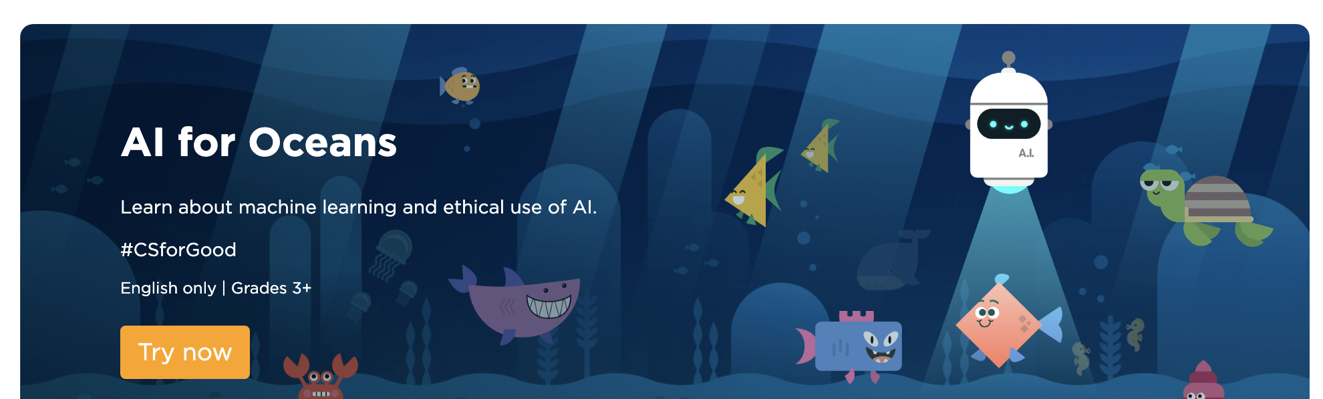
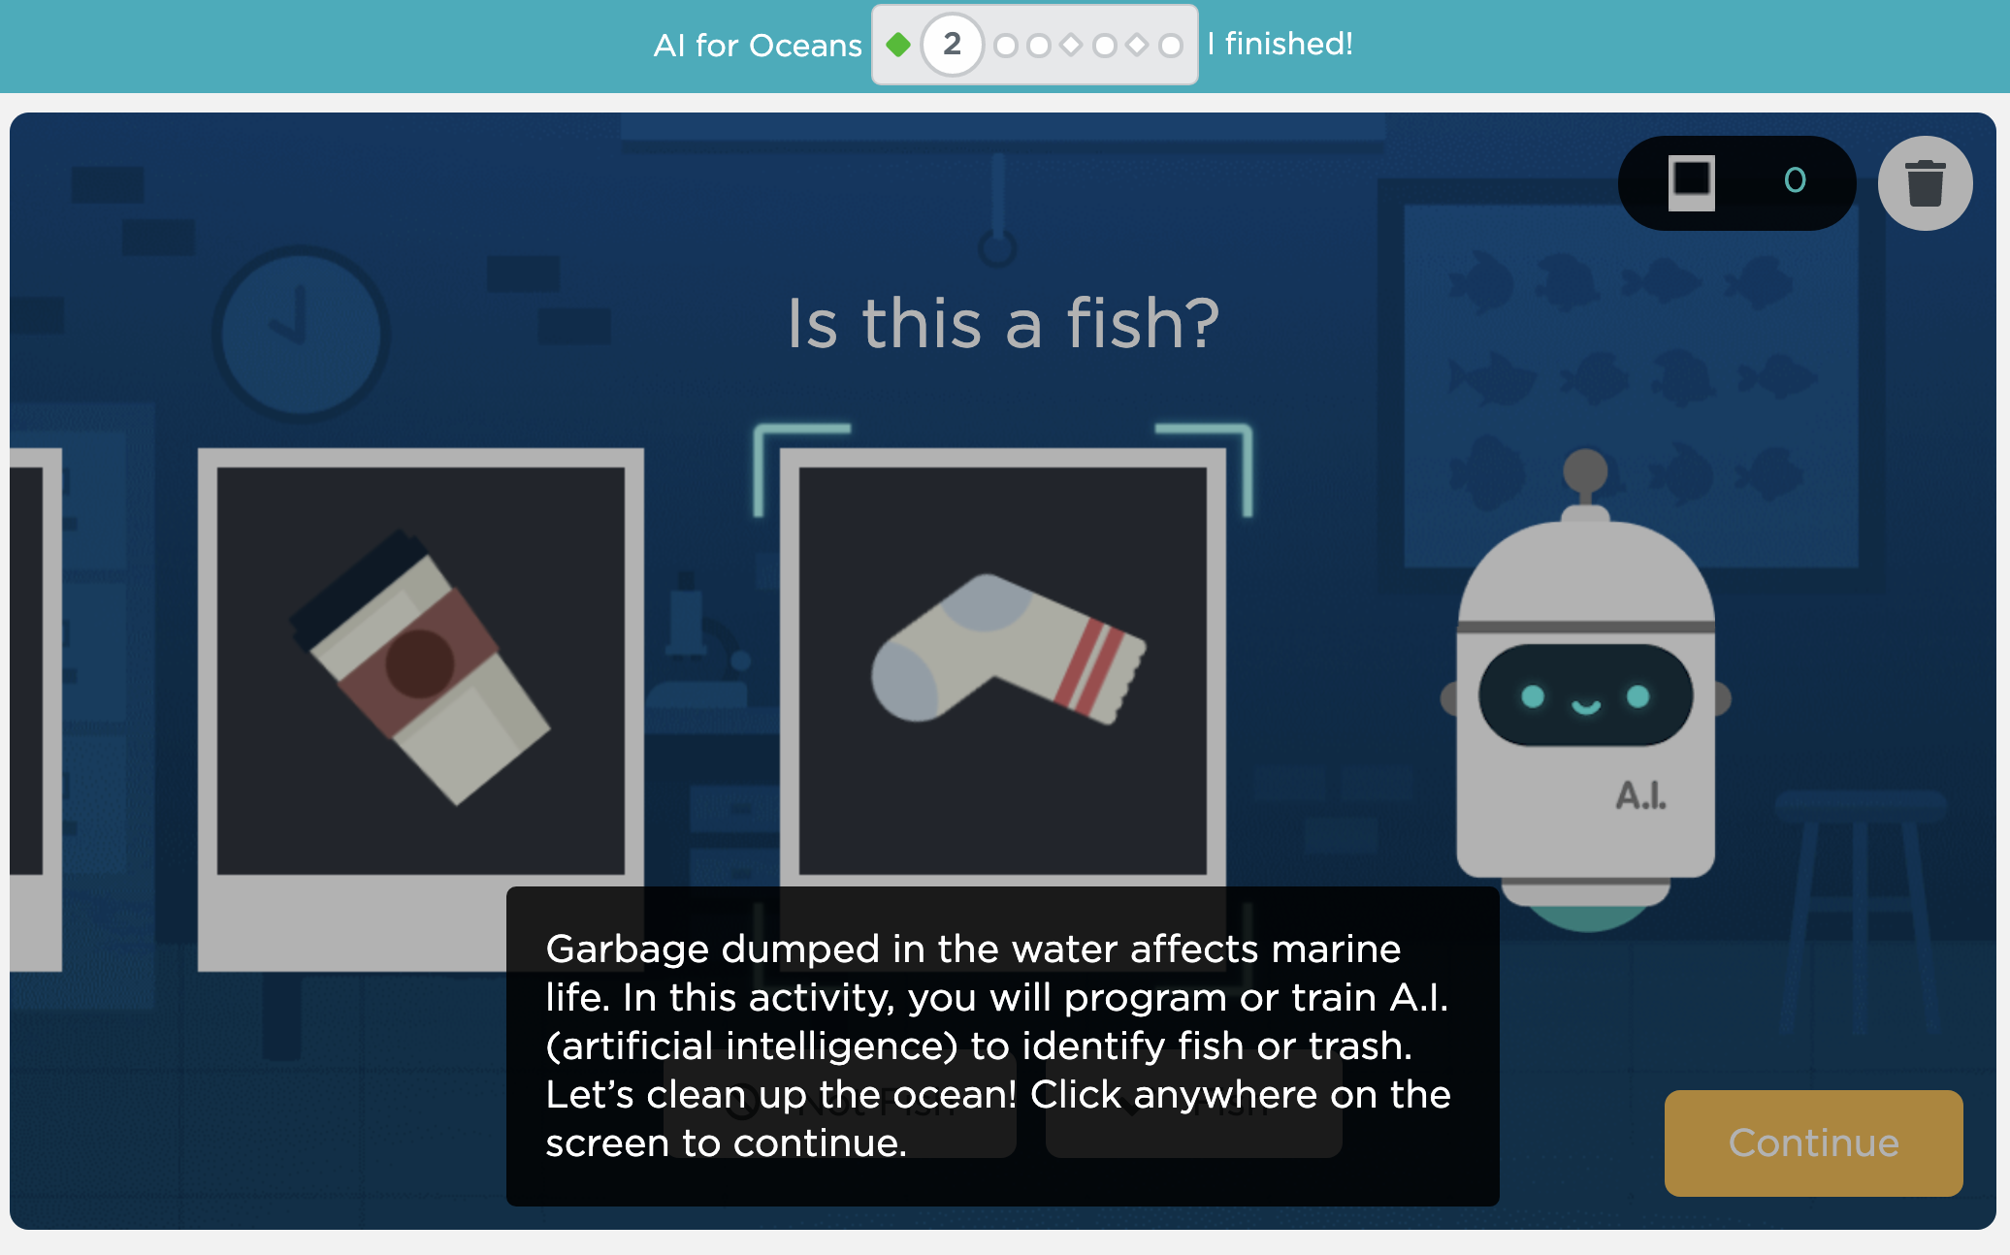
Notes:
New Hour of Code example: https://code.org/oceans?fbclid=IwAR0UOedrscwpLbX9yjSIVZghcaIdqfx1N4O36d-QxTEnf-wWcd4rsgS5FY0

Slide 32
Natural Language Processing
Notes:
In this part of the session, I will go through some classroom activities related to Natural language processing
We have included more unplugged and plugged activities in our AI MOOCs – You can check them out if you want to learn more

Slide 33
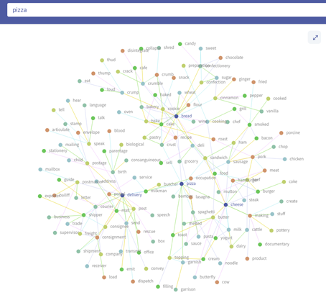
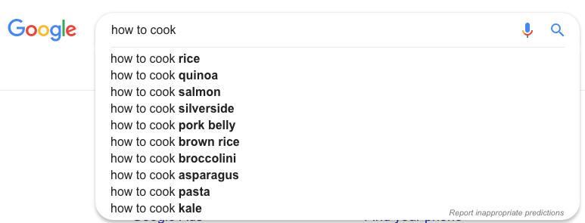
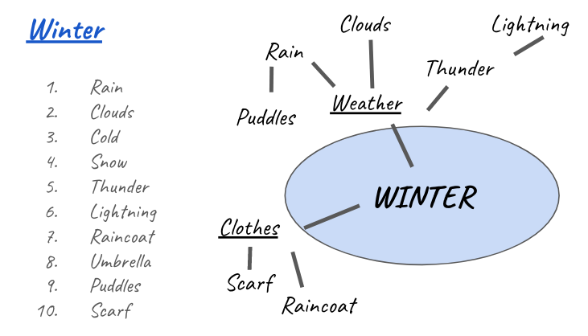
NLP (Unplugged)
https://www.twinword.com/ideas/graph/

Slide 34
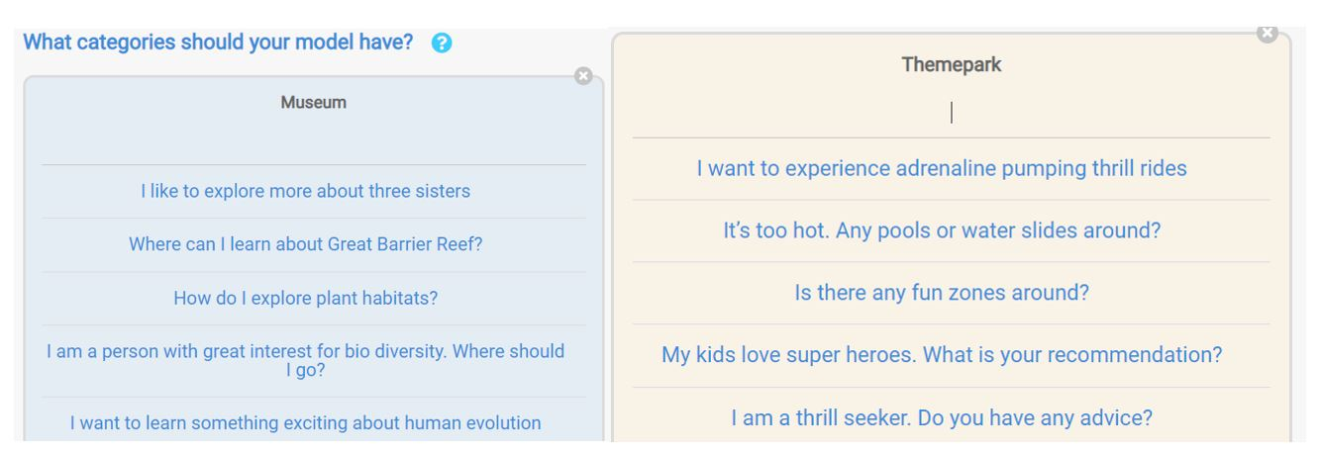
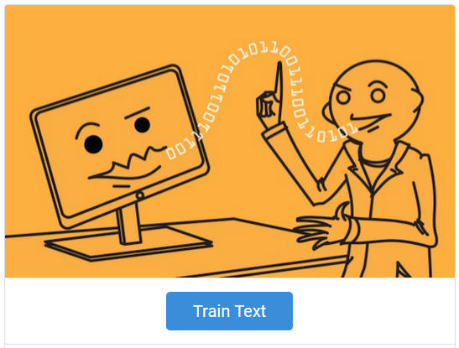

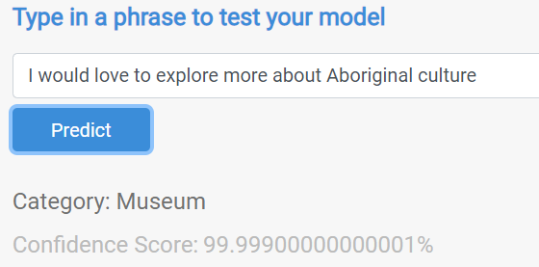
Cognimates - AI Travel Assistant
https://cognimate.me:2635/text_home
Notes:
Years F-6
In our CSER AI MOOC for primary teachers, we have an NLP activity example about using Cognimates to build a Travel assistant.

Slide 35
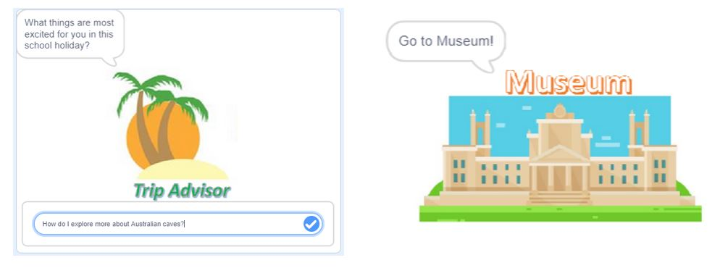
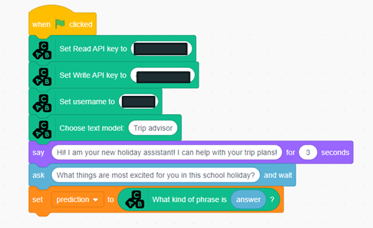
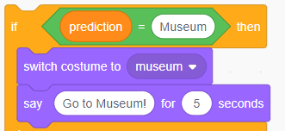

Try with Cognimates
https://codelab.cognimates.me/

Slide 36
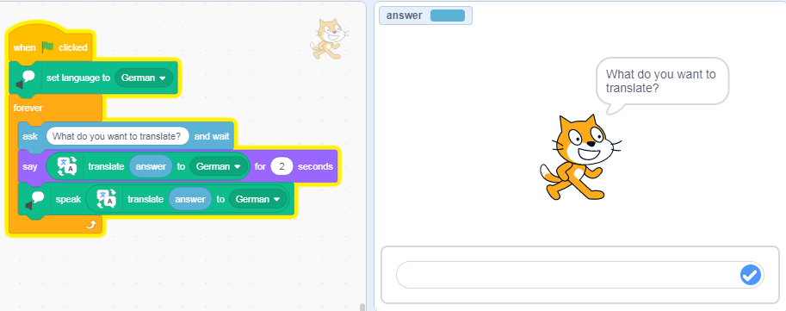
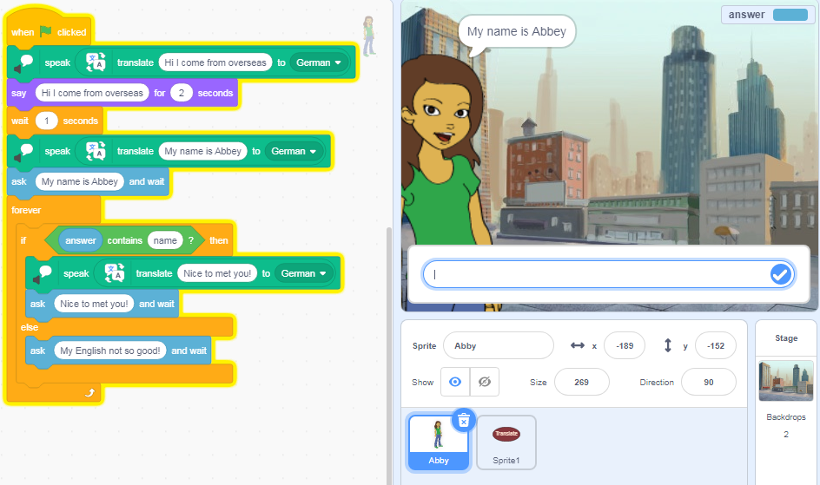
FUN PROJECTS WITH LANGUAGE TRANSLATION
Sample code: Text to speech translator
Unplugged: modelling a conversation
If the question is about finding out my name then … my response is …
Plugged:
Language translator: Text to speech using Scratch 3.0
Chatbot with foreign visitor
(Mimic AI) If the string contains a specific keyword and reply …
Python examples available in 2020 (module with video tutorials.
Foreign Chat
Notes:
Years 5-6
Mimic AI using a visual programming language like Scratch
Randomise conversation
You could take the idea and choose a topic and students create their own chatbot expert on their selected topic

Slide 37
Slide deck:
http://bit.ly/AI_DTHub
Questions?
csermoocs.adelaide.edu.au
digitaltechnologieshub.edu.au
Notes:
That brings us to the end of our session. Thank you so much for participating. We hope you have enjoyed the session! For more information about the Computer Science Education Research (CSER) Group and the free programs and resources they have on offer, please visit csermoocs.adelaide.edu.au

Slide 38
Resources
This session can be delivered alongside or in support of our AI MOOCs for primary (https://csermoocs.appspot.com/ai_primary) and secondary teachers (https://csermoocs.appspot.com/ai_secondary).
AI resources on the Digital Technologies hub https://www.digitaltechnologieshub.edu.au/teachers/topics/artificial-intelligence
Hour of Code AI
  https://studio.code.org/s/oceans/stage/1/puzzle/1

