Slide 1



User stories and design criteria
Fair use of the school basketball court
Digital Technologies Hub is brought to you by the Australian Government Department of Education. Creative Commons Attribution 4.0, unless otherwise indicated.

Slide 2
Designing for the user
We are learning to design effective user-focused solutions.
You will be able to:
identify and describe user needs
write user stories that capture users’ needs and goals
co-develop design criteria using user stories.
Digital Technologies Hub is brought to you by the Australian Government Department of Education. Creative Commons Attribution 4.0, unless otherwise indicated.

Slide 3

Design with the user in mind
Software developers create user stories to understand customer needs and guide product development.
Image: Flaticon.com
Digital Technologies Hub is brought to you by the Australian Government Department of Education. Creative Commons Attribution 4.0, unless otherwise indicated.
Notes:
Crowd Of Users free icon
https://www.flaticon.com/free-icon/crowd-of-users_33887?term=users&page=2&position=68&origin=search&related_id=33887

Slide 4

Format of a user story
Image: Flaticon.com
We can develop user stories to identify user roles, their goals, and why those goals are important.
To create a user story, use the format:
As a [user role], I want [goal] so that [reason].
Digital Technologies Hub is brought to you by the Australian Government Department of Education. Creative Commons Attribution 4.0, unless otherwise indicated.
Notes:
Communication free icon
https://www.flaticon.com/free-icon/communication_3820107?term=communication+two+people&page=1&position=1&origin=search&related_id=3820107

Slide 5


Find out about the user
Images: Flaticon.com
Digital Technologies Hub is brought to you by the Australian Government Department of Education. Creative Commons Attribution 4.0, unless otherwise indicated.
Notes:
To create a user story, you need to find out about the user.
Who free icon
https://www.flaticon.com/free-icon/who_5129544?term=users&page=3&position=94&origin=search&related_id=5129544
Research free icon
https://www.flaticon.com/free-icon/research_6012993?term=users&page=5&position=12&origin=search&related_id=6012993

Slide 6

Design a solution
How can time on the school basketball courts be more fairly shared during playtime?
Image: Flaticon.com
Digital Technologies Hub is brought to you by the Australian Government Department of Education. Creative Commons Attribution 4.0, unless otherwise indicated.
Notes:
Let’s apply that to a design context such as this example: How can time on the school basketball courts be more fairly shared during playtime?
Basketball Court free icon
https://www.flaticon.com/free-icon/basketball-court_704910?term=basketball+court&page=1&position=37&origin=search&related_id=704910

Slide 7
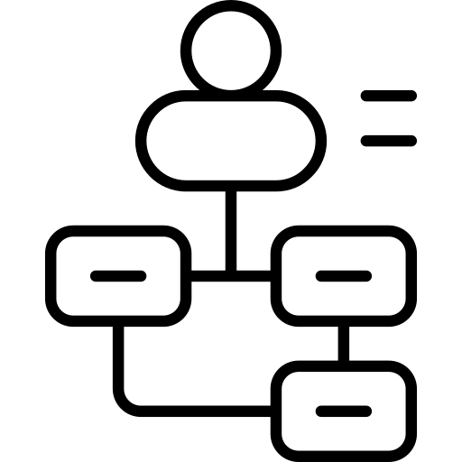

Find out about the users
How can time on the school basketball courts be more fairly shared during playtime?
I like playing games like basketball at playtime.
But it is always the big kids using the courts.
We never get to have a turn.
I’d like a way to share the courts, so we all get a turn, and use of the court is fair.
If there was a good process to follow, we wouldn’t always be the ones to miss out.
Images: Flaticon.com
Digital Technologies Hub is brought to you by the Australian Government Department of Education. Creative Commons Attribution 4.0, unless otherwise indicated.
Notes:
User free icon
https://www.flaticon.com/free-icon/user_2603258?term=users&page=6&position=31&origin=search&related_id=2603258
Shrug free icon
https://www.flaticon.com/free-icon/shrug_6009540?term=shrugging&page=1&position=3&origin=search&related_id=6009540

Slide 8


Turn this into a user story
How can time on the school basketball courts be more fairly shared during playtime?
I like playing games like basketball at playtime.
But it is always the big kids using the courts.
We never get to have a turn.
I’d like a way to share the courts, so we all get a turn, and use of the court is fair.
If there was a good process to follow, we wouldn’t always be the ones to miss out.
Use the format of a user story:
As a [user role], I want [goal] so that [reason].
Discuss as a group and write the user story.
Images: Flaticon.com
Digital Technologies Hub is brought to you by the Australian Government Department of Education. Creative Commons Attribution 4.0, unless otherwise indicated.
Notes:
Conversation free icon
https://www.flaticon.com/free-icon/conversation_3050525?term=discussion&page=1&position=3&origin=search&related_id=3050525
Shrug free icon
https://www.flaticon.com/free-icon/shrug_6009540?term=shrugging&page=1&position=3&origin=search&related_id=6009540

Slide 9
Example of a user story
How can time on the school basketball courts be more fairly shared during playtime?
As a [user role], I want [goal] so that [reason].
As a [student], (user role)
I want [a fairer way to use the basketball courts during playtime] (goal)
so that [everyone gets a chance to play]. (reason)
Image: Flaticon.com
Digital Technologies Hub is brought to you by the Australian Government Department of Education. Creative Commons Attribution 4.0, unless otherwise indicated.
Notes:
Shrug free icon
https://www.flaticon.com/free-icon/shrug_6009540?term=shrugging&page=1&position=3&origin=search&related_id=6009540

Slide 10
Design criteria
How can time on the school basketball courts be more fairly shared during playtime?
We use design criteria to describe important functionality to achieve the user goals.
User story: As a student, I want a fairer way to use the basketball courts during playtime so that everyone gets a chance to play.
Brainstorm: What design criteria do we need to include to meet the user needs?
One criteria is fairness; everyone should have a chance to use the basketball courts.
In small groups, discuss other important criteria.
Image: Flaticon.com
Digital Technologies Hub is brought to you by the Australian Government Department of Education. Creative Commons Attribution 4.0, unless otherwise indicated.
Notes:
Conversation free icon
https://www.flaticon.com/free-icon/conversation_3050525?term=discussion&page=1&position=3&origin=search&related_id=3050525

Slide 11
Co-develop design criteria
How can time on the school basketball courts be more fairly shared during playtime?
We use design criteria to describe the functionality to achieve the user goals.
Here are some examples.
Fairness: everyone should have a chance to use the basketball courts.
Simplicity: the design solution needs to be easily implemented.
Safety: all participants need to be safe.
Monitored: the system needs to include a way to monitor the fair use of court time.
Easy to maintain: the system needs to work in the long term.
Image: Flaticon.com
Digital Technologies Hub is brought to you by the Australian Government Department of Education. Creative Commons Attribution 4.0, unless otherwise indicated.
Notes:
Shrug free icon
https://www.flaticon.com/free-icon/shrug_6009540?term=shrugging&page=1&position=3&origin=search&related_id=6009540

Slide 12

Generate designs
based on the user story and design criteria
User story: As a student, I want a fairer way to use the basketball courts during playtime so that everyone gets a chance to play.
Design criteria
Fairness: everyone should have a chance to use the basketball courts.
Simplicity: the design solution needs to be easily implemented.
Safety: all participants need to be safe.
Monitored: the system needs to include a way to monitor the fair use of court time.
Easy to maintain: the system needs to work in the long term.
Image: Flaticon.com
Digital Technologies Hub is brought to you by the Australian Government Department of Education. Creative Commons Attribution 4.0, unless otherwise indicated.
Notes:
Combine the insights from the user story and the design criteria to generate solutions.
Branding free icon
https://www.flaticon.com/free-icon/branding_1312313?term=generate+designs&page=1&position=15&origin=search&related_id=1312313

