Slide 1
Future-proofing in the past

Slide 2

Rock using ochre
22000 BC
Public Domain
Narwala Gabarnmang rock shelter: one of the oldest known pieces of rock art on Earth
Notes:
Teacher background:
The oldest firmly dated rock art painting in Australia is a charcoal drawing on a rock fragment found during the excavation of the Narwala Gabarnmang rock shelter in south-western Arnhem Land in the Northern Territory. Dated at 28,000 years, it is one of the oldest known pieces of rock art on Earth with a confirmed date.
During the excavation, a portion of a charcoal drawing on a rock fragment was found which was radiocarbon dated at 28,000 years. The art is the oldest firmly dated rock art painting in Australia and one of the oldest known pieces of rock art on Earth with a confirmed date.^{[6]}
Image: Painted Ceilings and Pillars of Nawarla Gabarnmang. Photo Credit: © Jean-Jacques Delannoy and the Jawoyn Association; published in Antiquity, 2013
Accessed 3 June 2016, http://archaeology.about.com/od/nterms/ss/Nawarla-Gabarnmang.htm#step2

Slide 3
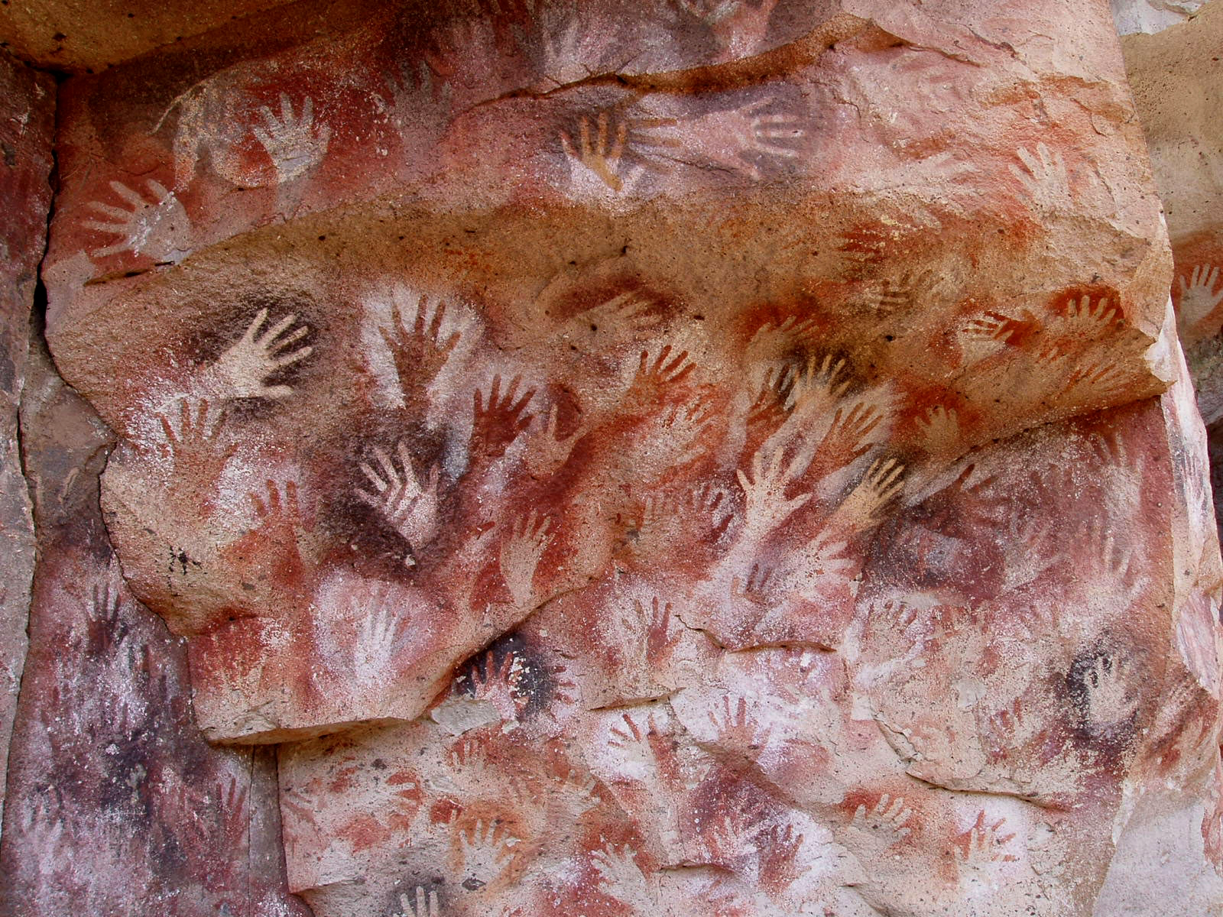
Rock using minerals
7300 BC
Public Domain
Cave of the hands (Cueva de las Manos), Santa Cruz, Argentina
Notes:
Teacher background:
The images of hands are stencilled and most are left hands. Besides hands there are also depictions of human beings, guanacos, rheas, felines and other animals, as well as geometric shapes, zigzag patterns, representations of the sun, and hunting scenes.
adapted from Wikipedia, https://en.wikipedia.org/wiki/Cueva_de_las_Manos accessed 3 June 2016
Image: CC BY-SA 3.0view terms accessed 3 June 2016 https://en.wikipedia.org/wiki/Cave_painting#/media/File:SantaCruz-CuevaManos-P2210651b.jpg

Slide 4

Engraved on tortoise shells
7000 BC
Public domain
Jiahu symbols, writing-like markings found in 2003 on tortoise shells, dated around 6000 BC, found 2003 at the Jiahu archaeological site, Henan Province, China
Notes:
Teacher background:
In 2003, tortoise shells were found in 24 Neolithic graves excavated at Jiahu, Henan province, Northern China, with radiocarbon dates from the 7th millennium BC.
Nature, April 28, 2003 (original filename writing_160.gif) Helen R. Pilcher 'Earliest handwriting found? Chinese relics hint at Neolithic rituals’ (Public domain)

Slide 5
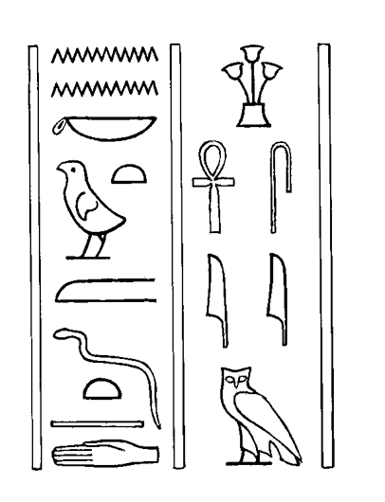
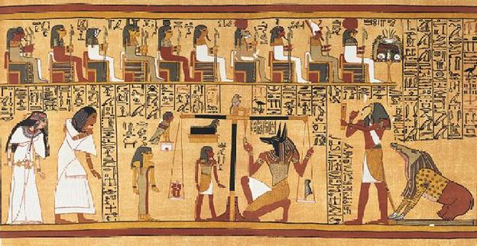
1250 BC
Papyrus using inks
Cursive hieroglyphs from the Papyrus of Ani, an example of the Egyptian Book of the Dead
Notes:
Teacher background:
The Papyrus of Ani is a papyrus manuscript with hieroglyphs and color illustrations created c. 1250 BCE. Egyptians compiled books for certain people upon their death, called the Book of Going Forth by Day, more commonly known as the Book of the Dead, typically containing declarations and spells to help the deceased in their afterlife.
This one was stolen from an Egyptian government storeroom in 1888 by Sir E. A. Wallis Budge, as described in his two-volume By Nile and Tigris, for the collection of the British Museum where it remains today. Before shipping the manuscript to England, he cut the seventy-eight foot scroll into thirty-seven sheets of nearly equal size, damaging the scroll's integrity at a time when technology had not yet allowed the pieces to be put back together.
Adapted from Wikipedia
Accessed 3 June 2016 https://en.wikipedia.org/wiki/Papyrus_of_Ani
Image: Public Domain accessed 3 June 2016 https://en.wikipedia.org/wiki/Papyrus_of_Ani#/media/File:Bookdead.jpg

Slide 6
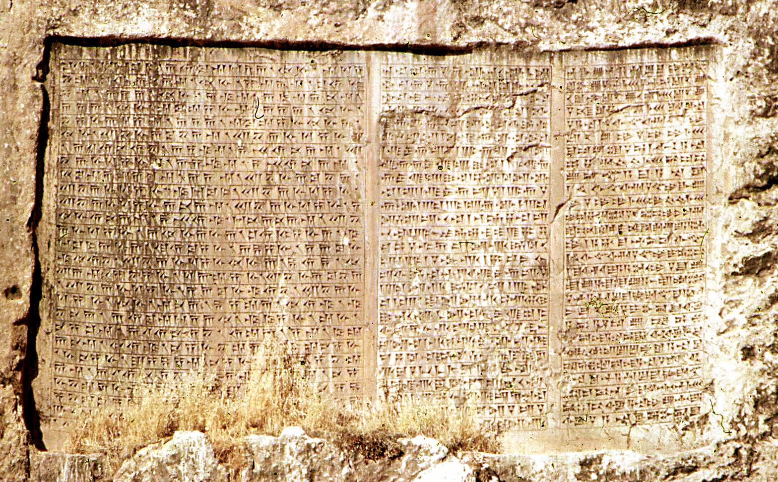

500 BC
Engraved
on a stone surface
Inscription of Xerxes, Van, Turkey in three languages, side-by-side.
Evolution over 2000 years of the symbol for “head”
Notes:
Teacher background:
Cuneiform (meaning “wedge-shaped”) script is one of the earliest systems of writing made by means of a blunt reed for a stylus.
This one reads, in part:
King Xerxes says: King Darius, my father, by the grace of Ahuramazda built much that was good, and he gave orders to dig this niche out, but because he did not make an inscription, I ordered this inscription to be made.
May Ahuramazda and the other gods protect me, my kingdom, and what I have made.
The Sumerian writing system first used clay tokens to represent different objects, such as supplies. By the 4th millennium BC, a round-shaped stylus impressed into soft clay was being used to keep accounts and records of numbers. Net pictographs were added by using a sharp stylus to show the thing being counted. Finally around 2700-2500 BC wedge-shaped styluses were developed to include phonetic symbols by the 29th century BC and eventually to represent syllables.
Image 1: CC-BY-SA-2.5,2.0,1.0; Released under the GNU Free Documentation License. Accessed 3 June 2016 https://en.wikipedia.org/wiki/Cuneiform_script#/media/File:Trilingual_inscription_of_Xerxes,_Van,_1973.JPG
Image 2: CC BY-SA 3.0 accessed 3 June 2016 https://en.wikipedia.org/wiki/Cuneiform_script#/media/File:SAG.svg

Slide 7
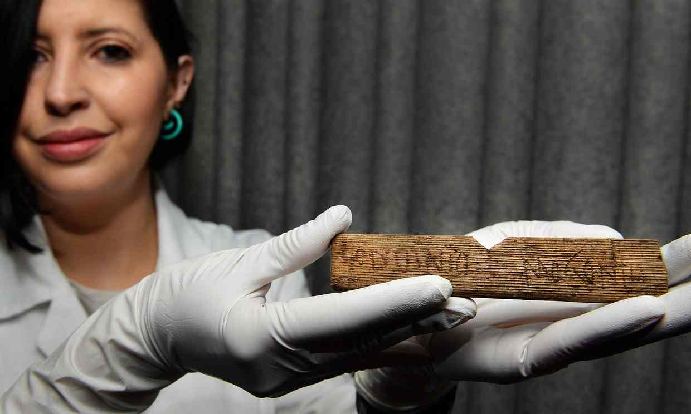
Wood coated with wax
43 AD
Photograph: John Stillwell/PA
A conservator for the Museum of London, holds a piece of wood bearing the words ‘Londinio Mogontio: ‘to Mogontius in London‘, the oldest handwritten document ever found in the UK.
Notes:
Teacher background:
Wood slabs were hollowed out, filled with wax and coated with soot. A stylus was used to write but often scratched into the wood as well.
Description of this discovery made when excavating for new Bloomberg building in London 2015:
“Tertius the Brewer, Junius the Cooper and Julius Classicus – the up-and-coming military commander who would turn traitor against Rome a decade later – have sprung back to life from the first decade of Roman London, their names – along with the first reference to London itself – miraculously preserved on writing tablets in a sodden hole in the heart of the City.
The wooden tablets, preserving the faint marks of the words written on bees wax with a metal stylus almost 2,000 years ago, are the oldest handwritten documents ever found in the UK.
The tablets were found under a 1950s office block in the still smelly, wet mud of the lost river Walbrook, as the site was being cleared for a huge new European headquarters for Bloomberg.
“They give us a glimpse into a carpet-bagging community in the new wild west frontier of the Roman empire,” said Roger Tomlin, the expert on early Roman writing who spent a year poring over the faint scratches on slivers of fir wood recycled from old barrels.
The oldest tablets, one of which was addressed “Londinio Mogontio” – to Mogontius in London – come from a layer securely dated to the first decade after the Roman invasion in 43 AD, through the timbers and coins also found.
That makes it the earliest reference to the Celtic name the Romans chose for their new settlement, written half a century before the Roman historian Tacitus used the name in his annals.
…
In total there were 405 writing tablets, 87 of which Tomlin succeeded in deciphering – a process he described as “code-breaking”.
…
“They represent the first generation of Londoners speaking to us,” said Sophie Jackson, the director of the Museum of London Archaeology unit which excavated the site. She called the tablets “the email of the Roman world”. “
The Guardian
Accessed 3 June 2016 from : http://www.theguardian.com/uk-news/2016/jun/01/tablets-unearthed-city-glimpse-roman-london-bloomberg

Slide 8
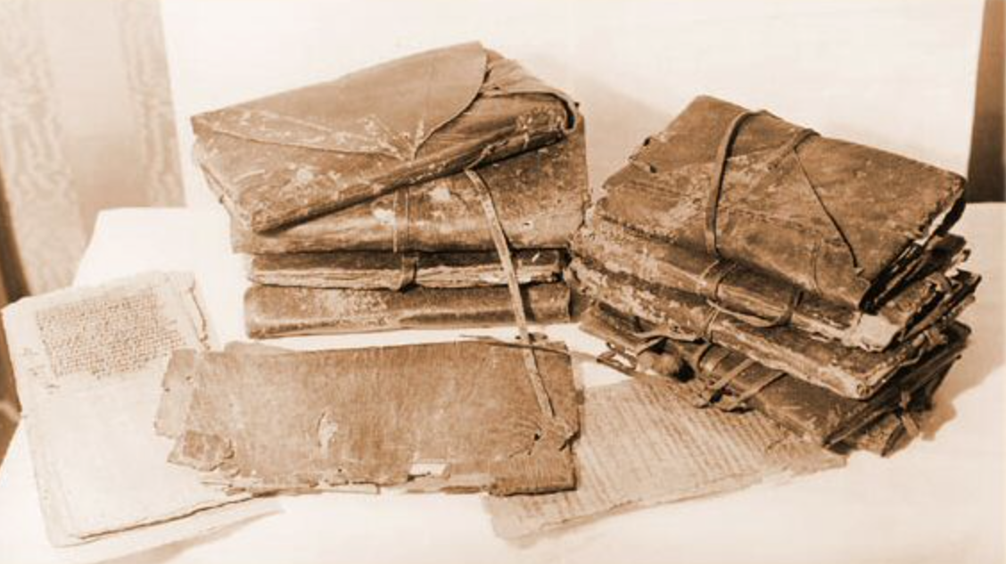
Papyrus bound into a book
300 AD
Image:
Unknown
Nag Hammadi codex: One of the earliest books
Notes:
Teacher background:
The story of the discovery of the Nag Hammadi library in 1945 has been described as 'exciting as the contents of the find itself'.[3] In December of that year, two Egyptian brothers found several papyri in a large earthenware vessel while digging for fertilizer around the Jabal al-Ṭārif caves near present-day Hamra Dom in Upper Egypt. Neither originally reported the find, as they sought to make money from the manuscripts by selling them individually at intervals. The brothers' mother burned several of the manuscripts, worried, apparently, that the papers might have 'dangerous effects’
Image accessed 3 June 2016 source unknown http://www.gailallen.com/rel/nhltoc.html

Slide 9
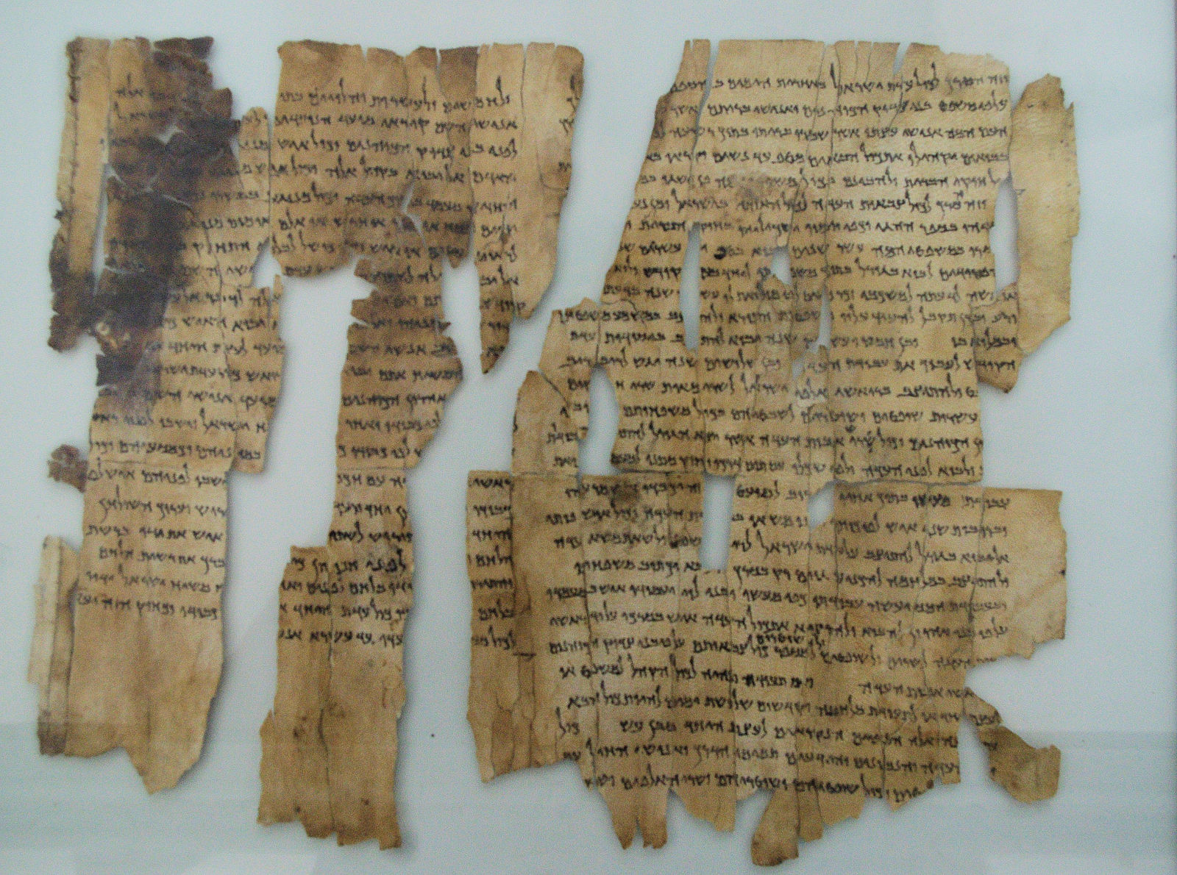
Papyrus scroll
60 AD
Image: Creative Commons
Dead Sea Scrolls
Notes:
Teacher background:
The so-called "Dead Sea Scrolls" are a set of ancient Jewish/Biblical documents discovered on the northwest shore of the Dead Sea between 1946 and 1956. Most are in Israel today
They were written in Hebrew, Aramaic and Greek, on parchment, papyrus and even copper.
These manuscripts date between 150 BC and 70 AD. Many scholars believe they were buried just before the Romans put down the "Jewish rebellion" that ran from about 67 to 73 AD. The scrolls are traditionally identified with the ancient Jewish sect called the Essenes.
Image CC accessed 3 June 2016 source https://commons.wikimedia.org/wiki/File:Dead_Sea_Scroll_--_the_World%27s_Oldest_Secrets.jpg

Slide 10
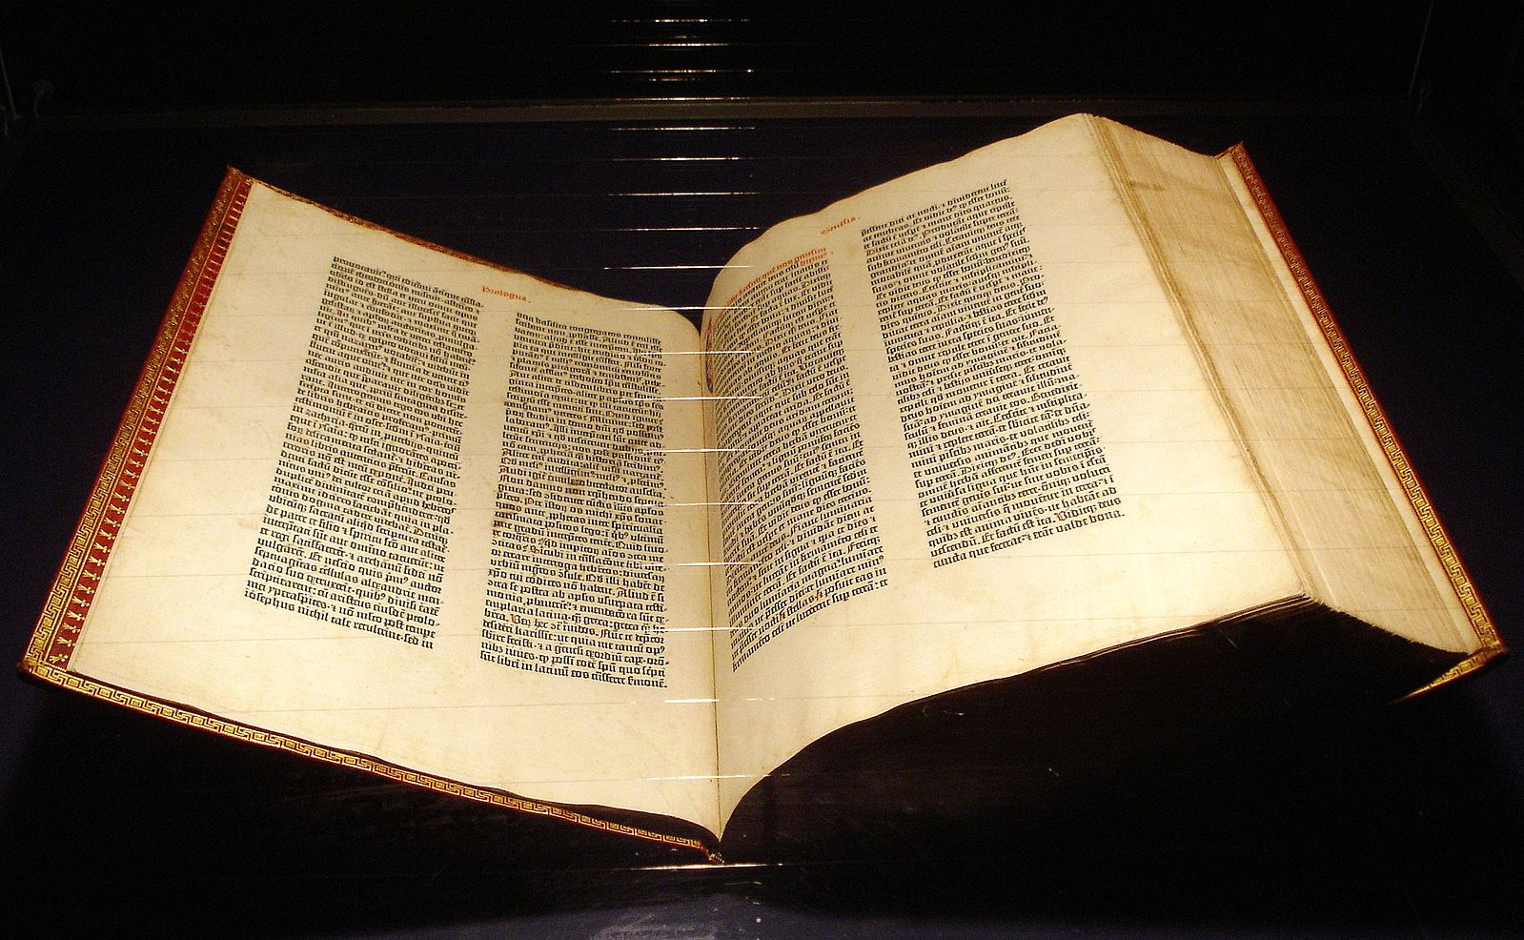
1450 AD
Bound book using ink
Image: Creative Commons
First printed book
Notes:
Teacher background:
The so-called "Dead Sea Scrolls" are a set of ancient Jewish/Biblical documents discovered on the northwest shore of the Dead Sea between 1946 and 1956. Most are in Israel today
They were written in Hebrew, Aramaic and Greek, on parchment, papyrus and even copper.
These manuscripts date between 150 BC and 70 AD. Many scholars believe they were buried just before the Romans put down the "Jewish rebellion" that ran from about 67 to 73 AD. The scrolls are traditionally identified with the ancient Jewish sect called the Essenes.
Image CC accessed 3 June 2016 source:
https://commons.wikimedia.org/wiki/File:Gutenberg_Bible_Mainz_Copy.jpg

Slide 11
Future-proofing digital data

Slide 12
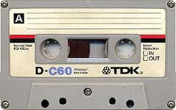
1962 AD
Cassette tapes
Image: Creative Commons
Notes:
Teacher background:
In 1962, Philips invented the Compact Cassette medium for audio storage, introducing it in Europe on 30 August 1963 at the Berlin Radio Show, and in the United States (under the Norelco brand) in November 1964, with the trademark name Compact Cassette. Early desktop computersused cassettes as the only available method of storing data and applications. Computers had no internal storage and all was lost when they were turned off.
Image CC accessed 3 June 2016 source:
https://en.wikipedia.org/wiki/Compact_Cassette#/media/File:Tdkc60cassette.jpg

Slide 13
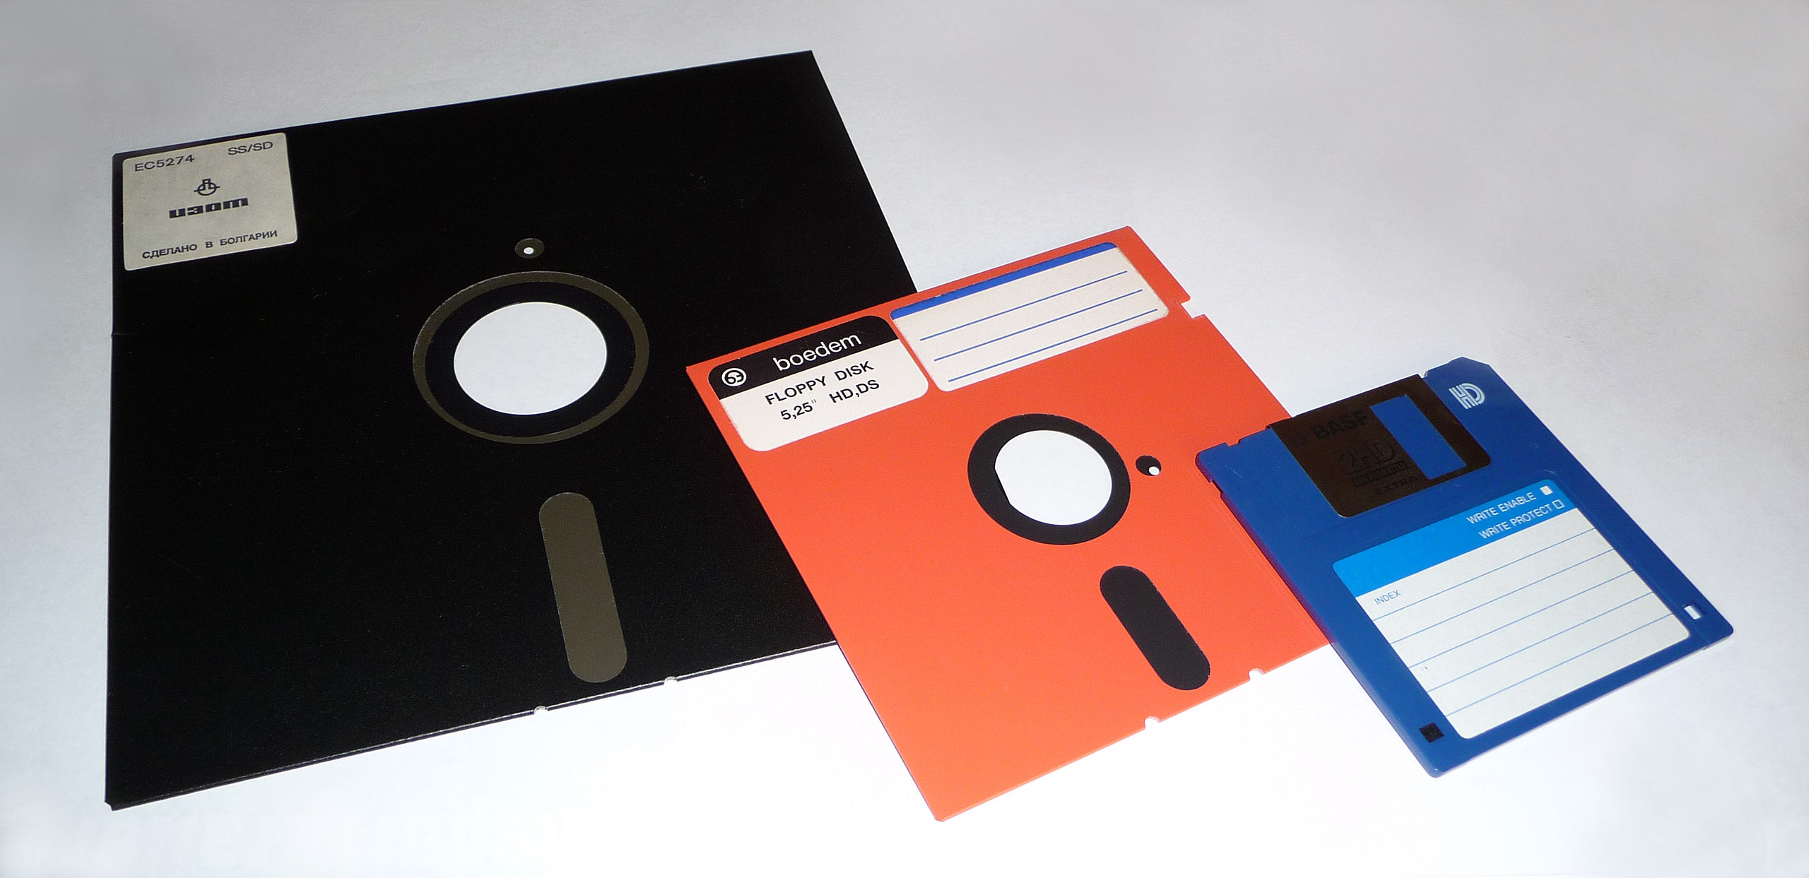
1971 AD
Floppy discs
Image: Creative Commons
Notes:
Teacher background:
Popular for 40 years from 1971
8-inch (approx 250 KB), 5¼-inch (approx 110 KB), and 3½-inch floppy disks (originally 400 kB then high density 1.44 MB)
Image CC accessed 3 June 2016 source:
https://commons.wikimedia.org/wiki/File:Atari_Master_Diskette_3_DOS_3_Floppy_Disk.jpg

Slide 14
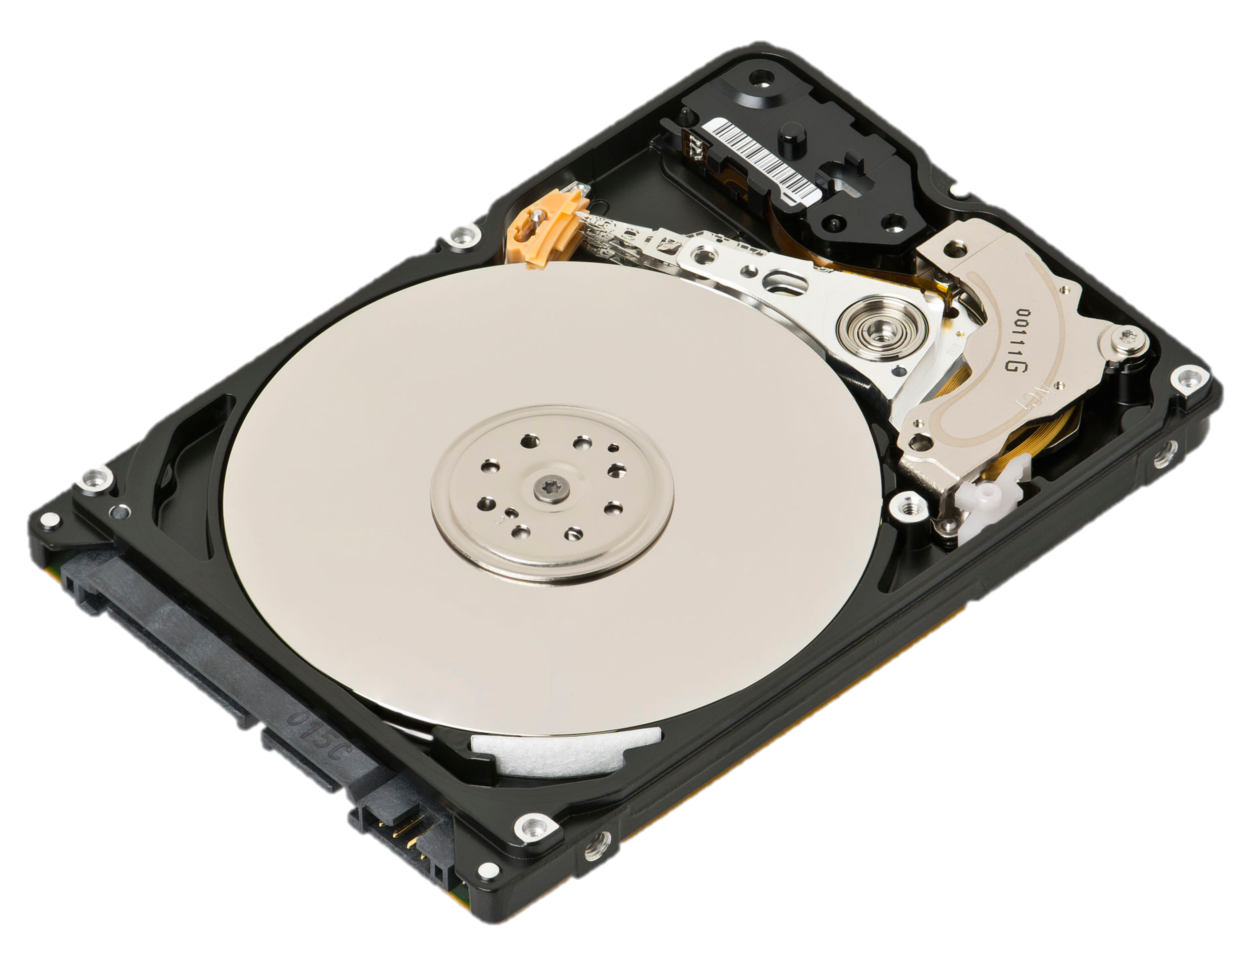
Early 1960s AD
Hard disk drive
Image: Creative Commons
Notes:
Teacher background:
Invented in 1956 by IBM
Started with 3.75 MB now improved to 10 TB.
Image CC accessed 3 June 2016 source: https://en.wikipedia.org/wiki/Hard_disk_drive#/media/File:Laptop-hard-drive-exposed.jpg

Slide 15
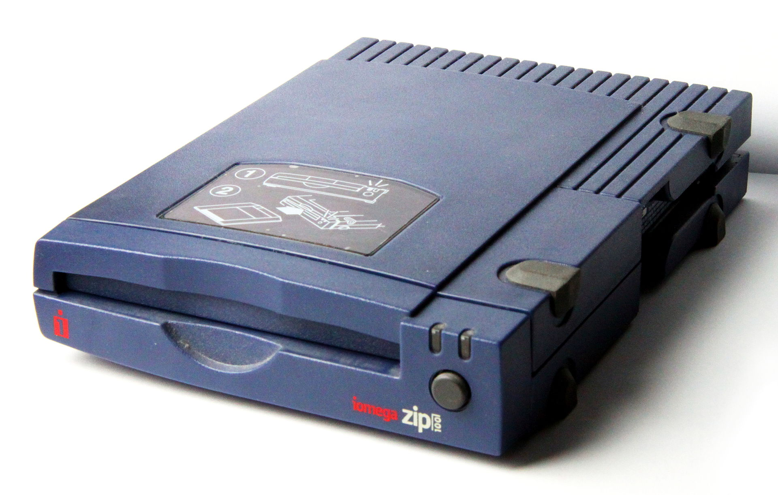
1994 AD
Zip discs
Image: Creative Commons
Notes:
Teacher background:
1994
Capacity originally 100 MB then 750 MB
The format became the most popular of the superfloppy products which filled a niche in the late 1990s portable storage market. However, it was never popular enough to replace the 3.5-inch floppy disk.
Zip drives fell out of favor for mass portable storage during the early 2000s.
Image CC accessed 3 June 2016 source: https://en.wikipedia.org/wiki/Zip_drive#/media/File:ZIP_Drive_100,_2.jpg

Slide 16

1990 and 1997 AD
CD-R and DVD-R
Image: Creative Commons
Notes:
Teacher background:
1990
CD-R (Compact Disc-Recordable) is a digital optical disc storage format. A CD-R disc is a compact disc that can be written once and read arbitrarily many times. Storage approx 700 MB.
1997
A DVD-R typically has a storage capacity of 4.7 GB.
Image CC accessed 3 June 2016 source: https://commons.wikimedia.org/wiki/File:CD_DVD_Collections.jpg

Slide 17
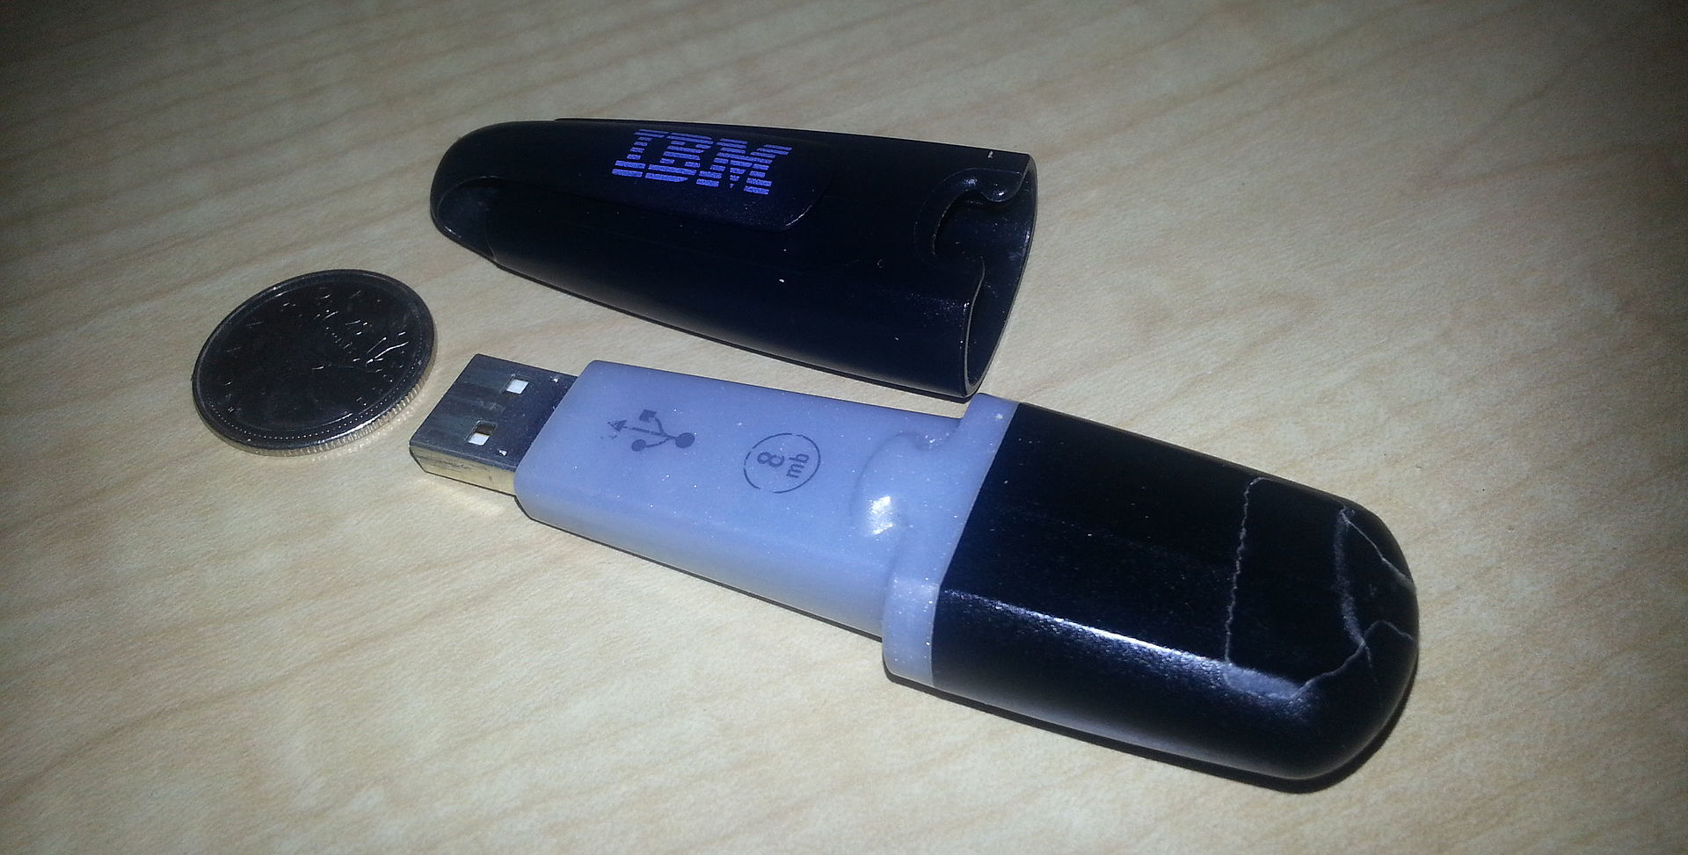
2000 AD
USB flash storage
Image: Creative Commons
Original IBM fkash drive
Notes:
Teacher background:
A USB flash drive, also commonly known as a USB drive, USB stick and a variety of other names, is a data storage device that includes flash memory with an integrated USB interface. USB flash drives are typically removable and rewritable, and physically much smaller than an optical disc.
A one-terabyte (TB) drive became available for the first time in 2013.
Storage capacities as large as 2 TB are planned.
Some allow up to 100,000 write/erase cycles, depending on the exact type of memory chip used, and have a 10-year shelf storage time.
Image CC accessed 3 June 2016 source: https://en.wikipedia.org/wiki/USB_flash_drive#/media/File:8mb_ibm_disk_on_key.jpg

Slide 18
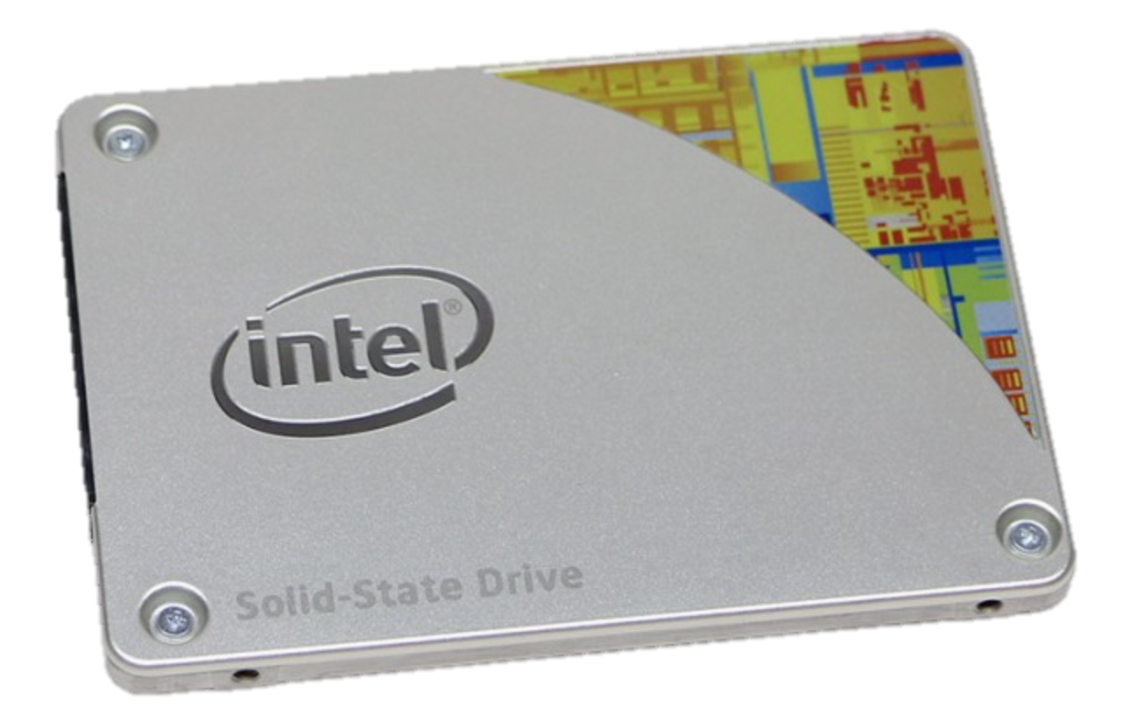
1989 AD
Solid State Drive (SSD)
Image: Intel
Intel SSD Pro 2500 series a7mm drive Flash memory
Notes:
Teacher background:
A solid-state drive (SSD) is a data storage device, typically used in a computer. It uses flash memory to store data even after power is turned off. SSDs are designed to access data in the same way as traditional hard disk drives (HDDs). A HDD can usually be directly replaced with a SSD.
The best thing about solid state drives is that they have a much faster read/write speed than hard disk drives.
They also have no moving parts, which means they don't make noise or break as easily. Unfortunately, SSDs are much more expensive than hard disk drives. This also means that for the same price, someone can get much more capacity if they select a HDD instead.
Image CC accessed 3 June 2016 source: http://www.intel.com.au/content/www/au/en/solid-state-drives/solid-state-drives-pro-2500-series.html

Slide 19

2012 AD
Cloud storage
Image: Intel
Notes:
Teacher background:
Cloud computing is believed to have been invented by Joseph Carl Robnett Licklider in the 1960s with his work on ARPANET to connect people and data from anywhere at any time.
Advantages:
Use anywhere
Energy consumption
Cost: Pay as needed
Backup automated
Disaster proof
Disadvantages:
Supplier stability
Ownership
Security
Cost: ongoing subscription cost
Unauthorised access
Image CC accessed 3 June 2016 source: http://theindustry.cc/2014/09/18/good-design-environmentally-friendly/

Slide 20

2500 AD ?
…in future?
Helium Drives
Image: https://www.backblaze.com/blog/data-storage-technologies-of-the-future/
Holographic
DNA
Quantum
SMR
Notes:
Teacher background:
Data Storage Technologies of the Future
If someone from the future–two decades or two centuries from now–traveled back in time to today, they’d probably smile at our use of hard drives and USB sticks, the way we now wonder how we ever survived with floppy disks and Zip drives.
What kinds of storage devices we’ll be using in the future?
Inventors and researchers continue to push the envelope when it comes to capacity, performance, and the physical size of our storage media.
In future we will be able to store an almost incomprehensible amount data–zettabytes if not domegemegrottebytes. (A petabyte is equivalent to one million gigabytes, a zettabyte equals one million petabytes, and a domegemegrottebyte equals 1,000 zettabytes.)
Helium Drives
Helium-filled hard drives have lately been pushing the capacity boundaries of hard drives, which are typically filled with air. Last September, Western Digital announced the world’s first 10TB hard drive. By using helium instead of air, helium-filled drives use less power to spin the disks (which spin more easily thanks to less resistance compared to air), they run cooler, and they can pack in more disks.
Shingled Magnetic Recording (SMR)
SMR achieves higher areal densities by squeezing tracks closer together. Tracks overlap one another, like shingles on a roof, allowing more data to be written to the same space. As new data is written, the drive tracks are trimmed, or shingled. Because the reader element on the drive head is smaller than the writer, all data can still be read off the trimmed track without compromise to data integrity or reliability.
DNA storage
Harvard researchers in 2012 were able to encode DNA with digital information, including a 53,400-word book in HTML, eleven JPEG images, and one JavaScript program. DNA offers incredible storage density, 2.2 petabytes per gram, which means that a DNA hard drive about the size of a teaspoon could fit all of the world’s data on it–every song ever composed, book ever written, video ever shared. Besides the space savings, DNA is ideal for long-term storage: While you’re lucky if your hard drive lasts four years and optical disks are susceptible to heat and humidity, lead Harvard researcher George Church says “You can drop DNA wherever you want, in the desert or your backyard, and it will be there 400,000 years later.”
DNA takes a long time to read and write to and, as you might imagine, the technology is still too expensive to be usable now.
Holographic storage
Scientists and tech companies have been working on holographic data storage for at least a decade.
Quantum storage
Quantum storage. Scientists are currently investigating ways to store data using quantum physics-e.g., a bit of data attached to the spin of an electron. Right now this technology can only store tiny amounts of data for a very short amount of time (not even a day yet), but if it works and takes off, we could see instant data syncing between two points anywhere, thanks to quantum entanglement.
Adapted from Backblaze: accessed 3 June 2016
https://www.backblaze.com/blog/data-storage-technologies-of-the-future/
Image CC accessed 3 June 2016 source: https://www.backblaze.com/blog/data-storage-technologies-of-the-future/

Slide 21
Data storage research

