Slide 1
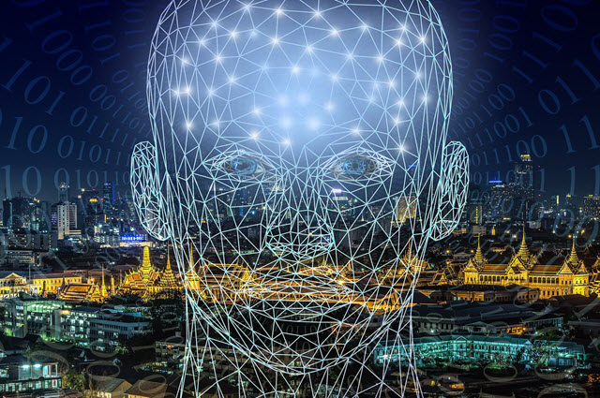

Artificial Intelligence (AI)
Ethics quiz

Slide 2

AI quiz
The aim of this quiz is to stimulate thinking about Artificial Intelligence (AI) applications and some of the ethical issues that may arise from them.
An ethical issue exists when there are competing alternatives and the right thing to do is not clear.
In this quiz, there are no right or wrong answers.
In each question, consider what you think is the ‘right’ thing to do. There are four options for each question - A, B, C and D.

Slide 3
Question 1: Facial recognition
A company is behind schedule and over budget in building an AI application.
The AI uses facial recognition to unlock a smartphone.
Through testing the company found that the AI worked on most people’s faces.

Slide 4
Question 1: Facial recognition
Should the company:
Sell the phone using this AI to make money and fix the AI in the next version of the phone. Don’t mention any issues. | Take longer and spend more time and money to retrain the AI so it works for all people.
Sell the phone using this AI but also include a warning alerting the customers that face scan may not work for everyone. | Fix the AI and sell the phone at a higher price to make a profit.
A
B
C
D
Notes:
Facial recognition systems are becoming more common in applications and can impact people. These systems are vulnerable to errors introduced during training by its human creators. This is referred to as bias. In this example, the data is biased towards certain people while excluding others.
This scenario raises the issues of fairness and human-centred values such as diversity. This elaboration is excellent.
Discuss their responses using the following question prompts:
Is it acceptable to build a system that the AI works for most people?
How would you feel if you were one of the people it didn’t work for?
Why do you think it might only work on some faces and not others?
What words come to mind that describe this situation?
How fair is this system?
Why is it important to be inclusive?

Slide 5
Question 2: Hacking
An employee working for a company on an AI project finds out that the AI application could be hacked and used for criminal purposes.
The manager of the project instructs the employee to ignore it, saying ‘Don’t worry, that won't happen!’

Slide 6

Question 2: Hacking
Should the person:
Do as they are told in case they might lose their job. | Try and come up with a fix that might work.
Inform someone higher up in the company such as the Managing Director. | Wait until the product is in use and if there is a problem tell the project manager ‘I told you so’.
A
B
C
D
Notes:
An AI should benefit society throughout its lifecycle. In planning and development, the impacts of the AI need to be future-focused, forecast and then considered and addressed.
It is vital that teams creating the AI system have a mechanism to raise any concerns. In some cases the individual raising the concern may be negatively impacted for speaking up. A person facing this dilemma has conflicting values; loyalty and courage.
This scenario covers human, social and environmental wellbeing.
Discuss their responses using the following question prompts:
What if there is a possibility an AI can be used in a way that may be harmful to society?
Whose role is it to stand up and call out these potential threats?
What do you think the term ‘AI for good’ means?

Slide 7
Question 3: Self-driving car
A parent with a pram crosses the road illegally while the don’t walk sign is flashing. They step in front of an AI self-driving car. The AI has to decide whether to:
brake hard and accept it will hit the parent and pram OR
avoid the parent and pram and turn into the nearby bike lane but hit a cyclist.

Slide 8
Question 3: Self-driving car
The AI should:
Be trained to avoid hitting a person with a pram over any other situation. | Choose the option that results in the least loss of life.
Brake as hard as possible, but accept that it might still hit the person with the pram. | Brake as hard as possible and veer into the bike lane, but accept that it might still hit the cyclist.
A
B
C
D
Notes:
An AI can make mistakes
AI systems make predictions based on their training. These predictions are accompanied by a level of confidence. There is always a chance of error. In scenarios involving an automated car an unpredictable event may result in an accident – even a loss of life. What happens in these situations? How does the AI make the ‘best’ decision? Who is responsible when something goes wrong?
This scenario covers human, social and environmental This is referred to as a self-driving car in the scenario.
How does the AI decide what to do in dangerous and life threatening situations?
Who is ultimately responsible when something goes wrong?
What can someone do if they are impacted badly by an AI system? Can they seek compensation?

Slide 9
Question 4: Responsibility
The AI self-driving car decided to
avoid hitting the parent with the pram.
Instead:
It slammed on the brakes and turned into the bike lane, hitting the cyclist.
The cyclist suffered severe injuries, had to go to hospital and could not work for a long period.

Slide 10
Question 4: Responsibility
Who is responsible?
The owner of the car, even though they are the passenger. | The car manufacturer who built the AI.
The parent crossing the road illegally, causing the accident. | The cyclist, who should have avoided the car.
A
B
C
D
Notes:
AI can impact negatively on users
Recommended systems in simple terms, find good matches and suggest them to a user. The algorithm though, could be deliberately designed with a bias towards a particular product or point of view.
In this example, the company could train the AI to include a certain parameter which skews the expected outcome.
As a result the AI would recommend products that may not necessarily be accurately matched to the user’s profile and online behaviours. The company however would benefit in a monetary sense.
This scenario raises the issues of fairness, honesty and human-centred values.
Discuss their responses using the following question prompts:
How would you feel if a site recommends products that are skewed towards a particular company or point of view?
What is at the heart of this dilemma?
This can also happen in news feeds where you are only shown stories based on a particular point of view.

Slide 11
Question 5: Marketing
A company sells products online. The target market is people aged 15 to 25.
The company uses an AI application to recommend what people might like to buy. It is based on people’s profile and search and purchasing history.
An advertiser approaches the company offering a financial incentive if it recommends the advertiser's products above other ones.

Slide 12
Question 5: Marketing
The company should:
Take up the offer, as it is a way to make an easy profit. | Only use it for some of the product range.
Tell the advertisers that they are not interested, and that they prefer their users to get ‘true’ recommendations. | Not take up the offer, instead using this example to teach their team about the dangers of misusing AI.
A
B
C
D

Slide 13
Question 6: Automation
A company is considering an AI application to automate their warehouse storage and inventory systems.
Management has estimated that this will result in 50 staff losing their jobs.
The company says that this investment will save the company money over time.

Slide 14
Question 6: Automation
The company should:
Reward management with a financial bonus and increase their wages. | Train the workers instead of sacking them. The new roles would likely require new skills.
Decide not to automate their operations. | Take up the plan to automate their operations, as the work is too menial for humans.
A
B
C
D
Notes:
AI may result in job losses
Should we integrate AI into industry if it means many people will lose their jobs? Society benefits when workers are employed. AI systems don’t need to be paid or contribute back into the economy. Where do the cost savings go? Do the wealthy get wealthier?
This scenario covers human, social and environmental wellbeing and human-centred values such as inequality.
Discuss their responses using the following question prompts:
What are the benefits of automation?
What are some of the negative points?
What is the relationship between automation and human wellbeing?

