Slide 1

Communicating safely and appropriately online

Slide 2
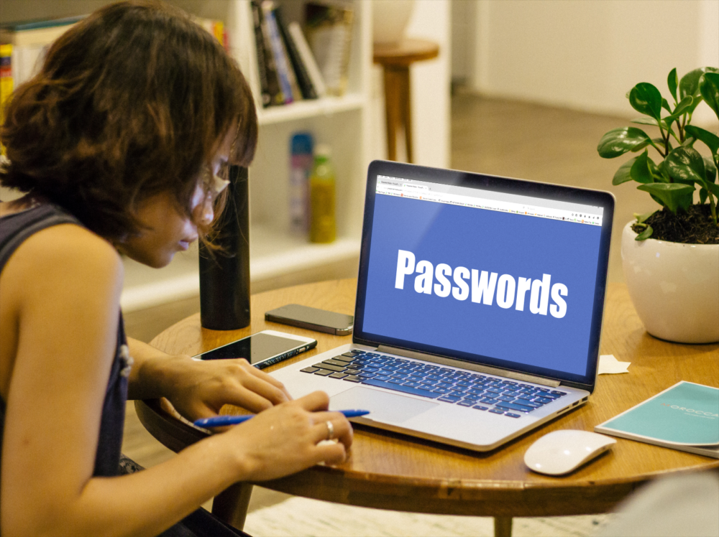
Notes:
A password is a secret code that we use to protect our personal details when we are online. We usually need a password to access the computer/ipad, ipod, smartphone, online accounts etc.
The password is like a secret code that stops other people from using our accounts and our personal devices such as phones and ipads.

Slide 3
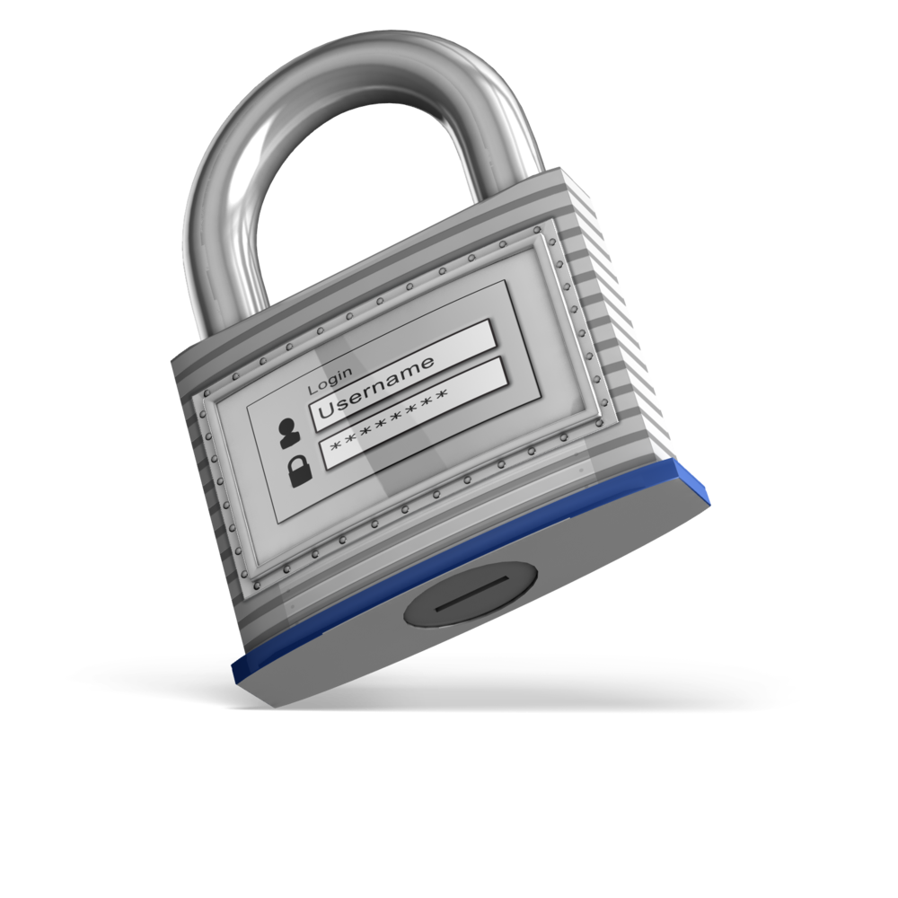
Why do we need passwords?
Notes:
The password is like a secret code that stops other people from using our accounts and our personal devices such as phones and ipads.

Slide 4

A password is a secret code that we use to protect our personal details when we are online.

Slide 5
One day Jane shared her email password with her friend Sue. A few days later Jane and Sue had an argument. Sue logged onto the computer and pretended to be Jane. Sue sent some emails to three of Jane’s friends and said some very mean things to them. Jane’s friends thought it was Jane. The next time they saw Jane, they were very sad and angry with her.

Slide 6
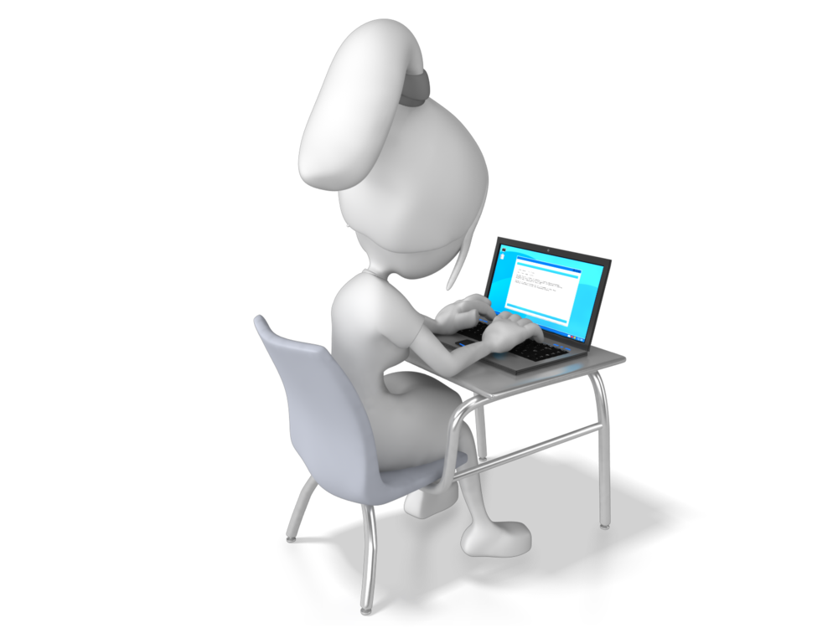
Passwords
What do you think are some common passwords?
What should you do if someone finds out your password?
How often should you change your password?
How can you make your password strong so others cannot guess it?
Should you have the same password for all of your devices and online accounts?

Slide 7
Tips for creating strong passwords
1
Use letters and numbers
5
Use a mixture of capitals and lower case letters
2
Use a minimum of 8 characters
6
Use something that is easy to remember
3
Don’t include any personal information
7
Change the password every 6 months
4
Use characters including brackets, &, %
8
Use a different password for all online acounts

Slide 8
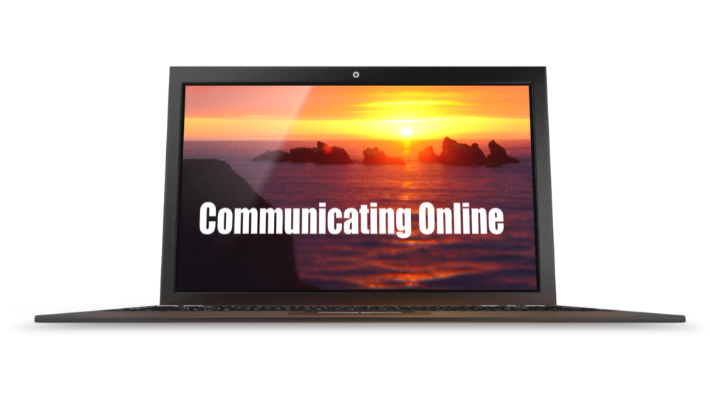
What does it mean to be online?

Slide 9
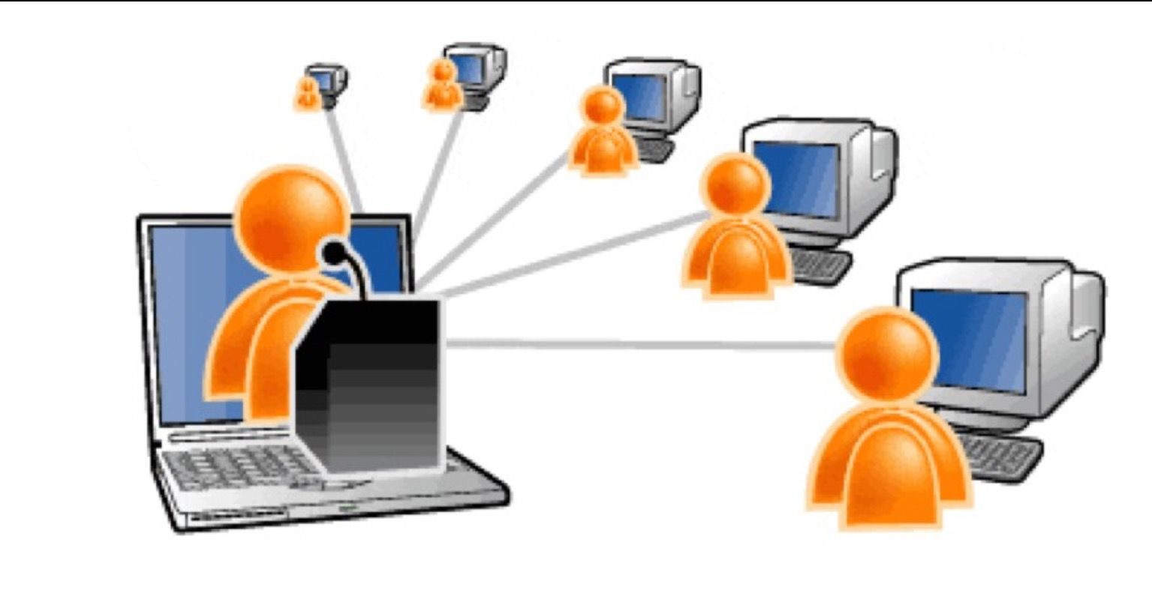

A network is a collection of two or more computers that are connected to each other.

Slide 10
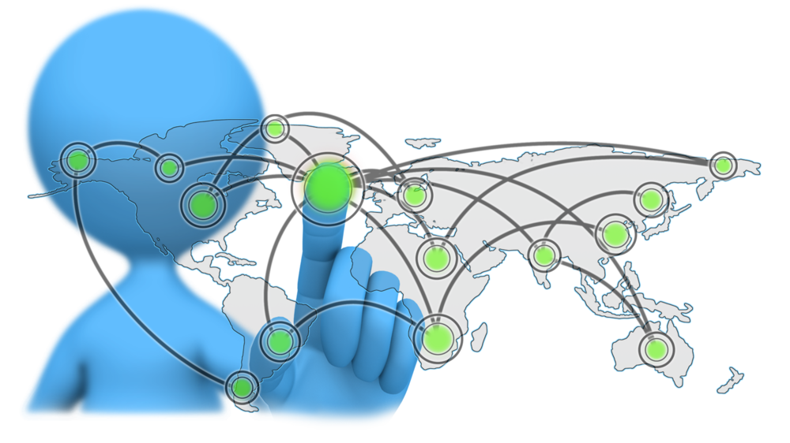
The internet is a world wide system of connected computer networks.

Slide 11
This means we can communicate
with people anywhere in the world.

Slide 12
Why do people communicate online?
To learn new things
To share information
To form and maintain social connections

Slide 13
Sending and receiving emails
Text Messages
Skype
Playing games with people
we may or may not know
Facetime
Social Media
Participating in a web conference
Writing a blog
Contributing to a wiki

Slide 14


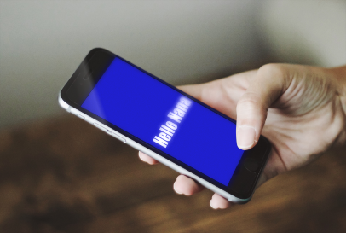
Who do we communicate with online?
People who we send information to directly.
Friends and family
Anyone who can see and read our profile

Slide 15
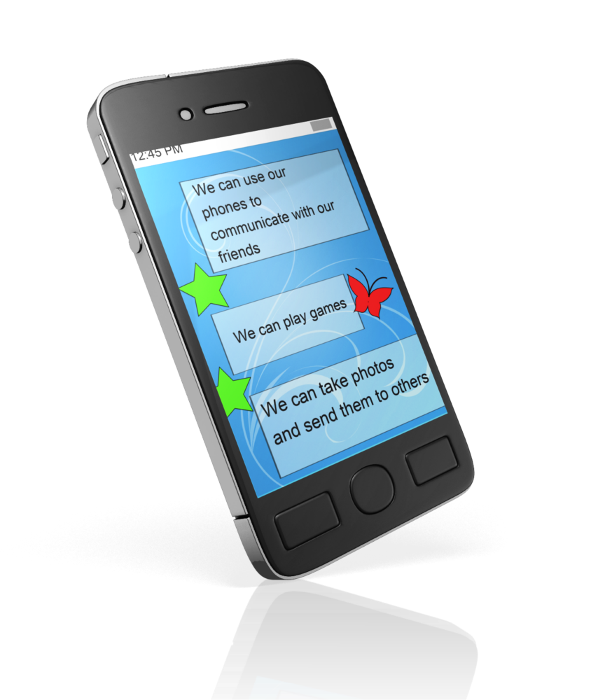
I like to send text messages on my phone.

Slide 16




I use my webcam to video chat when I am playing online games.
I write blogs about my hobbies and interests.

Slide 17
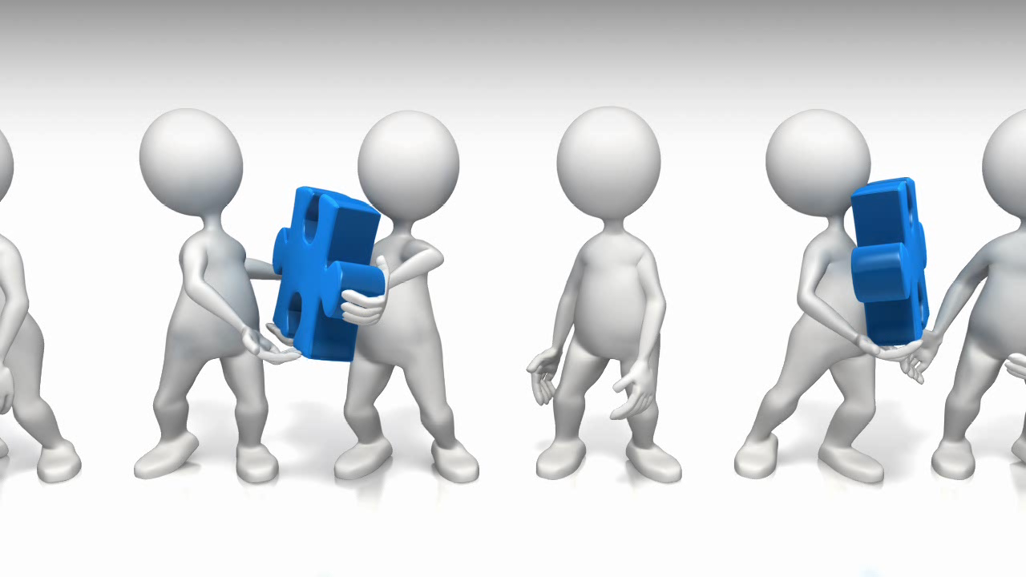

I post pictures and videos on social media.

Slide 18
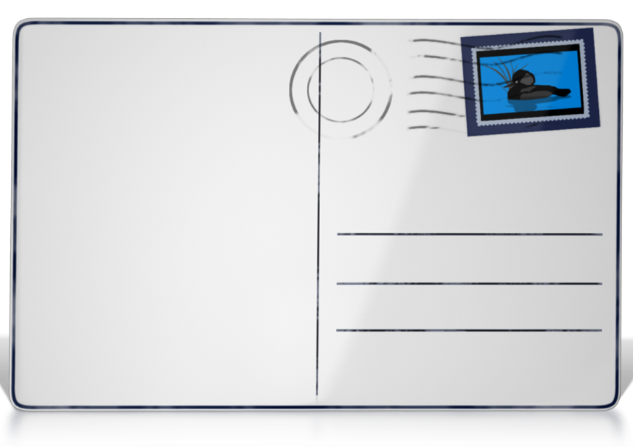

I write emails to my nana in England.
I send emails to my friends.
Dear Nana
I am learning about online communication.

Slide 19
Always check with an adult before communicating in an online space.
Always tell a trusted adult if you think something is not right or you feel uncomfortable or unsafe when online.

Slide 20
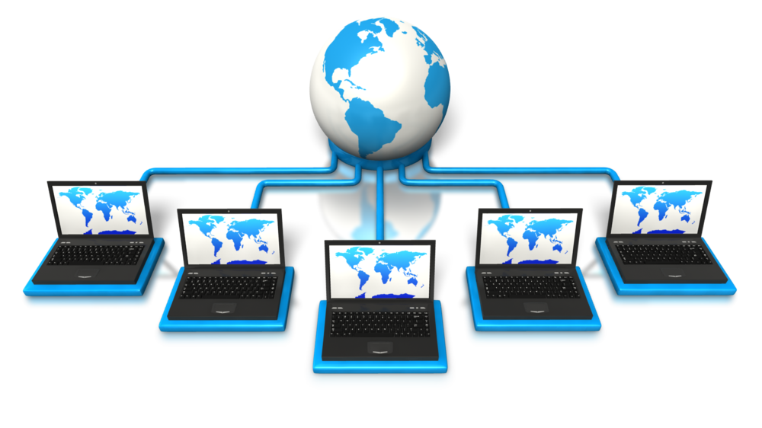
The information we share online stays with us forever

Slide 21
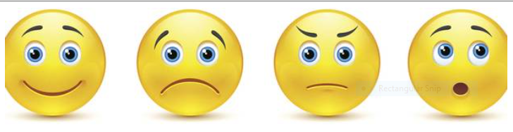
Can you suggest a feeling to match each emoticon?

Slide 22

Notes:
www.flickr.com Good Manners by sinclair.sharon

Slide 23


Slide 24

Do not use UPPERCASE letters
Use nice words and images
Use emoticons to help explain your feelings
Do not write nasty and hurtful things about others
Make sure your messages are positive

Slide 25
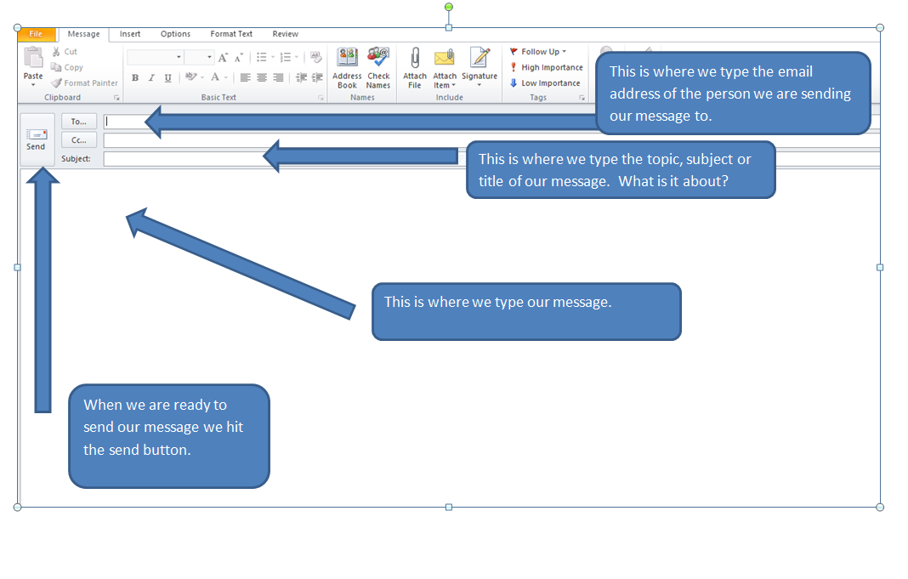

Slide 26
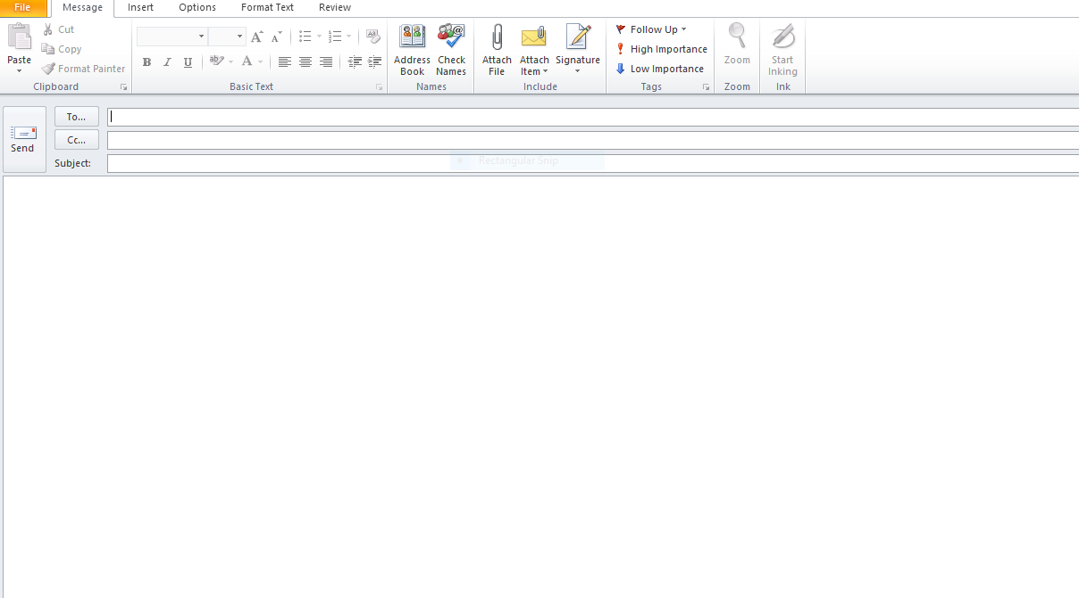
Email messages

