Slide 1


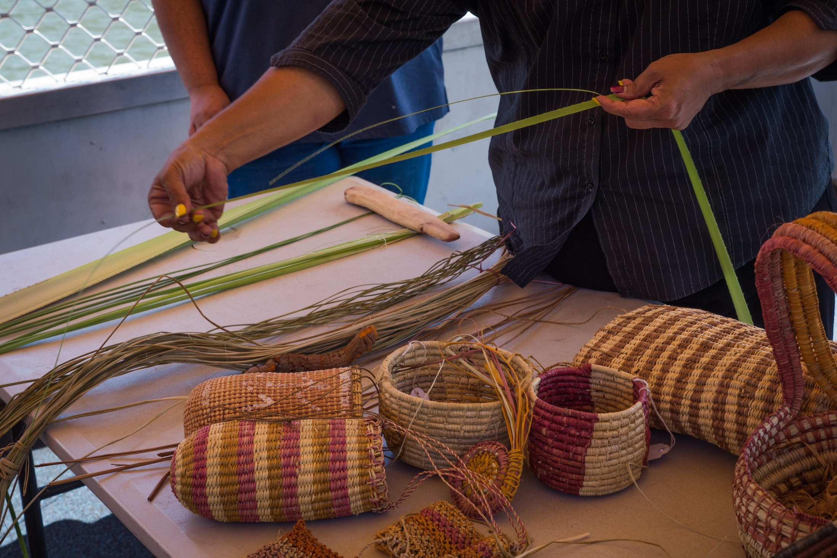
Algorithms: story maps
Ngarrindjeri weaving
Digital Technologies Hub is brought to you by the Australian Government Department of Education. Creative Commons Attribution 4.0, unless otherwise indicated.
Notes:
Image source: Crystal Egan/Alamy Stock Photo

Slide 2
Discussion
What procedures do you complete regularly?
Could you recall and share all the steps
if you needed to ?
Could you recall the steps if you had
not completed the procedure in a very long time?
Digital Technologies Hub is brought to you by the Australian Government Department of Education. Creative Commons Attribution 4.0, unless otherwise indicated.
Notes:
What procedures do you complete regularly? For example, tying shoelaces, brushing teeth. As a family it might be cooking or sharing a meal together or a movie night at home, a weekend bike ride or playing a game.
Ask students: Could you write down all the steps for one of these tasks if you needed to?
What about if you hadn’t done it in more than a year? How good would your memory be at recalling each of the steps without forgetting anything? What about your skills completing the task? Would they be as good if you hadn’t done it in a long time or would some time practising help?

Slide 3
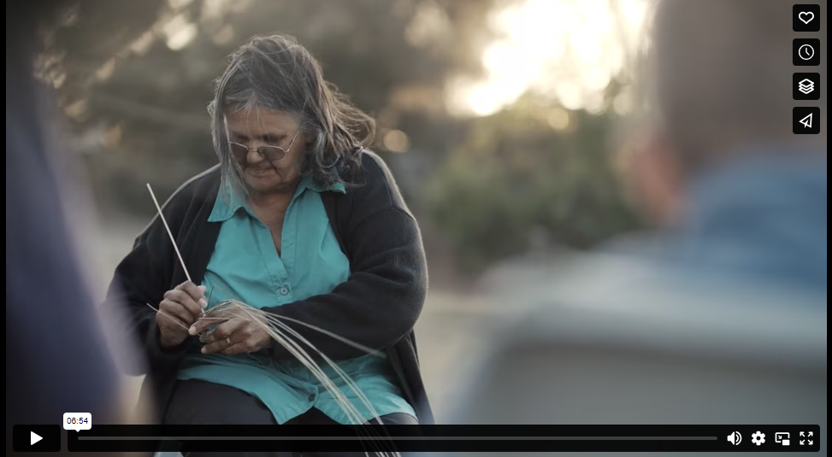
Ellen Trevorrow (Auntie Ellen) Ngarrindjeri Weaving
Everything Is Connected
Digital Technologies Hub is brought to you by the Australian Government Department of Education. Creative Commons Attribution 4.0, unless otherwise indicated.
Notes:
https://vimeo.com/153710780?fbclid=IwAR2C0_X5RgojJKPfUV4nKpgPNgPFDMRtclourIeVn0Q6NSaPnAJCI6Mnw8I
https://bit.ly/Ellenweaving
7-minute video
Older 20-minute video of the weaving process with Auntie Ellen:
https://www.youtube.com/watch?v=dLqSiboDVFA

Slide 4
Knowledge check
What is a procedure?
What is the procedure in the video?
Why might it be important to Ellen and her community to continue weaving?
Where and when does the weaving process start?
Digital Technologies Hub is brought to you by the Australian Government Department of Education. Creative Commons Attribution 4.0, unless otherwise indicated.
Notes:
Discuss what a procedure is. Why might it be important to Ellen and her community to continue this process? Where or when does the process start? For example, is it when they all get in the car to collect the plant materials, or is it when they start weaving together?

Slide 5

Flowcharts
Put toothpaste on toothbrush
Brush teeth
Check if all teeth are clean
Rinse toothbrush
START
FINISH
Are there details missing? How could we make it more accurate?
Could standard colours or shapes help classify choices and decisions when we create our own flowcharts?
NO
YES
Digital Technologies Hub is brought to you by the Australian Government Department of Education. Creative Commons Attribution 4.0, unless otherwise indicated.
Notes:
Model a flowchart with the class using an everyday experience the class will all be familiar with. Allow for discussion and iteration of the flowchart based on the class discussion. For example, brushing your teeth or getting ready for bed. Here is an example from CSER Digital Technologies MOOC. For a more complex example visit BBC Bitesize: Iteration - https://www.bbc.co.uk/bitesize/guides/zg46tfr/revision/4
Discuss if colours or shapes might make it easier to read the flowchart. For example, if the start and stop steps were the same colour or shape, or could arrows improve understanding for the end user? Add in some of the students’ feedback.
Discuss reasons for including or excluding the whole morning routine before school. For example, each family do things differently, what time they get up, when and what they have for breakfast, how they get to school and who packs the lunches. The flowchart would be very complicated with options. This one specific task can be isolated and easily transferred to a flowchart for everyone.
Discuss different elements of the flowchart. For example, start, stop, choices and decisions, direction or flow of the chart and actions to be carried out.
As a class, agree on any constants for everyone’s flowcharts. For example, will the start and stop be a certain colour or shape for everyone’s flowchart?
Ask class what extra information could you add to make your flowchart more detailed and accurate; for example, how much toothpaste goes on the toothbrush, where do you get the toothbrush from, do you add water to it? Where do you put it when finished? What about how to brush different sets of teeth; for example, front teeth and back teeth, top teeth and bottom teeth, and for how long?
Tooth image (CC) source: https://www.rawpixel.com/image/11419240/beaver-brushing-teeth-image-element

Slide 6
Task
View Auntie Ellen’s Ngarrindjeri
weaving video again.
Record the steps in the weaving process in a way that will help you to remember and recall the steps.
Transfer the procedure to a flowchart. You can use paper and pencils or an app.
Digital Technologies Hub is brought to you by the Australian Government Department of Education. Creative Commons Attribution 4.0, unless otherwise indicated.
Notes:
Students record the steps while viewing the video again in whatever format or combination of recordings suits them. For example, this could be with words, images or symbols or a combination.
Consider sharing the video link with students so that individuals can view and rewind the video as many times as they need to gather the information they feel is important to capture.
Students then have a go at transferring their procedure notes to a flowchart. This can be done using A3 or A4 paper and pencils or a word processing program with SmartArt options, such as Microsoft Word, Google Docs, or Apple Pages.
(20 minutes)

Slide 7
Test and get feedback
In pairs, take turns sharing your flowchart.
Compare similarities and differences. Give each other feedback on ideas for improving the clarity of the flowchart. (5 minutes each)
Spend 5-10 minutes improving your flowchart based on the feedback and ideas from your chat with your partner.
Discuss as a class or with a new partner, any changes you made to your design and reasons. (5-10 minutes)
Digital Technologies Hub is brought to you by the Australian Government Department of Education. Creative Commons Attribution 4.0, unless otherwise indicated.
Notes:
Ask students to share their flowchart with a peer (pairs).
Students compare differences and similarities. (10 minutes: 5 minutes each person)
Provide an opportunity for students to iterate and improve their flowchart after discussing and sharing with a peer. (5–10 minutes)
Students share their flowchart in a second round of pairs and discuss things they improved or would do differently next time to improve readability or flow. For example: Did you start or finish in different places? Give your reasons for starting or ending the process where you did.
Discuss as a class: What other types of tasks might an algorithm or flowchart be helpful for? For example, teaching a grandparent how to set the clock on the microwave. Finally, connect the process of creating a flowchart to algorithms and computational thinking by … or have a discussion about how machine learning might use flowcharts to learn new tasks and processes for handling data or information.
(20–30 minutes)

Slide 8
Code.org
View a code.org video about algorithms.
Real-life Algorithms: Planting a Seed
Digital Technologies Hub is brought to you by the Australian Government Department of Education. Creative Commons Attribution 4.0, unless otherwise indicated.
Notes:
View this code.org video if your class could benefit from extra information about algorithms.
https://studio.code.org/s/course1/lessons/6/levels/1

