Slide 1

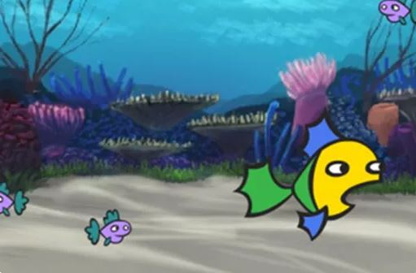

Game design
Create your own mini-game: programming tips
Years 5–6
Digital Technologies Hub is brought to you by the Australian Government Department of Education. Creative Commons Attribution 4.0, unless otherwise indicated.

Slide 2
Coding tips
When designing a mini-game, you will use your programming skills to control character movement, create interactive events and switch between scenes.
These slides provide code examples to:
change backdrops
move a sprite (character)
trigger an event if two sprites touch
use a variable such as adding scoring.
Digital Technologies Hub is brought to you by the Australian Government Department of Education. Creative Commons Attribution 4.0, unless otherwise indicated.

Slide 3
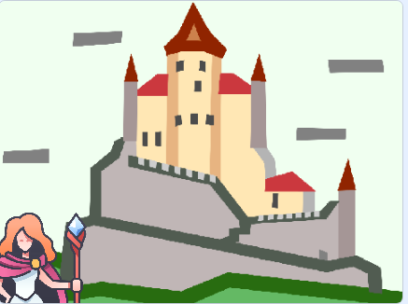
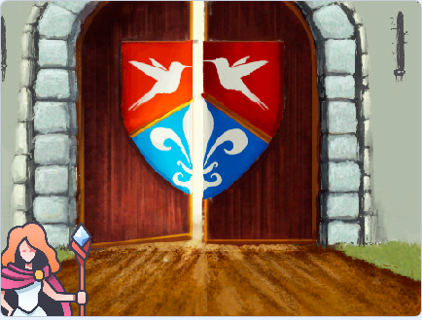
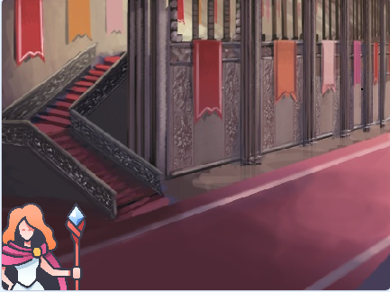
Switching between different scenes
Imagine your game has three levels.
In this example, in the first level the magician is outside the castle.
After completing the first level, the magician is on the second level reaching the castle doors.
After completing the second level, the magician is now inside the castle.
How would you program these switches in scene?
Image: Flaticon.com
Digital Technologies Hub is brought to you by the Australian Government Department of Education. Creative Commons Attribution 4.0, unless otherwise indicated.
Notes:
Scratch code example castle https://scratch.mit.edu/projects/1049915172/editor
This code is for the sprite: treasure.

Slide 4
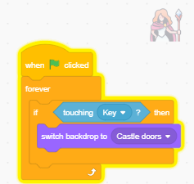
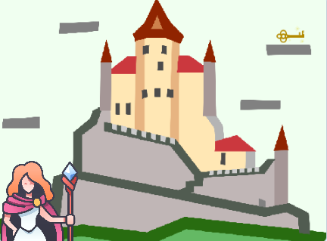
Switching between different scenes: code
Use an event to trigger the next level.
For example, If the magician finds the key, then switch the backdrop to the Castle doors.
Image: Flaticon.com
Digital Technologies Hub is brought to you by the Australian Government Department of Education. Creative Commons Attribution 4.0, unless otherwise indicated.
Notes:
Scratch code example castle https://scratch.mit.edu/projects/1049915172/editor
This code is for the sprite: treasure.

Slide 5
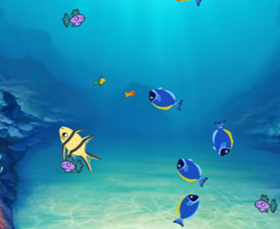
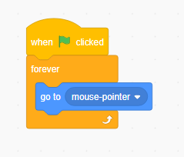
Introducing movement: make a sprite follow the mouse pointer
Hungry fish
Imagine a game where the hungry fish needs to catch the small orange fish but avoid the bigger fish.
You can make a sprite
follow the mouse pointer.
Image: Flaticon.com
Digital Technologies Hub is brought to you by the Australian Government Department of Education. Creative Commons Attribution 4.0, unless otherwise indicated.
Notes:
Fish chomp.
https://scratch.mit.edu/projects/1017263093/editor/

Slide 6
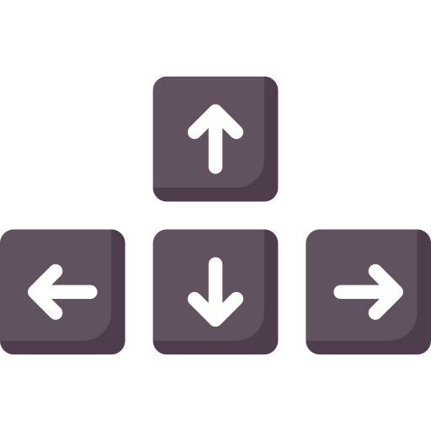

Using arrow keys to control a sprite
A sprite’s movement can be programmed to be controlled by the arrow keys.
Images: Flaticon.com
Digital Technologies Hub is brought to you by the Australian Government Department of Education. Creative Commons Attribution 4.0, unless otherwise indicated.
Notes:
A sprite’s movement can be programmed to be controlled by the arrow keys.

Slide 7
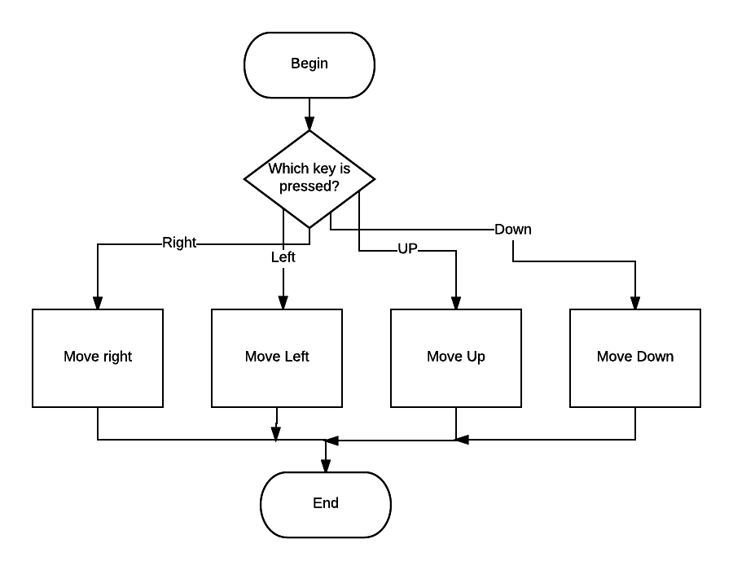
A flowchart representing the use of arrow keys to control a sprite
Images: Flaticon.com
Digital Technologies Hub is brought to you by the Australian Government Department of Education. Creative Commons Attribution 4.0, unless otherwise indicated.
Notes:
We can show that using a flowchart.

Slide 8
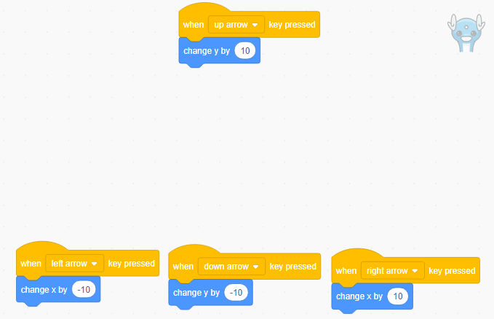
Using arrow key pressed blocks to control a sprite
Images: Flaticon.com
Digital Technologies Hub is brought to you by the Australian Government Department of Education. Creative Commons Attribution 4.0, unless otherwise indicated.
Notes:
Communication free icon
https://www.flaticon.com/free-icon/communication_3820107?term=communication+two+people&page=1&position=1&origin=search&related_id=3820107

Slide 9
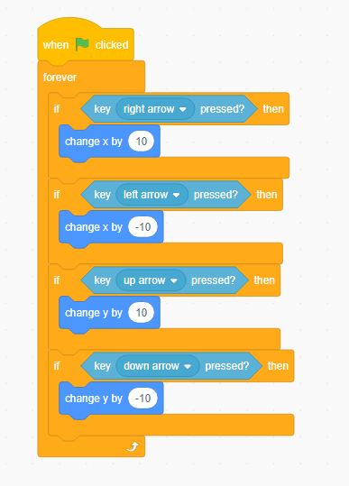
Another way: arrow key pressed using If/Then blocks
Image: Flaticon.com
Digital Technologies Hub is brought to you by the Australian Government Department of Education. Creative Commons Attribution 4.0, unless otherwise indicated.

Slide 10
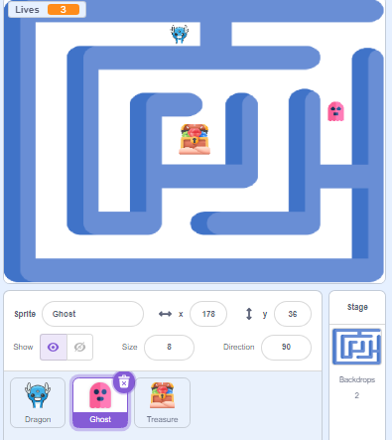
Using glide blocks to move a sprite from one position to another
Imagine a maze game where we want the ghost to move automatically within the maze.
You can use the glide blocks and adjust the x and y coordinates.
Adjust the time in seconds to speed up or slow the movement.
Image: Flaticon.com
Digital Technologies Hub is brought to you by the Australian Government Department of Education. Creative Commons Attribution 4.0, unless otherwise indicated.
Notes:
This code moves the sprite around the maze.
https://scratch.mit.edu/projects/1047742432/editor
Set up coordinates: Determine the x and y coordinates for different points within the maze where you want the ghost to glide.
Create a path: Use multiple glide blocks to create a sequence of movements that will navigate the ghost through the maze.

Slide 11
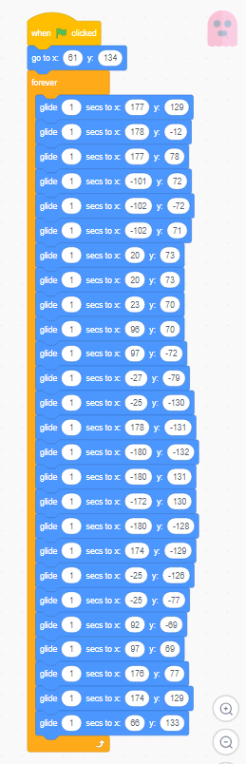
Using glide blocks
Image: Flaticon.com
Digital Technologies Hub is brought to you by the Australian Government Department of Education. Creative Commons Attribution 4.0, unless otherwise indicated.
Notes:
This code moves the sprite around the maze
https://scratch.mit.edu/projects/1047742432/editor
Set up coordinates: Determine the x and y coordinates for different points within the maze where you want the ghost to glide.
Create a path: Use multiple glide blocks to create a sequence of movements that will navigate the ghost through the maze.

Slide 12
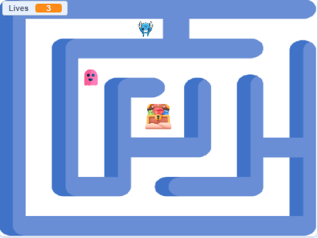
If touching colour
Start position (x: -19, y: 133)
In this game, we need to keep the dragon within the maze.
If the dragon touches the colour , then move back to start (x: -19, y: 133).
Image: Flaticon.com
Digital Technologies Hub is brought to you by the Australian Government Department of Education. Creative Commons Attribution 4.0, unless otherwise indicated.

Slide 13
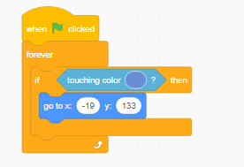
Code example: if touching colour
Start position (x: -19, y: 133)
Image: Flaticon.com
Digital Technologies Hub is brought to you by the Australian Government Department of Education. Creative Commons Attribution 4.0, unless otherwise indicated.
Notes:
One way to code the sprite is to use an If/Then block.
Using a sensing block ‘touching colour’, we change the colour to match the maze wall exactly using the eyedropper tool.
We add a motion block go to (x, y) and add the coordinates.
The code is nested in a forever block so it works continuously when the program is running.

Slide 14


Detect when one sprite touches another
In games, we often trigger an event if one sprite touches another.
Specify the action to take when the sprites touch.
In this maze game, if the ghost touches the dragon, then game over.
Image: Flaticon.com
Digital Technologies Hub is brought to you by the Australian Government Department of Education. Creative Commons Attribution 4.0, unless otherwise indicated.

Slide 15
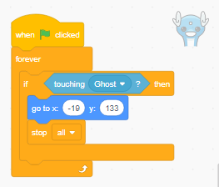
Detect when one sprite touches another: code
Image: Flaticon.com
Digital Technologies Hub is brought to you by the Australian Government Department of Education. Creative Commons Attribution 4.0, unless otherwise indicated.
Notes:
This is a simple script; students can use this as a starting point.

Slide 16
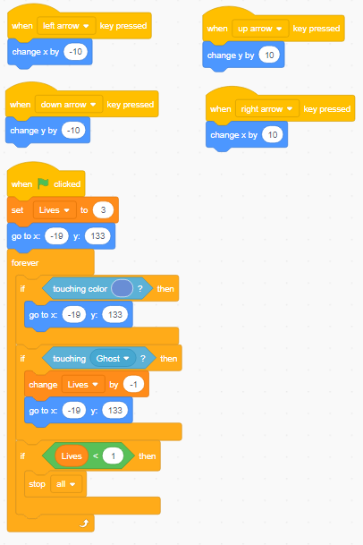

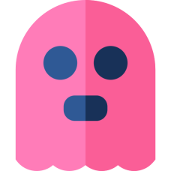
Match the code to the sprite (1)
or
or
Image: Flaticon.com
Digital Technologies Hub is brought to you by the Australian Government Department of Education. Creative Commons Attribution 4.0, unless otherwise indicated.
Notes:
This code is for the sprite: dragon.
Clues:
Arrow keys to move up, down, left and right.
Starts with 3 lives.
If it touches the maze wall, it goes back to the starting position.
If it touches the ghost, it loses a life and goes back to the starting position.
If it has less than 1 life, the game is over.
Scratch code example maze game https://scratch.mit.edu/projects/1047742432/editor

Slide 17
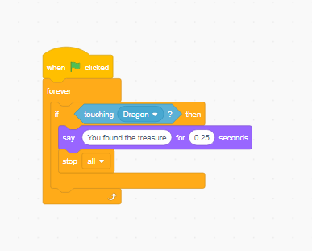
Match the code to the sprite (2)
or
or
Image: Flaticon.com
Digital Technologies Hub is brought to you by the Australian Government Department of Education. Creative Commons Attribution 4.0, unless otherwise indicated.
Notes:
This code is for the sprite: treasure.
Scratch code example maze game https://scratch.mit.edu/projects/1047742432/editor

Slide 18
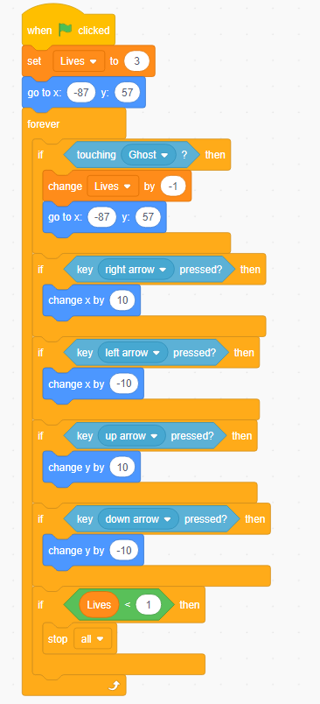
Predict what the code does
Starts with 3 lives.
Loses a life if ghost catches dragon.
Arrow keys move dragon by 10.
If lives are less than 1, then game over.
Image: Flaticon.com
Digital Technologies Hub is brought to you by the Australian Government Department of Education. Creative Commons Attribution 4.0, unless otherwise indicated.
Notes:
Scratch code example (no maze) dragon movement only https://scratch.mit.edu/projects/1046454937/editor/

Slide 19
Introducing a variable
A common part of gameplay is to have a set number of lives.
To track information like a character's lives, programs use a ‘variable’.
This variable updates based on events and can be used throughout the program.
Image: Flaticon.com
Digital Technologies Hub is brought to you by the Australian Government Department of Education. Creative Commons Attribution 4.0, unless otherwise indicated.

Slide 20
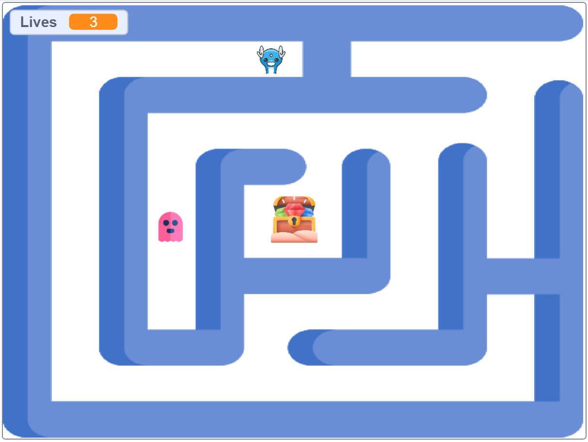
How do I keep track of lives?
Imagine you want a character to start off with three lives, like in this maze game.
Image: Flaticon.com
Digital Technologies Hub is brought to you by the Australian Government Department of Education. Creative Commons Attribution 4.0, unless otherwise indicated.
Notes:
This code is for the sprite: treasure.
Scratch code example maze game https://scratch.mit.edu/projects/1047742432/editor

Slide 21
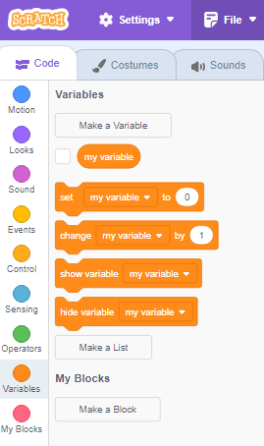
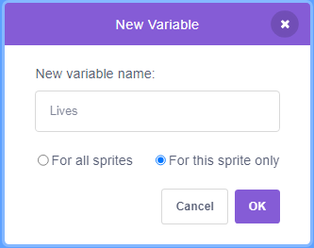
Make a variable called ‘Lives’
Select 'Variables', then
‘Make a Variable’.
Next,
Name your new variable.
Image: Flaticon.com
Digital Technologies Hub is brought to you by the Australian Government Department of Education. Creative Commons Attribution 4.0, unless otherwise indicated.
Notes:
This code is for the sprite: treasure.
Scratch code example maze game https://scratch.mit.edu/projects/1047742432/editor
For more support and guidance, view the video:
How to add 'Lives' to your Scratch computer game | Introduction coding tutorial with Scratch code
https://www.youtube.com/watch?v=1sa0yISqqXM

Slide 22
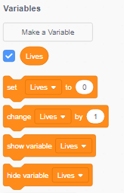
Use the ‘Lives’ variable in your program
Now you can use the variable ‘Lives’ in your program.
Image: Flaticon.com
Digital Technologies Hub is brought to you by the Australian Government Department of Education. Creative Commons Attribution 4.0, unless otherwise indicated.

Slide 23
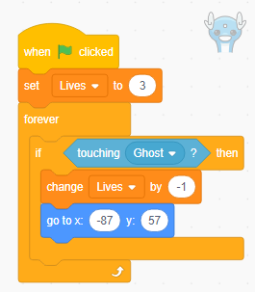
Use the ‘Lives’ variable in your program: code example
Set lives to 3 at the start of the game.
If the dragon touches the ghost, lose 1 life.
The blue block is a motion block. The sprite returns to this position.
Image: Flaticon.com
Digital Technologies Hub is brought to you by the Australian Government Department of Education. Creative Commons Attribution 4.0, unless otherwise indicated.

Slide 24
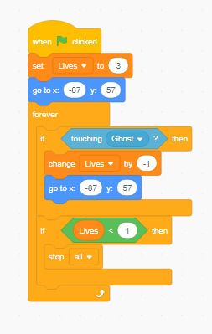
'Lives left' example
You can add code to end the game if the dragon has no lives left.
Image: Flaticon.com
Digital Technologies Hub is brought to you by the Australian Government Department of Education. Creative Commons Attribution 4.0, unless otherwise indicated.

