Slide 1

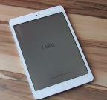
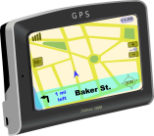
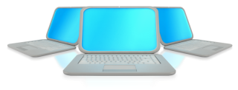
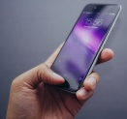
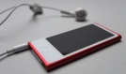
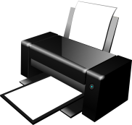

Digital
Systems
What are they?
Notes:
iPad - PIX1861/pixabay.com, public domain
Hand holding iPhone - fancycrave1/pixabay.com, public domain
iPod nano and headphones - LudewigMe/pixabay.com, public domain

Slide 2
Digital Systems include:
Hardware
Software
Peripheral Devices

Slide 3
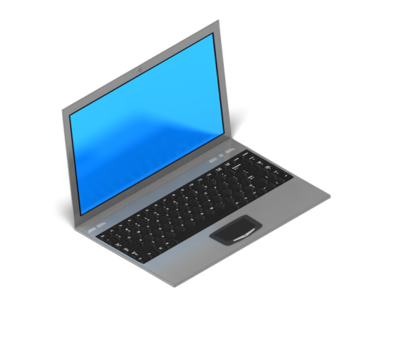

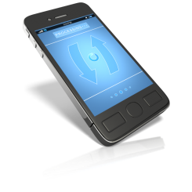
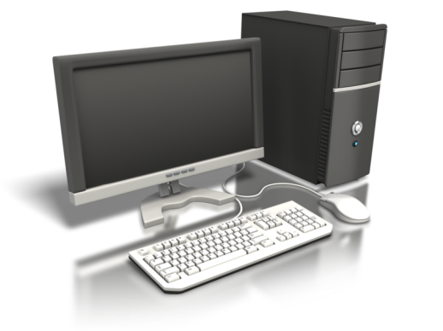
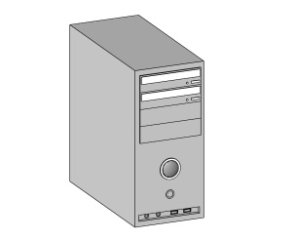

Hardware includes the physical parts of the computer system. These are the components you can touch and see.
Tablet
Mouse
Laptop
Tower
Monitor
Keyboard

Slide 4


Hardware
A monitor displays images and texts

Slide 5


Slide 6


Software is a set of instructions that tells the computer what to do.
Software includes:
Word Processor
Slideshow
Spreadsheet
Games
Apps
Photo editor
Software helps you create something such as drawings and stories.

Slide 7
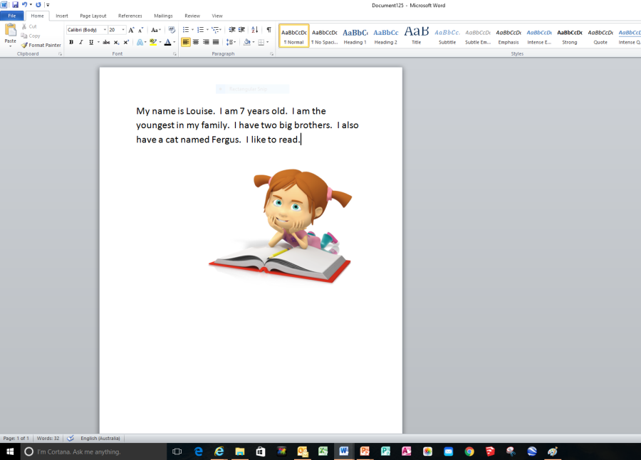
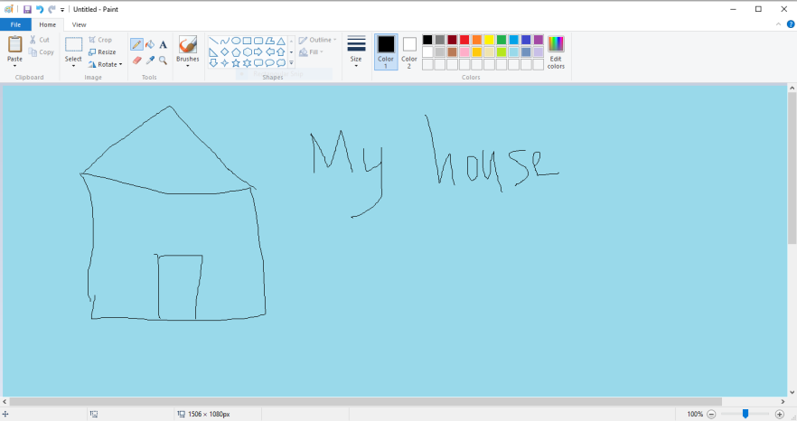
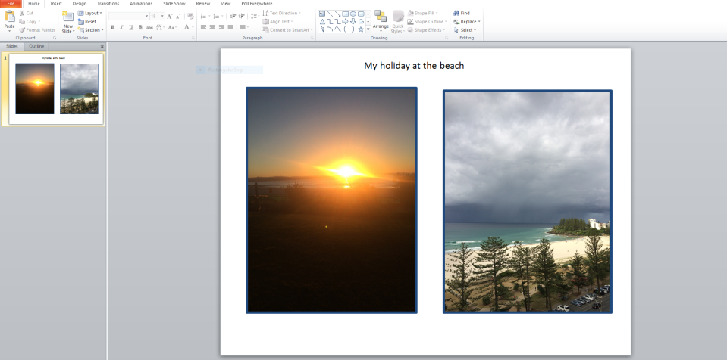
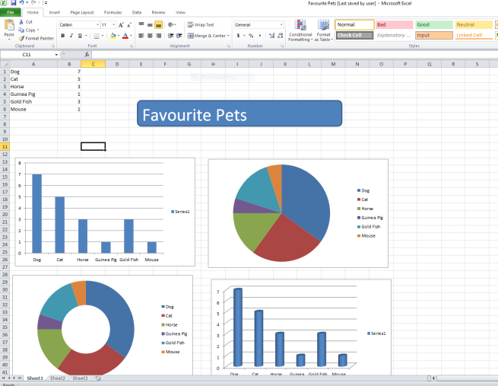
Software
Word processing –To create stories
To paint and draw
To create presentations
Spreadsheets to arrange data

Slide 8
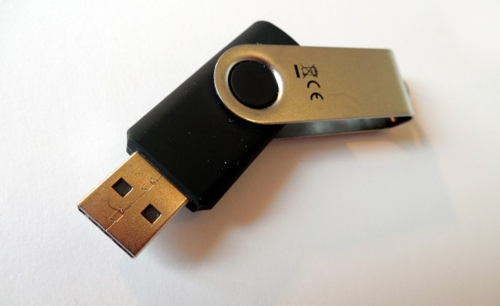
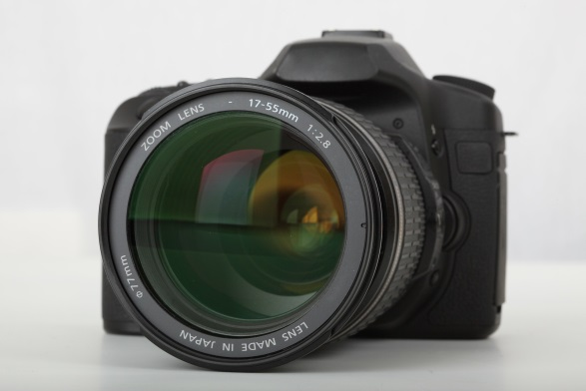
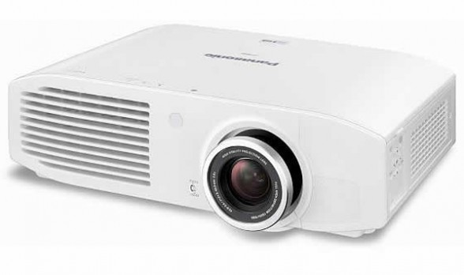
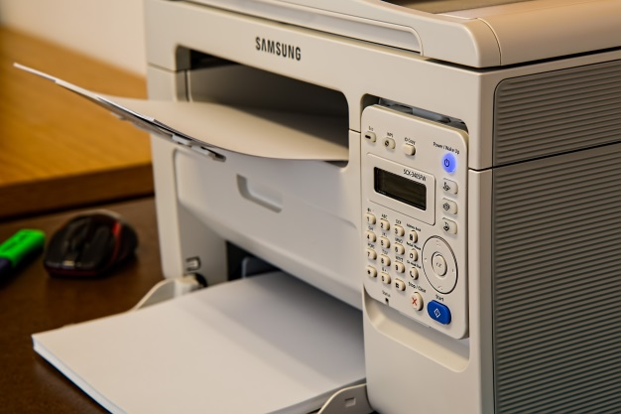
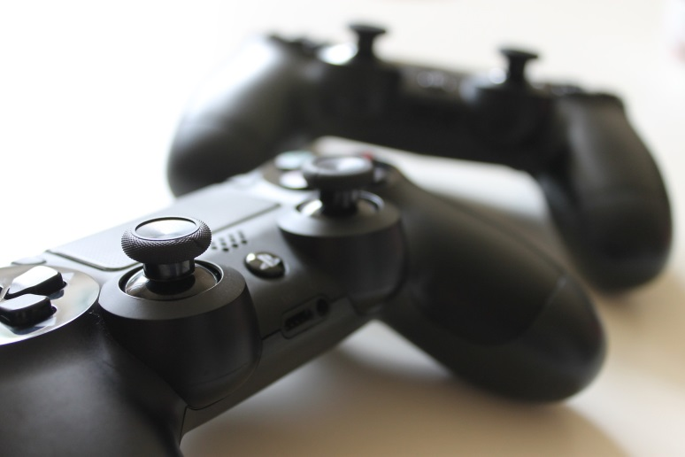
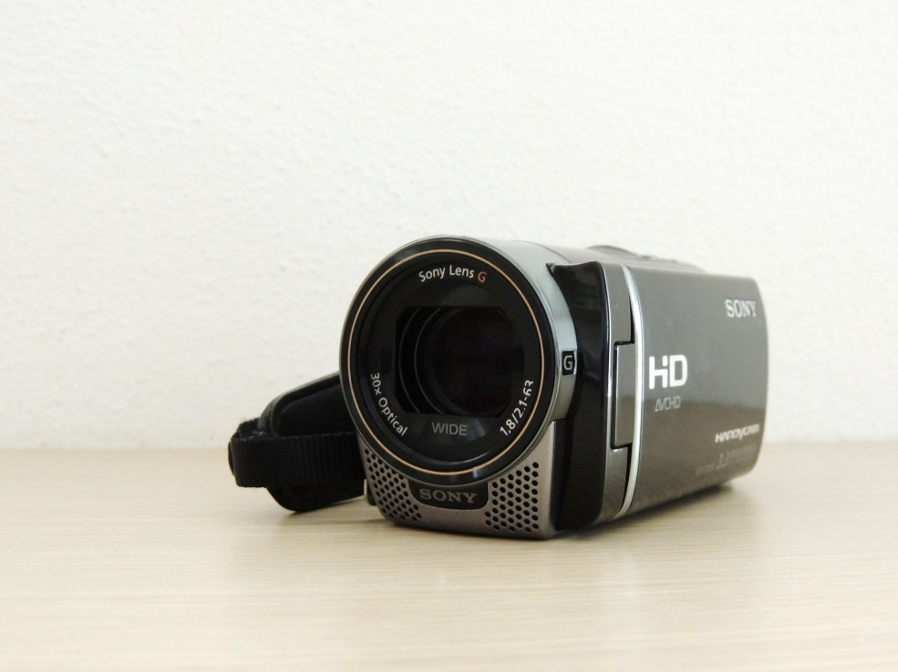
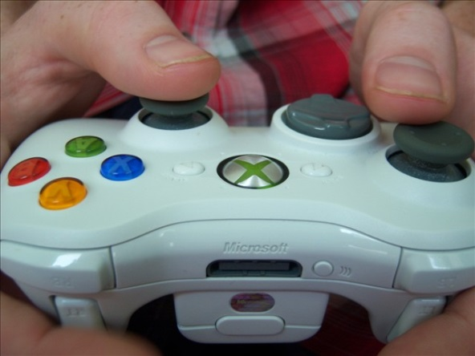
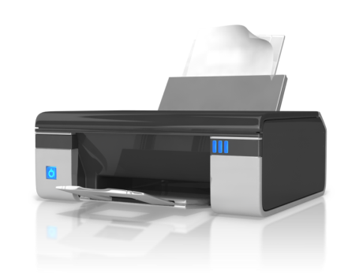
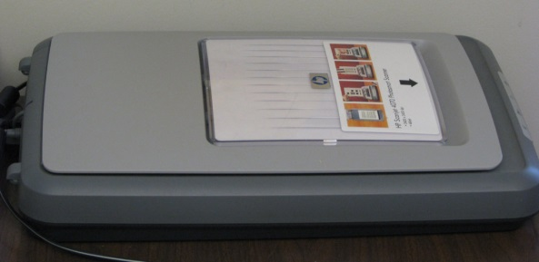
Peripheral Devices
Notes:
Camera - PublicDomainPictures/pixabay.com, public domain
Projector - EricRobson214/flickr.com, CC BY 2.0
Printer - stevepb/pixabay.com, public domain
USB stick - succo/pixabay.com, public domain
Video game controller - christianladewig0/pixabay.com, public domain
Video camera - fill/pixabay.com, public domain
XBox controller - Brandon and Allison Ejem/flickr.com, CC BY-NC-ND 2.0
Scanner - npslibrarian/flickr.com, CC BY-SA 2.0

Slide 9
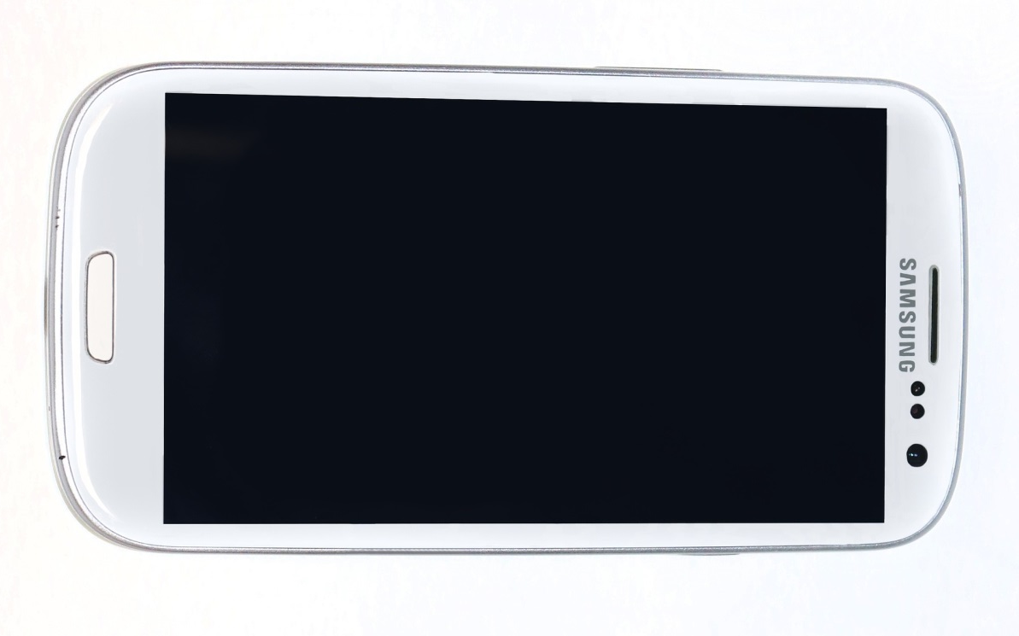
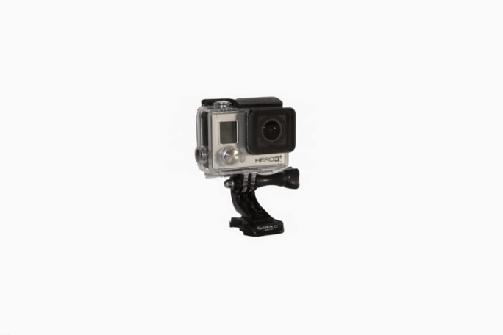

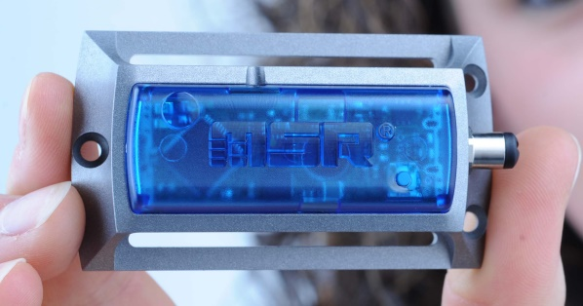

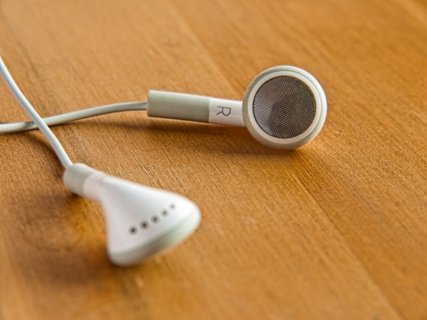

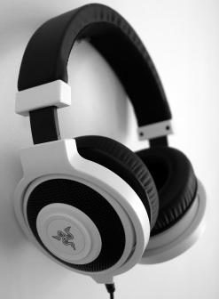
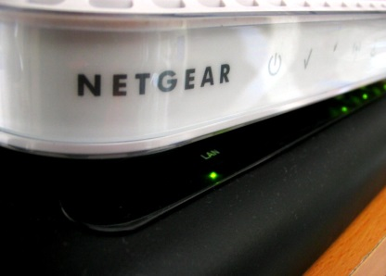
Digital Devices
Notes:
Data logger small data logger with integrated sensors measuring temperature, pressure, humidity and light.
Samsung phone - jtuckermktg/pixabay.com, public domain
iPad - PIX1861/pixabay.com, public domain
Earbuds - Eric Bennett/flickr.com, CC BY-SA 2.0
Headphones - aniepanes/pixabay.com, public domain
Modem - Allan Reyes/flickr.com, CC BY-NC-ND 2.0
iPod nano and headphones - LudewigMe/pixabay.com, public domain
Hand holding iPhone - fancycrave1/pixabay.com, public domain

Slide 10
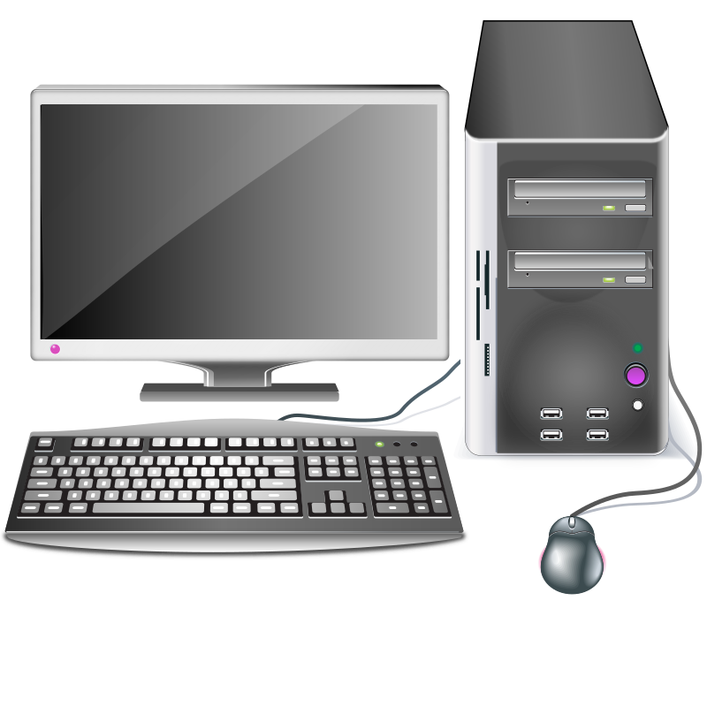
Can you match the labels to this digital system?
Monitor
Keyboard
Mouse
Computer Tower
On/ Off Button
USB Portal

Slide 11
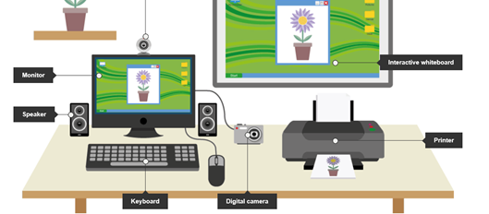
Label the hardware

Slide 12
