Slide 1



Project management
How to use a burndown chart
Digital Technologies Hub is brought to you by the Australian Government Department of Education. Creative Commons Attribution 4.0, unless otherwise indicated.

Slide 2

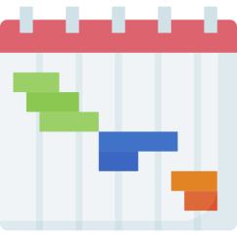
Project management
Reflect on what you know about project management.
Which do you think is the most important part of managing a project?
Planning
Tracking progress
Team collaboration
Adjusting plans
Images: Flaticon.com
Digital Technologies Hub is brought to you by the Australian Government Department of Education. Creative Commons Attribution 4.0, unless otherwise indicated.
Notes:
Step though what project management is.
This introduction sets the stage for understanding tools like burndown charts and emphasises why project management is important for success.
You could use a poll to answer this and display the students’ responses.

Slide 3
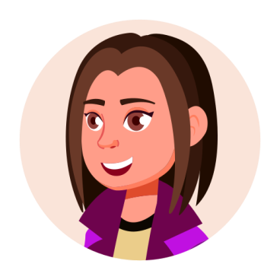
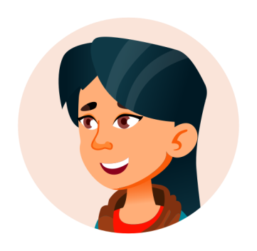
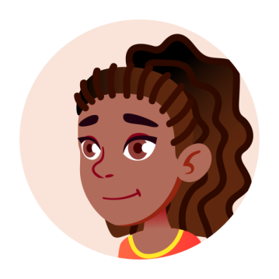
Example: Design challenge
Our design challenge:
Design and create an app that helps teens navigate the challenges they face in their teenage years.
We had 8 weeks
with a 2-hour session
per week.
Images: Flaticon.com
Digital Technologies Hub is brought to you by the Australian Government Department of Education. Creative Commons Attribution 4.0, unless otherwise indicated.
Notes:
Use an example project to illustrate one way of planning an app design project.

Slide 4
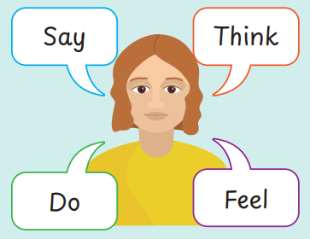
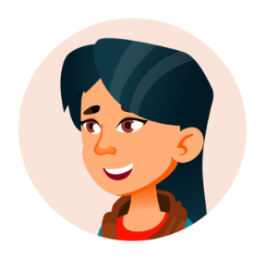

Understanding the user
We used an empathy map to visualise teens' thoughts, feelings, needs and behaviours to inform stakeholder interview questions.
We used stakeholder interviews to check assumptions, gather insights and deepen our understanding of the target audience.
Digital Technologies Hub is brought to you by the Australian Government Department of Education. Creative Commons Attribution 4.0, unless otherwise indicated.
Notes:
Remind students of the need to understand the user.

Slide 5

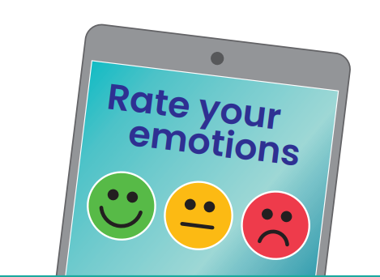
User story and acceptance
As a <role>
I want <goal>
so that <benefit>
Acceptance criteria
(conditions of satisfaction)
As a teenager,
I want to receive daily suggestions,
so that I can stay motivated, build healthy habits and earn rewards for my progress.
Acceptance criteria
Receive personalised daily activity suggestions to stay on track.
See progress with a visual tracker to stay motivated.
Get rewards for completing tasks and building habits.
Our wellbeing app will promote mental and physical health for teens, with mindfulness exercises and screen time management.
Digital Technologies Hub is brought to you by the Australian Government Department of Education. Creative Commons Attribution 4.0, unless otherwise indicated.
Notes:
Talk through user stories as a way to simply write the user needs.
Discuss acceptance criteria which are the conditions that will satisfy the user.

Slide 6
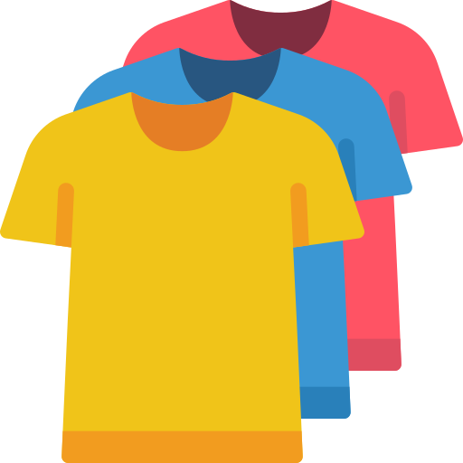
Estimation of effort
We had to estimate the effort of each task to help us plan and track progress effectively. It is called ‘task sizing’.
A popular way to do this is ‘t-shirt sizing’. We categorised tasks into sizes like Small, Medium, and Large, based on their complexity, amount of work, or time required.
Each size is given a numeric value called ‘story points’.
Small: 1–3 story points (simple and quick tasks)
Medium: 5–8 story points (moderately complex tasks)
Large: 9–20 story points (tasks requiring significant effort and time).
Digital Technologies Hub is brought to you by the Australian Government Department of Education. Creative Commons Attribution 4.0, unless otherwise indicated.
Notes:
https://www.flaticon.com/free-icon/tshirt_4715310?term=t+shirt&page=1&position=5&origin=search&related_id=4715310

Slide 7
List and estimate effort
Next, we made a list of the tasks to develop our app related to our user story and acceptance criteria.
Design an interface using wireframe
Make a paper prototype for user feedback
Create a visual mood tracker feature
Write content for daily activity suggestions
Build notification system (daily suggestions)
Add gamification elements such as badges and rewards
Test and refine the app
Digital Technologies Hub is brought to you by the Australian Government Department of Education. Creative Commons Attribution 4.0, unless otherwise indicated.
Notes:
https://www.flaticon.com/free-icon/tshirt_4715310?term=t+shirt&page=1&position=5&origin=search&related_id=4715310

Slide 8
Table: Estimation of effort
We gave each task a story score using
t-shirt sizing.
Task | T-shirt sizing | Story points
Design interface using wireframe | S | 3
Make a paper prototype for user feedback | S | 3
Create a visual mood tracker feature | M | 6
Write content for daily activity suggestions | S | 3
Build notification system for daily suggestions | M | 6
Add gamification elements such as badges and rewards | L | 9
Test and refine the app | S | 2
 | Total | 32
Digital Technologies Hub is brought to you by the Australian Government Department of Education. Creative Commons Attribution 4.0, unless otherwise indicated.
Notes:
https://www.flaticon.com/free-icon/tshirt_4715310?term=t+shirt&page=1&position=5&origin=search&related_id=4715310

Slide 9
Data to create burndown chart
 | Initial estimate | 8-Aug | 15-Aug | 22-Aug | 29-Aug | 5-Sep | 12-Sep | 19-Sep | 26-Sep
 | Day 0 | Day 1 | Day 2 | Day 3 | Day 4 | Day 5 | Day 6 | Day 7 | Day 8
Design interface using wireframe | 3 | 2 | 1
Make a paper prototype for user feedback | 3 |  | 2 | 1
Create a visual mood tracker feature | 6 |  |  | 4 | 2
Write content for daily activity suggestion | 3 |  |  |  | 3
Build notification system for daily suggestions | 6 |  |  |  |  | 6
Add gamification elements such as badges and rewards | 9 |  |  |  |  |  | 5 | 4
Test and refine the app | 2 |  |  |  |  |  |  |  | 2
Remaining effort | 32 | 30 | 27 | 22 | 17 | 11 | 6 | 2 | 0
Ideal progress | 32 | 28 | 24 | 20 | 16 | 12 | 8 | 4 | 0
Digital Technologies Hub is brought to you by the Australian Government Department of Education. Creative Commons Attribution 4.0, unless otherwise indicated.
Notes:
https://www.flaticon.com/free-icon/tshirt_4715310?term=t+shirt&page=1&position=5&origin=search&related_id=4715310

Slide 10
Burndown chart
The burndown chart tracks project progress over 8 days, comparing ideal progress (planned work completion rate) with actual progress (work completed).
Digital Technologies Hub is brought to you by the Australian Government Department of Education. Creative Commons Attribution 4.0, unless otherwise indicated.
Notes:
The burndown chart tracks project progress over 8 days, comparing ideal progress (planned work completion rate) with actual progress (work completed).

