Slide 1
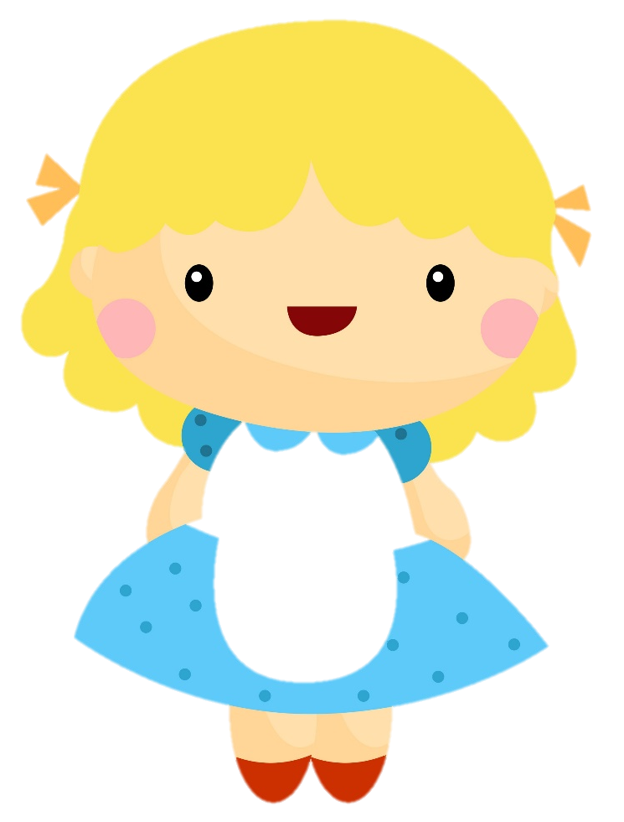


Sort the slides in order to retell the story
Oh no! These slides are out of order.
Can you help?
Type your own text in the text box for each slide.
Image credit: comodo777©123RF.com
Creative Commons BY 4.0 licence, unless otherwise indicated.
Digital Technologies Hub is brought to you by
Australian Government Department of Education and Training

Slide 2

Goldilocks found some porridge.
Image credit: comodo777©123RF.com
Creative Commons BY 4.0 licence, unless otherwise indicated.
Digital Technologies Hub is brought to you by
Australian Government Department of Education and Training

Slide 3


Goldilocks went to the three bears house.
Image credit: comodo777©123RF.com
Creative Commons BY 4.0 licence, unless otherwise indicated.
Digital Technologies Hub is brought to you by
Australian Government Department of Education and Training

Slide 4
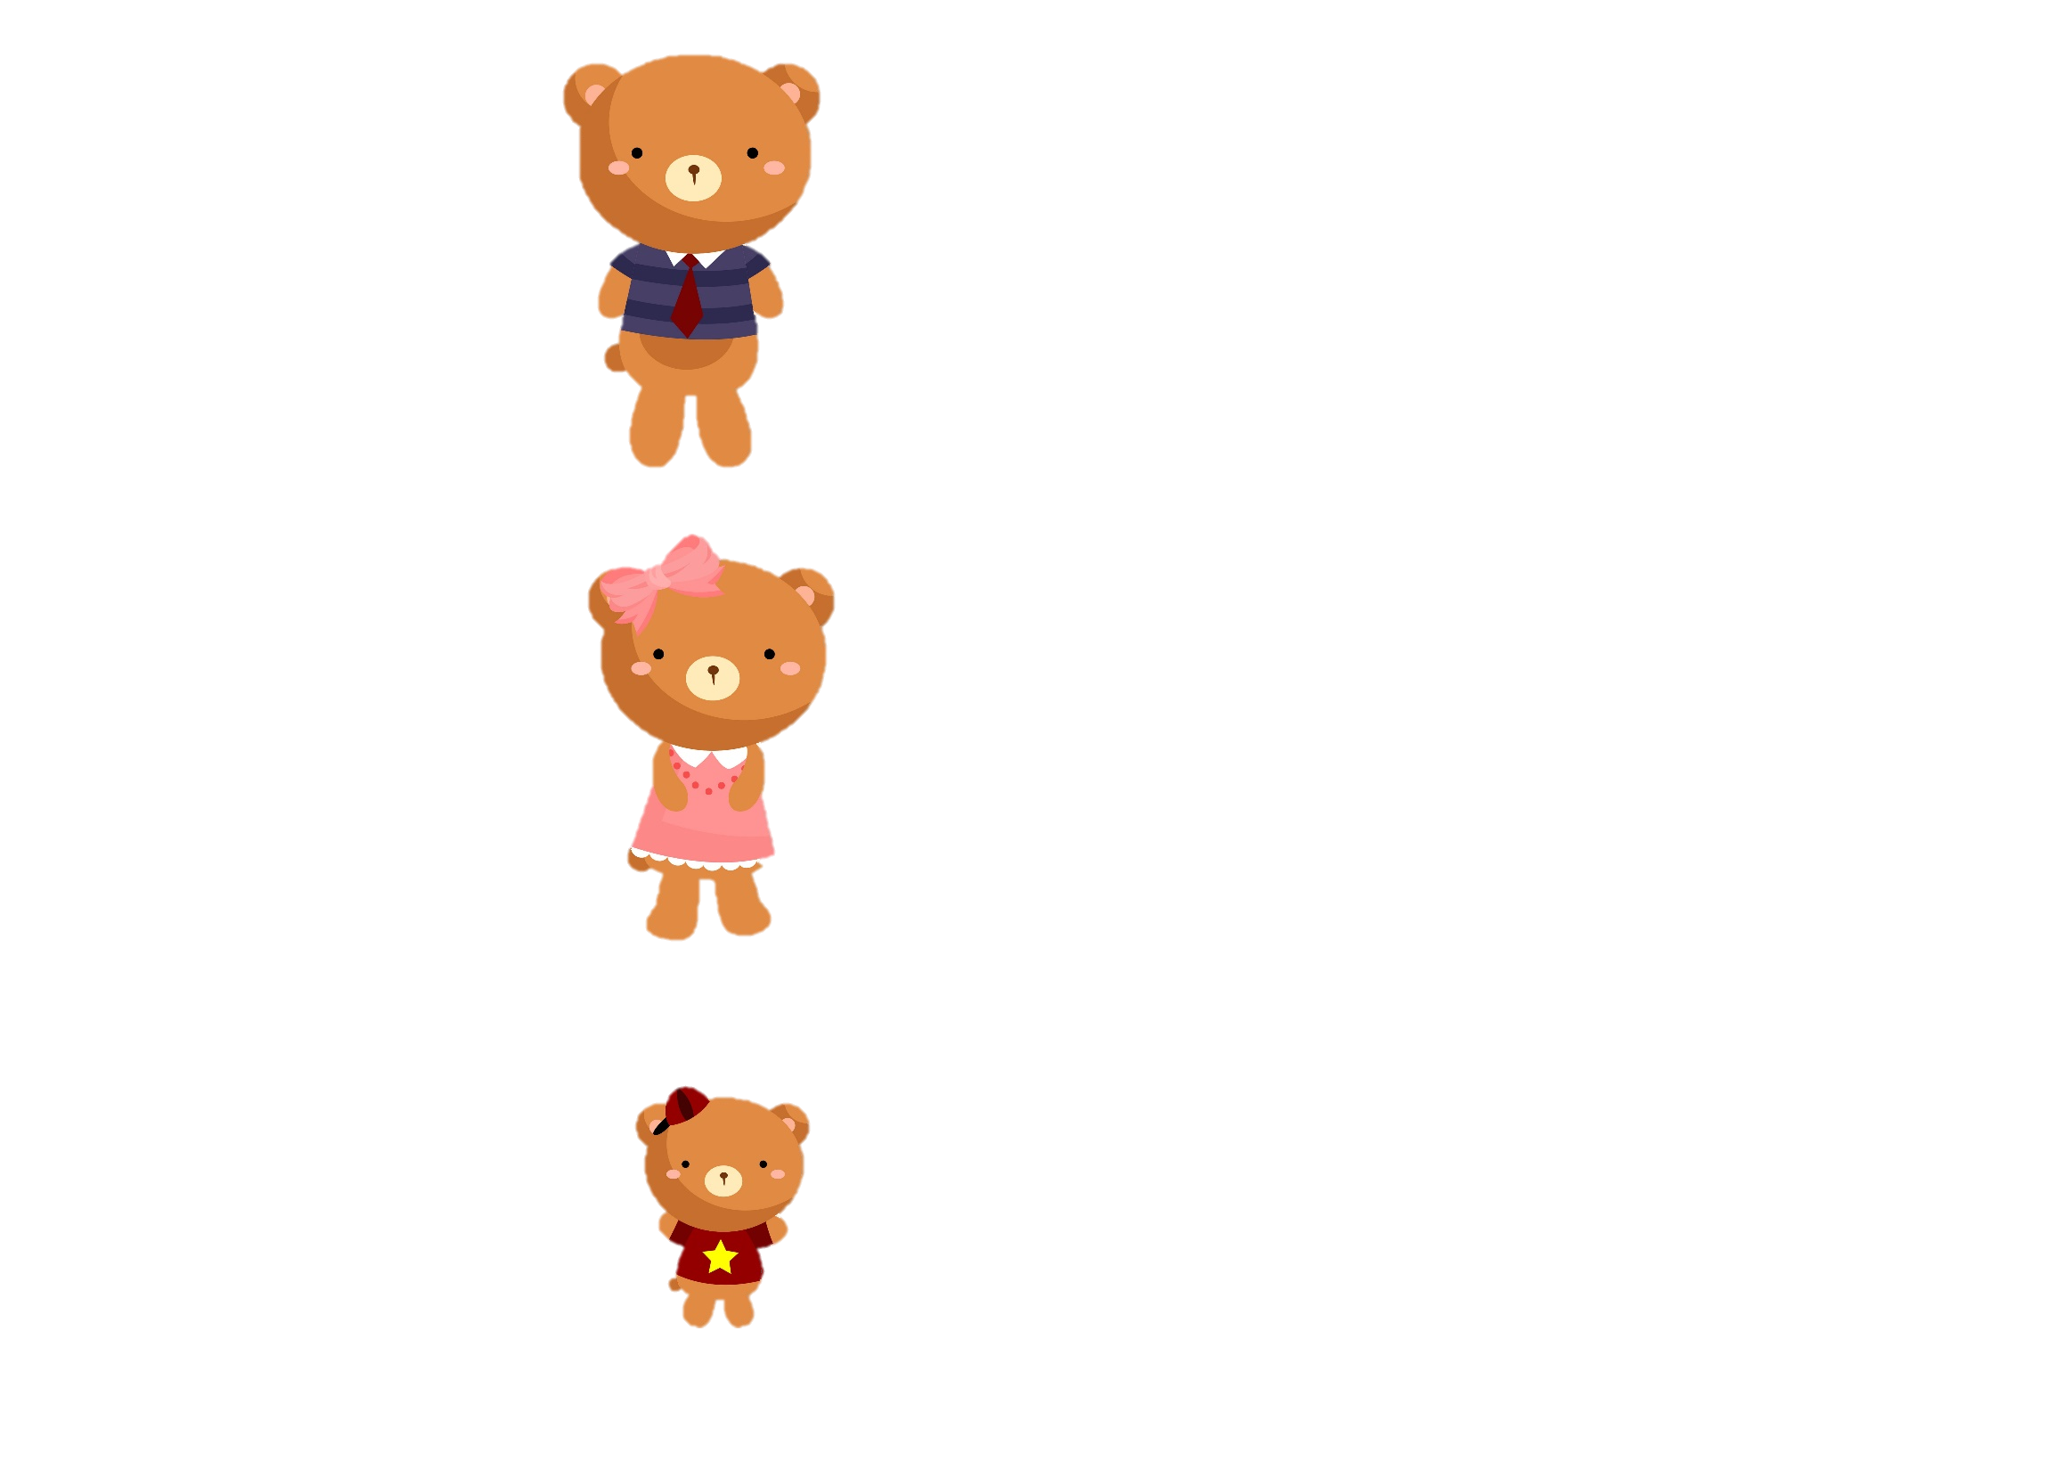



The three bears found Goldilocks in the house…
Image credit: comodo777©123RF.com
Creative Commons BY 4.0 licence, unless otherwise indicated.
Digital Technologies Hub is brought to you by
Australian Government Department of Education and Training

Slide 5




Goldilocks felt tired.
Image credit: comodo777©123RF.com
Creative Commons BY 4.0 licence, unless otherwise indicated.
Digital Technologies Hub is brought to you by
Australian Government Department of Education and Training

Slide 6

Once upon a time …
Image credit: comodo777©123RF.com
Creative Commons BY 4.0 licence, unless otherwise indicated.
Digital Technologies Hub is brought to you by
Australian Government Department of Education and Training

Slide 7




Goldilocks sat in the chairs.
Image credit: comodo777©123RF.com
Creative Commons BY 4.0 licence, unless otherwise indicated.
Digital Technologies Hub is brought to you by
Australian Government Department of Education and Training

