Slide 1
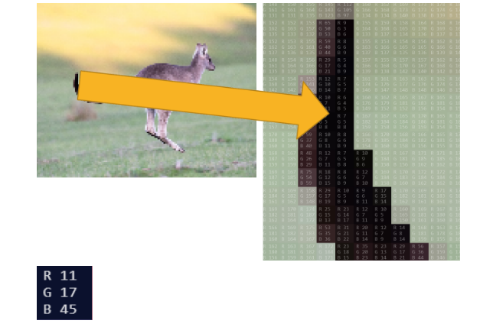

What do you notice and wonder?

