Slide 1
Developing data science skills
Authentic datasets
Martin Richards, Content Manager, ESA
Dr Linda McIver, Australian Data Science Education Institute

Slide 2
What are we covering?
Data science skills (transferable)
Using authentic datasets: Real data, collected by real scientists, for a real purpose (managing animal populations)
Linking to DT Hub resources (adapt to suit)
How to think like a data scientist (Mindset)
Work through two datasets (follow along with spreadsheet). Scaffold the process.

Slide 3
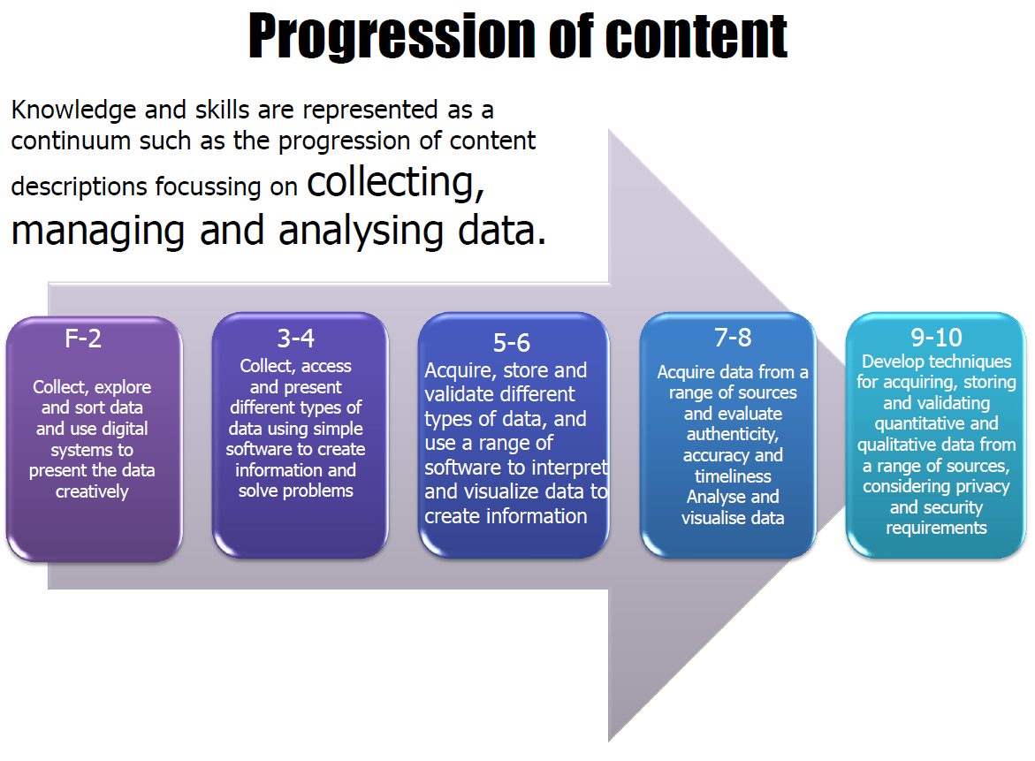

Slide 4
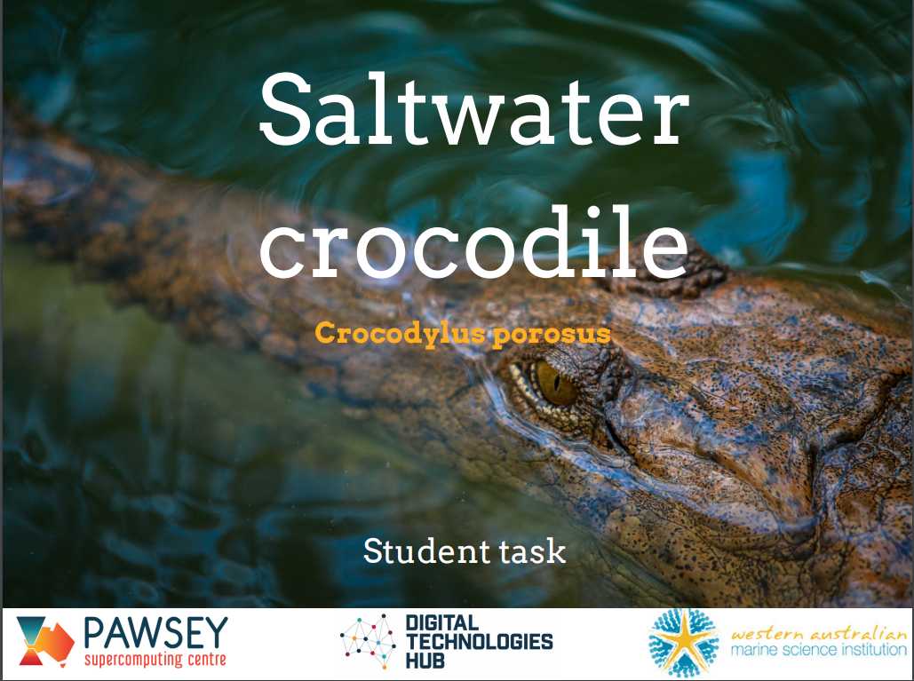

NEW RESOURCES ON THE DT HUB
Years 5-6 | Years 7-8
Saltwater crocs: resourceful or a resource? | Humpback whales: what the data reveals

Slide 5

Career profiles to inspire students
Achievable
Everyday people

Slide 6
Skills
Sort and filter data
Interpret and analyse; recognise patterns
Use a COUNT function
Create charts (select the right type of chart)
Plot spatial data (latitude/longitude) on an online map
Calculate averages

Slide 7
Mindset
Keep a clean copy of the dataset
Being methodical, logical, and skeptical
Checking the result
Just play and see what you find - no risks!

Slide 8
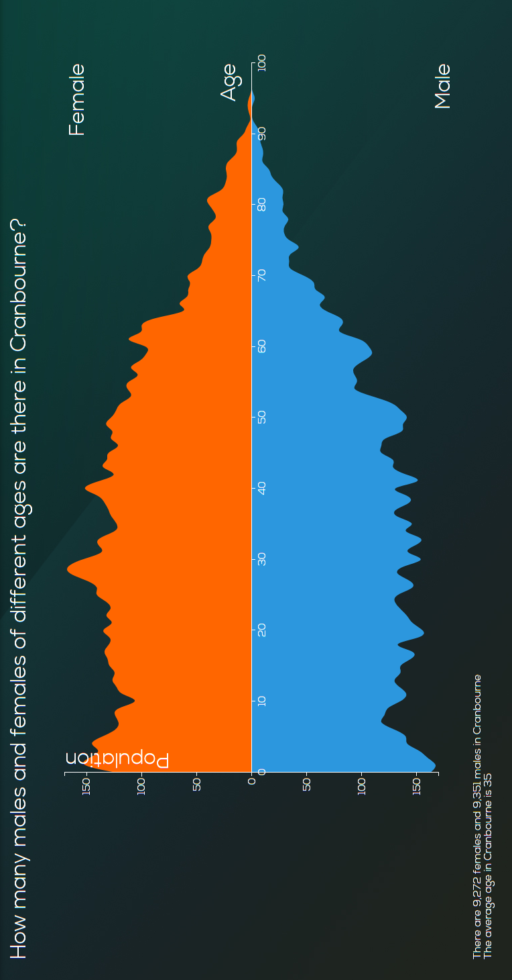
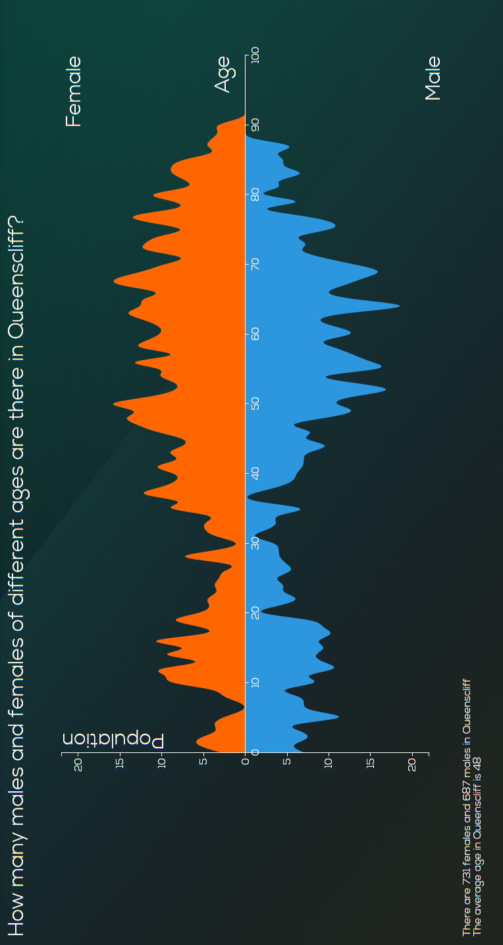
Populations
Data: Australian population
Gender: Male and Female
Age
ABC Splash - ConCensus
Can we create a similar population chart for an animal population?
Data: Saltwater crocodile
Length
Age is proportional to its length

Slide 9
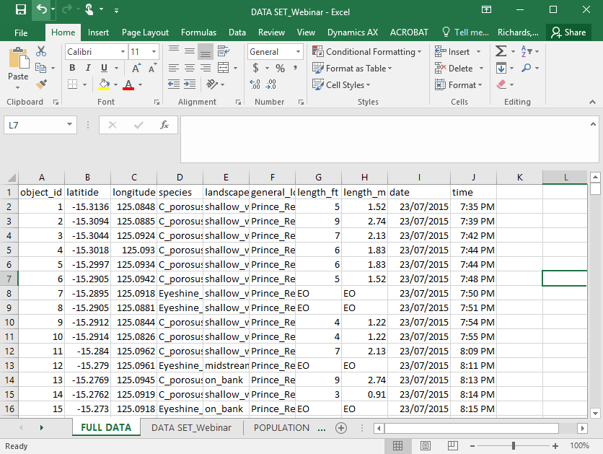
TIME TO PLAY! Download the Excel spreadsheet
DATA SET_Webinar.xls

Slide 10

Location data
Useful tool to introduce Lat/Long
https://getlatlong.net/
Introduce latitude (north and south)
and longitude (east to west)
Equator (Latitude is zero)
Greenwich (Longitude is zero)

Slide 11
Capital city | Latitude | Longitude
Melbourne | -37.535236 | 144.863052
Sydney | -35.629866 | 151.147231
Brisbane | -29.180247 | 153.080825
Cairns | ? | ?
Perth | -31.956027 | 115.860576
? | -42.882694 | 147.330264
? | -12.462288 | 130.840901
? | -34.927144 | 138.599807
Explore latitude, longitude

Slide 12
Assessment
Checklists and rubrics
Checklists: Knowledge and skills

Slide 13




Connect with the Digital Technologies Hub
DT Hub Newsletter
@DigiTechHub
DigitalTechnologiesHub
Digital Technologies Hub

