Slide 1


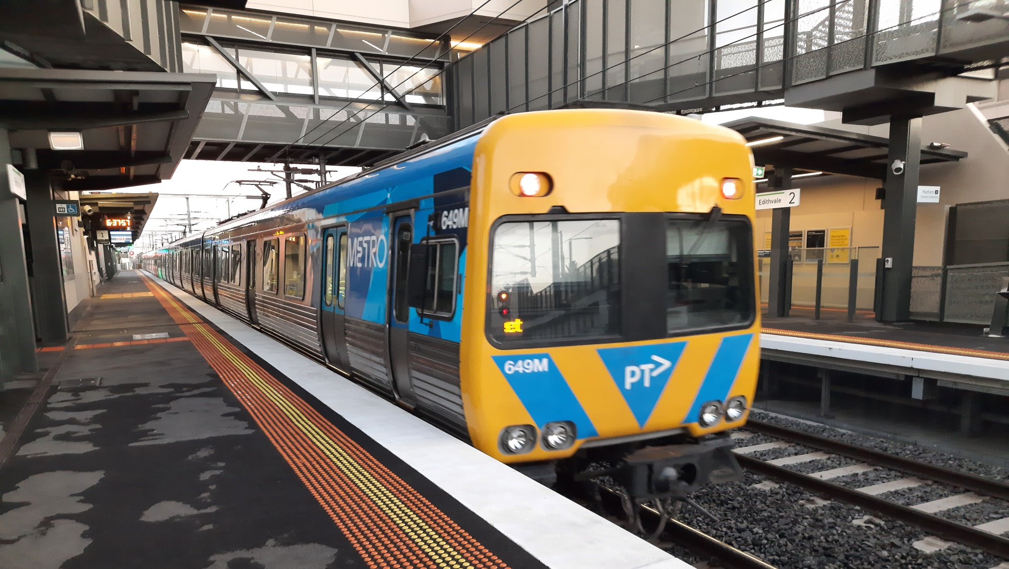
Public transport symbols
Digital Technologies Hub is brought to you by the Australian Government Department of Education. Creative Commons Attribution 4.0, unless otherwise indicated.
Notes:
Source M. Richards

Slide 2
Discussion
How is data represented in public transport?
Where have you seen information to help you use public transport?
How is the data represented?
Digital Technologies Hub is brought to you by the Australian Government Department of Education. Creative Commons Attribution 4.0, unless otherwise indicated.

Slide 3

What do you notice? What do you wonder?
Digital Technologies Hub is brought to you by the Australian Government Department of Education. Creative Commons Attribution 4.0, unless otherwise indicated.
Notes:
Source https://upload.wikimedia.org/wikipedia/commons/1/1c/Melbourne_suburban_and_regional_rail_symbols.png
Symbols are used to represent trains

Slide 4

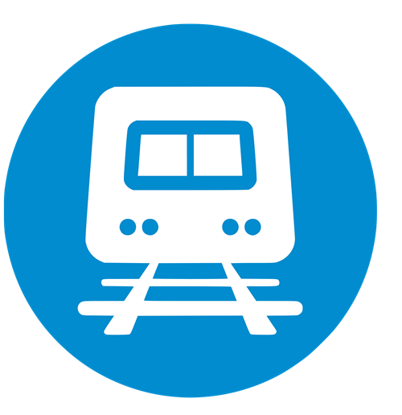
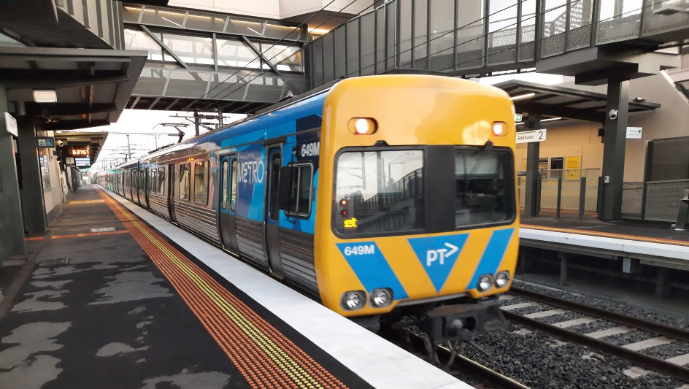


What is similar?
What is different?
Digital Technologies Hub is brought to you by the Australian Government Department of Education. Creative Commons Attribution 4.0, unless otherwise indicated.
Notes:
Use questioning to prompt students to understand that these are different ways to represent a train
Photograph
Text
Symbol
Drawing
They represent the same data in different ways

Slide 5
How might they be used for a particular purpose?
Digital Technologies Hub is brought to you by the Australian Government Department of Education. Creative Commons Attribution 4.0, unless otherwise indicated.
Notes:
Use questioning to prompt students to understand how these different ways to represent a train might be used.
Ask: How might they be used for a particular purpose?
Number 649M is the train identification number: used in timetable information (spreadsheets) by the organisation
Photo (brochure, poster, website) convey information about trains
Symbol used in maps and timetables including apps
Drawing information about types of trains
Text The word train is used in written texts about trains

Slide 6
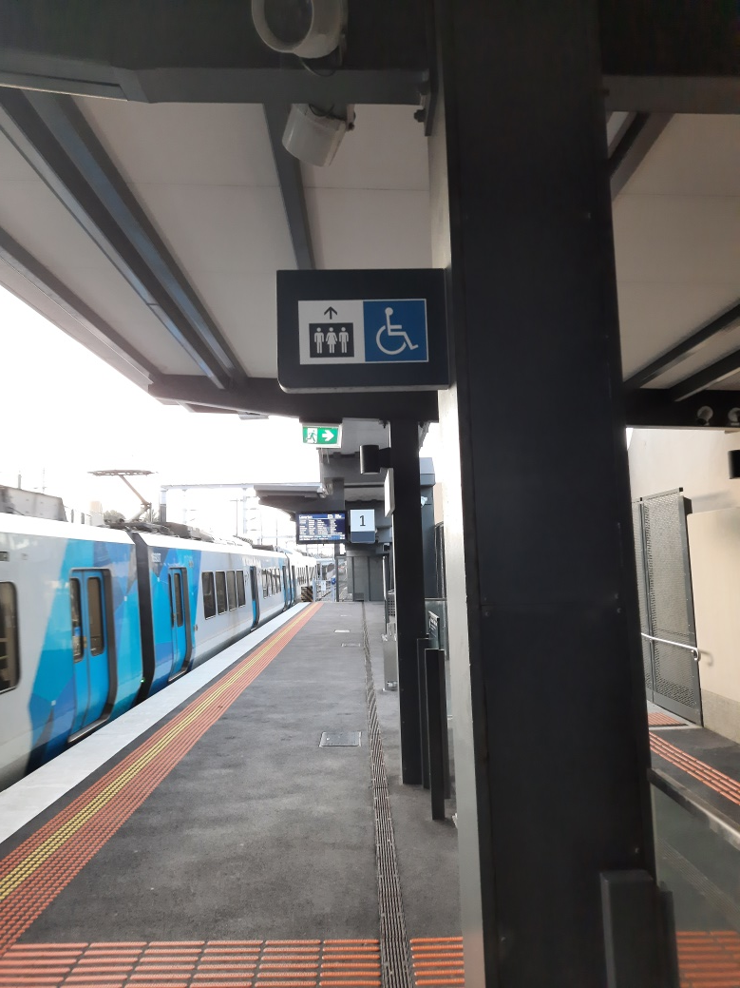
Discussion: symbols
What data might you see on a train station?
How might symbols be used?
How would you represent important information?
Digital Technologies Hub is brought to you by the Australian Government Department of Education. Creative Commons Attribution 4.0, unless otherwise indicated.
Notes:
Use this slide to investigate symbols in your local public transport.

