Slide 1



Design thinking
Applying project management tools and thinking in a collaborative design project
Digital Technologies Hub is brought to you by the Australian Government Department of Education. Creative Commons Attribution 4.0, unless otherwise indicated.

Slide 2


Design a digital solution
What challenges do people face in their daily lives that could be solved digitally?
Think about the digital tools you use every day—messaging apps, game platforms, online learning. What’s missing or what could be improved?
Imagine you could create a digital solution that changes how people live, work or play online. What would it be?
Images: Flaticon.com
Digital Technologies Hub is brought to you by the Australian Government Department of Education. Creative Commons Attribution 4.0, unless otherwise indicated.
Notes:
Encourage empathy and get students thinking about designing a digital solution that could make a positive impact in others’ lives.
Image flaticon:
https://www.flaticon.com/search/2?word=digital%20solutions

Slide 3



How do you get started?
Images: Flaticon.com
Digital Technologies Hub is brought to you by the Australian Government Department of Education. Creative Commons Attribution 4.0, unless otherwise indicated.
Notes:
Acknowledge that students need guidance to start a collaborative design project.
Image flaticon:
https://www.flaticon.com/free-icon/route_1758579?term=start+and+end&page=1&position=32&origin=search&related_id=1758579
https://www.flaticon.com/free-icon/person_14865144?term=thinking&page=1&position=57&origin=search&related_id=14865144
https://www.flaticon.com/free-icon/person_14865151?term=thinking&page=1&position=22&origin=search&related_id=14865151

Slide 4

Getting started
Identify a problem or need
Think about a group of people or a real-life challenge. What’s something they struggle with that a digital solution could improve?
Understand your audience
You’ll need to understand your audience, who we will call the ‘user’.
It is important to know a bit about them, such as their needs and preferences.
Form a team and brainstorm your ideas
Don’t worry about perfect ideas yet—list anything that comes to mind. The more ideas, the better!
Images: Flaticon.com
Digital Technologies Hub is brought to you by the Australian Government Department of Education. Creative Commons Attribution 4.0, unless otherwise indicated.
Notes:
As a starting point brainstorm ideas in teams to list ideas about how a digital solution could improve someone’s life.
Image flaticon:
https://www.flaticon.com/free-icon/start-line_9498628?term=start&page=1&position=65&origin=search&related_id=9498628

Slide 5
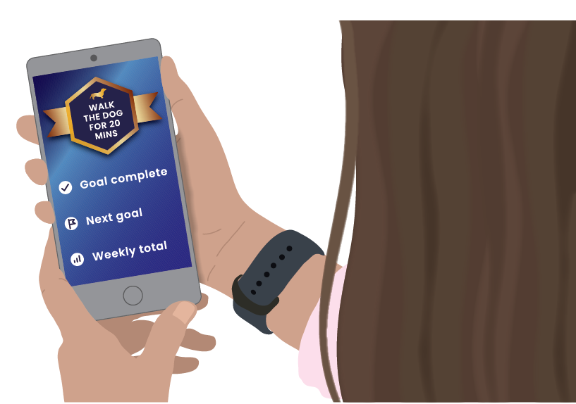
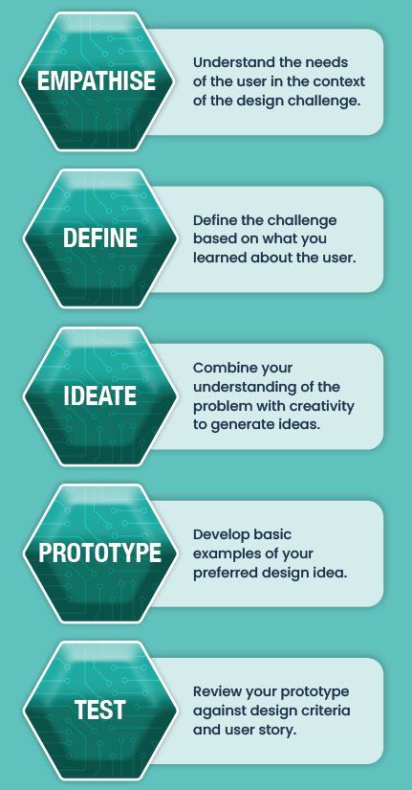
Overview of design thinking
Digital Technologies Hub is brought to you by the Australian Government Department of Education. Creative Commons Attribution 4.0, unless otherwise indicated.
Notes:
With our initial ideas students should have identified a problem of need.
Explain that design thinking is a process to help people develop design ideas in response to a problem or need.
Explain that design thinking helps us generate creative ideas, focusing on understanding user needs.
For example, in app design we need to understand the user and the design challenge.
Once we have defined the challenge we can generate design ideas, then choose our preferred design idea and develop a prototype to test our ideas.
But to bring those ideas to life in a structured way, we use project management to organise tasks, set timelines, and as a way to keep your team on track.

Slide 6
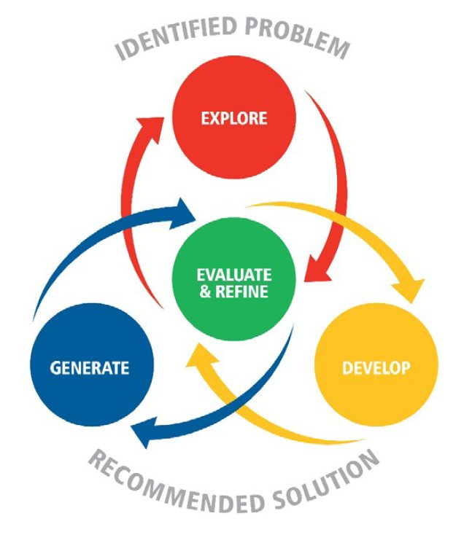
EDGE problem-solving framework
Problem-solving process in Digital Solutions (QCAA, 2019).
Digital Technologies Hub is brought to you by the Australian Government Department of Education. Creative Commons Attribution 4.0, unless otherwise indicated.
Notes:
As an alternative to design thinking you may decide to use the EDGE framework. Developing with EDGE: https://learnedge.com.au/

Slide 7
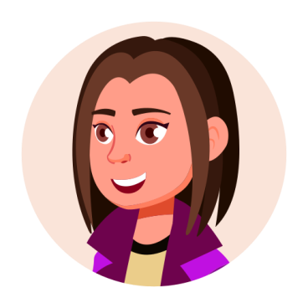
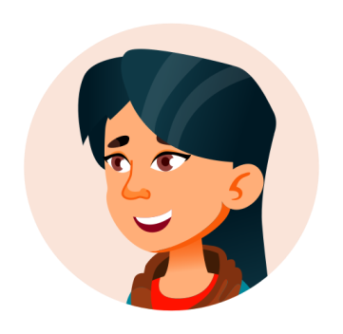
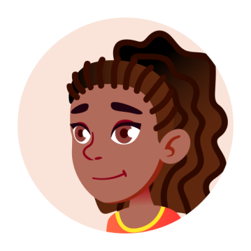
Designing + Managing: How do we organise it all?
Managing a project
What do you think are key elements that will help you manage a project?
How will you stay organised and keep on track?
We’ll use project management thinking and tools to keeps our ideas on track!
Images: Flaticon.com
Digital Technologies Hub is brought to you by the Australian Government Department of Education. Creative Commons Attribution 4.0, unless otherwise indicated.
Notes:
Raise the problem of how to organise and manage a project.
Encourage them to think about an approach that will help their team organise, plan, and deliver their design project efficiently and effectively.
Image source:
https://www.flaticon.com/free-icon/people_13848080?term=girl+teen&page=1&position=68&origin=search&related_id=13848080
https://www.flaticon.com/free-icon/avatar_13848246?related_id=13848246
https://www.flaticon.com/free-icon/black_13847759?term=girl+teen&page=1&position=50&origin=search&related_id=13847759
https://www.flaticon.com/free-icon/project-management_4844359?term=timeline&related_id=4844359
https://www.flaticon.com/free-icon/task_17597593?term=small+tasks&page=1&position=2&origin=search&related_id=17597593
https://www.flaticon.com/free-icon/collaborative_4959502?term=collaborate&page=1&position=87&origin=search&related_id=4959502
https://www.flaticon.com/free-icon/focus_8759352?term=goal+setting&page=3&position=2&origin=search&related_id=8759352

Slide 8


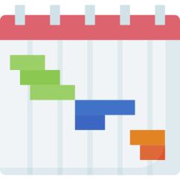

Overview of project management
Define the project
Set clear goals
Manage tasks
Break down the project into tasks
Organise the tasks into lists or boards
Assign responsibility
Schedule tasks
Define deliverables or milestones
Set deadlines
Create a timeline
Communicate and collaborate
Use digital tools to share and record ideas
Set up regular meetings to enable updates on task progress
Images: Flaticon.com
Digital Technologies Hub is brought to you by the Australian Government Department of Education. Creative Commons Attribution 4.0, unless otherwise indicated.
Notes:
Provide a some guidelines of the typical elements of project management.
Explain that the aim is to provide an approach that will help their team organise, plan, and deliver their collaborative design project efficiently and effectively.
Mention that the key stages should focus on identifying and breaking down the whole project into smaller sub tasks, to assign those tasks to a team member who is responsible for its completion, and to track progress ensuring that the project stays on track and is completed successfully and on time.
Image source:
https://www.flaticon.com/free-icon/people_13848080?term=girl+teen&page=1&position=68&origin=search&related_id=13848080
https://www.flaticon.com/free-icon/avatar_13848246?related_id=13848246
https://www.flaticon.com/free-icon/black_13847759?term=girl+teen&page=1&position=50&origin=search&related_id=13847759
https://www.flaticon.com/free-icon/project-management_4844359?term=timeline&related_id=4844359
https://www.flaticon.com/free-icon/task_17597593?term=small+tasks&page=1&position=2&origin=search&related_id=17597593
https://www.flaticon.com/free-icon/collaborative_4959502?term=collaborate&page=1&position=87&origin=search&related_id=4959502
https://www.flaticon.com/free-icon/focus_8759352?term=goal+setting&page=3&position=2&origin=search&related_id=8759352

Slide 9


Understanding the user
The more you understand the people who you’re designing for, the better you can solve their problems.
Empathy helps you create solutions that truly meet their needs and improve their lives.
Understand their thoughts, feelings and experiences before you start designing solutions for them.
Images: Flaticon.com
Digital Technologies Hub is brought to you by the Australian Government Department of Education. Creative Commons Attribution 4.0, unless otherwise indicated.
Notes:
Discuss the importance of knowing the user; who are you designing for?
Introduce three approaches to know the user and finding out more about the design challenge or context.
Explain what empathising is all about.
https://www.flaticon.com/free-icon/crowd-of-users_33887?term=user&page=2&position=75&origin=tag&related_id=33887

Slide 10

Gathering user insights
Just as developers create user stories to guide their work, we can also use them to influence our design decisions.
Interviewing users helps us gather valuable perspectives and insights.
We can acquire data about the design context and users, then analyse it to uncover patterns that inform our design decisions.
Images: Flaticon.com
Digital Technologies Hub is brought to you by the Australian Government Department of Education. Creative Commons Attribution 4.0, unless otherwise indicated.
Notes:
Discuss the importance of knowing the user; who are you designing for?
Introduce three approaches to know the user and finding out more about the design challenge or context.

Slide 11

What is a user story?
A user story describes a feature from the user's perspective, focusing on their need.
We can develop user stories to identify the user role, their goal, and why that goal is important.
Use the format:
As a [user role]
I want to [goal]
so that [reason]
Image: Flaticon.com
Digital Technologies Hub is brought to you by the Australian Government Department of Education. Creative Commons Attribution 4.0, unless otherwise indicated.
Notes:
Walk through the format of a user story.

Slide 12

A user story example
Imagine you’re designing a wellness app for teens that encourages positive habits. Here’s a user story that reflects a feature they might want.
As a teenager
I want to receive daily challenges, so that I can stay motivated, build healthy habits, and earn rewards for my progress.
Can you identify the user’s role, their goal and why it is important to them?
Image: Flaticon.com
Digital Technologies Hub is brought to you by the Australian Government Department of Education. Creative Commons Attribution 4.0, unless otherwise indicated.
Notes:
Walk through the format of a user story with a relevant example.
User’s role: Teenager
User’s goal: To receive daily challenges
Why it’s important: To stay motivated, build healthy habits, and earn rewards for progress
https://www.flaticon.com/free-icon/avatar_14465285?term=teenager&page=2&position=21&origin=tag&related_id=14465285

Slide 13
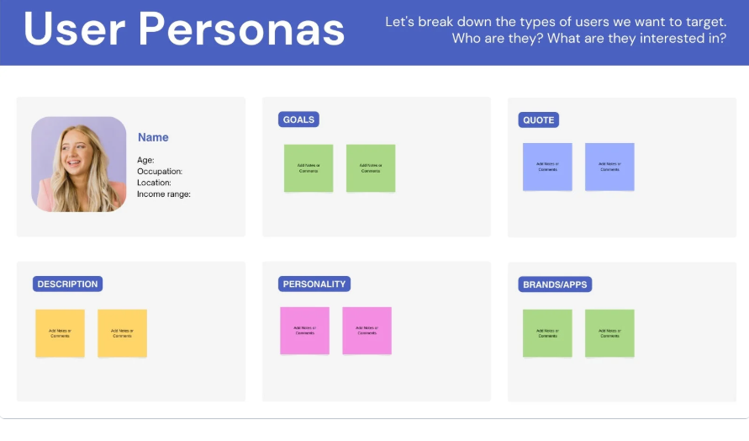
What is a user persona?
User personas are made to tap into the real needs of our users beyond features and designs.
This is where you can pick up on things like language choices, sizes of elements, and complexities of your applications that can make a big difference for users.
Image: Canva User persona template
Digital Technologies Hub is brought to you by the Australian Government Department of Education. Creative Commons Attribution 4.0, unless otherwise indicated.
Notes:
Walk through the format of a user story.

Slide 14
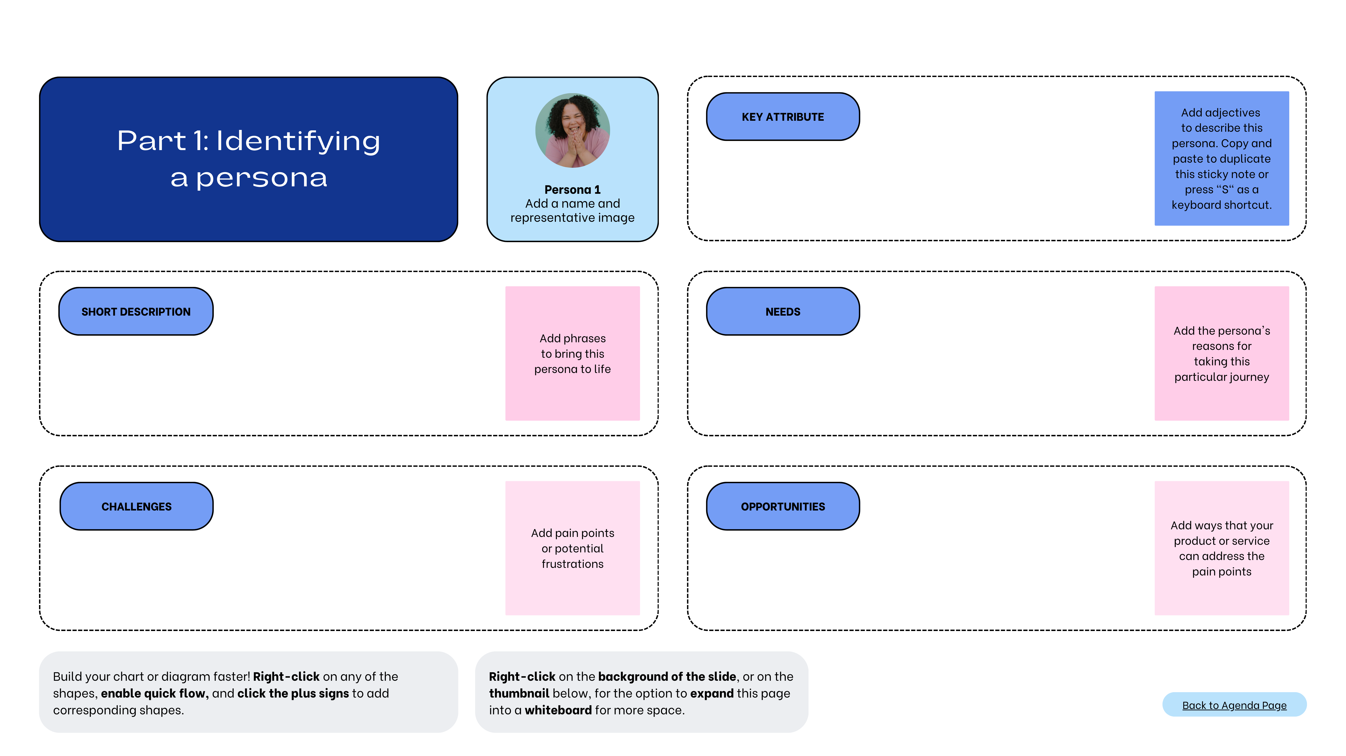
User persona template
Image: Canva User persona template
Digital Technologies Hub is brought to you by the Australian Government Department of Education. Creative Commons Attribution 4.0, unless otherwise indicated.
Notes:
Walk through the format of a user story.

Slide 15

User interviews
The goal of user interviews is to understand the user’s pain points, needs and motivations.
In your user interviews check assumptions, gather insights, and deepen your understanding of the target audience.
Image: Flaticon.com
Digital Technologies Hub is brought to you by the Australian Government Department of Education. Creative Commons Attribution 4.0, unless otherwise indicated.
Notes:
Walk through the format of a user interview.

Slide 16
User interview questions
Think about the types of questions that will give you insight into the design context or challenge.
How much time do you usually spend on this activity?
What was it like the last time you tried to tackle this challenge?
What’s the hardest part about achieving this goal?
What would make this process easier?
Are you looking for a better way to handle this challenge?
Image: Flaticon.com
Digital Technologies Hub is brought to you by the Australian Government Department of Education. Creative Commons Attribution 4.0, unless otherwise indicated.
Notes:
Discuss the types of questions they might use for their interview.

Slide 17

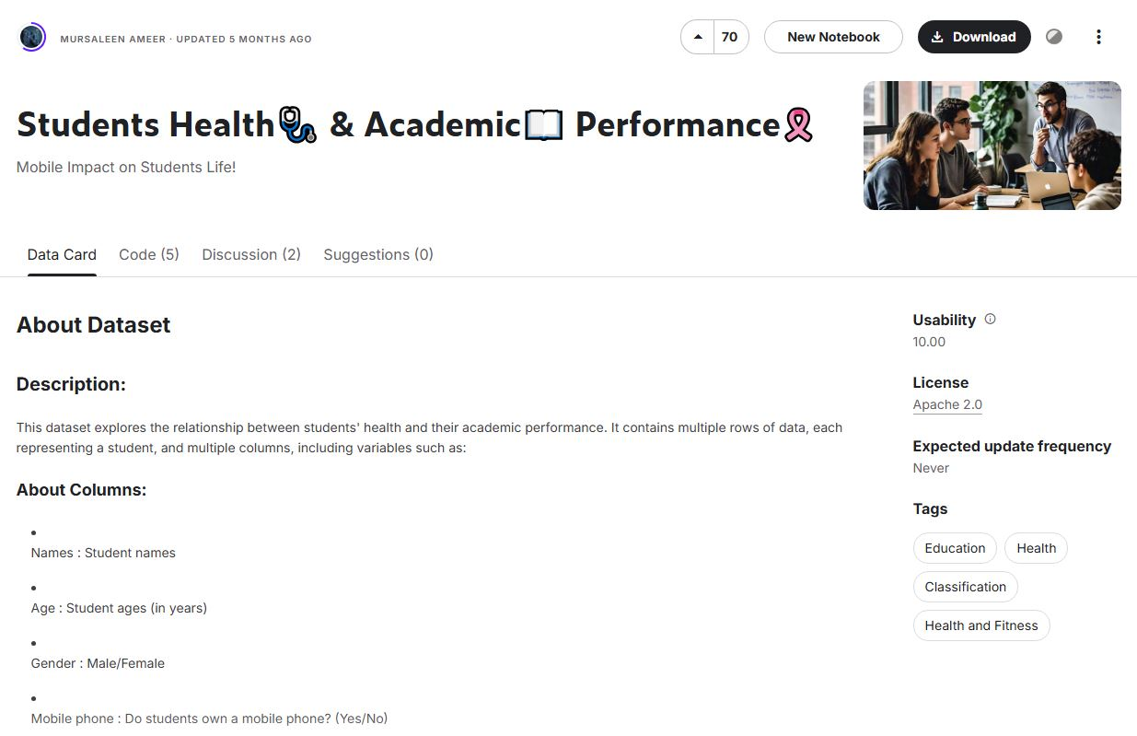

Acquire data
Use an online form or paper survey to gather data to learn more about the users and the design context.
Access data from online repositories such as Kaggle, to gather insights from similar users.
Images: Flaticon.com
Digital Technologies Hub is brought to you by the Australian Government Department of Education. Creative Commons Attribution 4.0, unless otherwise indicated.
Notes:
Discuss data acquisition techniques.
https://www.flaticon.com/free-icon/online-survey_10898277?term=survey&page=1&position=70&origin=search&related_id=10898277

Slide 18

Analyse the data
Analyse the feedback from your surveys and data from online repositories to understand patterns and refine your design.
Images: Flaticon.com
Digital Technologies Hub is brought to you by the Australian Government Department of Education. Creative Commons Attribution 4.0, unless otherwise indicated.
Notes:
Discuss data acquisition techniques.
https://www.flaticon.com/free-icon/online-survey_10898277?term=survey&page=1&position=70&origin=search&related_id=10898277

Slide 19
Using project management tools
Looking for a way to manage tasks?
Productivity tools like Trello and Notion can help you organise the tasks into boards and assign responsibility.
You can then track and monitor each task and move it along your workflow.
Need to communicate and collaborate?
Use Zoom or Teams to meet to connect, share information, and work together remotely.
Consider using AI-powered notetaking and summarising tools (like those in Teams), then remove any personal data and input it into ChatGPT for a summary.
Digital Technologies Hub is brought to you by the Australian Government Department of Education. Creative Commons Attribution 4.0, unless otherwise indicated.
Notes:
A reminder of what happens at this stage: - User stories - Interviewing stakeholders - Acquiring data (integrating some data analysis techniques) Project management and collaboration at this stage: - Agile principles - Tools (e.g. Microsoft Teams, Zoom, Miro, but also notepaper, AI-based note recording and summarising)

