Slide 1
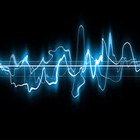

Converting sound into digital data
Image source Wikipedia: Sound wave.jpg

Slide 2
Sound waves
Sound is carried through the air by changes in air pressure.
We think of this as wavy lines, but computers don't understand wavy lines, so we need to change them into a different kind of language that computers can understand.
Image source Wikipedia: Sound wave.jpg

Slide 3
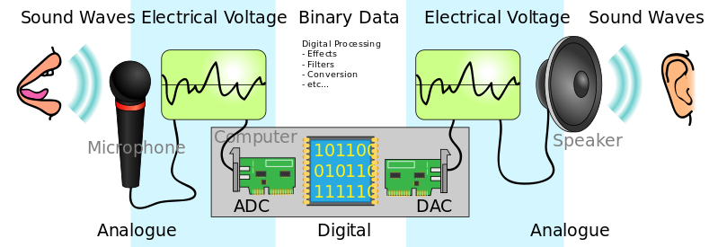
Analog-to-Digital Converter (ADC).
To do this, we use something called an Analog-to-Digital Converter (ADC).
Image source Wikipedia : File:CPT-Sound-ADC-DAC.svg

Slide 4
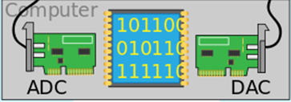
How an ADC works
The ADC takes ‘pictures’ of the sound wave at certain points.
It takes these ‘pictures’ regularly, like every little bit of time.
Each ‘picture’ is like a snapshot of the sound wave at that moment.
Image source Wikipedia : File:CPT-Sound-ADC-DAC.svg

Slide 5
An ADC working
Once the ADC has taken all these ‘pictures’, it turns them into numbers.
Image source Wikipedia : File:CPT-Sound-ADC-DAC.svg

Slide 6
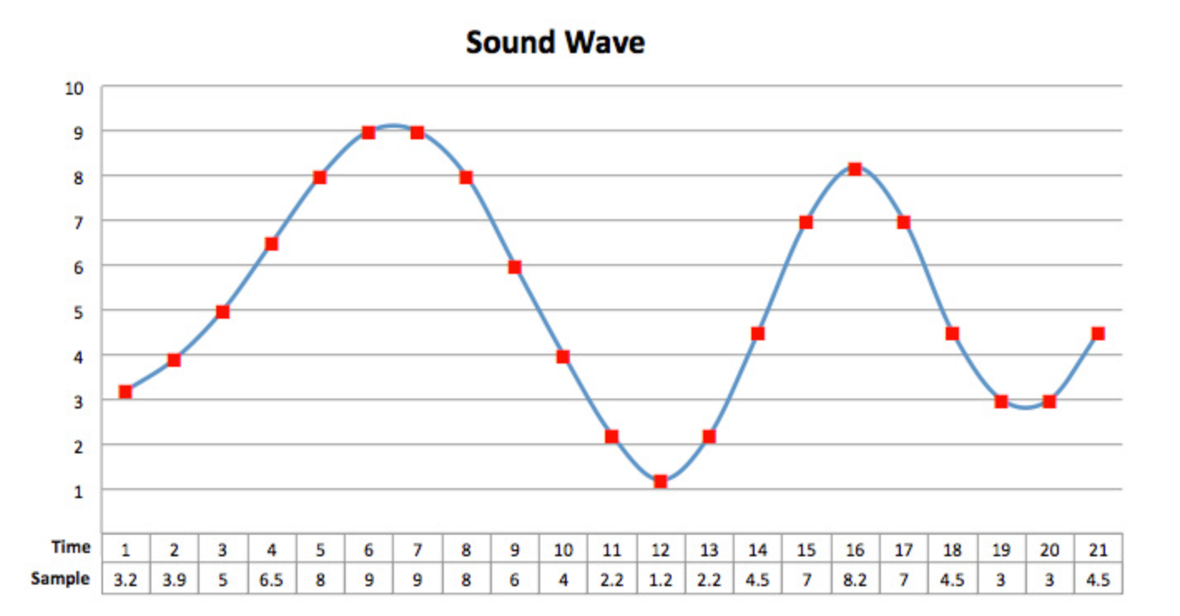
Sound wave graph
These numbers are like codes that the computer can read.
It’s a way of storing the sound wave in digital form so the computer can process it.
Image source Wikipedia : File:CPT-Sound-ADC-DAC.svg

Slide 7
Sound wave and sample rate
Sample rate
Refers to the number of samples taken per second.
When converting sound waves to digital form, each sample needs to be represented by a binary number.
The sample rate determines how frequently these samples are taken and have binary values assigned to them.

Slide 8
What is sample rate?
Sample rate
For example, if we have a sample rate of 44,100 samples per second, it means we take 44,100 snapshots of the sound wave every second, and each snapshot is represented by a binary number.

Slide 9
Bit rate
Bitrate
The bitrate is the number of bits used to store each sample.
Instead of values between 0 and 10, an 8-bit bitrate allows for whole numbers from 00000000 (decimal 0) to 11111111 (decimal 255).

Slide 10
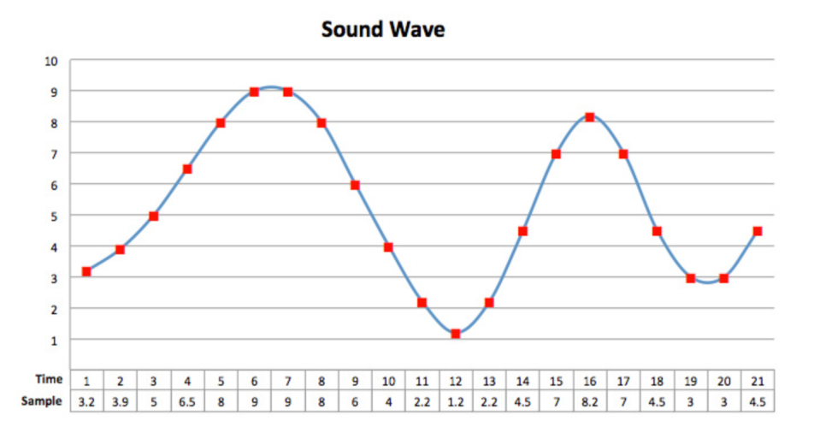
Converting a sound wave into a digital file
Imagine you have a sound wave that you want to convert into a digital file.
To do this, you need to take samples of the sound wave at regular intervals and represent them using binary numbers.

Slide 11
Converting a sound wave
Sample rate
Let’s say we have a sample rate of 4 samples per second.
It means we take 4 snapshots of the sound wave every second.
To represent each sample in binary, we can use a single digit (bit). Let's take four samples at different moments.

Slide 12
Converting a sound wave into a digital file: sample rate
Sample rate
Four samples taken at different moments:
Sample 1: The sound wave is at a high point
-> We represent it as 1.
Sample 2: The sound wave is at a low point
-> We represent it as 0.
Sample 3: The sound wave is at a middle point
-> We represent it as 0.
Sample 4: The sound wave is at a high point
-> We represent it as 1.
So, using a sample rate of 4 samples per second, we would have the binary sequence: 1001.

Slide 13
Converting a sound wave into a digital file:
Bit rate
Bitrate
The bitrate is the number of bits used to store each sample.
Instead of values between 0 and 10, an 8-bit bitrate allows for whole numbers from 00000000 (decimal 0) to 11111111 (decimal 255).

Slide 14
Bitrate and controlling distortion
Increasing the bitrate to 16-bits allows for whole numbers from 00000000 00000000 (decimal 0) to 11111111 11111111 (decimal 65535).
This allows more accurate sample values. To our ear, this means less distortion in the sound.

Slide 15
Example: converting sound wave into a digital file
An example:
First sample: 10
-> In binary, it represents the number 2.
Second sample: 10
-> In binary, it represents the number 2.
So, using a bit rate of three bits per sample, our sound wave can be represented by the numbers 2 and 2.

Slide 16
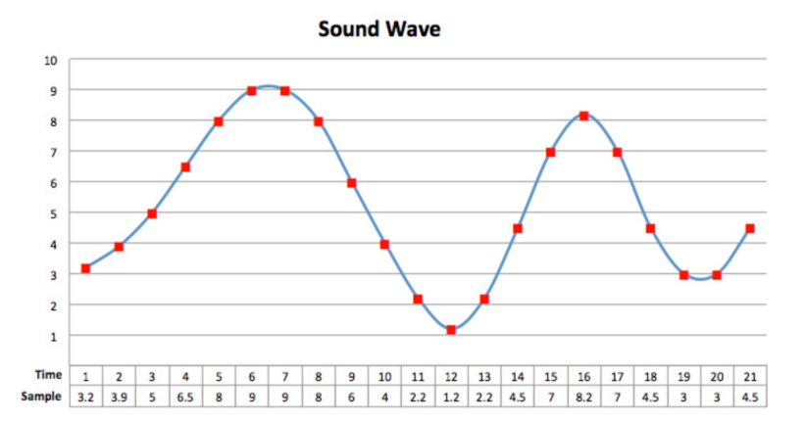
Summary
The sample rate determines how often we take snapshots of the sound wave and represent them using binary.
The bitrate determines the number of bits used to store each sample, allowing us to represent more detailed information about the sound wave.

Slide 17
Helpful terms
Terms that will help you understand how this transformation to sound waves happens.
Digital audio: Digital audio is when we take sound waves and change them into numbers that computers can work with. It’s like translating the language of sound into a language that computers can understand.
Analog-to-Digital Conversion (ADC): Analog-to-Digital Conversion is the process of changing the continuous sound waves into individual numbers. It’s like taking a picture of the sound wave at regular intervals and writing down the numbers that represent its loudness.

Slide 18
Helpful terms (cont.)
Sampling: Sampling is the name given to this picture-taking process. We take small snapshots of the sound wave at specific times. The more snapshots we take, the better quality the digital representation will be.
Bit depth: Bit depth tells us how detailed each snapshot is. It's like how many colours we can use to paint each snapshot. The more colours we have, the more details we can capture.

