Slide 1

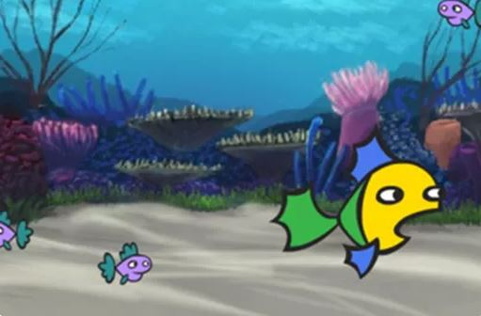

Game design
Create your own mini-game
Digital Technologies Hub is brought to you by the Australian Government Department of Education. Creative Commons Attribution 4.0, unless otherwise indicated.

Slide 2



Designing a mini-game
What is your game about? Who will play it? What is the purpose of the game?
Who are the characters?
What is the theme?
What is the goal of each level?
How does the player progress?
How do you code the game?
Images: Flaticon.com
Digital Technologies Hub is brought to you by the Australian Government Department of Education. Creative Commons Attribution 4.0, unless otherwise indicated.
Notes:
In this session, we will consider these questions to guide our design.
Ghost free icon
https://www.flaticon.com/free-icon/ghost_11378546?related_id=11378546
Game free icon
https://www.flaticon.com/free-icon/game_13129048?term=pacman&page=1&position=4&origin=search&related_id=13129048
Labyrinth free icon
https://www.flaticon.com/free-icon/labyrinth_3874609?term=maze+game&page=1&position=43&origin=search&related_id=3874609

Slide 3
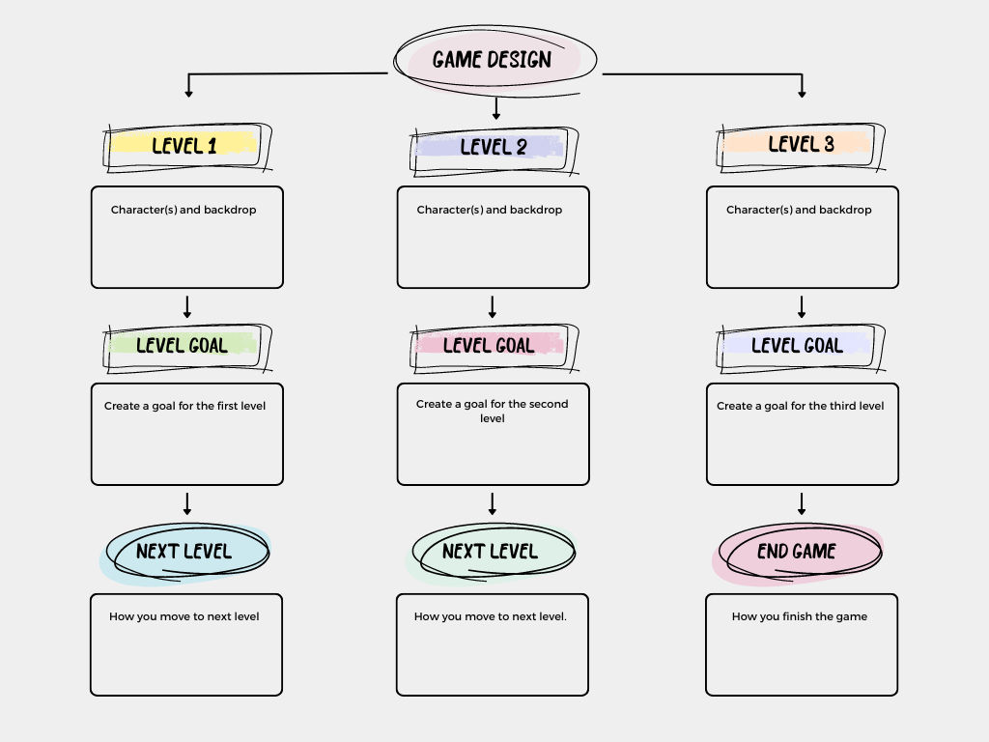
A three-level mini-game
Images: Designed in Canva
Digital Technologies Hub is brought to you by the Australian Government Department of Education. Creative Commons Attribution 4.0, unless otherwise indicated.
Notes:
We will use this template to help design our game and record our ideas.
The idea is to capture what the overall game is about and what happens at each level.
Who are the game's characters? What are their backgrounds?
What is the goal of each level? How do players progress?

Slide 4
What is the objective?
What is the purpose or goal of your game?
Does the player:
collect or find things?
hit a target?
save something or someone?
build something?
solve a puzzle or problem?
need to get somewhere?
Images: Flaticon.com
Digital Technologies Hub is brought to you by the Australian Government Department of Education. Creative Commons Attribution 4.0, unless otherwise indicated.
Notes:
To start with, identify the objective (the purpose or goal of the game).
Ghost free icon
https://www.flaticon.com/free-icon/ghost_11378546?related_id=11378546
Game free icon
https://www.flaticon.com/free-icon/game_13129048?term=pacman&page=1&position=4&origin=search&related_id=13129048
Labyrinth free icon
https://www.flaticon.com/free-icon/labyrinth_3874609?term=maze+game&page=1&position=43&origin=search&related_id=3874609

Slide 5

What is the theme? Space?
Digital Technologies Hub is brought to you by the Australian Government Department of Education. Creative Commons Attribution 4.0, unless otherwise indicated.
Image: Designed by Wannapik
Notes:
Where will your game take place?
Image source: https://www.wannapik.com/

Slide 6

What is the theme? Gardens?
Images: Designed by Wannapik
Digital Technologies Hub is brought to you by the Australian Government Department of Education. Creative Commons Attribution 4.0, unless otherwise indicated.
Images: Designed by Wannapik
Notes:
Image source: https://www.wannapik.com/

Slide 7

What is the theme? Ancient civilisation?
Images: Designed by Wannapik
Digital Technologies Hub is brought to you by the Australian Government Department of Education. Creative Commons Attribution 4.0, unless otherwise indicated.
Images: Designed by Wannapik
Notes:
Image source: https://www.wannapik.com/

Slide 8
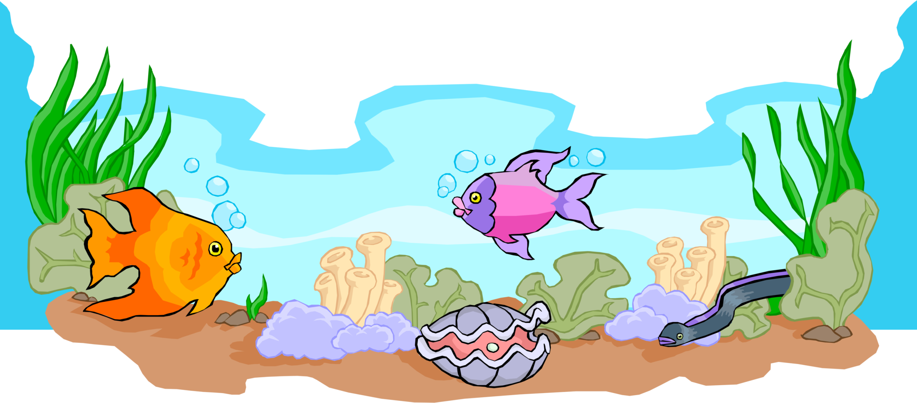
What is the theme? Under the sea?
Images: Designed by Wannapik
Digital Technologies Hub is brought to you by the Australian Government Department of Education. Creative Commons Attribution 4.0, unless otherwise indicated.
Images: Designed by Wannapik
Notes:
Image source: https://www.wannapik.com/

Slide 9
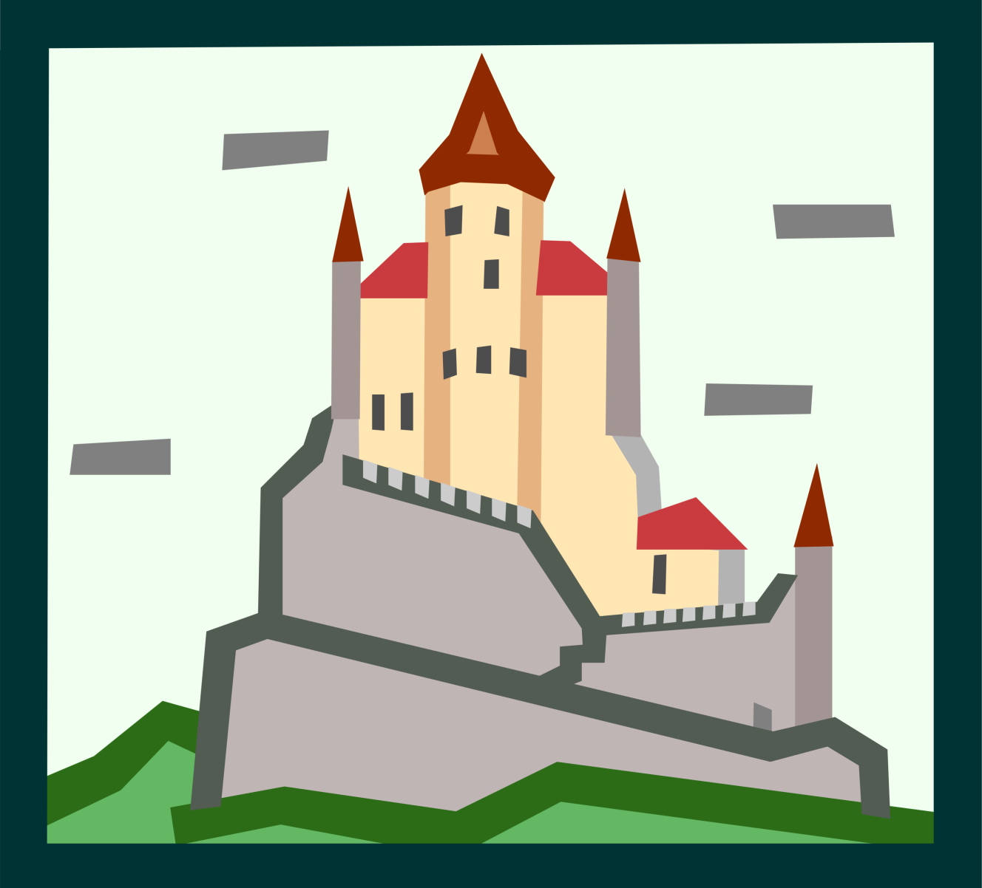
What is the theme? Fantasy?
Images: Designed by Wannapik
Digital Technologies Hub is brought to you by the Australian Government Department of Education. Creative Commons Attribution 4.0, unless otherwise indicated.
Images: Designed by Wannapik
Notes:
Image source: https://www.wannapik.com/

Slide 10



What is the theme? Dinosaurs?
Images: Designed by Wannapik
Digital Technologies Hub is brought to you by the Australian Government Department of Education. Creative Commons Attribution 4.0, unless otherwise indicated.
Notes:
Image source: https://www.wannapik.com/

Slide 11

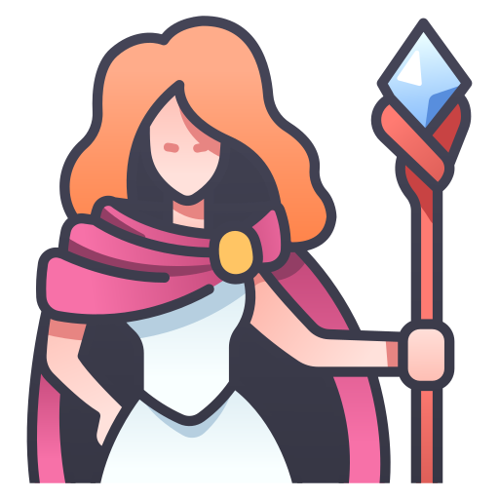
Who is the main character?
What is their role?
Do they have:
unique abilities?
important knowledge?
special powers?
Do they have:
opponents or obstacles?
enemies, rivals or villains?
Magician: Flaticon.com
Castle: Designed by Wannapik
Digital Technologies Hub is brought to you by the Australian Government Department of Education. Creative Commons Attribution 4.0, unless otherwise indicated.

Slide 12
Progressing to the next level
What does each level look like?
How do players get from one level to the next?
Does the player need to:
collect a key to unlock a door?
reach a certain score?
find an exit through a maze?
solve a problem or puzzle?
Images: Flaticon.com
Digital Technologies Hub is brought to you by the Australian Government Department of Education. Creative Commons Attribution 4.0, unless otherwise indicated.

Slide 13
Next level: make it more challenging
How will it get harder?
More enemies?
Collect more items?
More difficult puzzle or problem?
New setting?
Complete task within a time limit?
Images: Flaticon.com
Digital Technologies Hub is brought to you by the Australian Government Department of Education. Creative Commons Attribution 4.0, unless otherwise indicated.

Slide 14
Scoring, lives and timer
Coding skills required:
To include elements such as scoring, lives and using a timer you need to be able to program using a variable.
Images: Flaticon.com
Digital Technologies Hub is brought to you by the Australian Government Department of Education. Creative Commons Attribution 4.0, unless otherwise indicated.

Slide 15
A three-level mini-game
Images: Designed in Canva
Digital Technologies Hub is brought to you by the Australian Government Department of Education. Creative Commons Attribution 4.0, unless otherwise indicated.
Notes:
Using our template, let's look at an example level.

Slide 16
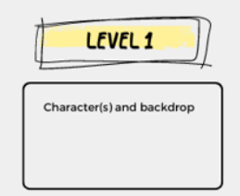



Level 1 example: characters and backdrop
Characters/sprites
Backdrop/scene
Images: Flaticon.com
Digital Technologies Hub is brought to you by the Australian Government Department of Education. Creative Commons Attribution 4.0, unless otherwise indicated.
Notes:
In the program Scratch, a character or object is called a sprite.

Slide 17
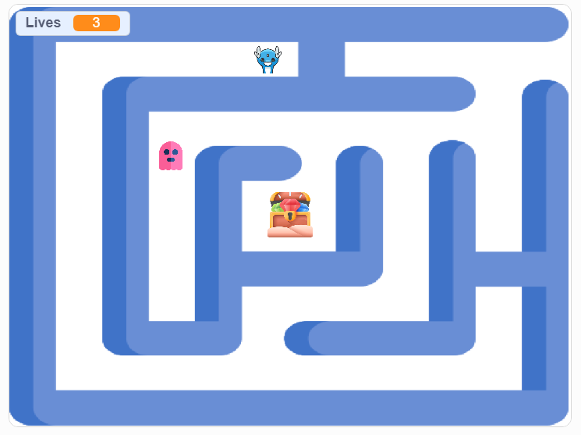
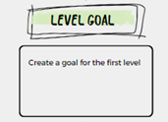
Goal: reach the treasure before getting caught by the ghost
Images: Flaticon.com
Maze Designed by Wannapik
Digital Technologies Hub is brought to you by the Australian Government Department of Education. Creative Commons Attribution 4.0, unless otherwise indicated.
Notes:
Talk through a typical example, such as: a hero, an enemy, and a treasure.
If the pink ghost touches the blue dragon, then game over
If the ghost reaches the treasure then you win
https://scratch.mit.edu/projects/1046454937

Slide 18
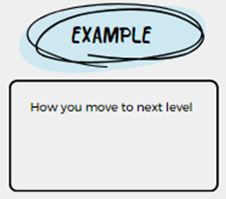
When you reach the treasure, you unlock the next level
Images: Flaticon.com
Maze Designed by Wannapik
Digital Technologies Hub is brought to you by the Australian Government Department of Education. Creative Commons Attribution 4.0, unless otherwise indicated.
Notes:
https://scratch.mit.edu/projects/1046454937

Slide 19

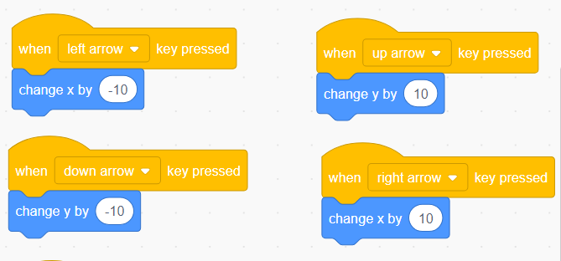





Coding movement
How do we make them stay within the maze?
Move the dragon with arrow keys.
We want the ghost to move automatically within the maze.
Image: Flaticon.com
Digital Technologies Hub is brought to you by the Australian Government Department of Education. Creative Commons Attribution 4.0, unless otherwise indicated.
Notes:
Communication free icon
https://www.flaticon.com/free-icon/communication_3820107?term=communication+two+people&page=1&position=1&origin=search&related_id=3820107

Slide 20
Code
To keep in the maze:
If the dragon or ghost touches the colour , then … move back.
If the dragon touches the treasure, then … you win.
If the ghost catches the dragon, then … game over.
Image: Flaticon.com
Digital Technologies Hub is brought to you by the Australian Government Department of Education. Creative Commons Attribution 4.0, unless otherwise indicated.

Slide 21
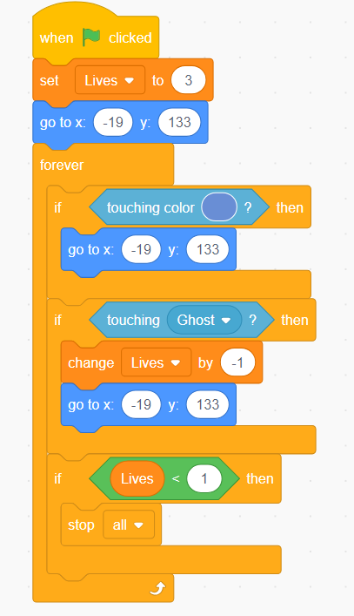
Predicting the code
Starts with 3 lives.
If touching blue maze wall go back to start
Loses a life if ghost catches dragon.
If lives are less than 1, then game over.
Image: Flaticon.com
Digital Technologies Hub is brought to you by the Australian Government Department of Education. Creative Commons Attribution 4.0, unless otherwise indicated.

Slide 22
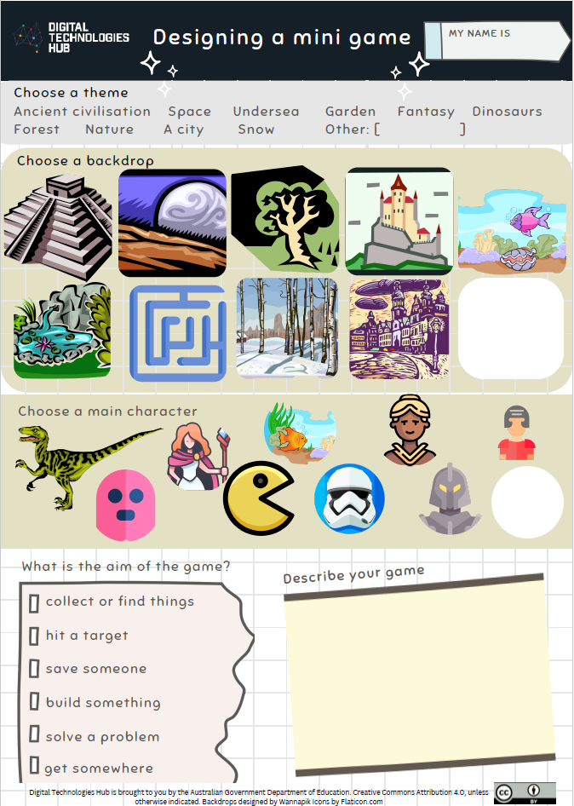

Generate designs: one level
Image: Flaticon.com
Digital Technologies Hub is brought to you by the Australian Government Department of Education. Creative Commons Attribution 4.0, unless otherwise indicated.
Notes:
Branding free icon
https://www.flaticon.com/free-icon/branding_1312313?term=generate+designs&page=1&position=15&origin=search&related_id=1312313

Slide 23
Generate designs: three levels
What is your three-level game?
What is your game about and who will play it?
What is the purpose?
Who are the characters?
What is the theme?
What is the goal of each level?
How does the player progress?
What do players need to know?
How will you code the game?
Image: Flaticon.com
Digital Technologies Hub is brought to you by the Australian Government Department of Education. Creative Commons Attribution 4.0, unless otherwise indicated.
Notes:
Branding free icon
https://www.flaticon.com/free-icon/branding_1312313?term=generate+designs&page=1&position=15&origin=search&related_id=1312313

Slide 24
Lesson plans
Teacher lesson plans available on DT Hub
Years 3–4 Creating a mini-game
Years 5–6 Creating a mini-game with variables
Digital Technologies Hub is brought to you by the Australian Government Department of Education. Creative Commons Attribution 4.0, unless otherwise indicated.

