Slide 1


Binary acknowledgement of Country
Digital Technologies Hub is brought to you by the Australian Government Department of Education. Creative Commons Attribution 4.0, unless otherwise indicated.
Notes:
Note there is teacher background information on Acknowledgement of Country that is part of this resource set that can be located in the lesson accompanying this resource.

Slide 2
What do you notice?
What do you wonder?
A
0100 0001
b
o
r
i
g
i
n
a
0110 0001
l
Digital Technologies Hub is brought to you by the Australian Government Department of Education. Creative Commons Attribution 4.0, unless otherwise indicated.
Notes:
Some points to cover to prompt and direct thinking:
What do you notice about the letters, squares and numbers?
How many squares do you notice in a row?
Do you notice any patterns?
What might the squares show or represent?
Can you see any relationship between the squares and numbers made up of ones and zeros?
Point out if not noticed that the binary number of ‘A’ is 0100 0001 and that ‘a’ is represented by 0110 0001.
Why might these need to be different? Each letter has a lower case and a capital letter representation.
Students may notice most of the lower-case letters start with black square, two white squares and a black square (apart from ‘r’)
Some students may wonder how other words might be represented in binary.

Slide 3
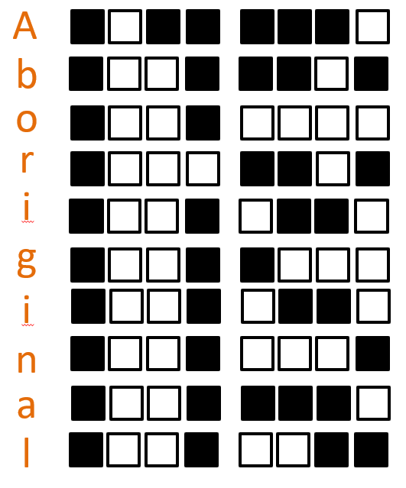
Match the binary number to the correct letter
0100 0001
Drag these to the correct letter.
0111 0010
0110 1100
0110 1111
0110 0001
Digital Technologies Hub is brought to you by the Australian Government Department of Education. Creative Commons Attribution 4.0, unless otherwise indicated.
Notes:
Before matching and dragging the three binary numbers to the correct letter …
Ensure that students have made the connection that the binary number of ‘A’ is 0100 0001 and that ‘a’ is represented by 0110 0001.
How do they know what binary number goes with what letter?
Explain that the 0 represents an off state, which we see represented as black.
Explain that the 1 represents an on state, which we see represented as white.

Slide 4
Match the binary number to the correct letter (answers)
0100 0001
0110 1111
0111 0010
0110 0001
0110 1100
Digital Technologies Hub is brought to you by the Australian Government Department of Education. Creative Commons Attribution 4.0, unless otherwise indicated.
Notes:
Let's check our answers.

Slide 5


Traditional Owners
In our Acknowledgement of Country who are the Traditional Owners of the lands on which our school sits?
Digital Technologies Hub is brought to you by the Australian Government Department of Education. Creative Commons Attribution 4.0, unless otherwise indicated.
Notes:
Find out more about the Aboriginal flag and the Torres Strait Islander flag.
https://australian.museum/learn/cultures/atsi-collection/cultural-objects/indigenous-australia-flags/
Image sources:
https://en.wikipedia.org/wiki/Australian_Aboriginal_Flag
https://en.wikipedia.org/wiki/Torres_Strait_Islander_Flag

Slide 6
Representing our local language group in binary
We can make a binary representation of the Traditional Owners and Custodians for our Acknowledgement of Country.
We could use beads made up of two different colours (one light and one dark) to represent each letter.
How many beads will make up each letter?
Digital Technologies Hub is brought to you by the Australian Government Department of Education. Creative Commons Attribution 4.0, unless otherwise indicated.

Slide 7











Binary bead example
B
u
n
u
r
o
n
g
Digital Technologies Hub is brought to you by the Australian Government Department of Education. Creative Commons Attribution 4.0, unless otherwise indicated.
Notes:
This slide has animation linked. The letters are meant to be off-screen. They will be included on the next screen.

Slide 8


Binary bead example (Bunurong People)
u
o
n
g
B
n
u
r
Digital Technologies Hub is brought to you by the Australian Government Department of Education. Creative Commons Attribution 4.0, unless otherwise indicated.

Slide 9
Sample acknowledgement
I begin by acknowledging the local Traditional Owners and Custodians, the __________ People of the land on which we gather today, and their deep feelings of attachment and relationship to this Country.
Digital Technologies Hub is brought to you by the Australian Government Department of Education. Creative Commons Attribution 4.0, unless otherwise indicated.
Notes:
This slide has animation linked. The image is meant to be off-screen. It will be included on the next screen.
Another example is Reconciliation Australia's own Acknowledgement of Country: Reconciliation Australia acknowledges Traditional Owners of Country throughout Australia and recognises the continuing connection to lands, waters and communities. We pay our respect to Aboriginal and Torres Strait Islander cultures; and to Elders past and present.

Slide 10
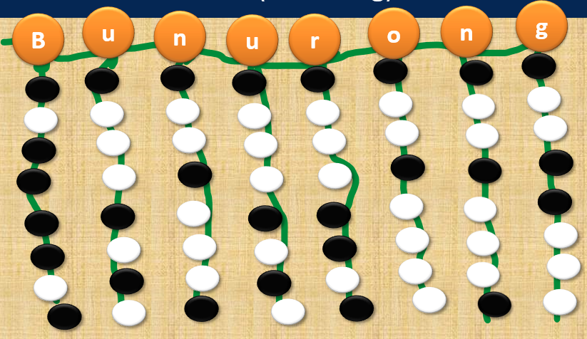
Sample acknowledgement: Bunurong People
I begin by acknowledging the local Traditional Owners and Custodians, the
People of the land on which we gather today, and their deep feelings of attachment and relationship to this Country.
Digital Technologies Hub is brought to you by the Australian Government Department of Education. Creative Commons Attribution 4.0, unless otherwise indicated.

Slide 11
Sample acknowledgment Binary beads: Bunurong
I respect and value the
People’s connection to land, sea, sky and waters and pay my respects to Elders past and present.
Digital Technologies Hub is brought to you by the Australian Government Department of Education. Creative Commons Attribution 4.0, unless otherwise indicated.

Slide 12




Alphabet in binary (A-G)
A |  | a
B |  | b
C |  | c
D |  | d
E |  | e
F |  | f
G |  | g
Digital Technologies Hub is brought to you by the Australian Government Department of Education. Creative Commons Attribution 4.0, unless otherwise indicated.
Notes:
Ask students to notice any patterns from capital letter to lower-case letter representations.

Slide 13


Alphabet in binary H-N
H |  | h
I |  | i
J |  | j
K |  | k
L |  | l
M |  | m
N |  | n
Digital Technologies Hub is brought to you by the Australian Government Department of Education. Creative Commons Attribution 4.0, unless otherwise indicated.

Slide 14

Alphabet in binary (O-U)
O |  | o
P |  | p
Q |  | q
R |  | r
S |  | s
T |  | t
U |  | u
Digital Technologies Hub is brought to you by the Australian Government Department of Education. Creative Commons Attribution 4.0, unless otherwise indicated.
Notes:
Notice what happens after ‘P’ for representation of black and white square sequences.

Slide 15
Alphabet in binary (V-Z)
V |  | v
W |  | w
X |  | x
Y |  | y
Z |  | z
Digital Technologies Hub is brought to you by the Australian Government Department of Education. Creative Commons Attribution 4.0, unless otherwise indicated.

