Slide 1


Data representation: totems and pixel art
Turtle art © Tania Taylor
Digital Technologies Hub is brought to you by the Australian Government Department of Education. Creative Commons Attribution 4.0, unless otherwise indicated.

Slide 2
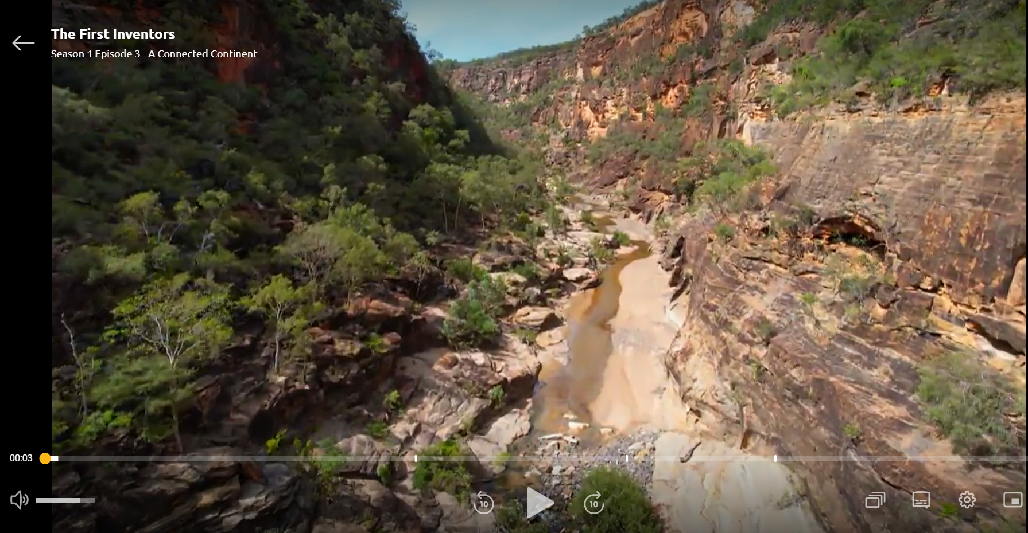
Totems and pixel art
The First Inventors: Episode 3: A Connected Continent
Digital Technologies Hub is brought to you by the Australian Government Department of Education. Creative Commons Attribution 4.0, unless otherwise indicated.
Notes:
View the SBS program, The First Inventors Episode 3: A Connected Continent, story 5: Totems. This can be done as a class or as part of a flipped learning experience.
Discuss as a class what new information was in the story for you. Was there anything you already knew or a piece of information that changed your mind about the way you think about the significance of totems for First Nations Australians?
Discuss how the class might begin to relate to this concept by discussing their favourite animal – would they like to protect it from harm and keep the animal and the environment they need to survive safe?
For information: https://www.sbs.com.au/ondemand/tv-series/the-first-inventors
https://www.sbs.com.au/ondemand/watch/2225052227769 Requires free registration

Slide 3
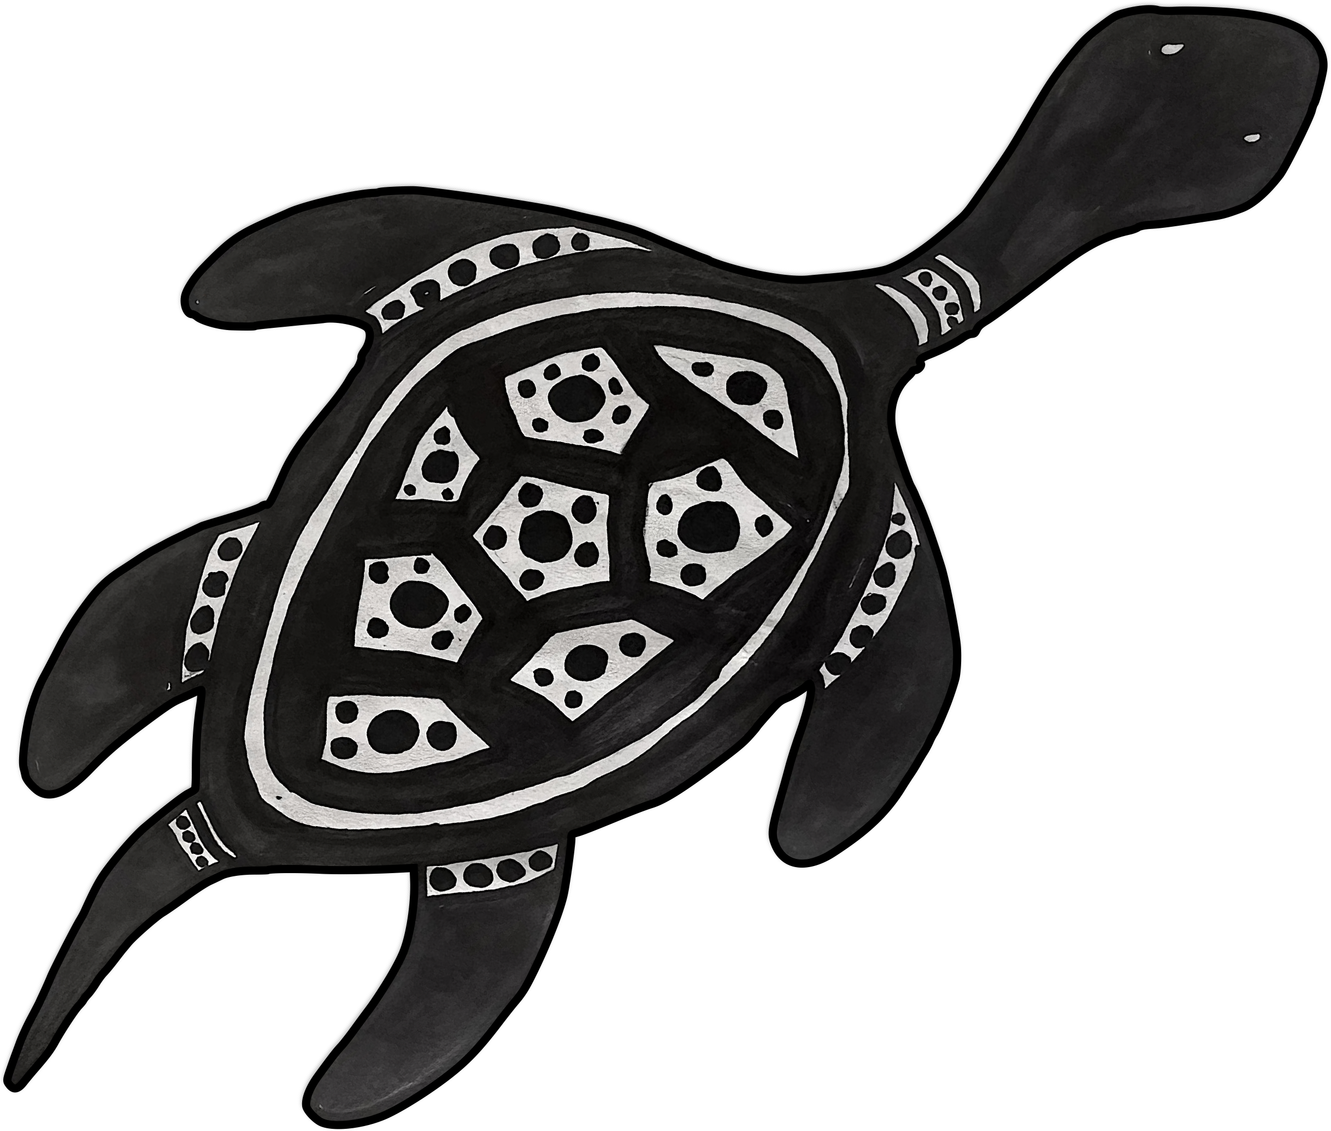
Discussion: kinship and totems
Turtle art © Tania Taylor
What new information was in the story for you?
Was there anything you already knew?
Was there information that changed your mind about
the way you think about something?
How can we relate to the concept of totems and kinship?
Think about your favourite Australian animal.
What would it need in its environment to survive?
Digital Technologies Hub is brought to you by the Australian Government Department of Education. Creative Commons Attribution 4.0, unless otherwise indicated.
Notes:
Class discussion

Slide 4
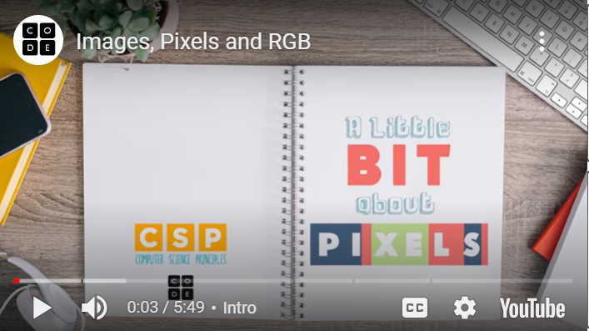
How do computers create images?
Code.org video
Digital Technologies Hub is brought to you by the Australian Government Department of Education. Creative Commons Attribution 4.0, unless otherwise indicated.

Slide 5
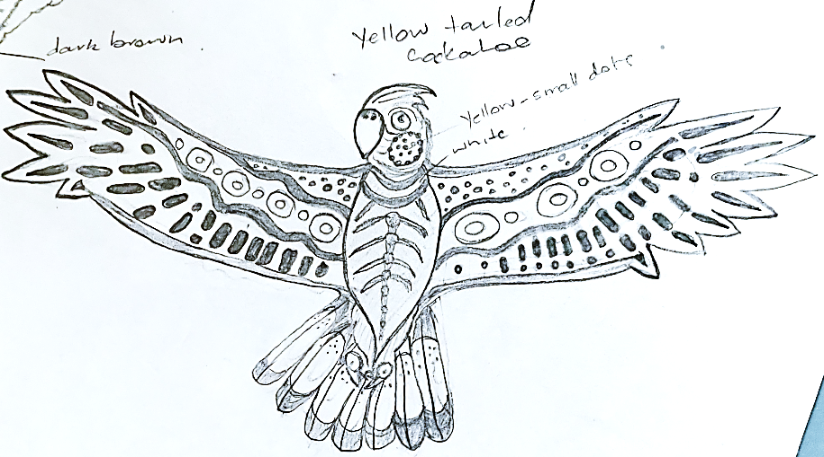
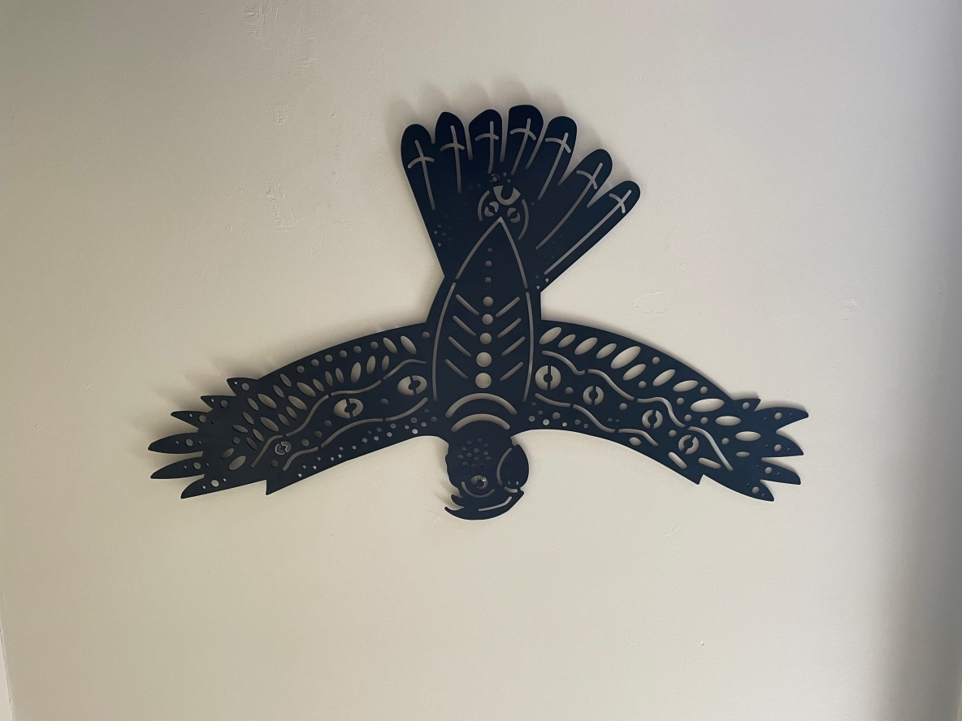
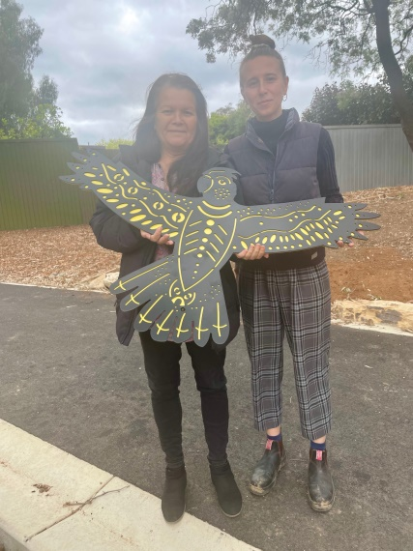
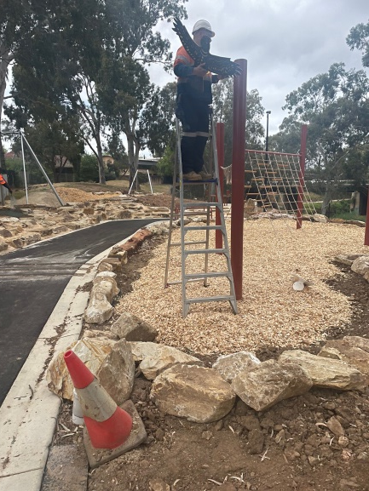
Art by Kaurna, Narrunga and Ngadjuri artist Tania Taylor
1
2
3
4
Digital Technologies Hub is brought to you by the Australian Government Department of Education. Creative Commons Attribution 4.0, unless otherwise indicated.
Notes:
Images 1–4 show Tania Taylor’s process of creating an artwork for a cultural elements installation in a play space in Adelaide, South Australia. Dunstan Adventure Playground, on Karrawirra Pari on Kaurna Country. Note the focus on the simplification of the design elements.
1 First sketch 2 Design for fabrication 3 Fabrication 4 Installation

Slide 6
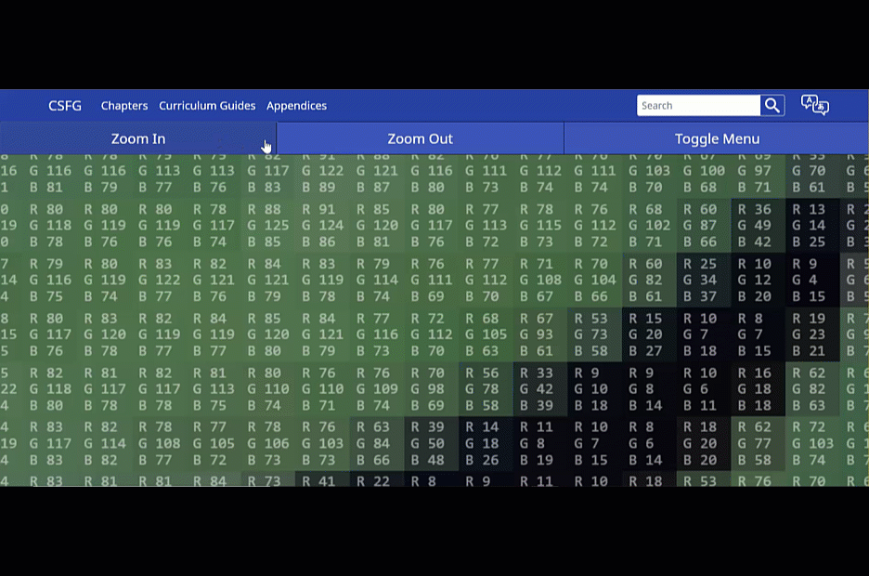
Zooming in on pixels
Digital Technologies Hub is brought to you by the Australian Government Department of Education. Creative Commons Attribution 4.0, unless otherwise indicated.
Notes:
Use this animated gif of zooming out on an image of a kangaroo, shared via Digital Technologies Hub.
https://www.digitaltechnologieshub.edu.au/media/cj0ikojd/ai-and-image-recognition_kangaroo-rgb-colour-coding.gif

Slide 7
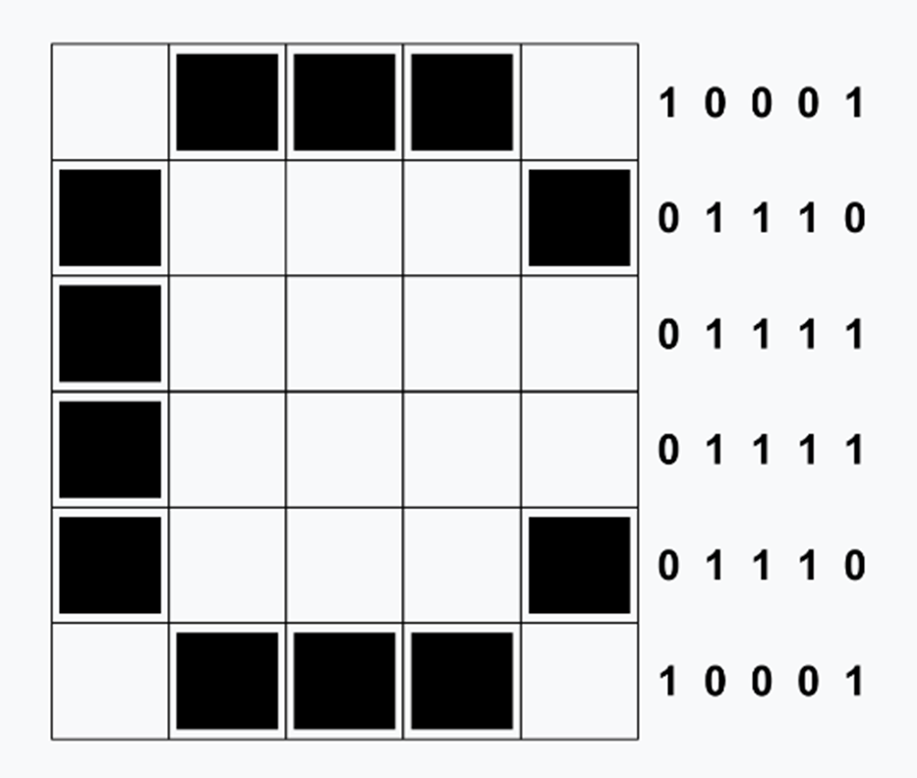
Image representation with binary
Digital Technologies Hub is brought to you by the Australian Government Department of Education. Creative Commons Attribution 4.0, unless otherwise indicated.
Notes:
Demonstrate how to use binary to create an image.
0 = off
1 = on

Slide 8
Image representation: create your own pixel art
Thinking about totems, research an animal that lives on Country where our school is situated or lived here in the past.
Make a list of what kind of environment your animal needs to not only survive but thrive. What, if any, changes would need to be made to our current local environment to facilitate this?
Create a picture of your animal in the style of pixel art (like Minecraft) using graph paper and binary numbers.
Turtle art © Tania Taylor
Digital Technologies Hub is brought to you by the Australian Government Department of Education. Creative Commons Attribution 4.0, unless otherwise indicated.
Notes:
Think about the simplest way to represent this animal as an image. For example, if I draw a square with a triangle on the top and a rectangle in the middle of the square, most people recognise this as a house, despite little detail in the image.

Slide 9
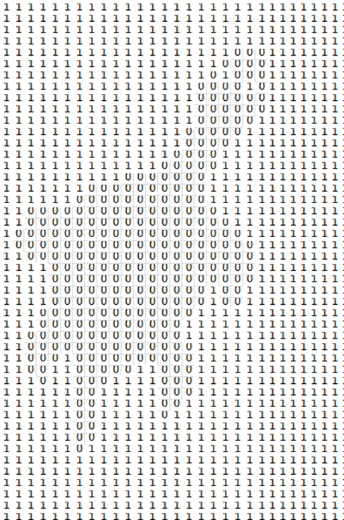

Pixel art practice with Tania Taylor’s turtle
Turtle art © Tania Taylor
Digital Technologies Hub is brought to you by the Australian Government Department of Education. Creative Commons Attribution 4.0, unless otherwise indicated.
Notes:
Student worksheet for practice if needed

Slide 10
Create your own pixel art and binary code
Using graph paper or a spreadsheet application, create pixel art of your chosen animal using black (0=off) and white (1=on).
Write the binary code for the image.
Share the code with a friend and see if they can recreate your image.
Make changes to your binary code to improve it if needed based on feedback from your friend.
Digital Technologies Hub is brought to you by the Australian Government Department of Education. Creative Commons Attribution 4.0, unless otherwise indicated.

