Slide 1


Entry and exit tickets
Digital Technologies Hub is brought to you by the Australian Government Department of Education. Creative Commons Attribution 4.0, unless otherwise indicated.

Slide 2




Entry ticket: What might this represent?
Digital Technologies Hub is brought to you by the Australian Government Department of Education. Creative Commons Attribution 4.0, unless otherwise indicated.
Notes:
Have students share their thoughts about what the sequence of black and white squares might represent.
Present in slide show mode as the slides include animation.

Slide 3
Entry ticket
Now do the lesson.
At the end of the lesson come back to see if you guessed what the black and white squares represent.
Digital Technologies Hub is brought to you by the Australian Government Department of Education. Creative Commons Attribution 4.0, unless otherwise indicated.

Slide 4
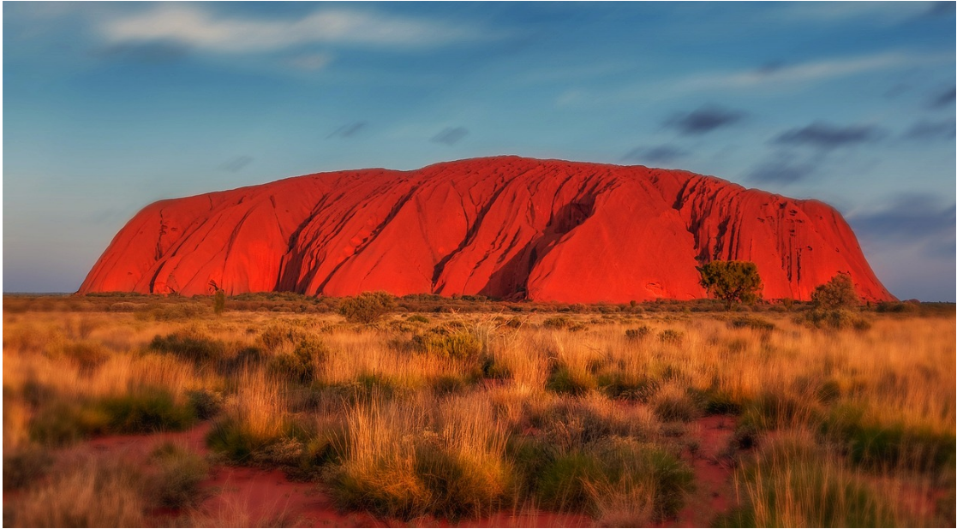
Exit ticket: Here's a clue
Digital Technologies Hub is brought to you by the Australian Government Department of Education. Creative Commons Attribution 4.0, unless otherwise indicated.
Notes:
Image source https://pixabay.com/photos/uluru-australia-monolith-2058380/

Slide 5
Clue 1
U
Digital Technologies Hub is brought to you by the Australian Government Department of Education. Creative Commons Attribution 4.0, unless otherwise indicated.
Notes:
Image source https://pixabay.com/photos/uluru-australia-monolith-2058380/

Slide 6
Clue 2
U
l
Digital Technologies Hub is brought to you by the Australian Government Department of Education. Creative Commons Attribution 4.0, unless otherwise indicated.
Notes:
Image source https://pixabay.com/photos/uluru-australia-monolith-2058380/

Slide 7
Clue 3
U
l
u
Digital Technologies Hub is brought to you by the Australian Government Department of Education. Creative Commons Attribution 4.0, unless otherwise indicated.
Notes:
Image source https://pixabay.com/photos/uluru-australia-monolith-2058380/

Slide 8
Clue 4
U
l
u
r
Digital Technologies Hub is brought to you by the Australian Government Department of Education. Creative Commons Attribution 4.0, unless otherwise indicated.
Notes:
Image source https://pixabay.com/photos/uluru-australia-monolith-2058380/

Slide 9
Here is the answer
U
l
u
r
u
Digital Technologies Hub is brought to you by the Australian Government Department of Education. Creative Commons Attribution 4.0, unless otherwise indicated.
Notes:
Image source https://pixabay.com/photos/uluru-australia-monolith-2058380/

