Slide 1



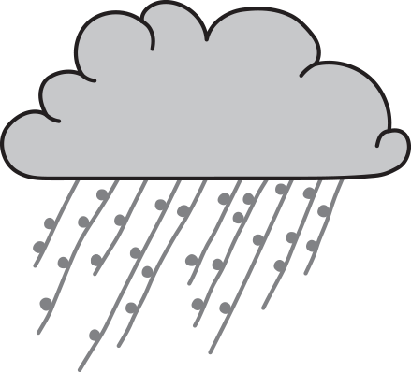

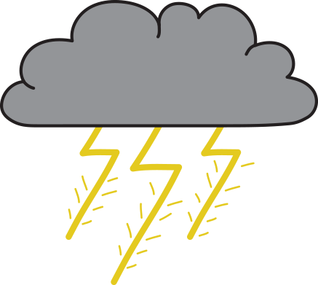

Data representation: Weather icons
Weather icons © Tania Taylor
Digital Technologies Hub is brought to you by the Australian Government Department of Education. Creative Commons Attribution 4.0, unless otherwise indicated.

Slide 2
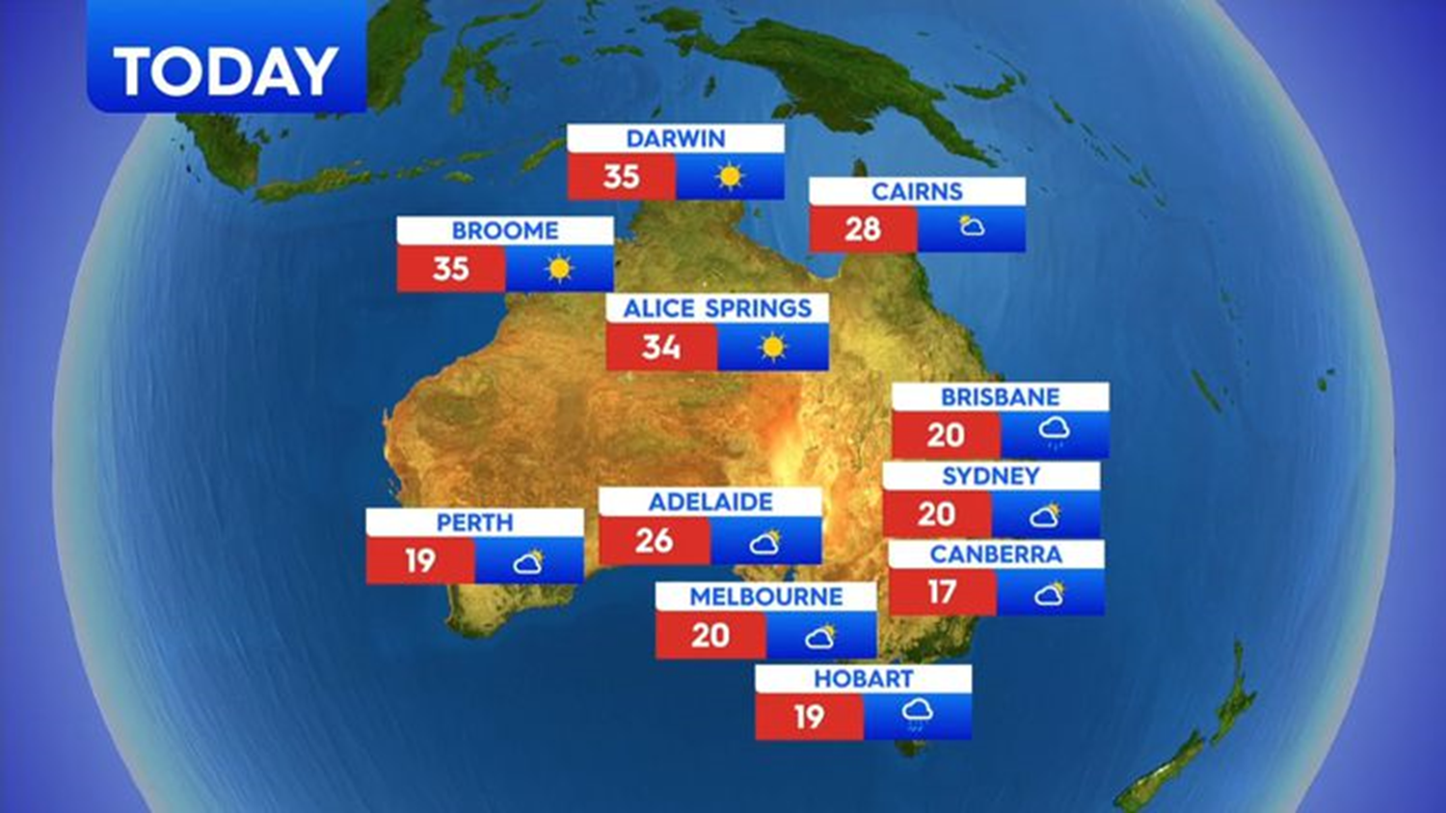
Weather information
Digital Technologies Hub is brought to you by the Australian Government Department of Education. Creative Commons Attribution 4.0, unless otherwise indicated.
Notes:
This is from 9 News weather forecast September 11, 2020, for Australia.
Discussion questions:
- How do the numbers and pictures help us know what the weather might be like tomorrow?
- Is there another way that this information could be shared with us?
- What clothes might you pick to wear if you lived in, say, Hobart compared to Darwin?
- What other decisions might this information influence? For example, deciding whether to go for a family day trip to the beach or to the movies?
- Is there information that is missing that you think would be helpful?
Image taken from
https://www.9news.com.au/national/weather-forecast-australia-wind-warnings-all-states-weatherzone/1204cac8-e828-474c-bcfb-85b218c47662
Accessed January 07, 2024

Slide 3
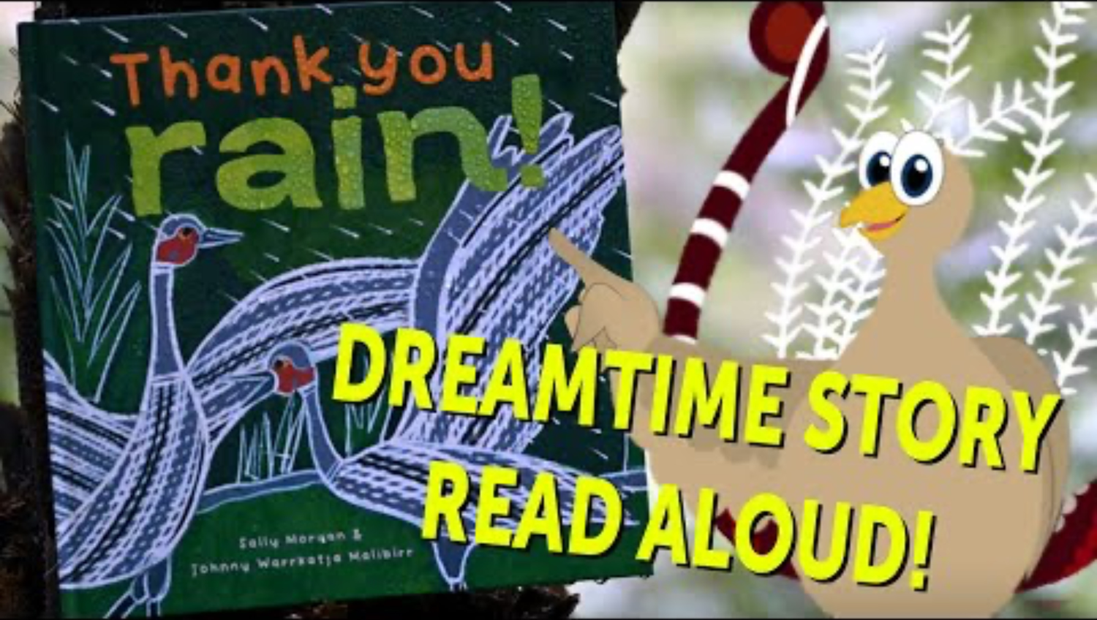
Read aloud by Justin from Wooyal Dreaming
Thank you rain!
Digital Technologies Hub is brought to you by the Australian Government Department of Education. Creative Commons Attribution 4.0, unless otherwise indicated.
Notes:
Use the read aloud to discuss types of weather and how we represent the weather.
Discuss the imagery used in the book’s illustrations.
Thank you rain! By Sally Morgan and illustrated by Johnny Warrkatja Malibirr
Read aloud by Justin from Wooyal Dreaming
https://www.youtube.com/watch?v=ZhqtTEvZgjQ

Slide 4
Guess the weather 1
Weather icons © Tania Taylor
Digital Technologies Hub is brought to you by the Australian Government Department of Education. Creative Commons Attribution 4.0, unless otherwise indicated.
Notes:
Weather icons by Tania Taylor ©
Instructions
1. As a class, look at the weather symbols (one per slide) created by Tania Taylor.
2. Discuss and consider what weather or season this symbol has been created to represent.
3. Students can make their own decision or teacher can ask for class consensus.
4. Click to the next slide, which shows the weather the symbol was created to represent.
5. Discuss what clues you used? Were you right? Was it confusing and how could it be clearer? Do we experience that weather type on Country where we live and learn?
6. Repeat for each of Tania’s weather symbol slides.

Slide 5
Guess the weather 2
Weather icons © Tania Taylor
Digital Technologies Hub is brought to you by the Australian Government Department of Education. Creative Commons Attribution 4.0, unless otherwise indicated.

Slide 6
Guess the weather 3
Weather icons © Tania Taylor
Digital Technologies Hub is brought to you by the Australian Government Department of Education. Creative Commons Attribution 4.0, unless otherwise indicated.

Slide 7
Guess the weather 4
Weather icons © Tania Taylor
Digital Technologies Hub is brought to you by the Australian Government Department of Education. Creative Commons Attribution 4.0, unless otherwise indicated.

Slide 8
Guess the weather 5
Weather icons © Tania Taylor
Digital Technologies Hub is brought to you by the Australian Government Department of Education. Creative Commons Attribution 4.0, unless otherwise indicated.

Slide 9

Weather represented as sounds
How would you describe weather for each sound?
Digital Technologies Hub is brought to you by the Australian Government Department of Education. Creative Commons Attribution 4.0, unless otherwise indicated.
Notes:
Class discussion
We can represent weather using sounds
They are all from BBC Sounds https://sound-effects.bbcrewind.co.uk/

Slide 10
Seasons in Australia
How would you describe our weather seasons?
In many places, we use the terms:
summer
autumn
winter
spring
Digital Technologies Hub is brought to you by the Australian Government Department of Education. Creative Commons Attribution 4.0, unless otherwise indicated.
Notes:
Discussion
- What images would you use to help someone understand a season?
- What is your favourite season? Why? Is it the activities you do only at that time of year, the clothes you get to wear, the places you visit, the food you can eat?
- Can you think of any environmental indicators/clues that a new season is coming?
For example,
- the sun shines through your bedroom window a lot earlier in the morning
- you can stay outside and play a lot longer
- you family must water the plants and the lawn more or less
- your vegetable patch grows a particular veggie in a certain season
- you play a sport only during this season

Slide 11
Clues to know when a new season was coming
First Nations Australians use many different clues to know when a new season was coming.
What seasonal clues might First Nations Australians use?
Digital Technologies Hub is brought to you by the Australian Government Department of Education. Creative Commons Attribution 4.0, unless otherwise indicated.
Notes:
Depending on the location in Australia, signs of a new season approaching may include:
- particular plants start growing or flowering
- specific fruits and food sources become more readily available; depending on where they are in the country, this might include kangaroo, fish, yabbies, plant-based foods
- The wind blowing predominantly from a specific direction
- baby animals start appearing
- the sun in a different place in the sky
- different stars closer to the moon or in a different place in the sky
- temperature changes

Slide 12
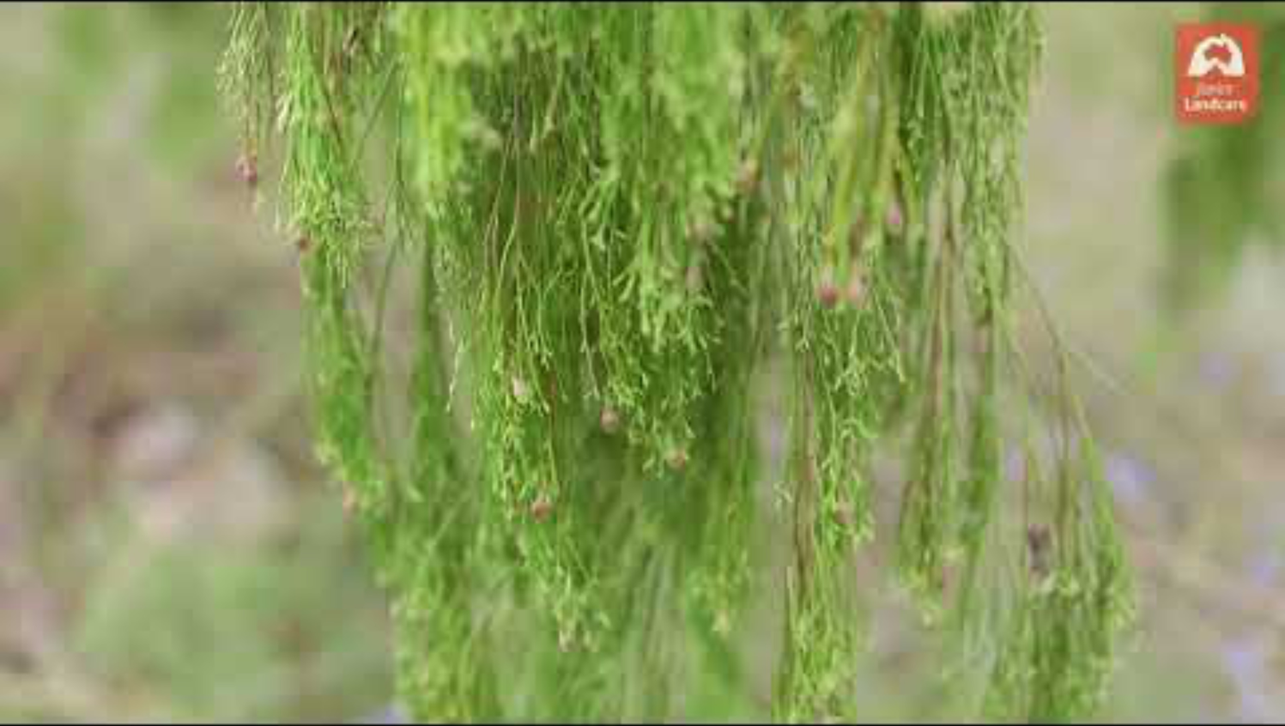
Exploring First Nations weather knowledge
Local Seasons: exploring First Nations weather knowledge
Digital Technologies Hub is brought to you by the Australian Government Department of Education. Creative Commons Attribution 4.0, unless otherwise indicated.
Notes:
Video 3 minutes duration by Junior Landcare
Uploaded 14 April 2022
Local Seasons: exploring First Nations weather knowledge
https://www.youtube.com/watch?v=7Rvxp4W4gJs&t

Slide 13
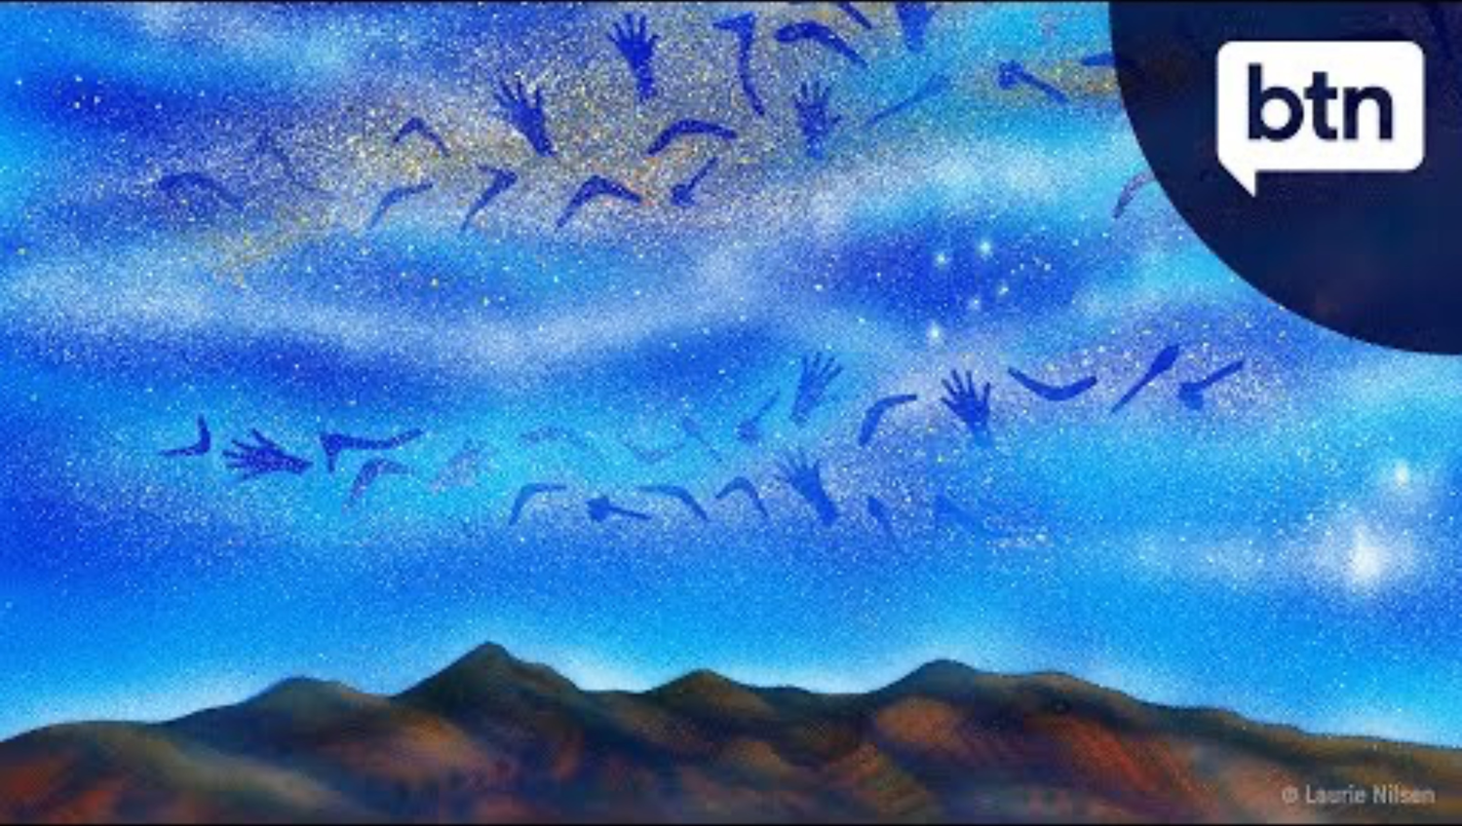
Kaurna Country: weather knowledge
The Different Seasons in Australia's Indigenous Cultures - Behind the News
Digital Technologies Hub is brought to you by the Australian Government Department of Education. Creative Commons Attribution 4.0, unless otherwise indicated.
Notes:
Video 3:11 minutes duration by ABC BTN
** Please note the video relates specifically to Kaurna Country (South Australia)
Uploaded 15 November 2017
The different seasons in Australia’s Indigenous Cultures
https://www.youtube.com/watch?v=_vQVjCdq-2I&t

