Slide 1



Developing user stories
How do you design a digital solution, such as an app, that will be useful to the people you designed it for?
Let’s find out …
Digital Technologies Hub is brought to you by the Australian Government Department of Education. Creative Commons Attribution 4.0, unless otherwise indicated.

Slide 2

Who is a user?
A user is someone we design for or who uses what we create.
They can be individuals or groups, often referred to as users or stakeholders.
Companies create pretend users to design products that real users will love.
Digital Technologies Hub is brought to you by the Australian Government Department of Education. Creative Commons Attribution 4.0, unless otherwise indicated.

Slide 3
Developing user stories
A key step of design is to understand user needs before developing a digital solution.
Once we identify a need, we can create a ‘user story’ to represent that person.
User stories help designers understand their target users and confirm their design by testing it on someone similar to the user.
Digital Technologies Hub is brought to you by the Australian Government Department of Education. Creative Commons Attribution 4.0, unless otherwise indicated.

Slide 4
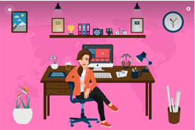
The role of a designer
Designers turn problems into solutions.
Designers find out what the need is or what the user would like to do by asking questions.
Digital Technologies Hub is brought to you by the Australian Government Department of Education. Creative Commons Attribution 4.0, unless otherwise indicated.

Slide 5
The role of a designer
For example, we might need to design a game that helps students in Year 3 learn their spelling words.
So, we find a child in Year 3 to ask:
What do you find hard about learning your spelling words? Why?
Do you have any ideas about what helps you learn?
Digital Technologies Hub is brought to you by the Australian Government Department of Education. Creative Commons Attribution 4.0, unless otherwise indicated.

Slide 6
Developing user stories
A user story includes the user’s role, a goal and a reason.
Digital Technologies Hub is brought to you by the Australian Government Department of Education. Creative Commons Attribution 4.0, unless otherwise indicated.

Slide 7
Developing user stories
A user role tells us who a product or feature is made for, like the type of person or group of people it’s meant to help.
A goal is a short, simple description of a product feature. It is what the user wants.
The reason explains why the user wants or needs the help.
Digital Technologies Hub is brought to you by the Australian Government Department of Education. Creative Commons Attribution 4.0, unless otherwise indicated.

Slide 8
.
Developing user stories
The following format can help us describe the user needs:
As a <user role>
I want to <goal to be accomplished>
So that I can <reason for the goal>
USER
GOAL
REASON
Digital Technologies Hub is brought to you by the Australian Government Department of Education. Creative Commons Attribution 4.0, unless otherwise indicated.

Slide 9
Developing user stories
Giving details about a user can change what you design. For example, would these user stories all end up with the same solution? Why?
As a <Year 10 student who loves reading sci-fi> I want <a way to easily find the books I like based on my interests> so that I can <discover new books I'll love> | As a <10-year-old boy who doesn’t like reading> I want <a way to find books that are fun and at a good level for me> so that I can <get better at reading and find books I like> | As a <librarian> I want <a way to recommend the right books to all types of readers based on their age and interest> so that I can <better meet their reading preferences>
Digital Technologies Hub is brought to you by the Australian Government Department of Education. Creative Commons Attribution 4.0, unless otherwise indicated.

Slide 10
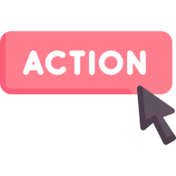

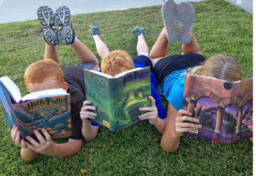
Developing user stories
Turn this into a user story
We love to read. As young avid readers, we want a way to easily find the books we like based on our interests. I like different books to Josie. I want book recommendations based on my interests, so I can discover new books I will love.
Action icon : Flaticon
Digital Technologies Hub is brought to you by the Australian Government Department of Education. Creative Commons Attribution 4.0, unless otherwise indicated.
Notes:
<a href="" title="action figure icons">Action figure icons created by Freepik - Flaticon</a>

Slide 11
Developing user stories
Identify a need and turn it into a user story that explains it clearly.
Who?
Who will be using my design (user)?
What?
What do they want or need to do?
Why?
Why do they want to do that? How will it meet their needs?
A <type of user> has <some goal> so that <some reason>
Students in Year 4 who love to read.
Want an easy way to find out about new books that suit their tastes and interests.
Walking around the library or getting recommendations from friends takes a lot of time and only provides limited suggestions.
Digital Technologies Hub is brought to you by the Australian Government Department of Education. Creative Commons Attribution 4.0, unless otherwise indicated.

Slide 12
Developing user stories
✅
Here is what it might look like
As an <avid reader>
I want <a way to easily find the books I might like based on my interests>
So that I can <discover new books I will love>
Digital Technologies Hub is brought to you by the Australian Government Department of Education. Creative Commons Attribution 4.0, unless otherwise indicated.

Slide 13
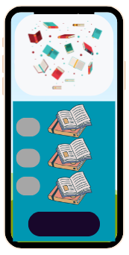
Developing user stories
Think about key functions
Features that meet user needs:
provides personalised book recommendations based on the user’s reading history and preferences
user-friendly filters to search for books, and make it easy to save and organise books in a virtual library.
Image “©[Martin Richards] via Canva.com
Digital Technologies Hub is brought to you by the Australian Government Department of Education. Creative Commons Attribution 4.0, unless otherwise indicated.

Slide 14
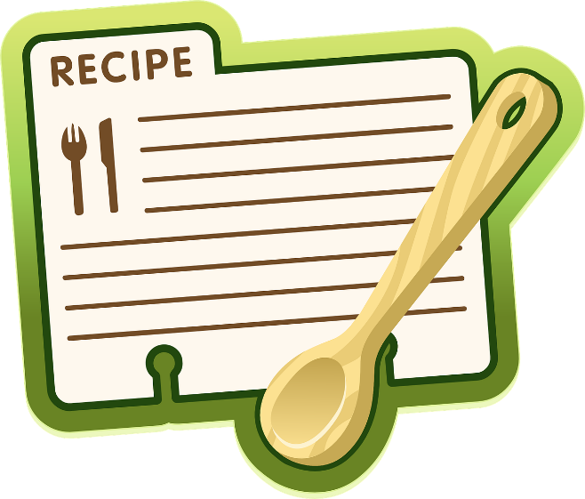
Developing user stories
Turn this into a user story
I like being a chef for my group of friends who are fussy and all like different foods. Some have allergies. I want to be able to find a recipe that can fit their likes and dislikes and be easy to prepare with a list of ingredients.
Action icon : Flaticon
Digital Technologies Hub is brought to you by the Australian Government Department of Education. Creative Commons Attribution 4.0, unless otherwise indicated.

Slide 15
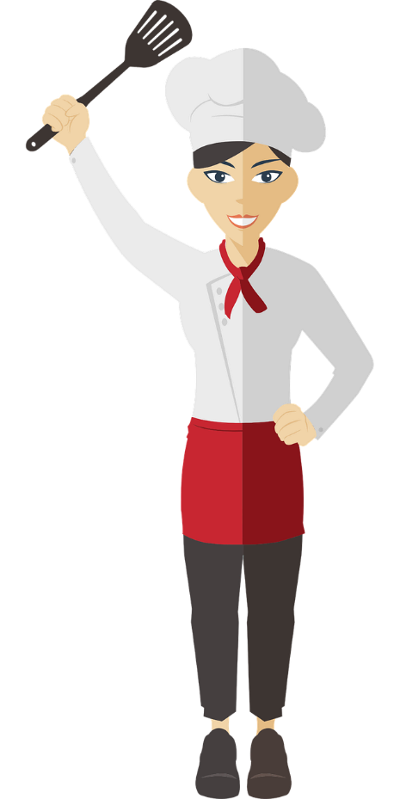
Developing user stories
✅
Here is what it might look like
As an <aspiring chef>
I want <to easily find recipes that can accommodate everyone’s likes and dislikes within my friend group>
So that I can <prepare delicious and inclusive meals that everyone can enjoy>
Digital Technologies Hub is brought to you by the Australian Government Department of Education. Creative Commons Attribution 4.0, unless otherwise indicated.

Slide 16
Developing user stories
Think about key functions
Features that meet user needs:
Search feature to filter and find recipes
Personalised recipe suggestions based on the previous selections
A list of ingredients included with each recipe
Step-by-step cooking instructions
Rating and review functionality
Option to add recipe ingredients to a shopping list
Image “©[Martin Richards] via Canva.com
Digital Technologies Hub is brought to you by the Australian Government Department of Education. Creative Commons Attribution 4.0, unless otherwise indicated.

Slide 17
Developing user stories
Sometimes designers start with a product idea and work backwards.
Why are we designing?
We need to stop people polluting the beach.
What do we need to do?
Teach them why pollution is a bad thing.
Who is it for?
Primary-age children.
A <type of user> has <some goal> so that <some reason>
Students in Year 4 who visit the beach with their family.
Learn about pollution.
People can change their habits when they visit the beach and tell other people about the harms of pollution.
Digital Technologies Hub is brought to you by the Australian Government Department of Education. Creative Commons Attribution 4.0, unless otherwise indicated.

Slide 18
Developing user stories
Create user stories for these examples
As a traveller to Japan, I want an easy way to instantly translate signs and menus for me, so I can navigate and order food easily, even if I don't speak the local language. | As a student with a busy schedule, I want a homework planner that allows me to set reminders for assignments, so I can stay organised and never miss a deadline.
As a busy farmer with many tasks and responsibilities on the farm, I want a farm management system that automates routine tasks and provides alerts for important activities, so I can efficiently manage my agricultural operations, save time, and ensure that essential farm tasks are completed on time. | As a gamer I find I learn best if the learning system incorporates gamified elements so that I can make the process of learning more engaging and enjoyable, using my gaming skills to acquire new knowledge and be better at learning and avoid losing interest in my studies.
Action icon : Flaticon
Digital Technologies Hub is brought to you by the Australian Government Department of Education. Creative Commons Attribution 4.0, unless otherwise indicated.

Slide 19
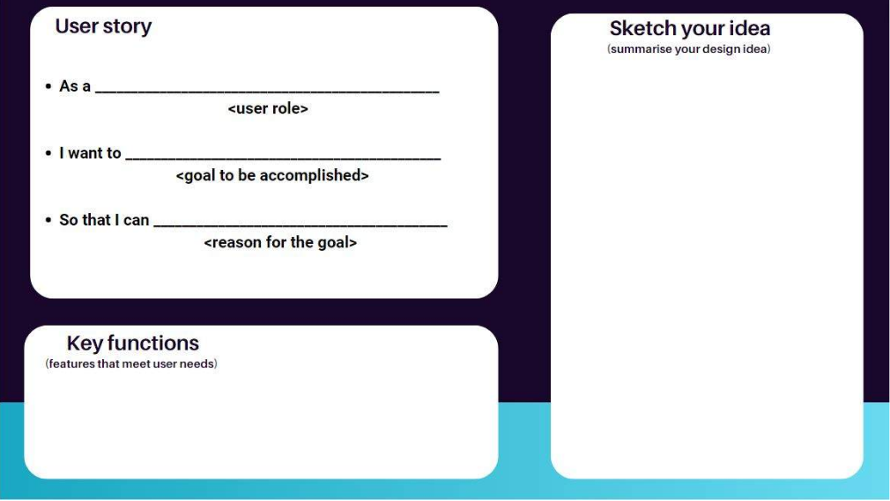
Developing user stories
Digital Technologies Hub is brought to you by the Australian Government Department of Education. Creative Commons Attribution 4.0, unless otherwise indicated.

