Slide 1

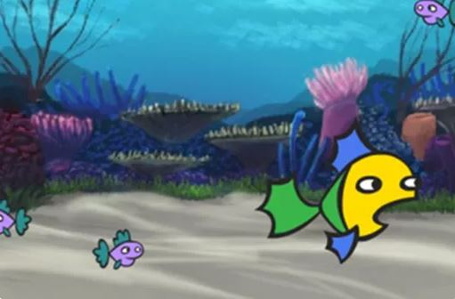

Game design
Create your own mini-game
Years 3–4
Digital Technologies Hub is brought to you by the Australian Government Department of Education. Creative Commons Attribution 4.0, unless otherwise indicated.

Slide 2
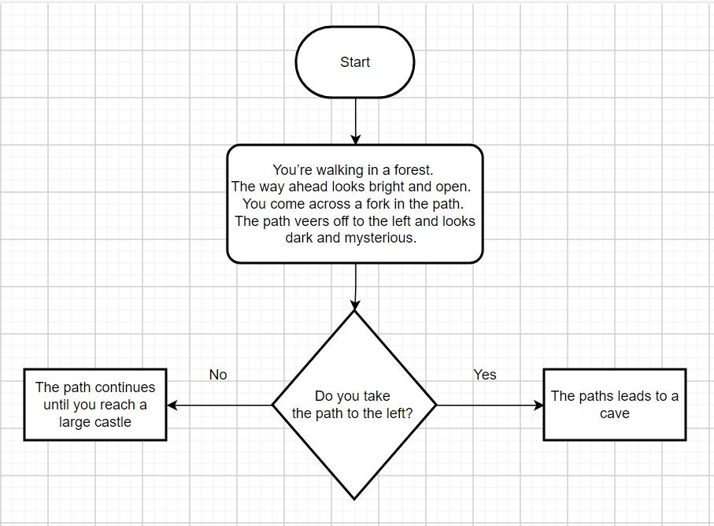
Branching
Images: flowchart drawn with draw.io
Digital Technologies Hub is brought to you by the Australian Government Department of Education. Creative Commons Attribution 4.0, unless otherwise indicated.
Notes:
In designing a mini-game, students incorporate branching. Branching is where yes/no decisions are used to determine the next steps in a process or program.
One way to engage students in thinking about branching is to start by presenting a story where the students are the main characters, for example:
‘You’re walking in a forest and come across a fork in the path. Do you take the left path, which looks dark and mysterious, or the right path, which is bright and open?’
Ask students to make a choice, and then describe an outcome based on their decision, for example, one path leads to a cave, the other continues to a castle. Share different outcomes suggested by students. Explain that branching allows for different scenarios. What happens next depends on your choice. The cave might hide a treasure, or the castle could be guarded by a dragon.
Explain to students that they will be using similar If/Then decisions in their game design, where the game will take different actions based on the player's choices or game conditions, such as ’If the player touches an enemy, then game over.’

Slide 3



Designing a mini-game
What is your game about? Who will play it? What is the goal or purpose?
Who are the characters?
What is the theme?
What is the goal of your game?
How do you code the game?
Images: Flaticon.com
Digital Technologies Hub is brought to you by the Australian Government Department of Education. Creative Commons Attribution 4.0, unless otherwise indicated.
Notes:
In this session, we will consider these questions to guide our design.
Ghost free icon
https://www.flaticon.com/free-icon/ghost_11378546?related_id=11378546
Game free icon
https://www.flaticon.com/free-icon/game_13129048?term=pacman&page=1&position=4&origin=search&related_id=13129048
Labyrinth free icon
https://www.flaticon.com/free-icon/labyrinth_3874609?term=maze+game&page=1&position=43&origin=search&related_id=3874609

Slide 4
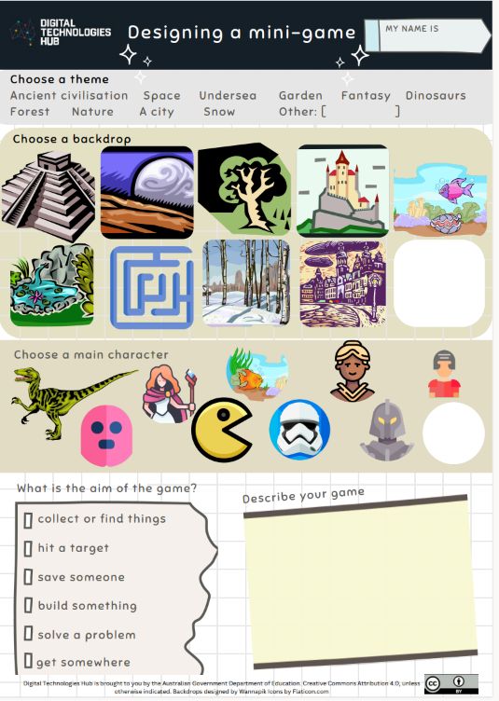
A mini-game
What is your game about? Who will play it? What is the purpose?
What is the theme?
What will be the backdrop?
Who are the characters?
What is the aim of your game?
What happens in the game?
Image: Designed in Canva
Digital Technologies Hub is brought to you by the Australian Government Department of Education. Creative Commons Attribution 4.0, unless otherwise indicated.
Notes:
We will use this template to help design our game and record our ideas.
The idea here is to capture what the overall game is about.
Who are the game’s characters? What are their background?
What is the goal of the game?
How do players win, lose or progress?

Slide 5
What is the objective?
What is the purpose or goal of your game?
Does the player:
collect or find things?
hit a target?
save something or someone?
build something?
solve a puzzle or problem?
need to get somewhere?
Images: Flaticon.com
Digital Technologies Hub is brought to you by the Australian Government Department of Education. Creative Commons Attribution 4.0, unless otherwise indicated.
Notes:
To start with, identify the objective (the purpose or goal of the game).
Ghost free icon
https://www.flaticon.com/free-icon/ghost_11378546?related_id=11378546
Game free icon
https://www.flaticon.com/free-icon/game_13129048?term=pacman&page=1&position=4&origin=search&related_id=13129048
Labyrinth free icon
https://www.flaticon.com/free-icon/labyrinth_3874609?term=maze+game&page=1&position=43&origin=search&related_id=3874609

Slide 6

What is the theme? Space?
Digital Technologies Hub is brought to you by the Australian Government Department of Education. Creative Commons Attribution 4.0, unless otherwise indicated.
Image: Designed by Wannapik
Notes:
Where will it take place?
Image source: https://www.wannapik.com/

Slide 7

What is the theme? Gardens?
Images: Designed by Wannapik
Digital Technologies Hub is brought to you by the Australian Government Department of Education. Creative Commons Attribution 4.0, unless otherwise indicated.
Images: Designed by Wannapik
Notes:
Image source: https://www.wannapik.com/

Slide 8

What is the theme? Ancient civilisation?
Images: Designed by Wannapik
Digital Technologies Hub is brought to you by the Australian Government Department of Education. Creative Commons Attribution 4.0, unless otherwise indicated.
Images: Designed by Wannapik
Notes:
Image source: https://www.wannapik.com/

Slide 9
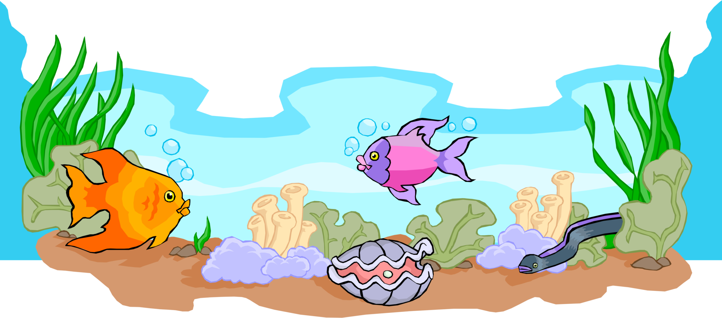
What is the theme? Under the sea?
Images: Designed by Wannapik
Digital Technologies Hub is brought to you by the Australian Government Department of Education. Creative Commons Attribution 4.0, unless otherwise indicated.
Images: Designed by Wannapik
Notes:
Image source: https://www.wannapik.com/

Slide 10
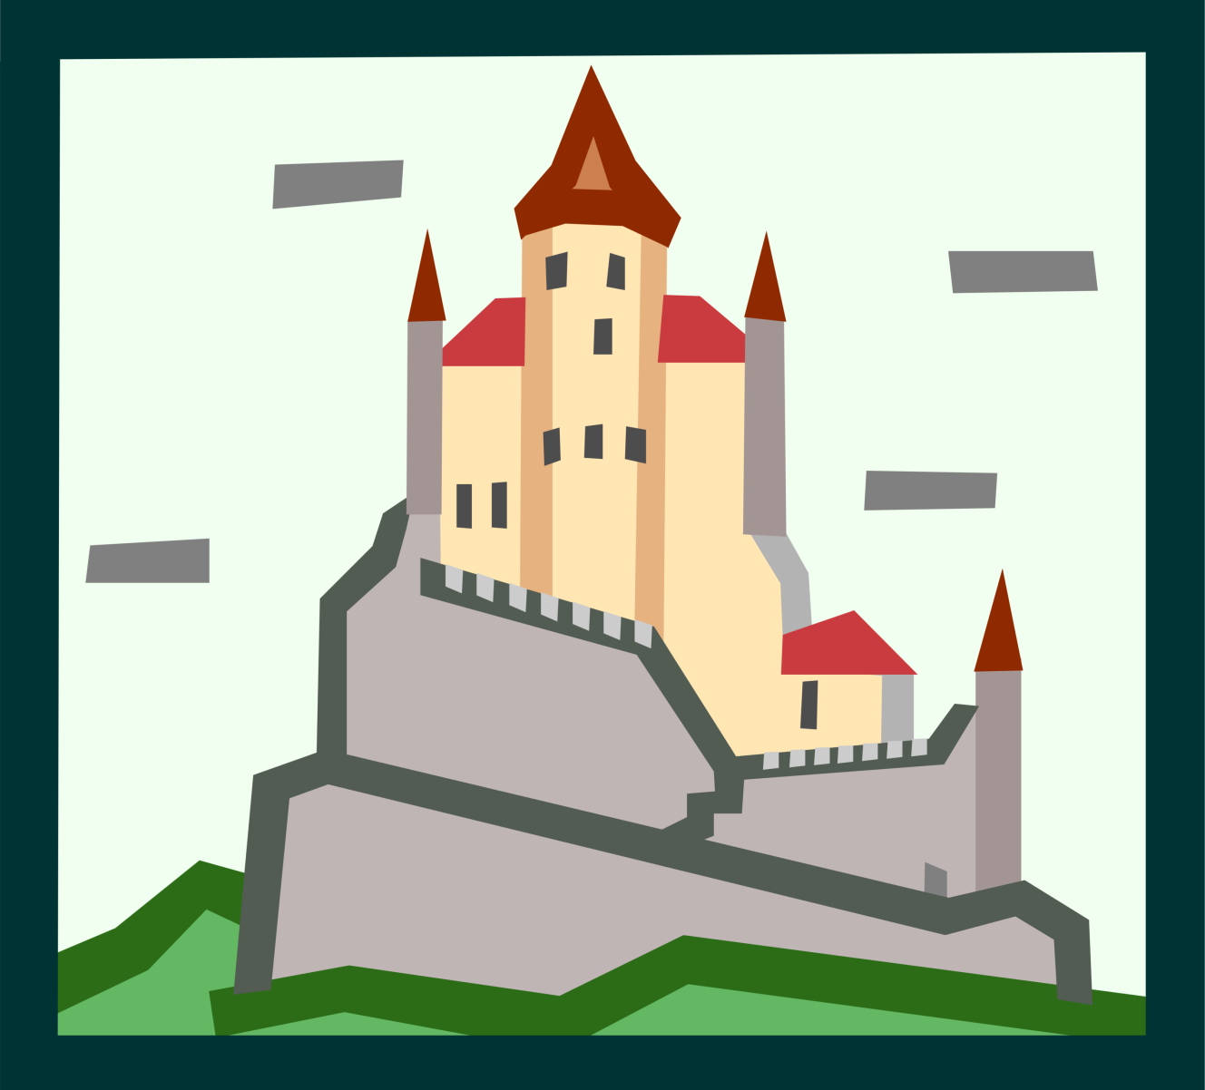
What is the theme? Fantasy?
Images: Designed by Wannapik
Digital Technologies Hub is brought to you by the Australian Government Department of Education. Creative Commons Attribution 4.0, unless otherwise indicated.
Images: Designed by Wannapik
Notes:
Image source: https://www.wannapik.com/

Slide 11


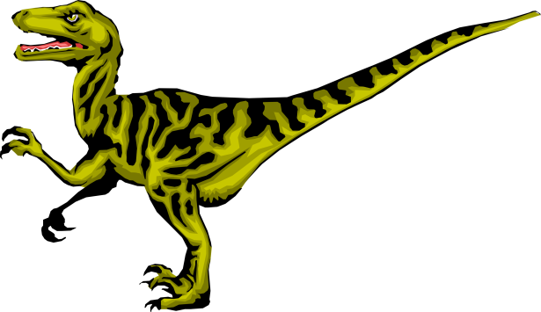
What is the theme? Dinosaurs?
Images: Designed by Wannapik
Digital Technologies Hub is brought to you by the Australian Government Department of Education. Creative Commons Attribution 4.0, unless otherwise indicated.
Notes:
Image source: https://www.wannapik.com/

Slide 12

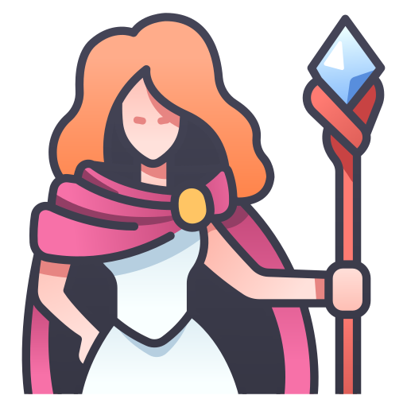
Who is the main character?
What is their role?
Do they have:
unique abilities?
important knowledge?
special powers?
Do they have:
opponents or obstacles?
enemies, rivals or villains?
Magician: Flaticon.com
Castle: Designed by Wannapik
Digital Technologies Hub is brought to you by the Australian Government Department of Education. Creative Commons Attribution 4.0, unless otherwise indicated.
Notes:
Encourage creative thinking when choosing their key character

Slide 13
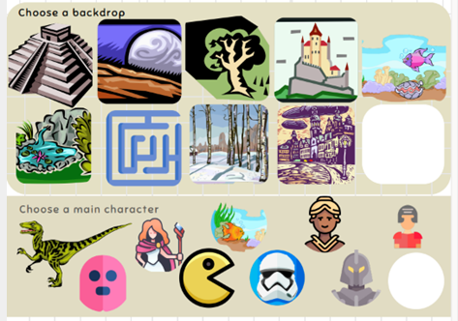



Level 1 example: characters and backdrop
Characters/sprites
Backdrop/scene
Images: Flaticon.com
Digital Technologies Hub is brought to you by the Australian Government Department of Education. Creative Commons Attribution 4.0, unless otherwise indicated.
Notes:
In the program Scratch, a character or object is called a sprite.
The background scene is called a backdrop.

Slide 14

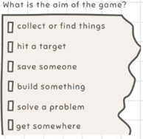


Goal: reach the treasure before getting caught by the ghost
Images: Flaticon.com
Maze Designed by Wannapik
Digital Technologies Hub is brought to you by the Australian Government Department of Education. Creative Commons Attribution 4.0, unless otherwise indicated.
Notes:
Talk through a typical example, such as: a hero, an enemy, and a treasure.
The goal is for the dragon to reach the treasure and avoid being caught by the ghost that moves along the maze.

Slide 15
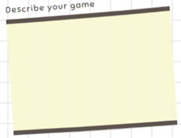
When you reach the treasure, you win!
Images: Flaticon.com
Maze Designed by Wannapik
Digital Technologies Hub is brought to you by the Australian Government Department of Education. Creative Commons Attribution 4.0, unless otherwise indicated.
Notes:
Discuss what you might see on the screen if the dragon reaches the treasure.

Slide 16






Coding movement
How do we make them stay within the maze?
Our hero moves with arrow keys
What code moves your character up, down, left and right using the arrow keys?
We want the ghost to move automatically within the maze
Image: Flaticon.com
Digital Technologies Hub is brought to you by the Australian Government Department of Education. Creative Commons Attribution 4.0, unless otherwise indicated.

Slide 17
Code
To keep in the maze:
If the dragon or ghost touches the colour , then … move back.
If our dragon touches the treasure, then … you win.
If the ghost catches the dragon, then … game over.
Image: Flaticon.com
Digital Technologies Hub is brought to you by the Australian Government Department of Education. Creative Commons Attribution 4.0, unless otherwise indicated.
Notes:
Communication free icon
https://www.flaticon.com/free-icon/communication_3820107?term=communication+two+people&page=1&position=1&origin=search&related_id=3820107

Slide 18
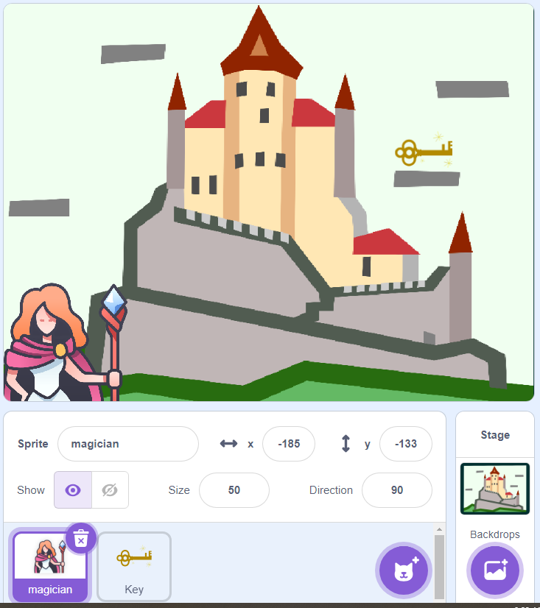
What might happen in this game?
To keep in the maze:
Image: Flaticon.com
Digital Technologies Hub is brought to you by the Australian Government Department of Education. Creative Commons Attribution 4.0, unless otherwise indicated.
Notes:
Ask questions like:
Where is this game set? Answer: A medieval castle.
What sprites (characters) do you notice? Answer: Magician and key.
What do you think the goal might be? Answer: Magician has to collect a key.
What might happen during the game?

Slide 19
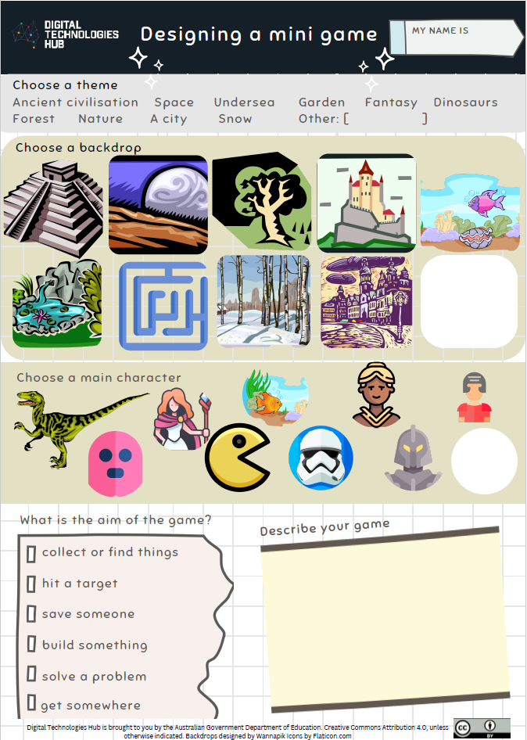

Generate designs: one level
Image: Flaticon.com
Digital Technologies Hub is brought to you by the Australian Government Department of Education. Creative Commons Attribution 4.0, unless otherwise indicated.
Notes:
Branding free icon
https://www.flaticon.com/free-icon/branding_1312313?term=generate+designs&page=1&position=15&origin=search&related_id=1312313

Slide 20
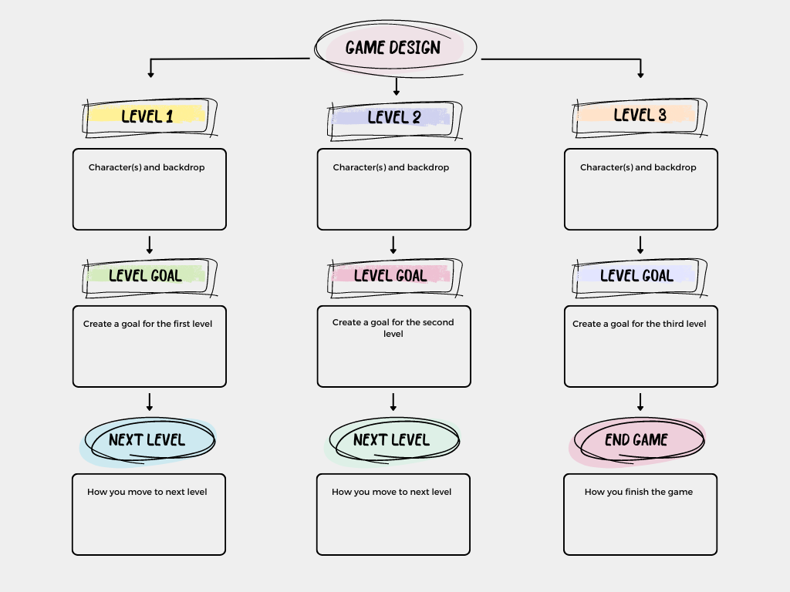
A three-level mini-game
Image: Designed in Canva
Digital Technologies Hub is brought to you by the Australian Government Department of Education. Creative Commons Attribution 4.0, unless otherwise indicated.
Notes:
For students who are more familiar with Scratch, and have well-developed programming skills, use this template to design a three-level mini-game.

Slide 21
Generate designs: three level
What is your three-level game?
What is your game about and who will play it?
What is the purpose?
Who are characters?
What is the theme?
What is the goal of each level?
How does the player progress?
What do players need to know?
How will you code the game?
Image: Flaticon.com
Digital Technologies Hub is brought to you by the Australian Government Department of Education. Creative Commons Attribution 4.0, unless otherwise indicated.
Notes:
Branding free icon
https://www.flaticon.com/free-icon/branding_1312313?term=generate+designs&page=1&position=15&origin=search&related_id=1312313

