Slide 1
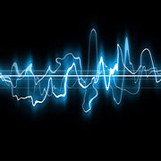

Quick quiz: Digital audio
Image source Wikipedia: Sound wave.jpg

Slide 2
Quick quiz: Question 1
Sound is carried through the air by changes in air pressure.
Which of these is correct?
a) Computers can understand sound waves represented as wavy lines.
b) Computers need sound waves to be converted it into a digital format.
c) Computers cannot store and work with sound waves even in digital format.
Image source Wikipedia: Sound wave.jpg

Slide 3
Quick quiz: Question 1 answer
Sound is carried through the air by changes in air pressure.
CORRECT ANSWER
b) Computers need sound waves to be converted it into a digital format.
Even as electrical waves from a microphone, the sound has not yet been converted to digital.
Image source Wikipedia: Sound wave.jpg

Slide 4
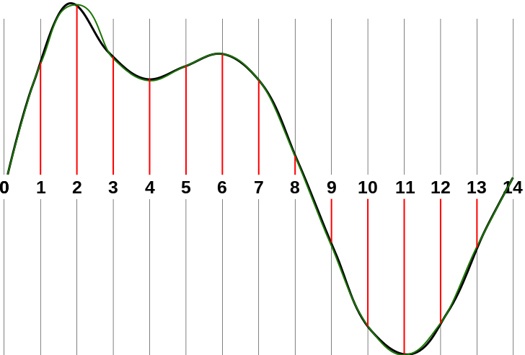
Quick quiz: Question 2
Sampling rate is the number of ‘pictures’ or samples taken per second.
Which of these is correct?
A higher sampling rate means more samples are taken, which leads to:
a) better audio quality.
b) no difference in audio quality.
c) lower audio quality.
Image source Wikipedia: Sound-SamplingRate-1.svg

Slide 5
Quick quiz: Question 2 answer
Sampling rate is the number of ‘pictures’ or samples taken per second.
CORRECT ANSWER
a) better audio quality.
Think of it as taking more pictures per second, capturing more detail. This higher detail leads to better audio quality.
Image source Wikipedia: Sound-SamplingRate-1.svg

Slide 6
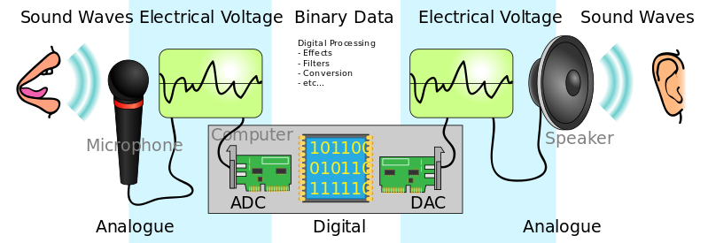
Quick quiz: Question 3
To covert sound waves into a digital representation, samples are taken at regular intervals.
Which of these is correct?
Each sample represents:
a) the loudness of the sound wave at that specific moment.
b) the speed of the sound wave at that specific moment.
c) the frequency of the sound.
Image source Wikipedia: Sound wave.jpg

Slide 7
Quick quiz: Question 3 answer
To covert sound waves into a digital representation, samples are taken at regular intervals.
CORRECT ANSWER
a) the loudness of the sound wave at that specific moment.
The loudness values are converted into numbers, made up of 0s and 1s. These numbers make up the digital representation of the sound wave.
Image source Wikipedia: Sound wave.jpg

