Slide 1


Classification: image recognition
How does a computer learn to recognise images?
Digital Technologies Hub is brought to you by the Australian Government Department of Education. Creative Commons Attribution 4.0, unless otherwise indicated.
Notes:
https://pixabay.com/photos/giraffe-animal-mammal-long-legged-6378717/

Slide 2

Image recognition: unlocking a smartphone
Digital Technologies Hub is brought to you by the Australian Government Department of Education. Creative Commons Attribution 4.0, unless otherwise indicated.
Notes:
Talk through example of using thumbprint or face to unlock a smartphone.
Help students understand that facial recognition in smartphones uses AI algorithms to analyse features like the distance between eyes and the shape of the face to create a unique ‘map’ of each person's face. This map is then compared to the stored map to unlock the device.

Slide 3
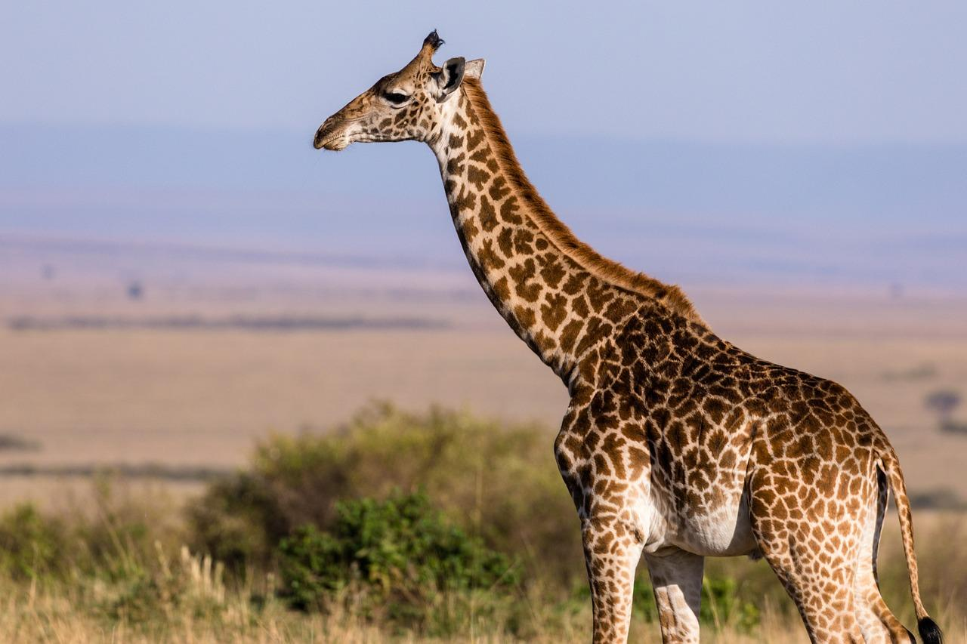
Monitoring animal populations
A giraffe can be identified by its unique spot pattern.
How might an AI help scientists monitor wild giraffe populations?
Digital Technologies Hub is brought to you by the Australian Government Department of Education. Creative Commons Attribution 4.0, unless otherwise indicated.
Notes:
https://pixabay.com/photos/giraffe-animal-mammal-long-legged-6378717/
Explain that AI can learn to recognise patterns in images. Scientists can use images of giraffes taken in the wild and submitted by the public to monitor the population.

Slide 4
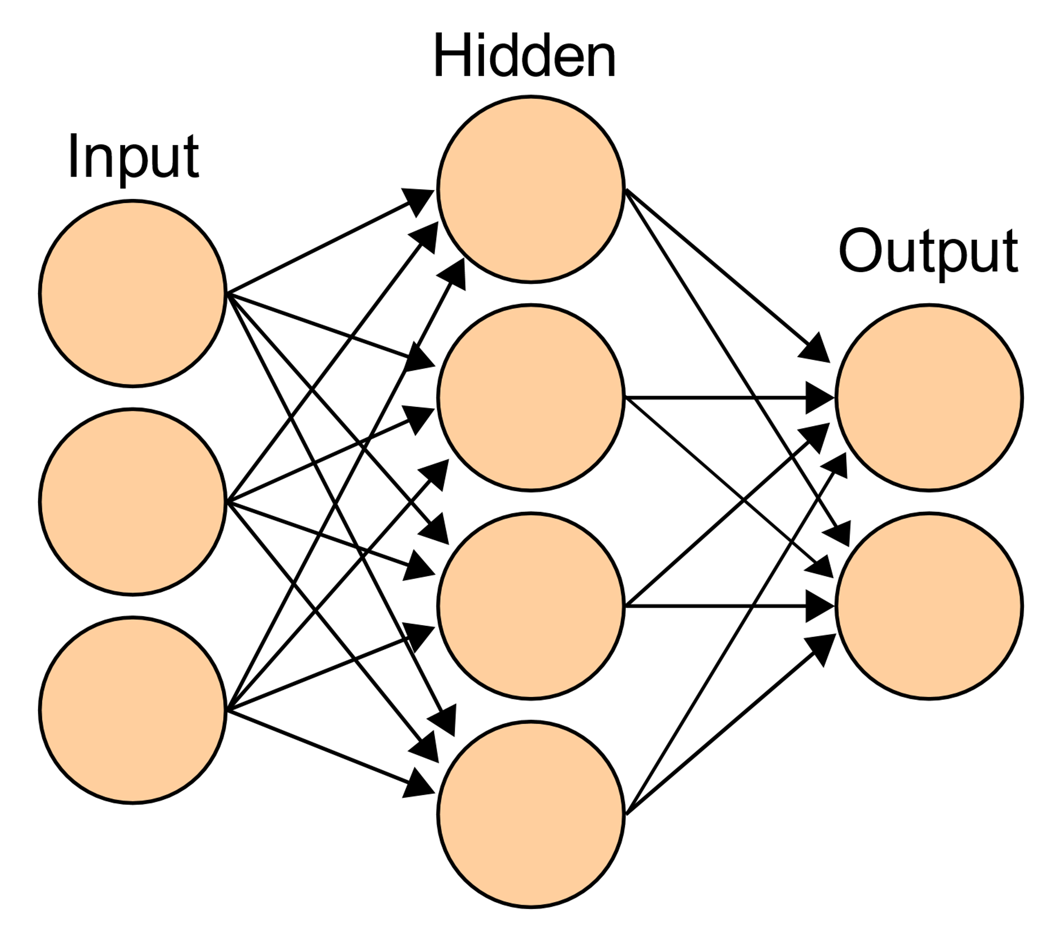
Monitoring animal populations
An AI needs to be trained to recognise objects.
The AI is trained on images.
A human labels the images.
The AI identifies patterns as it learns to recognise objects.
Digital Technologies Hub is brought to you by the Australian Government Department of Education. Creative Commons Attribution 4.0, unless otherwise indicated.
Notes:
This is an example of supervised learning.
The human labels images and the AI identifies patterns to recognise the objects.

Slide 5
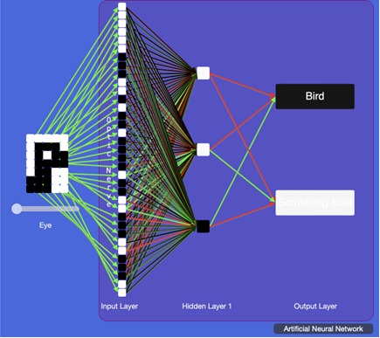
Train an AI to recognise birds
An Artificial Neural Network. Courtesy, Digital Technologies Institute
Digital Technologies Hub is brought to you by the Australian Government Department of Education. Creative Commons Attribution 4.0, unless otherwise indicated.
Notes:
Show how we can train an AI to recognise birds. This is an example of supervised learning.
The human labels images and the AI identifies patterns to recognise the objects.

Slide 6


Training an AI: Labelling
Is it a bird?
not a bird
bird
Digital Technologies Hub is brought to you by the Australian Government Department of Education. Creative Commons Attribution 4.0, unless otherwise indicated.
Notes:
You are the human doing the labelling.

Slide 7

Training an AI: Labelling image #1
Is it a bird?
not a bird
bird
Digital Technologies Hub is brought to you by the Australian Government Department of Education. Creative Commons Attribution 4.0, unless otherwise indicated.
Notes:
Tick icon: https://pixabay.com/vectors/ai-cutout-technology-digital-icon-7972021/
image: Freepik.com

Slide 8
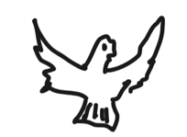
Training an AI: Labelling #2
Is it a bird?
not a bird
bird
Digital Technologies Hub is brought to you by the Australian Government Department of Education. Creative Commons Attribution 4.0, unless otherwise indicated.
Notes:
https://pixabay.com/vectors/ai-cutout-technology-digital-icon-7972021/
image: Freepik.com

Slide 9
Training an AI: Labelling image #2
Is it a bird?
not a bird
bird
Digital Technologies Hub is brought to you by the Australian Government Department of Education. Creative Commons Attribution 4.0, unless otherwise indicated.
Notes:
Tick icon: https://pixabay.com/vectors/ai-cutout-technology-digital-icon-7972021/
image: Freepik.com

Slide 10
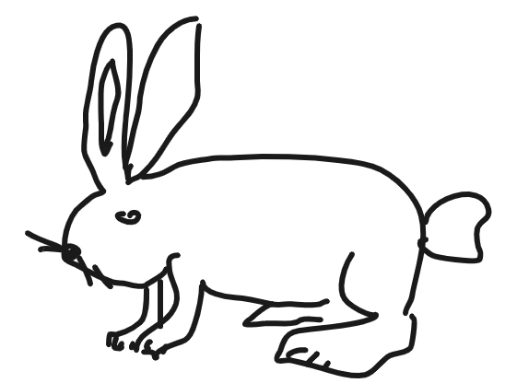
Training an AI: Labelling #3
Is it a bird?
not a bird
bird
Digital Technologies Hub is brought to you by the Australian Government Department of Education. Creative Commons Attribution 4.0, unless otherwise indicated.
Notes:
https://pixabay.com/vectors/ai-cutout-technology-digital-icon-7972021/
image: Freepik.com

Slide 11

Training an AI: Labelling image #3
Is it a bird?
not a bird
bird
Digital Technologies Hub is brought to you by the Australian Government Department of Education. Creative Commons Attribution 4.0, unless otherwise indicated.
Notes:
Cross icon: https://pixabay.com/vectors/ai-cutout-technology-digital-icon-7972021/
image: Freepik.com

Slide 12
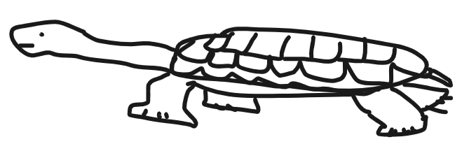
Training an AI: Labelling #4
Is it a bird?
not a bird
bird
Digital Technologies Hub is brought to you by the Australian Government Department of Education. Creative Commons Attribution 4.0, unless otherwise indicated.
Notes:
https://pixabay.com/vectors/ai-cutout-technology-digital-icon-7972021/
image: Freepik.com

Slide 13
Training an AI: Labelling image #4
Is it a bird?
not a bird
bird
Digital Technologies Hub is brought to you by the Australian Government Department of Education. Creative Commons Attribution 4.0, unless otherwise indicated.
Notes:
Cross icon: https://pixabay.com/vectors/ai-cutout-technology-digital-icon-7972021/
image: Freepik.com

Slide 14

Training an AI: Labelling #5
Is it a bird?
not a bird
bird
Digital Technologies Hub is brought to you by the Australian Government Department of Education. Creative Commons Attribution 4.0, unless otherwise indicated.
Notes:
https://pixabay.com/vectors/ai-cutout-technology-digital-icon-7972021/
image: Freepik.com

Slide 15
Training an AI: Labelling image #5
Is it a bird?
not a bird
bird
Digital Technologies Hub is brought to you by the Australian Government Department of Education. Creative Commons Attribution 4.0, unless otherwise indicated.
Notes:
Tick icon: https://pixabay.com/vectors/ai-cutout-technology-digital-icon-7972021/
image: Freepik.com

Slide 16

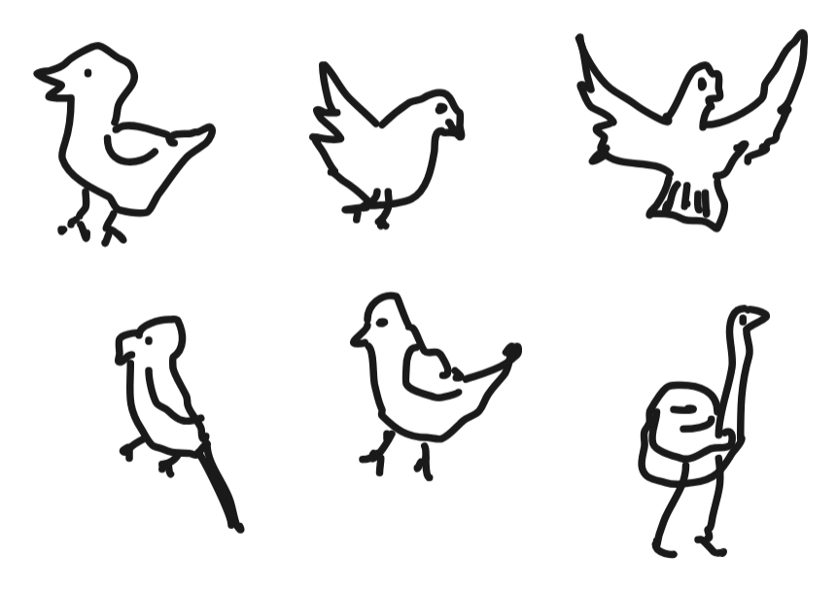
Trained on more images
Digital Technologies Hub is brought to you by the Australian Government Department of Education. Creative Commons Attribution 4.0, unless otherwise indicated.
Notes:
Tick icon: https://pixabay.com/vectors/ai-cutout-technology-digital-icon-7972021/
image: Freepik.com

Slide 17

Test AI on images it has not seen #1
bird
92% confident
Digital Technologies Hub is brought to you by the Australian Government Department of Education. Creative Commons Attribution 4.0, unless otherwise indicated.
Notes:
The AI is shown random images it has not seen before.
It classifies them according to its training data.
It predicts the classification with a level of confidence.
A level of confidence 100% means that it is certain of their prediction.

Slide 18
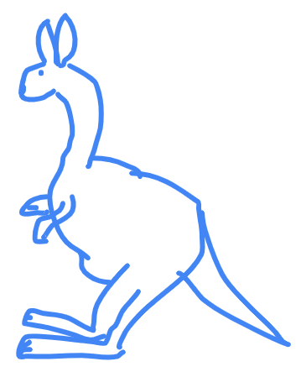
Test AI on images it has not seen #2
not a bird
88% confident
Digital Technologies Hub is brought to you by the Australian Government Department of Education. Creative Commons Attribution 4.0, unless otherwise indicated.
Notes:
The AI is shown random images it has not seen before.
It classifies them according to its training data.
It predicts the classification with a level of confidence.
A level of confidence 100% means that it is certain of their prediction.

Slide 19
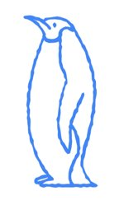
Test AI on images it has not seen #3
bird
81% confident
Digital Technologies Hub is brought to you by the Australian Government Department of Education. Creative Commons Attribution 4.0, unless otherwise indicated.
Notes:
The AI is shown random images it has not seen before.
It classifies them according to its training data.
It predicts the classification with a level of confidence.
A level of confidence 100% means that it is certain of their prediction.

