Slide 1


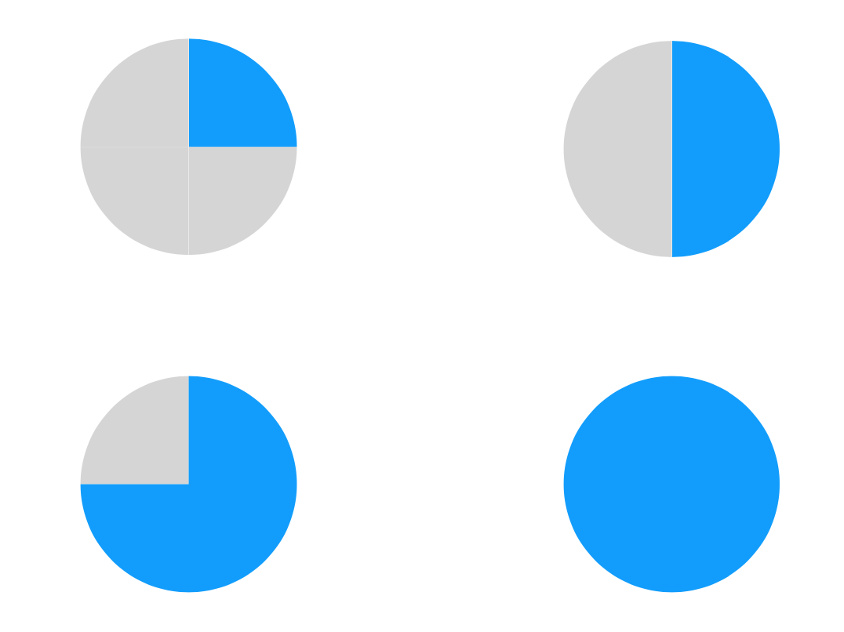
Teaching an AI to recognise fractions
Digital Technologies Hub is brought to you by the Australian Government Department of Education. Creative Commons Attribution 4.0, unless otherwise indicated.
Notes:
Demonstrate the Teachable Machine model that has been trained to recognise fractions represented as parts of a circle. It will work best for your demonstration circles represented as fractions on a white background.

Slide 2
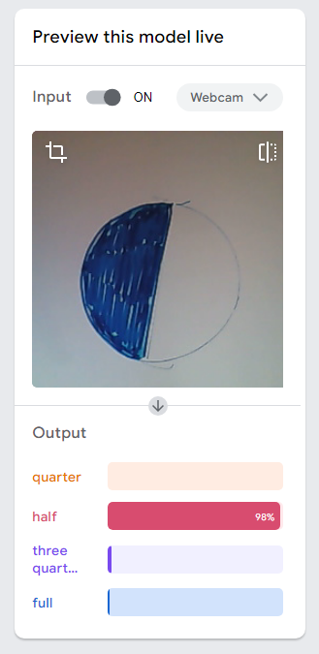
Review an AI model
This Teachable Machine model has been trained to recognise fractions represented as parts of a circle.
Let’s see it if it knows its fractions.
Open the model.
Digital Technologies Hub is brought to you by the Australian Government Department of Education. Creative Commons Attribution 4.0, unless otherwise indicated.
Notes:
Demonstrate the Teachable Machine model that has been trained to recognise fractions represented as parts of a circle. It will work best for your demonstration circles represented as fractions on a white background.
The model will open in another tab.

Slide 3
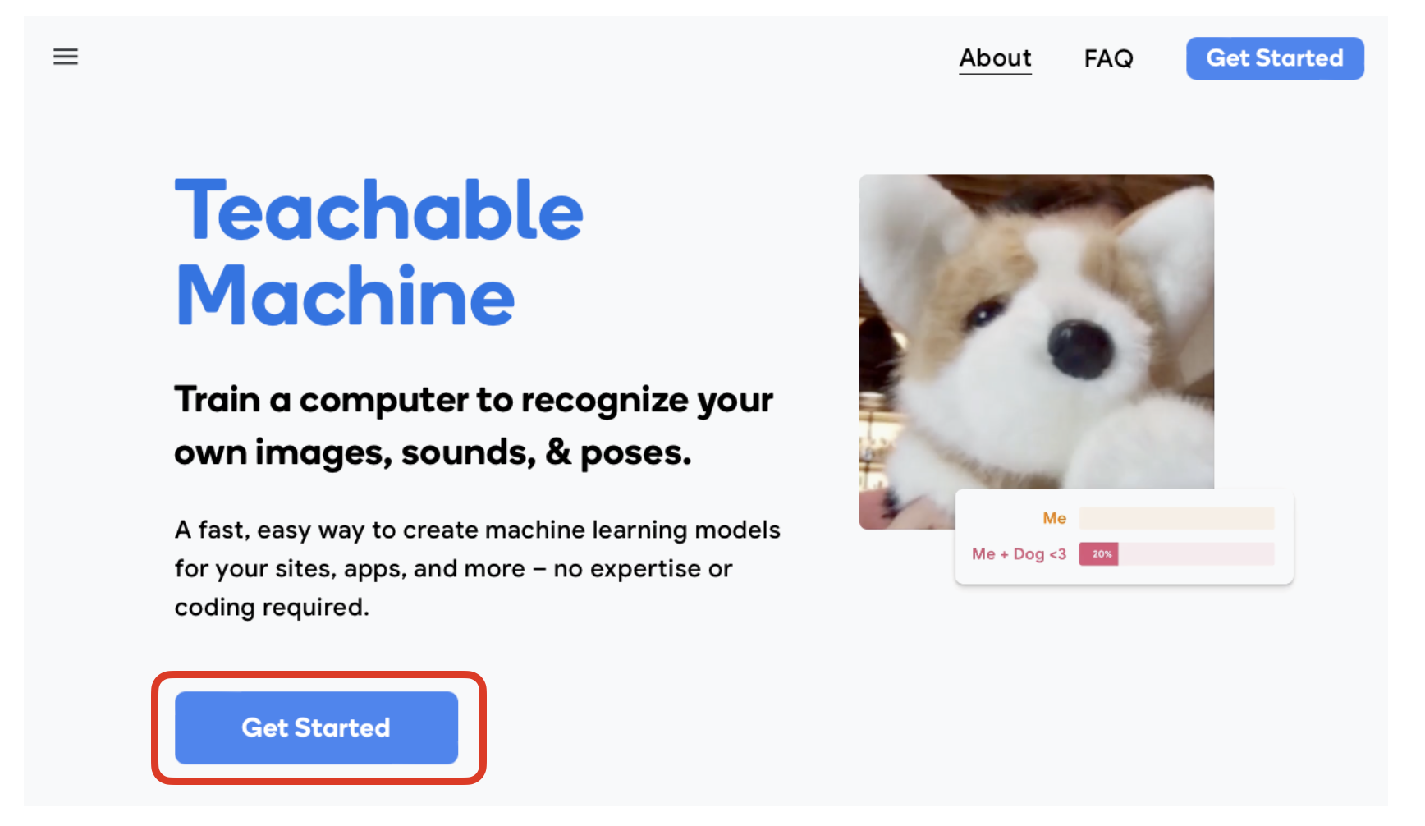
Use Teachable Machine
Here’s how to use Teachable Machine.
Select Get Started.
Digital Technologies Hub is brought to you by the Australian Government Department of Education. Creative Commons Attribution 4.0, unless otherwise indicated.
Notes:
We are using Teachable Machine to train our AI. Here are the steps you need to take.

Slide 4
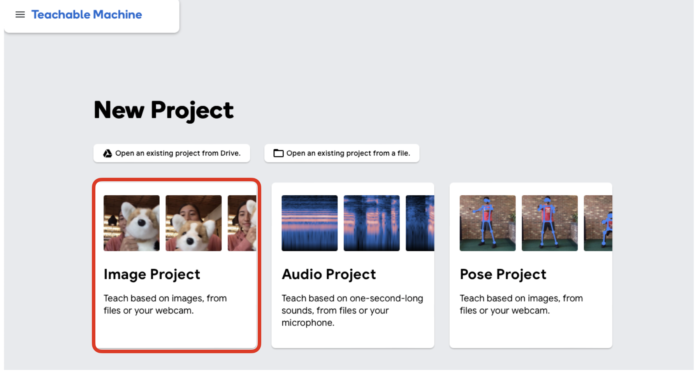
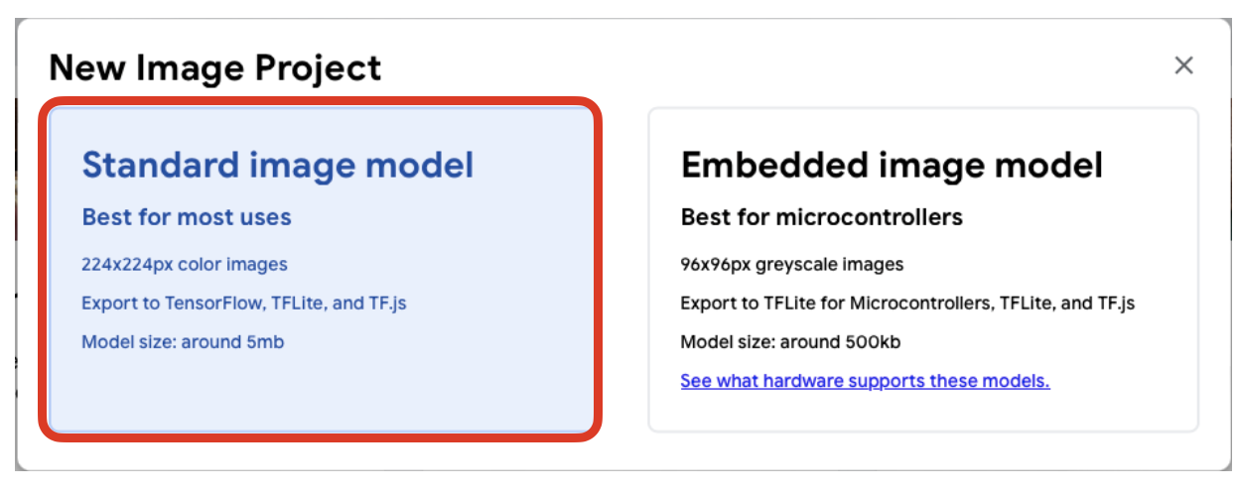
Start a new project
Select
Image Project
then, Standard image model
Digital Technologies Hub is brought to you by the Australian Government Department of Education. Creative Commons Attribution 4.0, unless otherwise indicated.
Notes:
We are using Teachable Machine to train our AI.

Slide 5
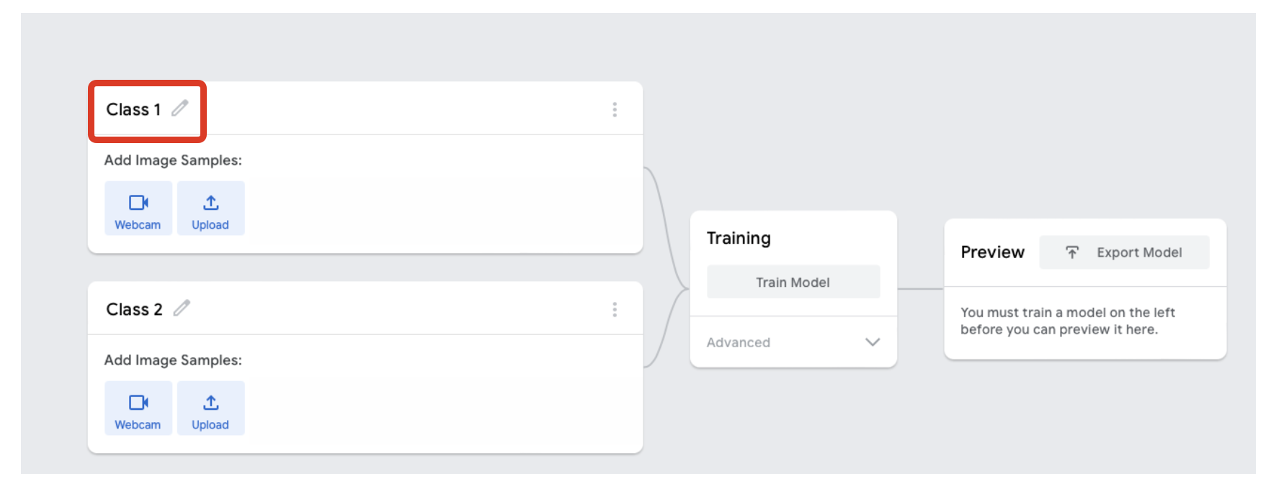
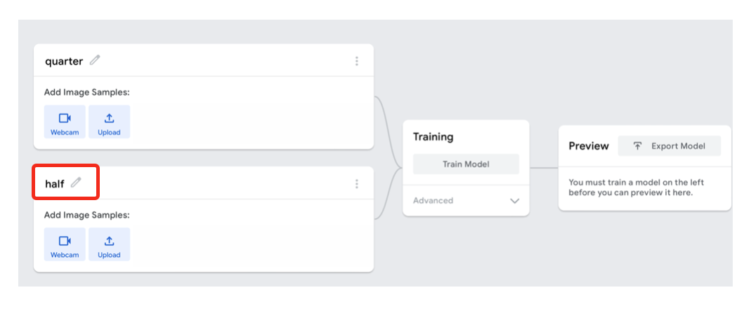
Name classes
Rename the existing classes
Class 1 – Change the name of Class 1 to ‘quarter’
Class 2 – Change the name of Class 2 to ‘half’
Digital Technologies Hub is brought to you by the Australian Government Department of Education. Creative Commons Attribution 4.0, unless otherwise indicated.
Notes:
We are using Teachable Machine to train our AI.

Slide 6
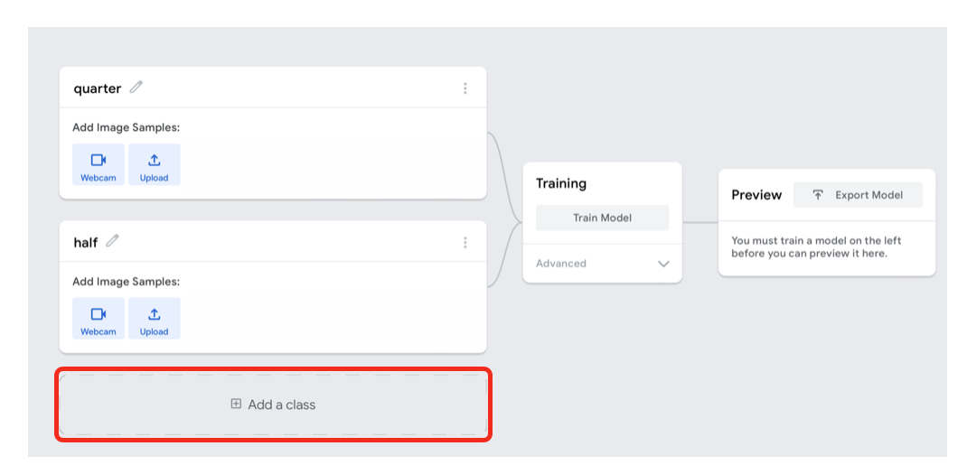
Add more classes
Add two more classes
Digital Technologies Hub is brought to you by the Australian Government Department of Education. Creative Commons Attribution 4.0, unless otherwise indicated.
Notes:
We are using Teachable Machine to train our AI.

Slide 7
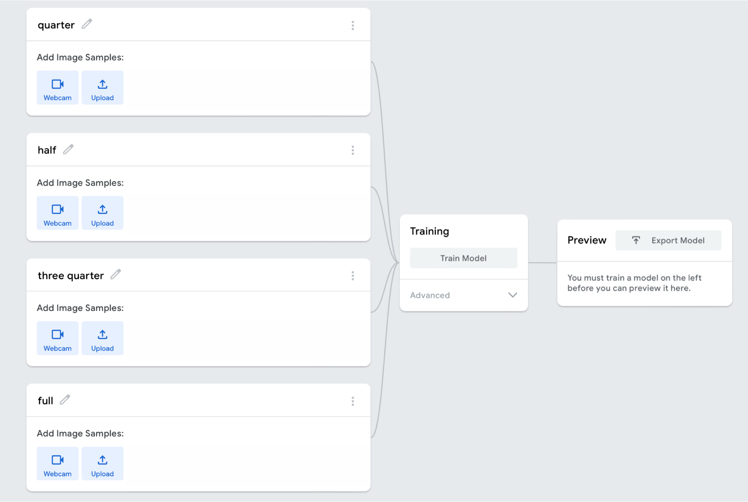
Complete the classes
Complete setup of the classes
Digital Technologies Hub is brought to you by the Australian Government Department of Education. Creative Commons Attribution 4.0, unless otherwise indicated.
Notes:
Now we have our four fractions set up ready to train.

Slide 8
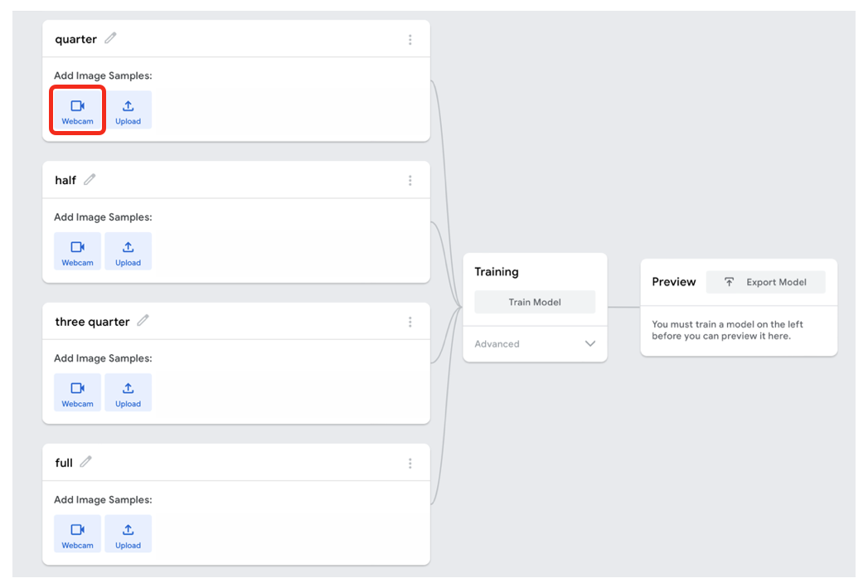

Uploading images
Upload images using the webcam.
Flaticon
Digital Technologies Hub is brought to you by the Australian Government Department of Education. Creative Commons Attribution 4.0, unless otherwise indicated.
Notes:
As you explain this stage, remind students when recording using webcam to avoid recording their image as part of process, just to be safe and use responsible practices.

Slide 9
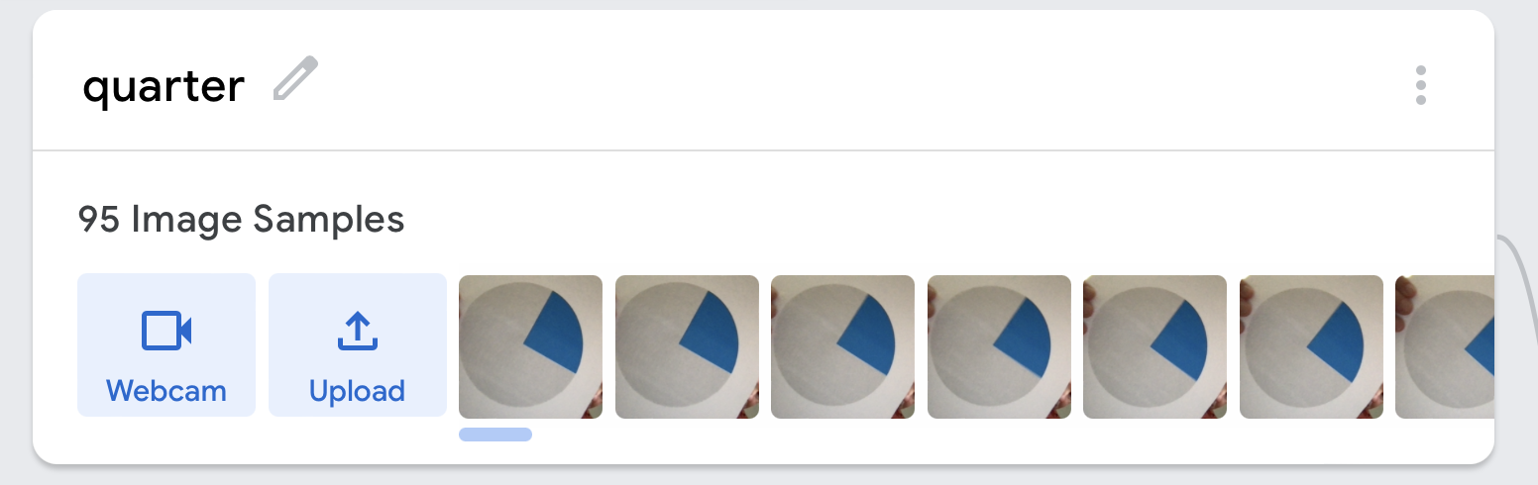
Record images
Record images using the webcam.
Show the quarter circle image to the camera.
Press and hold the ‘Hold to Record’ button.
Take at least 20 pictures while rotating the image.
Take at least 20 pictures holding the images close to and further from the camera.
Digital Technologies Hub is brought to you by the Australian Government Department of Education. Creative Commons Attribution 4.0, unless otherwise indicated.
Notes:
Show the quarter circle image to the camera and press and hold the ‘Hold to Record’ button.
Take at least 20 pictures while rotating the image.
Release the button to change the grip on the image.
Continue taking pictures.

Slide 10
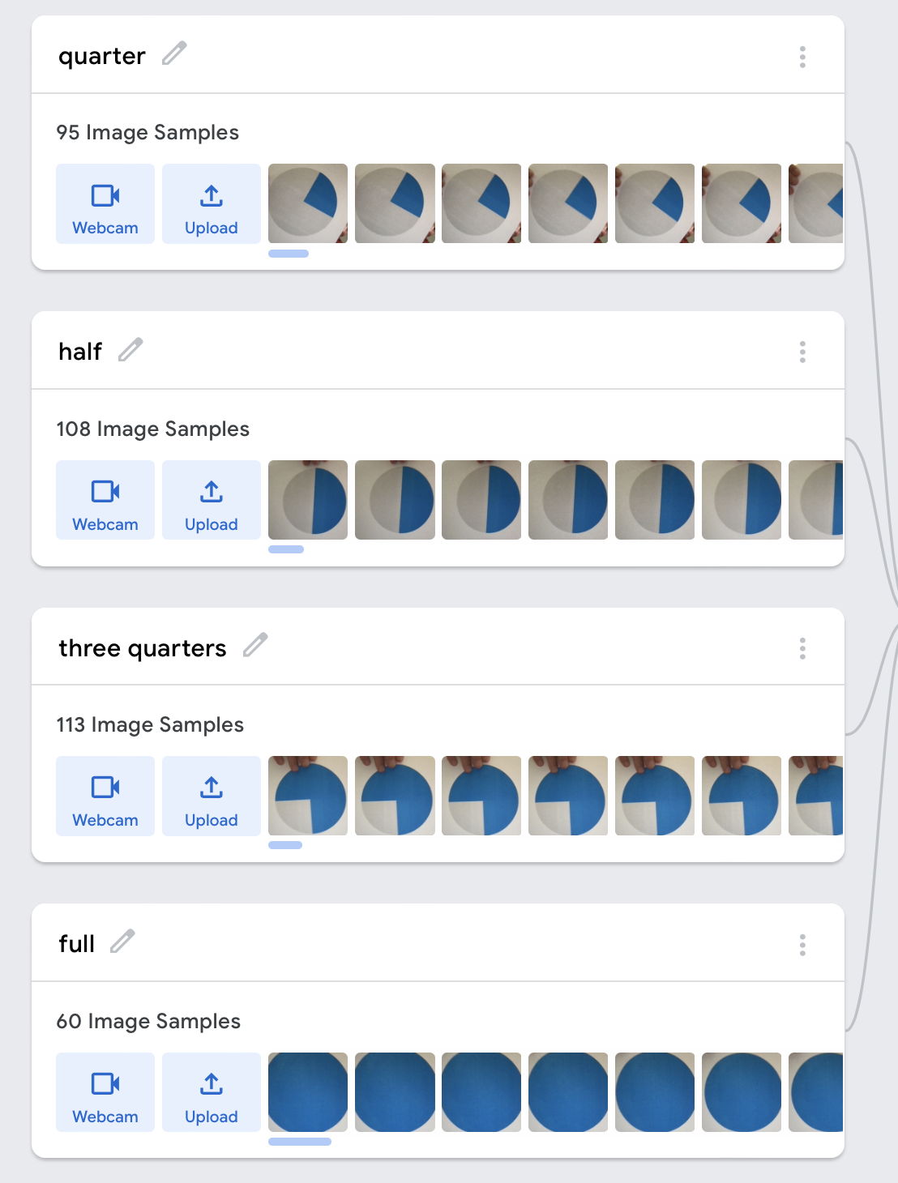
Record all images
Repeat the process for the half, three- quarters and full classes.
Digital Technologies Hub is brought to you by the Australian Government Department of Education. Creative Commons Attribution 4.0, unless otherwise indicated.
Notes:
Show the quarter circle image to the camera and press and hold the ‘Hold to Record’ button.
Take at least 20 pictures while rotating the image.
Release the button to change the grip on the image.
Continue taking pictures.

Slide 11
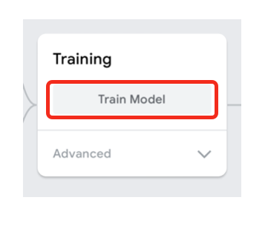
Ready to train the AI
Now we are ready to train the AI.
Select Train Model.
Digital Technologies Hub is brought to you by the Australian Government Department of Education. Creative Commons Attribution 4.0, unless otherwise indicated.
Notes:
Show the quarter circle image to the camera and press and hold the ‘Hold to Record’ button.
Take at least 20 pictures whilst rotating the image.
Release the button to change the grip on the image.
Continue taking pictures.

Slide 12
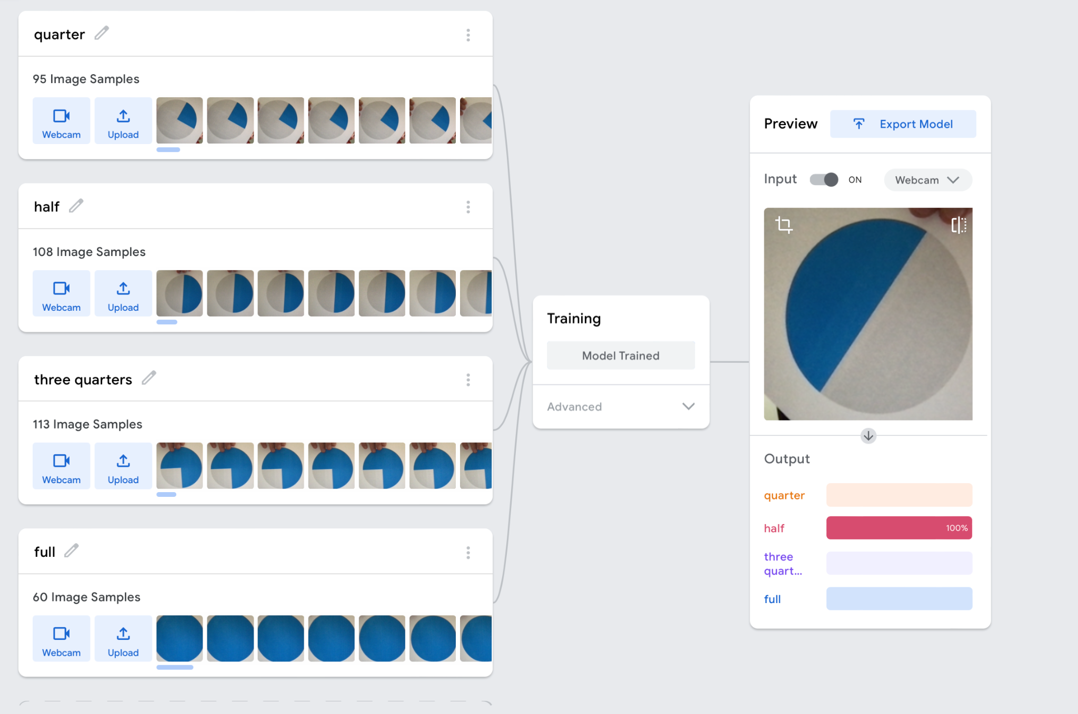
Testing the AI
Test the AI.
After the training process is complete, you can preview the model (on the right-hand side).
Check to see if your model works by holding up your images one at a time and watch the accuracy line.
Digital Technologies Hub is brought to you by the Australian Government Department of Education. Creative Commons Attribution 4.0, unless otherwise indicated.
Notes:
After the training process is complete, check to see if it works by holding up your images one at a time and watch the accuracy line. In the picture, the AI correctly identifies the image as depicting a half circle. Take at least 20 pictures while rotating the image. Note: Data sets of 20 or more images increase the accuracy of the AI models. However, the AI training process takes longer to complete with data sets that are significantly larger.

