Slide 1

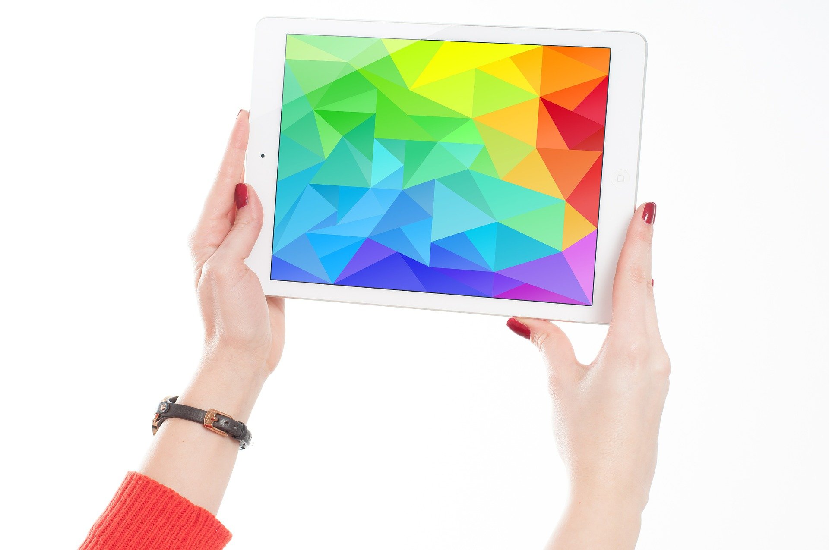
Technology Past and Present

Slide 2
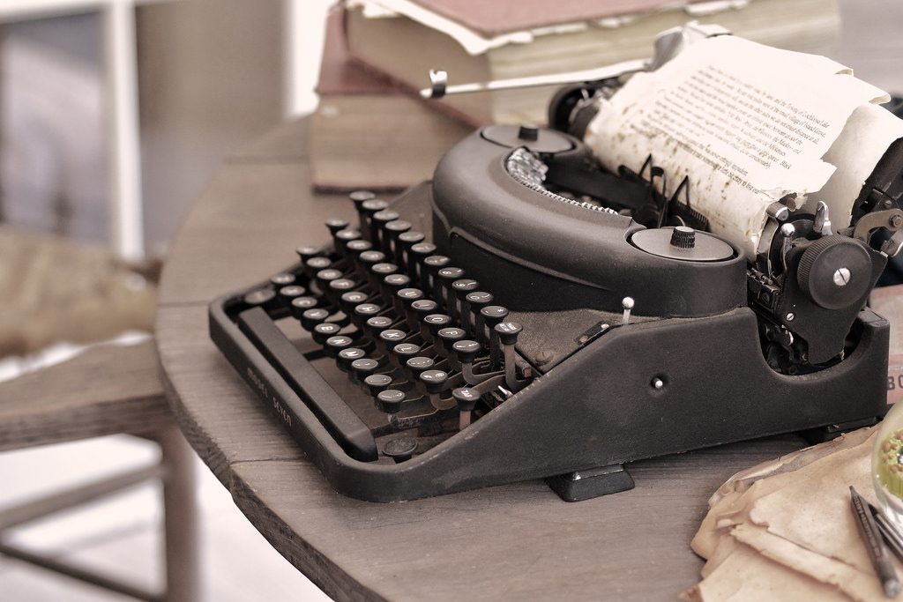

Notes:
Typewriter - JULIANNA BROWN/flickr.com, CC BY-NC-ND 2.0
Laptop - FirmBee/pixabay.com, public domain

Slide 3
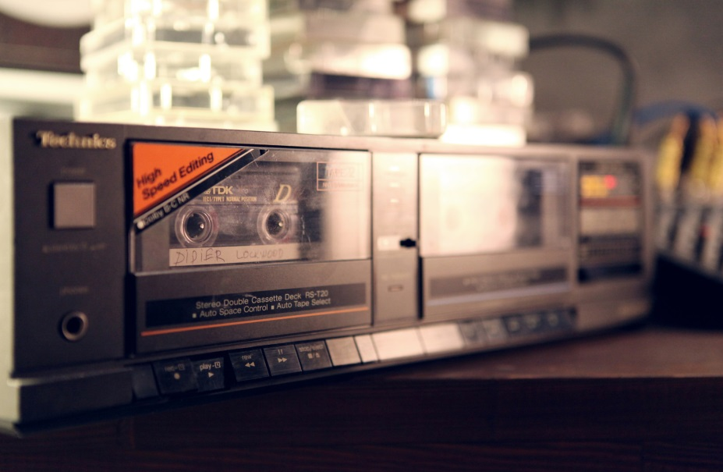
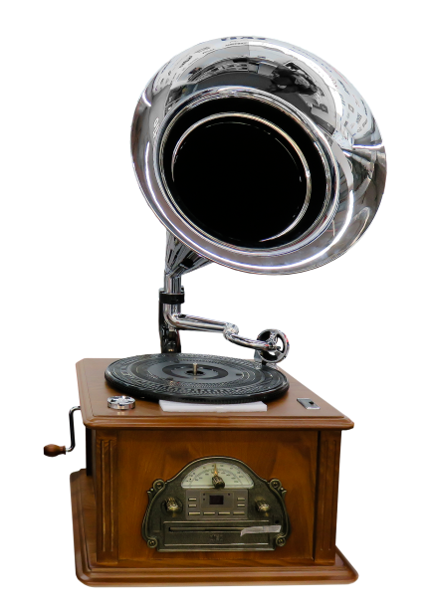
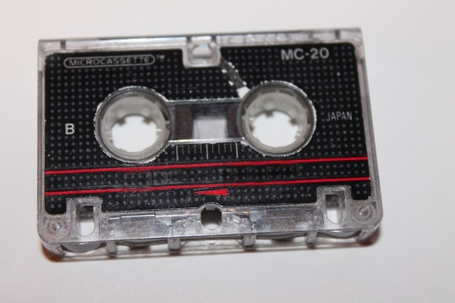
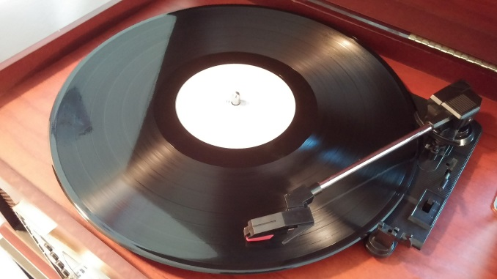
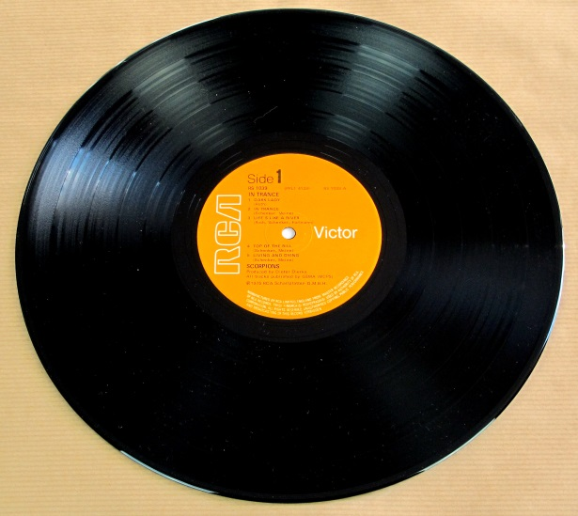
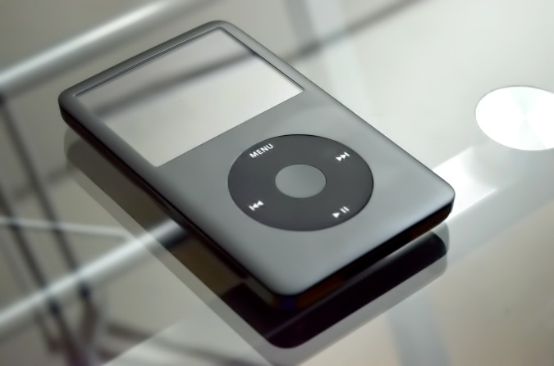
Notes:
Gramaphone - Gellinger/pixabay.com, public domain
Record player turntable - Brett_Hondow/pixabay.com, public domain
Tape player - Kontramax, flickr.com ,CC BY 2.0
Tape - bykst/pixabay.com, public domain
Record - vinylmeister/flickr.com, CC BY-NC 2.0
Mp3 player - mikefoster/pixabay.com, public domain

Slide 4
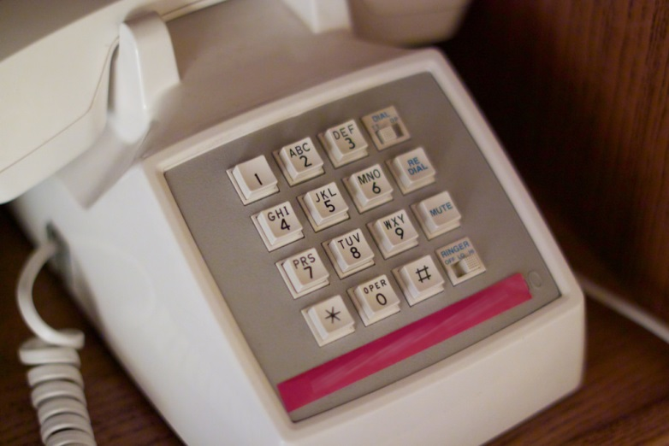
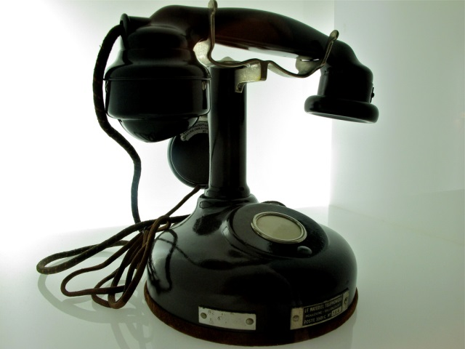
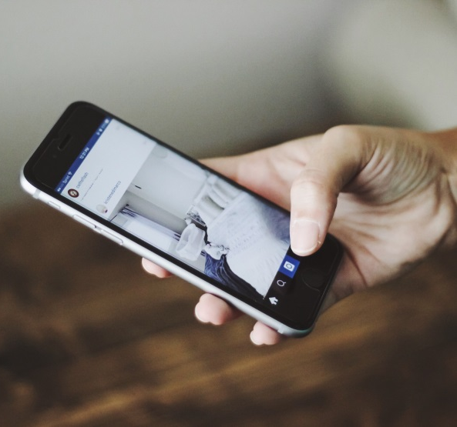
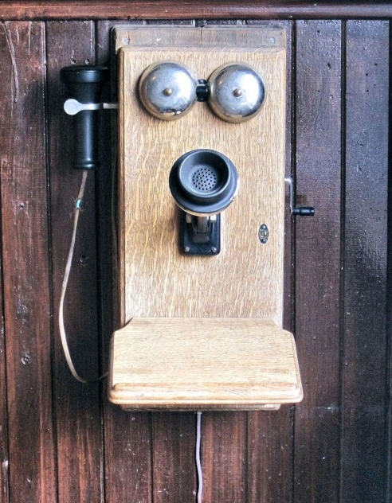
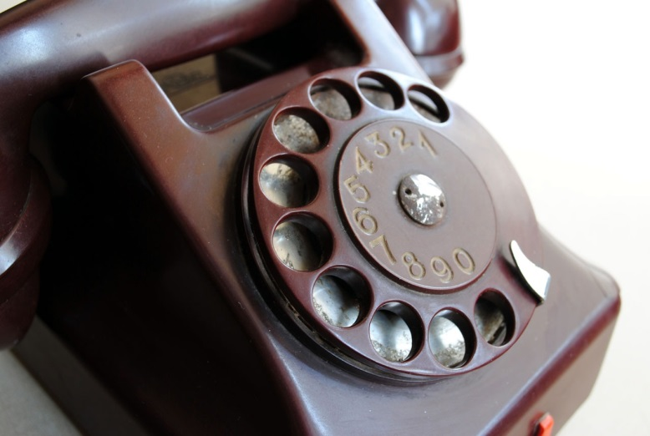
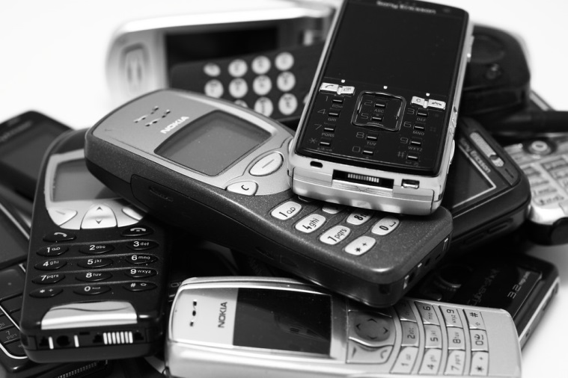
Notes:
Old- fashioned phone - Mohammad Abdullah/flickr.com, CC BY-NC 2.0
Old push button phone - Alan Levine/flickr.com, CC BY 2.0
iPhone - Unsplash/pixabay.com, public domain
Old wall crank phone - pixel1/pixabay.com, public domain
Old ring handset - PublicDomainPictures/pixabay.com, public domain
Pile of phones - Adrian Clark/flickr.com, CC BY-ND 2.0

Slide 5
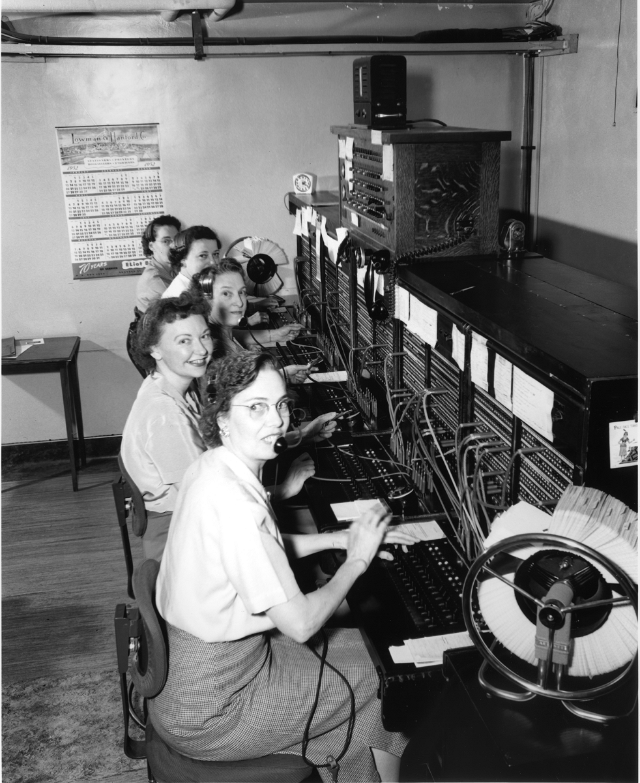
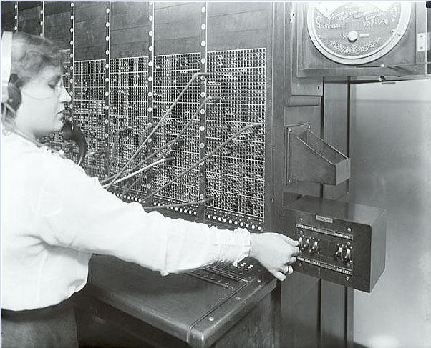

© 2016 Education Services Australia Ltd, unless otherwise indicated.
Creative Commons BY 4.0 licence, unless otherwise indicated.
Notes:
Switchboard Operator 1916, Photographer: Rosenfeld and Sons, image of negative Kenneth Martin/flickr.com, CC BY-NC-ND 2.0
Telephone operators, 1952, City Light Photographic Negatives/Seattle Municipal Archives, CC BY 2.0

